Slide 1
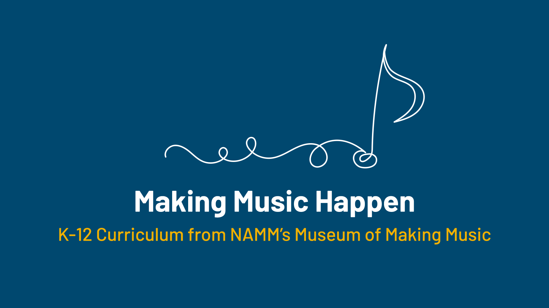

Slide 2
Sonic Palette:
Drums and the Drum Set

Slide 3
Lesson Objectives
Describe the history of the modern drum set.
Discuss innovations in manufacturing that led to advancements in the modern drum set.
Describe the relationship between manufacturers and endorsers and discuss how this relationship is used to create technological advancements in drum set manufacturing.
Create a drumbeat using an online drum machine.

Slide 4
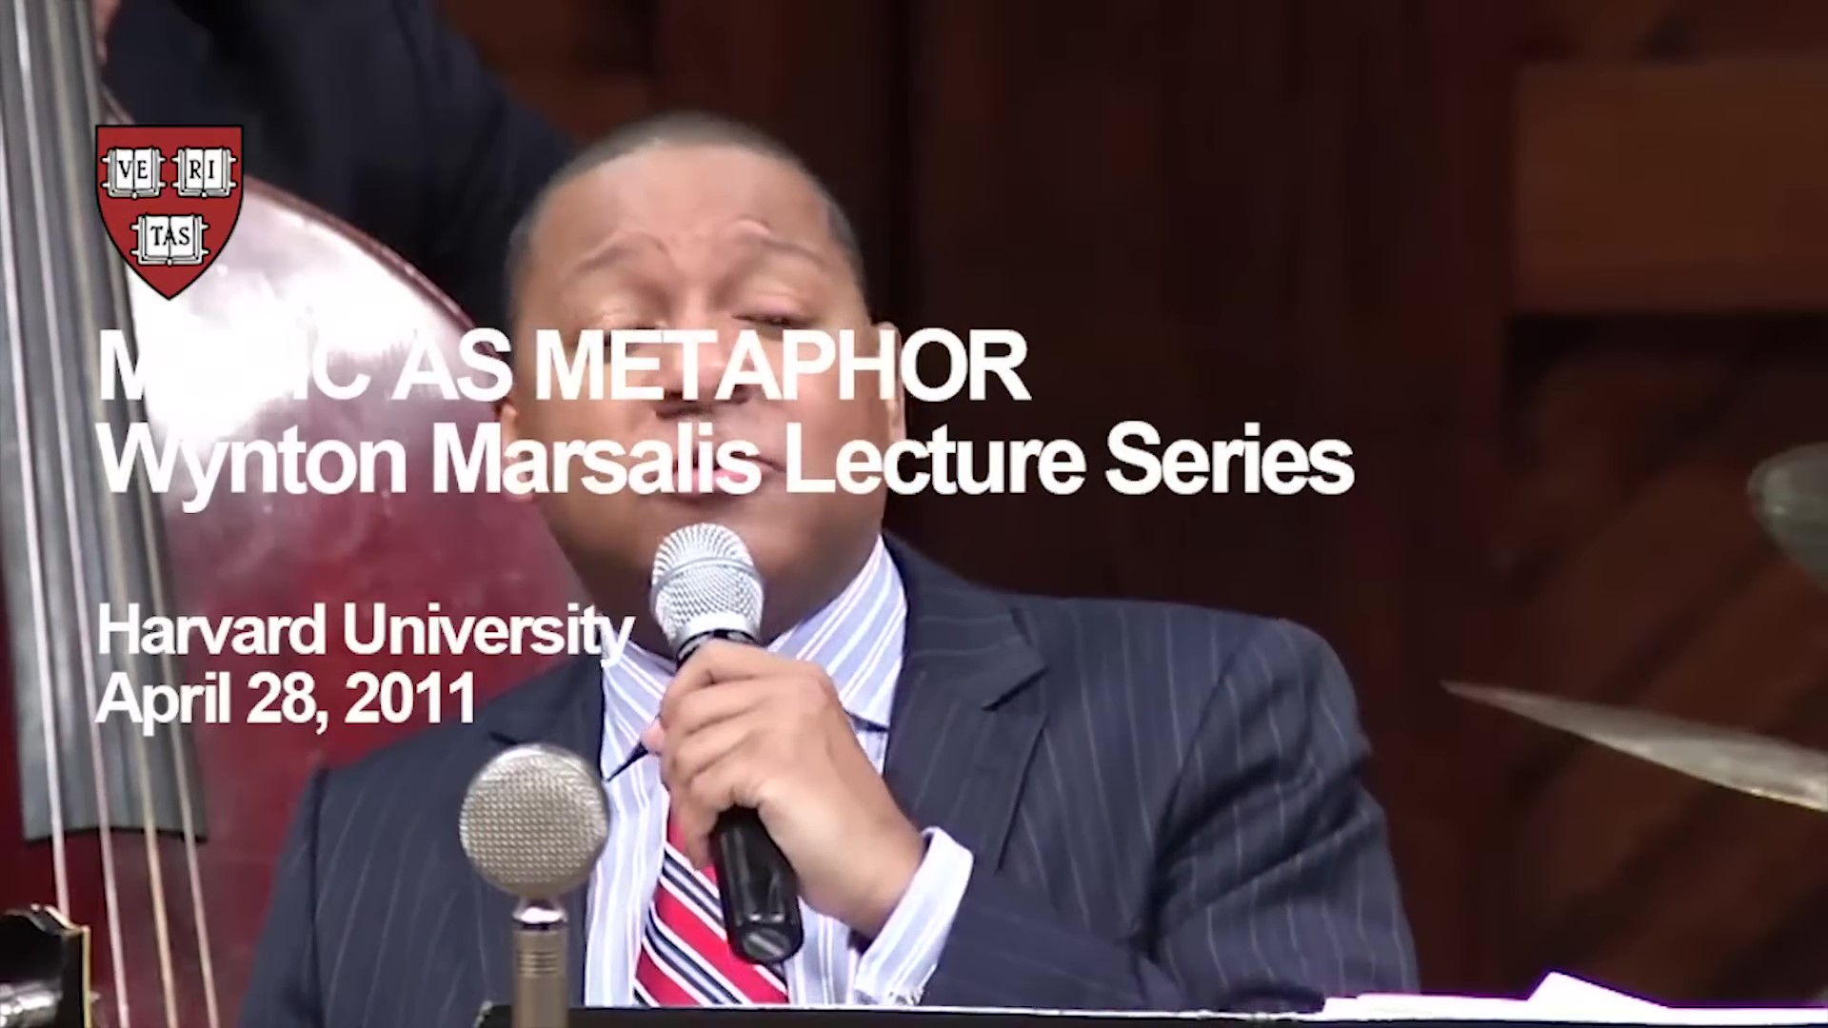
Lesson Introduction
Notes:
Sample questions:
What were some ways enslaved Africans communicated with percussive sound when drums were outlawed?
How do traditional marching bands perform percussion instruments? (One person on each instrument or one person playing multiple parts?)
What innovations in New Orleans led to the development of one seated percussionist playing multiple parts at the same time? (cymbal attached to bass drum and high society dance hall bands wanting the percussion instruments and also body and punch from bass drum)
What were the typical percussion instruments used in the early trap drum sets?
How were drums being used in popular music before the development of the modern drum set?
Discuss the evolution of the sock or hi-hat cymbal and stand. Who was the drummer instrumental in developing this new idea?

Slide 5


Slide 6
The Sonic Palette
Instrument makers and musicians are often searching for new sounds. In many cases, that has meant creating variations on existing instruments or developing entirely new ones. In others, it has meant finding ways to play more than one instrument at a time.
The makers and players of percussion instruments – drums, cymbals, and other instruments that are played by being struck – have been driven to adopt new instruments and new ways to play them.

Slide 7
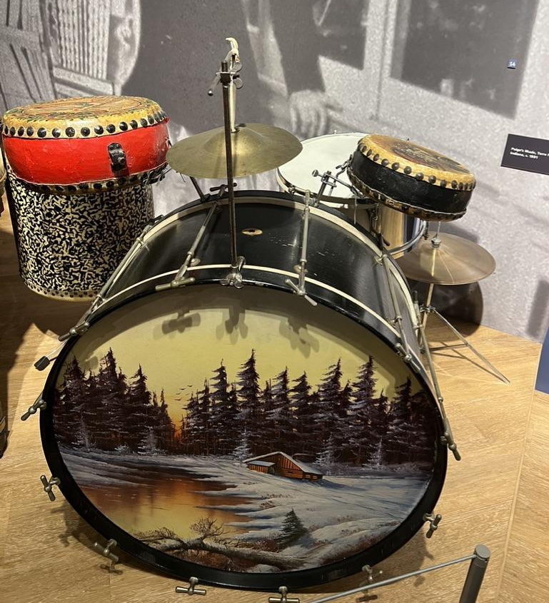
The Synthetic Drumhead
For most of our documented musical history, drums have been made by stretching animal skin over a frame.
Called drumheads, these skins provide a suitable balance of flexibility and rigidity but are also hugely affected by shifts in climate.
This can mean that a drum’s pitch and tone quality will change with the temperature. A small shift from a practice studio to a brightly-lit stage might lead to a detuned drum, while more extreme temperatures and humidity levels can cause the drumhead to crack and break.
Notes:
“Early Modern Drum Kit,” early 20th century
28” Bass Drum, 1920s
Snare Drum, 1911
Chinese Tom Tom Drums, 1900s.
Low-Boy Cymbal, 1920s.
Vintage Hardware.
The drum kit as we know it was developed in the early 20th century. The invention of the modern bass drum pedal in 1909 by William Ludwig, combined with the “low-boy” cymbal pedal, allowed drummers to play while sitting and effectively use their feet in addition to their hands. This dramatically expanded the number of instruments they could play at once, leading to the concept of the “contraption set,” or simply “trap set,” and later the drum kit. This kit includes a 28” bass drum with painted calfskin head (an internal lamp to illuminate the head and regulate its temperature), a low-boy cymbal, a hanging cymbal, three “Chinese” tom-tom drums, and a metal snare drum.

Slide 8
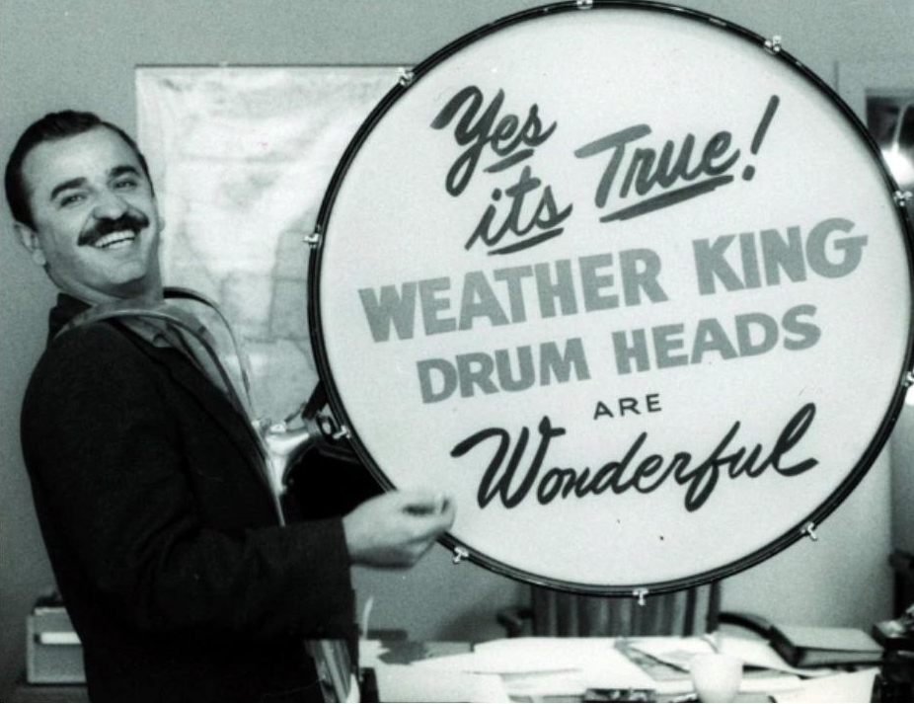
The Synthetic Drumhead
In the 1950s, drummer Remo Belli experimented with replacing skins with Mylar, a heat-resistant film developed during World War II. Belli’s aptly-named Weatherking synthetic drumhead, released in 1957, provided unprecedented reliability, predictability, and durability in a variety of climates. Put simply, it gave drummers more control over their sound.
Notes:
Remo Belli with a Weather King Promotional Drumhead. Courtesy: Remo, Inc.

Slide 9
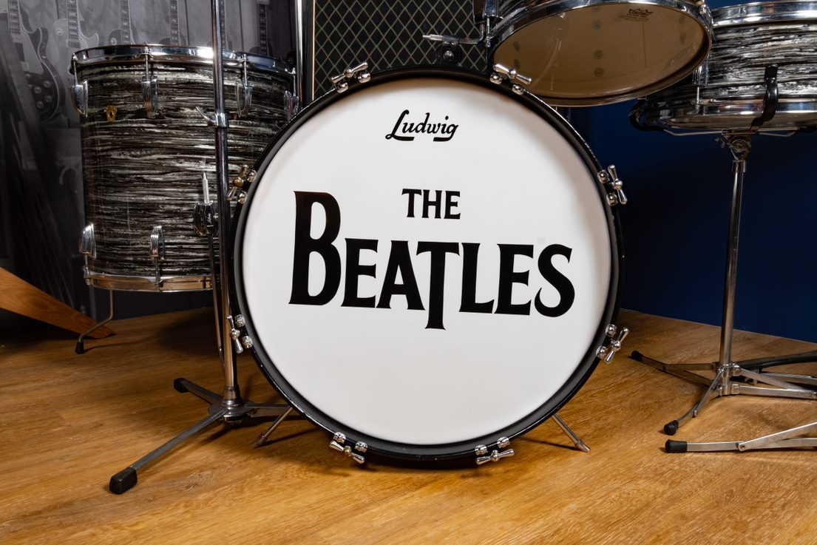
The Synthetic Drumhead
Synthetic drum heads became widespread in the 1960s, particularly as a result of Ringo Starr’s use of a Remo drumhead on the Beatles’ 1964 Ed Sullivan Show appearance.
Despite the advantages of the synthetic drum head, some players continue to use animal skin drum heads because of their unique and, in historical and recreation settings, traditional sound quality.
Notes:
Ludwig Drum Company
Black Oyster Pearl Drum Set, 1960
From the Collection of the Museum of Making Music
The Ludwig logo on Ringo Starr’s bass drum – positioned immediately above “The Beatles” – made Ludwig the country’s best-selling manufacturer of drum kits immediately following their 1964 Ed Sullivan appearance. In fact, Ludwig expanded its factory by 100,000 square feet and moved to round-the-clock production to keep up with demand. Bill Ludwig Jr. even gifted Ringo a gold-plated snare drum, saying “I have never known a drummer more widely acclaimed and publicized than you.”

Slide 10
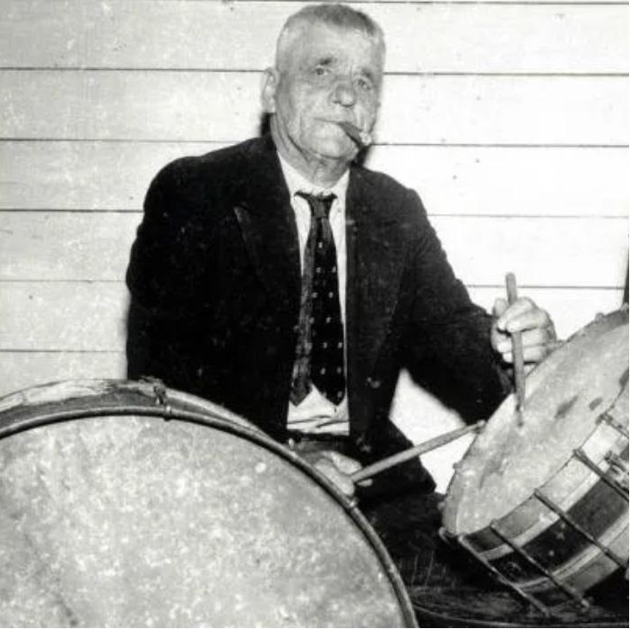
Breaking Through and Sitting Down
Through the first half of the 19th century, the percussion instruments in a band – typically a bass drum, a snare drum, and a cymbal – were generally played by separate musicians.
Players in the middle of the century consolidated instruments with the technique of “double drumming,” with one person playing two drums at once.
Notes:
Double Drumming. Courtesy: Vic Firth - Zildjian

Slide 11
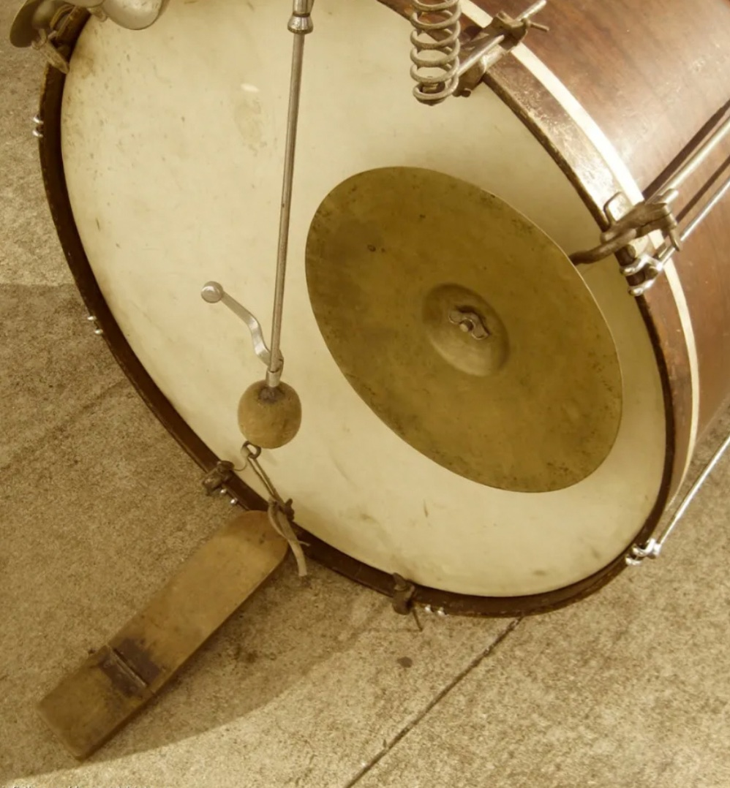
Breaking Through and
Sitting Down
By the turn of the century some drummers were crafting crude foot pedals connected to beaters hung from the top of a bass drum to free up a hand to play another instrument, but these “overhang” devices were slow and hard to control.
Notes:
The overhand pedal. Courtesy: Vic Firth - Zildjian

Slide 12
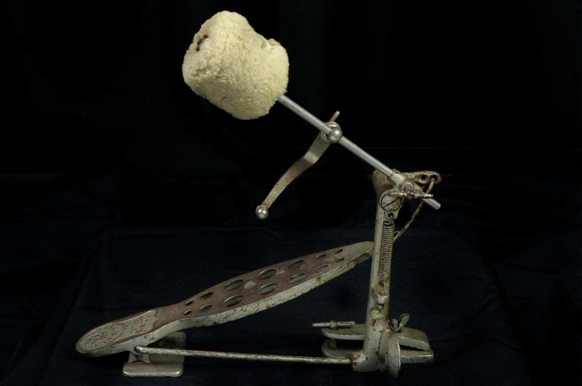
Early Bass Drum Pedal
In 1909, the Ludwig Drum Company patented and released a bass drum pedal with an incorporated beater. This new pedal was significantly faster and more responsive than overhang models, and quickly saw widespread use – and imitation.
This in turn helped more musicians shift to playing drum kits with additional instruments and sounds. The Ludwig design has proven to be highly durable, with modern pedals mirroring the shape while including improvements like ball bearings, chain drive mechanisms, and more durable materials.
Notes:
Ludwig Drum Company
Bass Drum Pedal, 1909-1911
From the Wm. F. Ludwig II Collection on loan from William F. Ludwig III, President of WFLIII Drums, who is happy to have this item on display at the Museum of Making Music and proud to continue the family tradition of drum making
While not the first bass drum pedal made, the design of Ludwig’s pedal, introduced in 1909, was an immediate hit. Rather than triggering the rotation of a beater arm at the top of the bass drum like most pedals of the time, the Ludwig model combined the pedal and beater into a single unit, joined by a strap. The result was better responsiveness, more accuracy, and the ability to play faster, a combination that helped kick off the widespread adoption of the drum set.

Slide 13
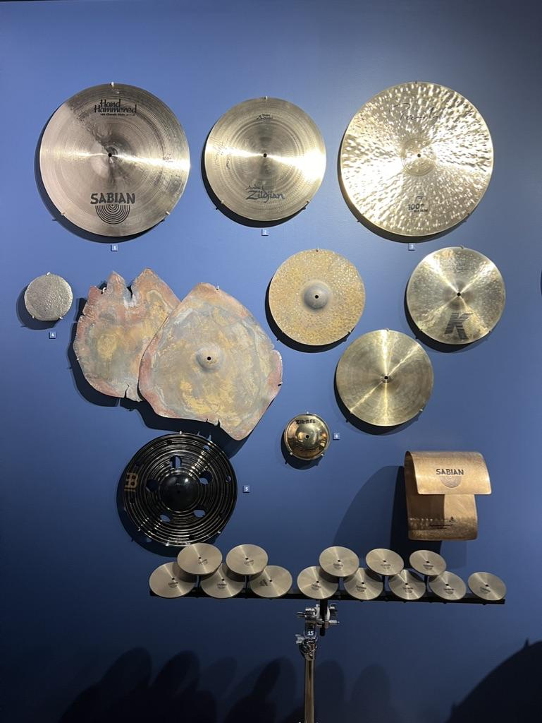
Centuries in a Cymbal
Even with similarities in appearance, and despite a remarkably consistent construction since their first documented creation almost 10,000 years ago, the many styles of cymbals can provide musicians with a huge range of sonic possibilities.
Notes:
The Sonic Palette display at the Museum of Making Music

Slide 14
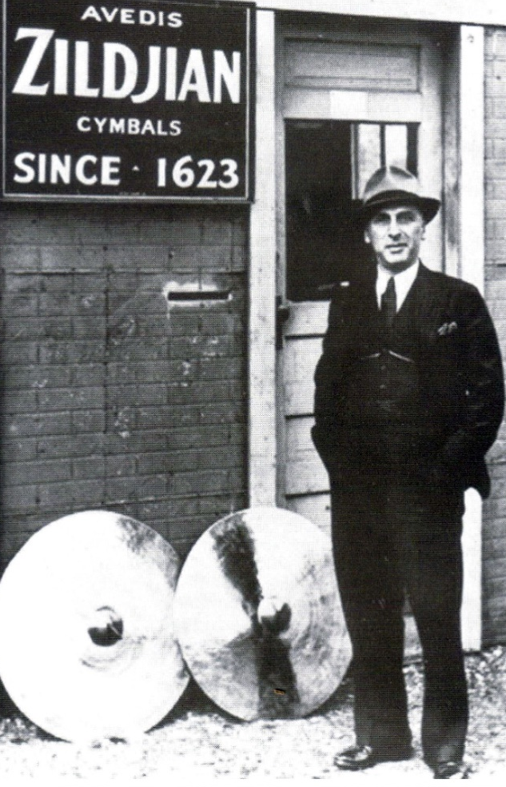
Centuries in a Cymbal
Indeed, the processes of cymbal making are steeped in tradition: the Avedis Zildjian Company has used the same in-house alloy to craft cymbals since their founding in 1623.
Yet cymbal making has been and continues to be a vibrant craft driven by passionate innovators.
Notes:
Avedis Zildjian III. Courtesy: Avedis Zildjian Company

Slide 15
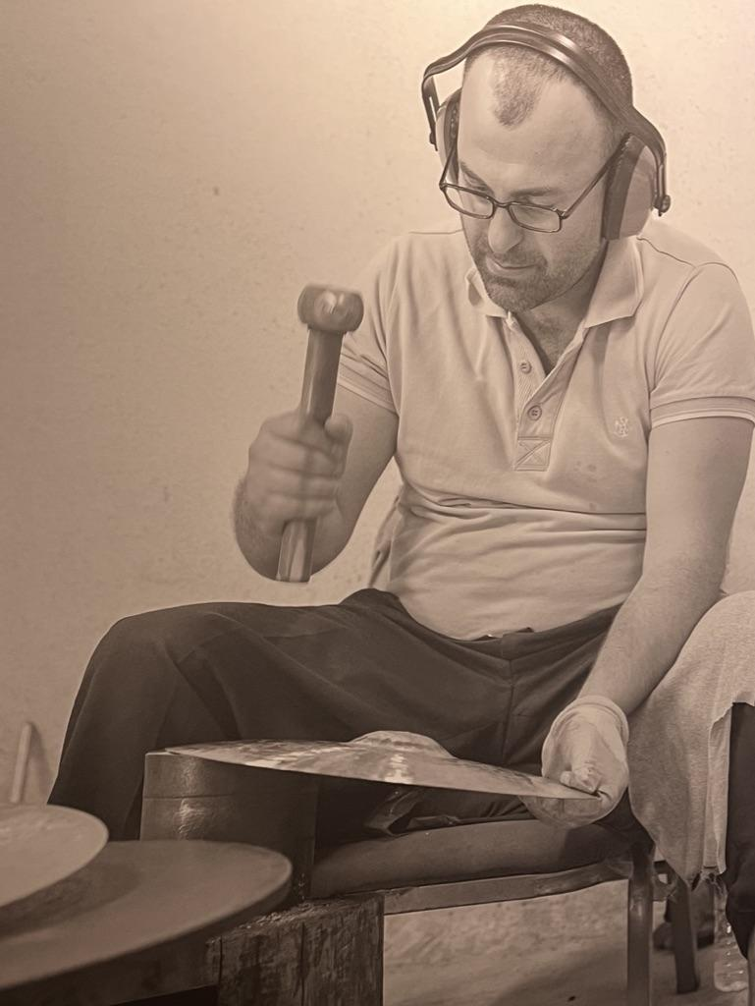
Centuries in a Cymbal
By varying the diameter, thickness, angle, finish, and many more parameters of the metal, makers have developed a wide range of cymbals – ride, crash, hi-hat, China, splash, swish, and more – that each provide their own unique sounds.
Notes:
A Bosphorus cymbalsmith hand-hammers a cymbal in Istanbul, Turkey, 2019
Photo by Bradley Secker

Slide 16
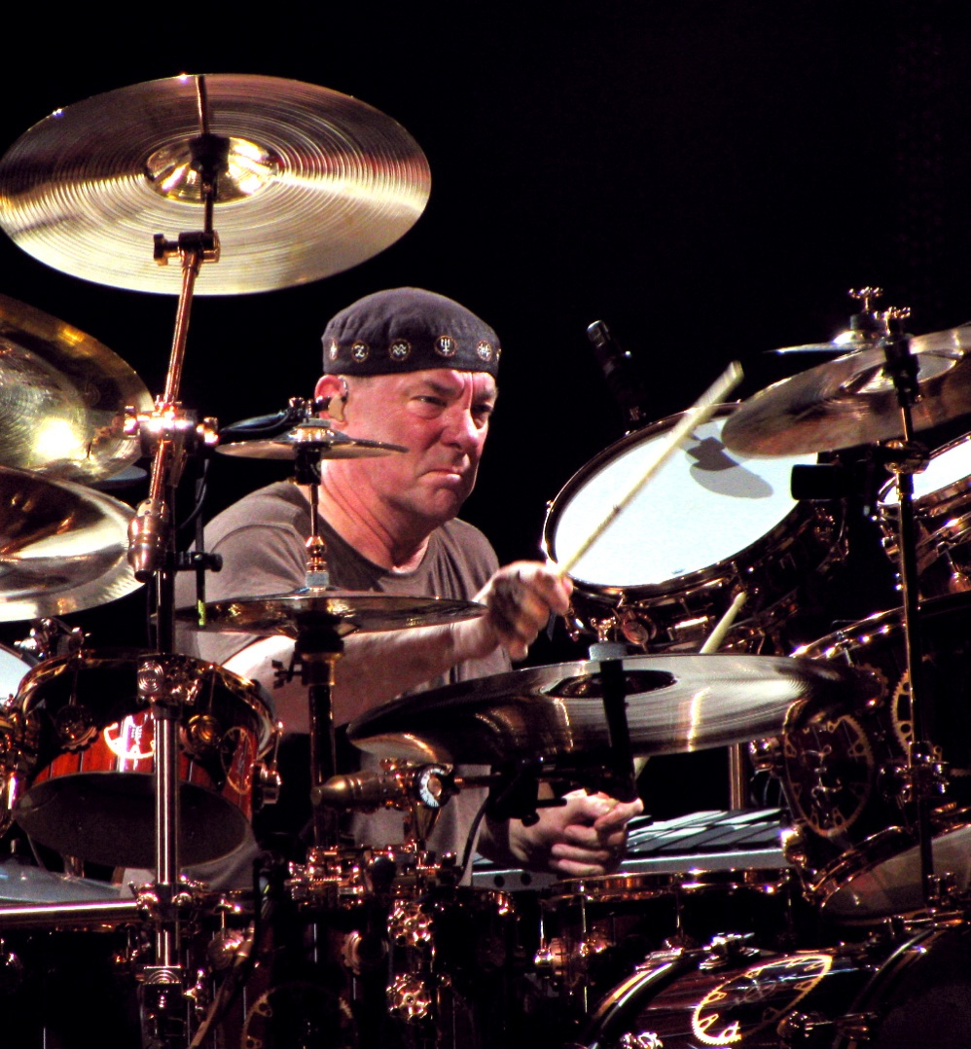
Centuries in a Cymbal
Drummers are free to combine cymbals of any style, and from any maker, to build a personal sonic palette. Some might prefer extensive sets with multiples of each cymbal type to access almost any sound they can think of, while others prefer a pared-down set with one ride, one crash, and a pair of hi-hat cymbals.
Notes:
Neil Peart performing at Bluesfest with Rush, 2010. Photo Ceedub13 (CC BY 2.0)

Slide 17
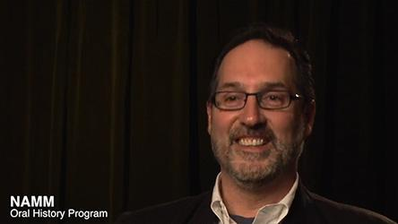
Andy Zildjian

Slide 18


Slide 19
Let's Discuss
Turn and talk to a neighbor. Discuss the following…
The relationship between manufacturers and endorsers.
How is the relationship between manufacturers and endorsers used to create technological advancements in manufacturing?

Slide 20
Let's Create!
Visit Virtualdrumming.com
Navigate to the drum machine tab
Select “Clear” to remove pre-arranged beat.
Create a beat by clicking on different parts of the drum set (each square represents one 16th note.
  A good place to start is Hi-Hat: All 8th notes, Snare: Beats 2 and 4 and Kick/Bass Drum: Beats 1 and 3).
Once you have created a beat begin navigating to the different drum set sounds to see how they affect the overall sound and feel of your groove.

Slide 21
Consider a Career in Music!
What careers are related to the lesson we just completed?
Clinician
Drum Manufacturer
Drum Technician
Drum Circle Facilitator
Music Therapist
Performer
Educator
Retailer/Music Store Owner

Slide 22


