Slide 1
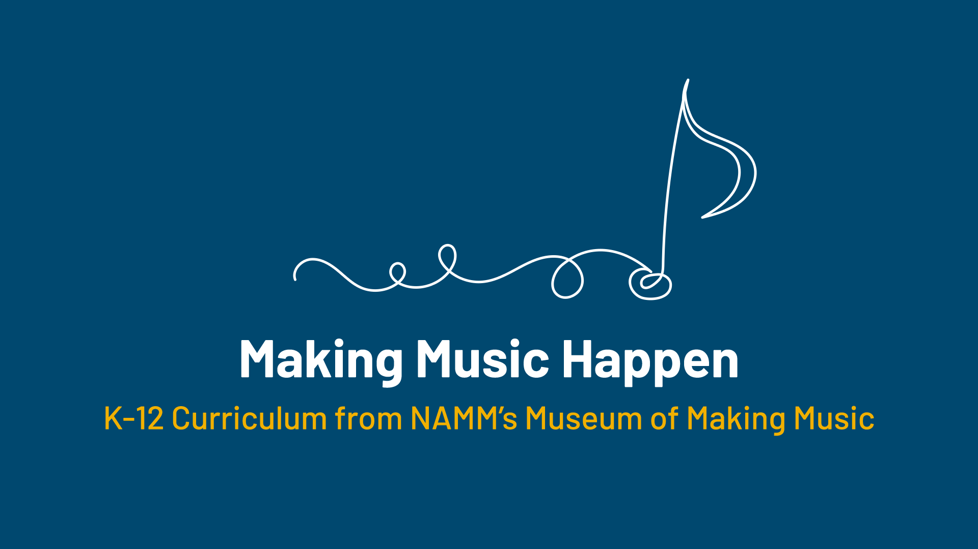

Slide 2
Making Music Electric

Slide 3
Lesson Objectives
Identify the four innovations in electronics that affected the music industry in the 20th/21st centuries.
Identify key electronic instruments and explain how they function.
Create a song using web-based instruments.

Slide 4
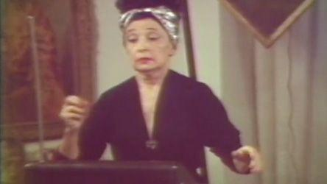
Lesson Introduction
Listen to this clip.
What instrument do you think is playing?

Slide 5


Slide 6
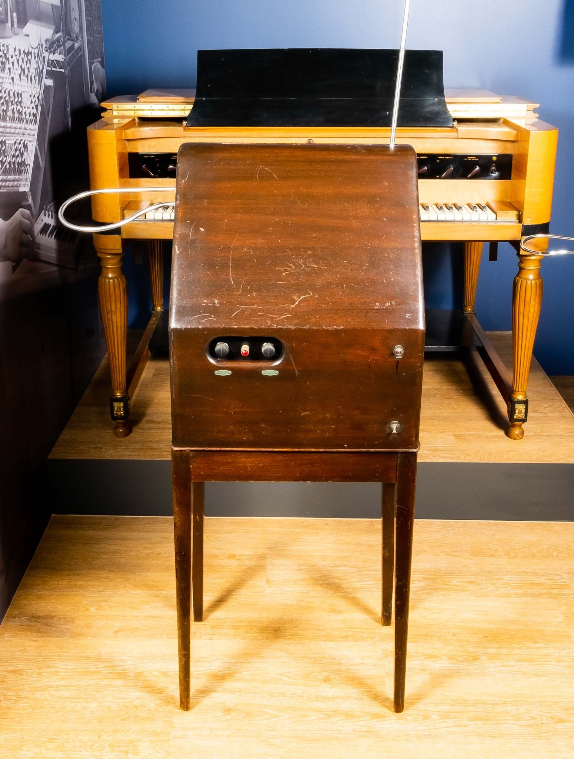
Theremin
The theremin, invented by Russian physicist Leon Theremin in 1920, is usually played without being touched by the performer.
Two antennae, one for the theremin’s pitch and one for its volume, are used to control the instrument.
As the performer moves their hands closer to or further from the antennae, the pitch and volume change.

Slide 7
Today we’ll be discussing advances in technology and their effect on music
The 20th and 21st centuries have seen unprecedented advances in technology, enabled by key innovations in electronics: the vacuum tube, the transistor, the integrated circuit, and the microprocessor. With each of these innovations, enterprising musicians and inventors have explored the ever-expanding possibilities of making sound with electricity, a technique now known as synthesis.

Slide 8
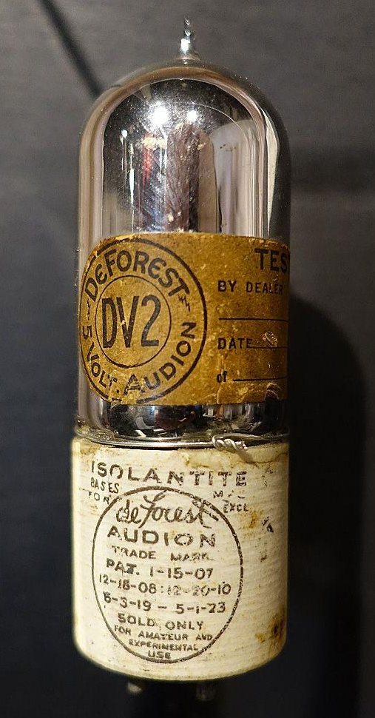
Vacuum Tube
Vacuum tubes, the first practical devices that could amplify an electrical signal, allowed the creation of new instruments – early synthesizers – unbound by existing designs and manufacturing processes.
Vacuum Tube - Photo by Daderot (CC 0)
Notes:
Audion (triode) VACUUM TUBE.
PHOTO BY DADEROT (CC 0).

Slide 9
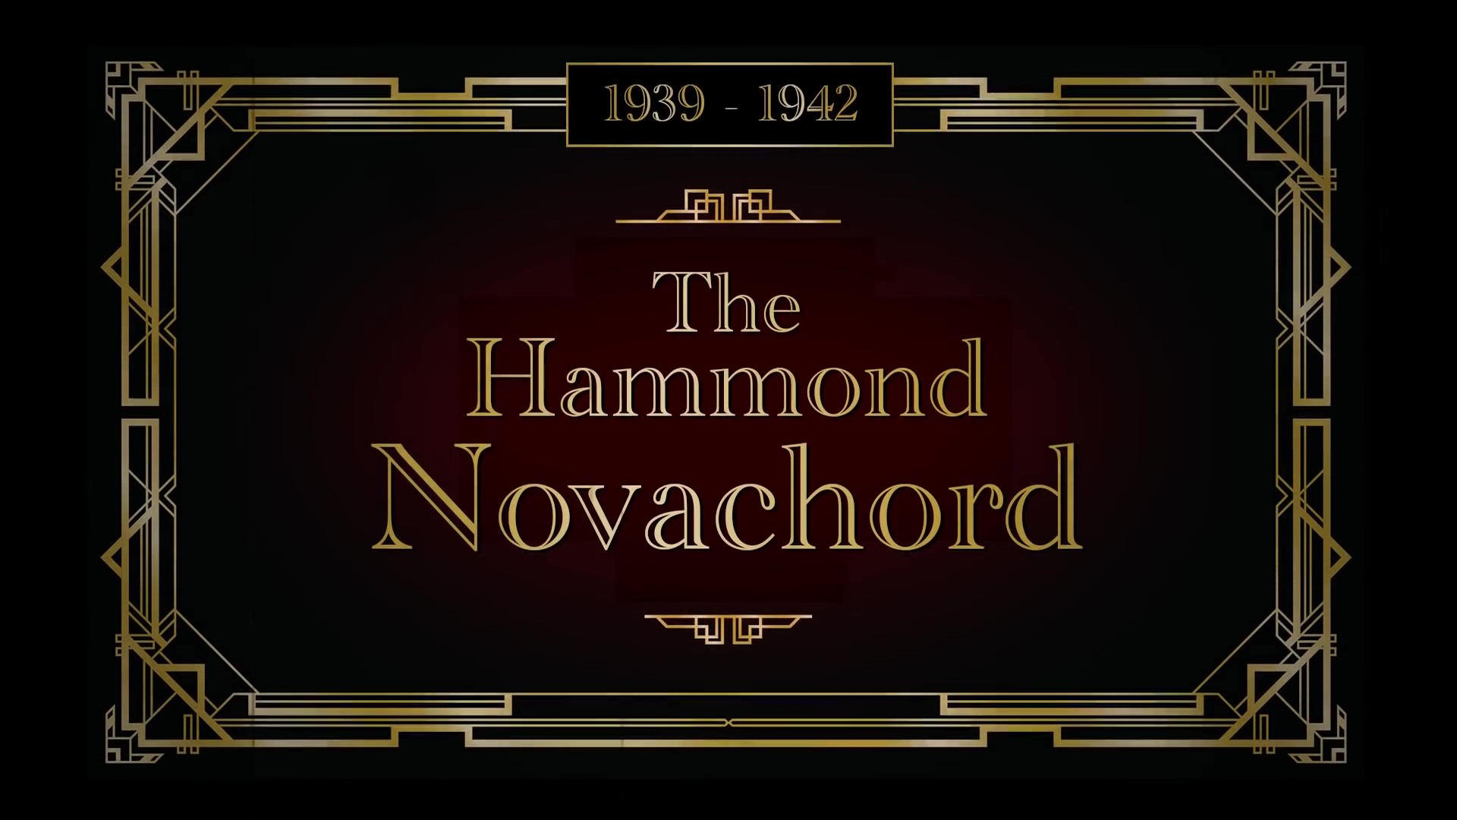
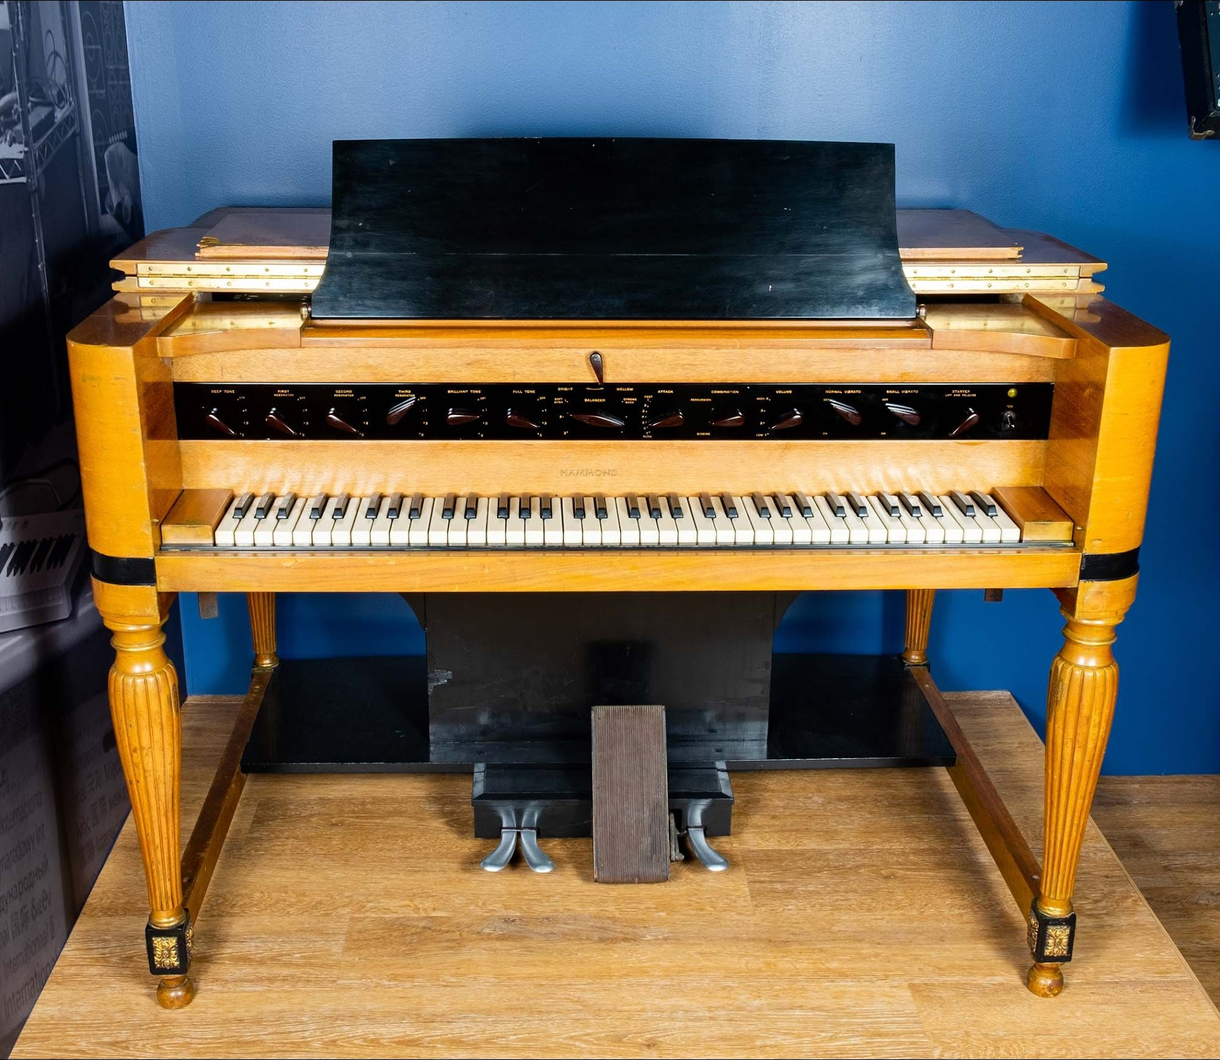
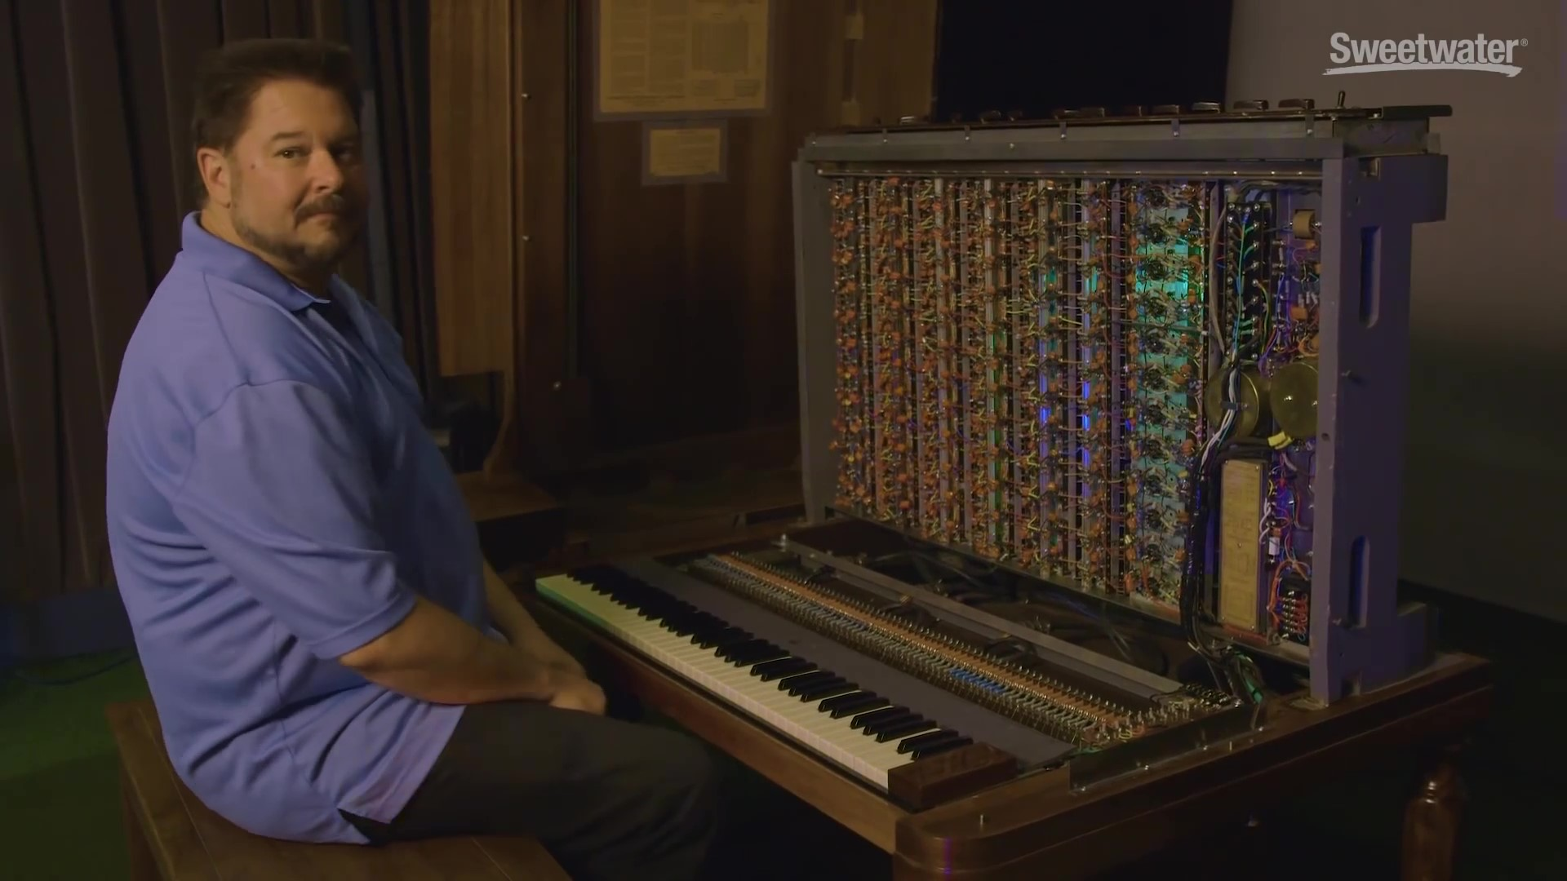
Hammond Novachord
Released in 1939, the Hammond Novachord was the first commercially available polyphonic synthesizer. All of its 72 notes could be played at the same time, a feat made possible by its massive array of 163 vacuum tubes. The Novachord anticipated technologies that appeared in synthesizers decades later. Despite its forward-thinking design and its inclusion in several film and music recordings, the Novachord saw little commercial success.
Notes:
Hammond Organ Company Novacord, 1939

Slide 10
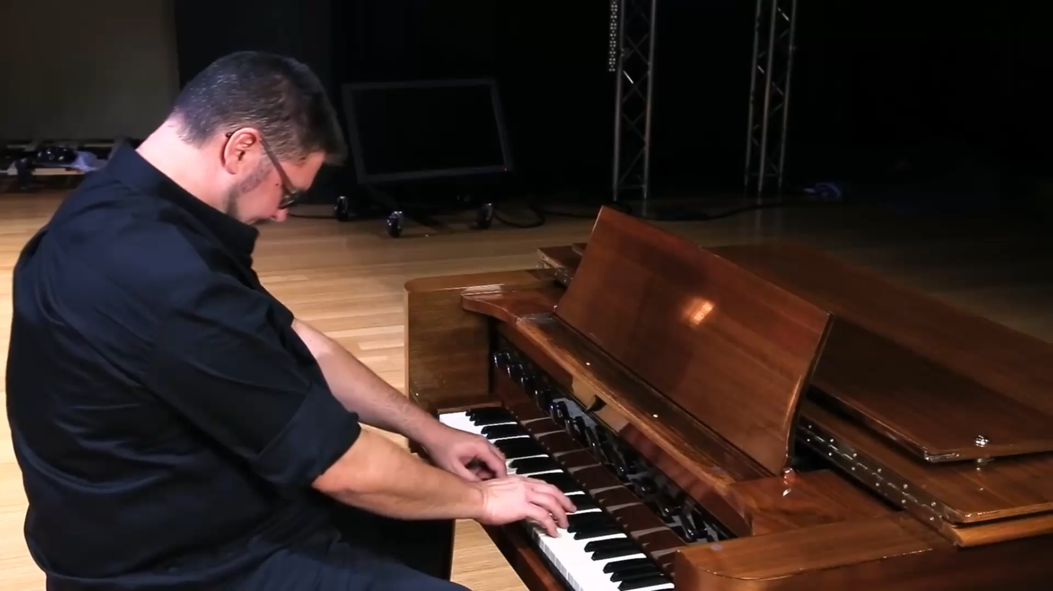

Slide 11
Hammond Novachord
Released in 1939, the Hammond Novachord was the first commercially available polyphonic synthesizer. All of its 72 notes could be played at the same time, a feat made possible by its massive array of 163 vacuum tubes. The Novachord anticipated technologies that appeared in synthesizers decades later. Despite its forward-thinking design and its inclusion in several film and music recordings, the Novachord saw little commercial success.

Slide 12
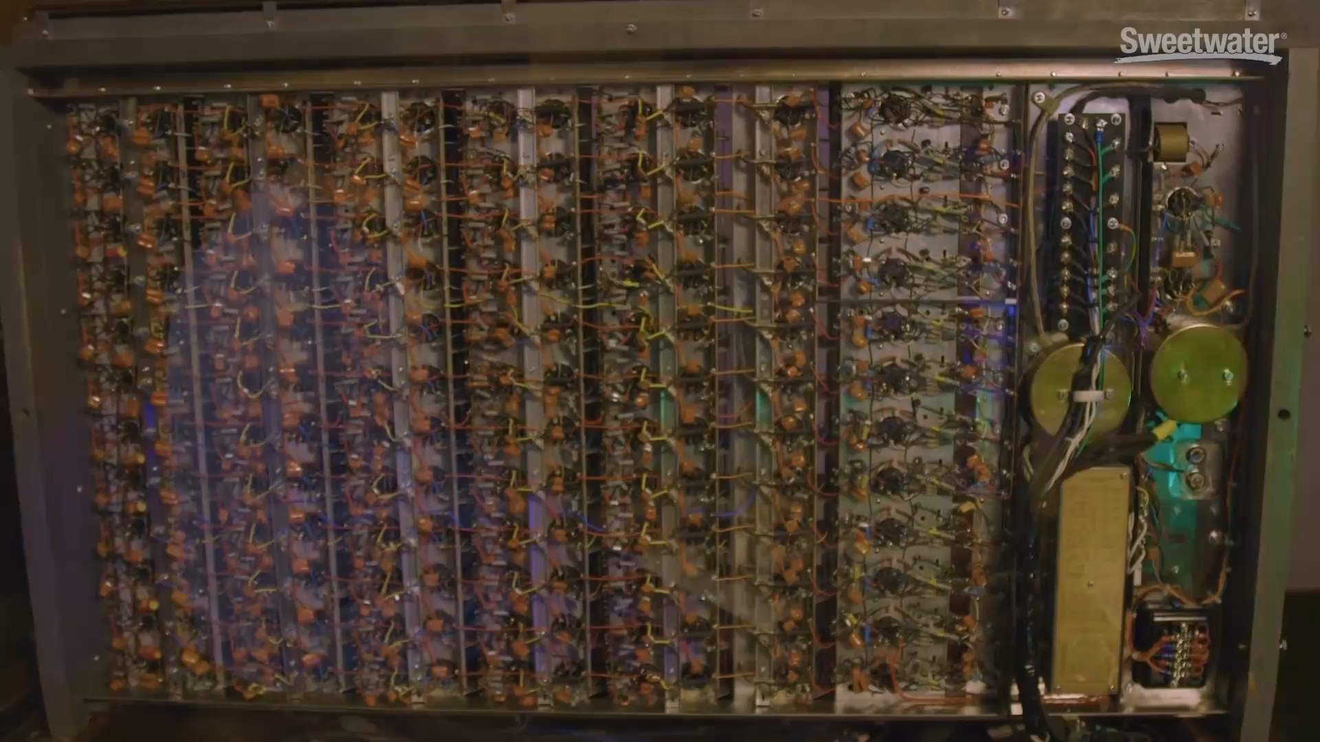

Slide 13
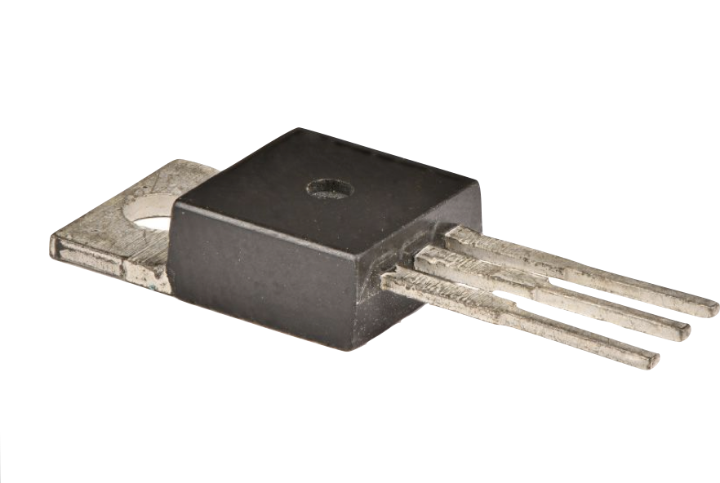
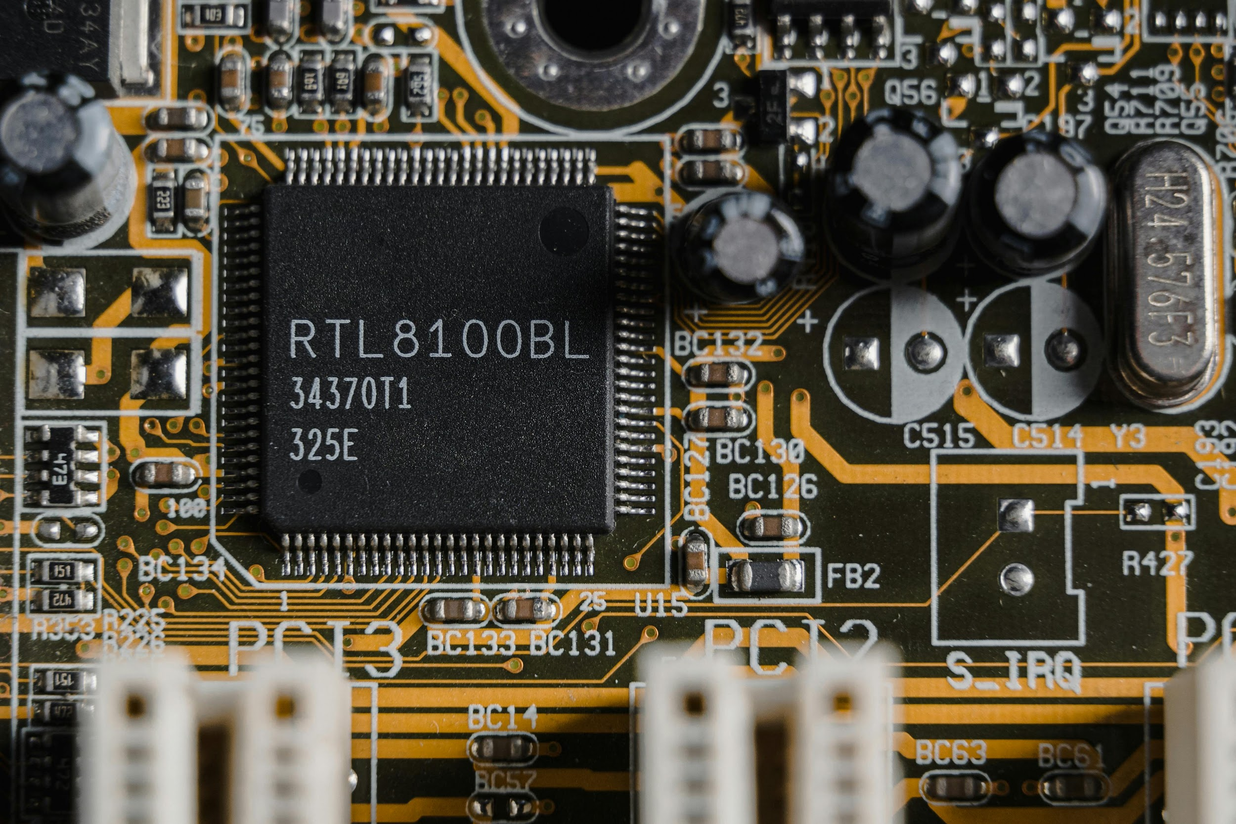
Transistors and
Integrated Circuits
Transistor
Integrated Circuit
Transistors, later packaged into integrated circuits, led to comparatively miniscule synthesizer designs that could offer far more functionality with better reliability and lower cost.

Slide 14
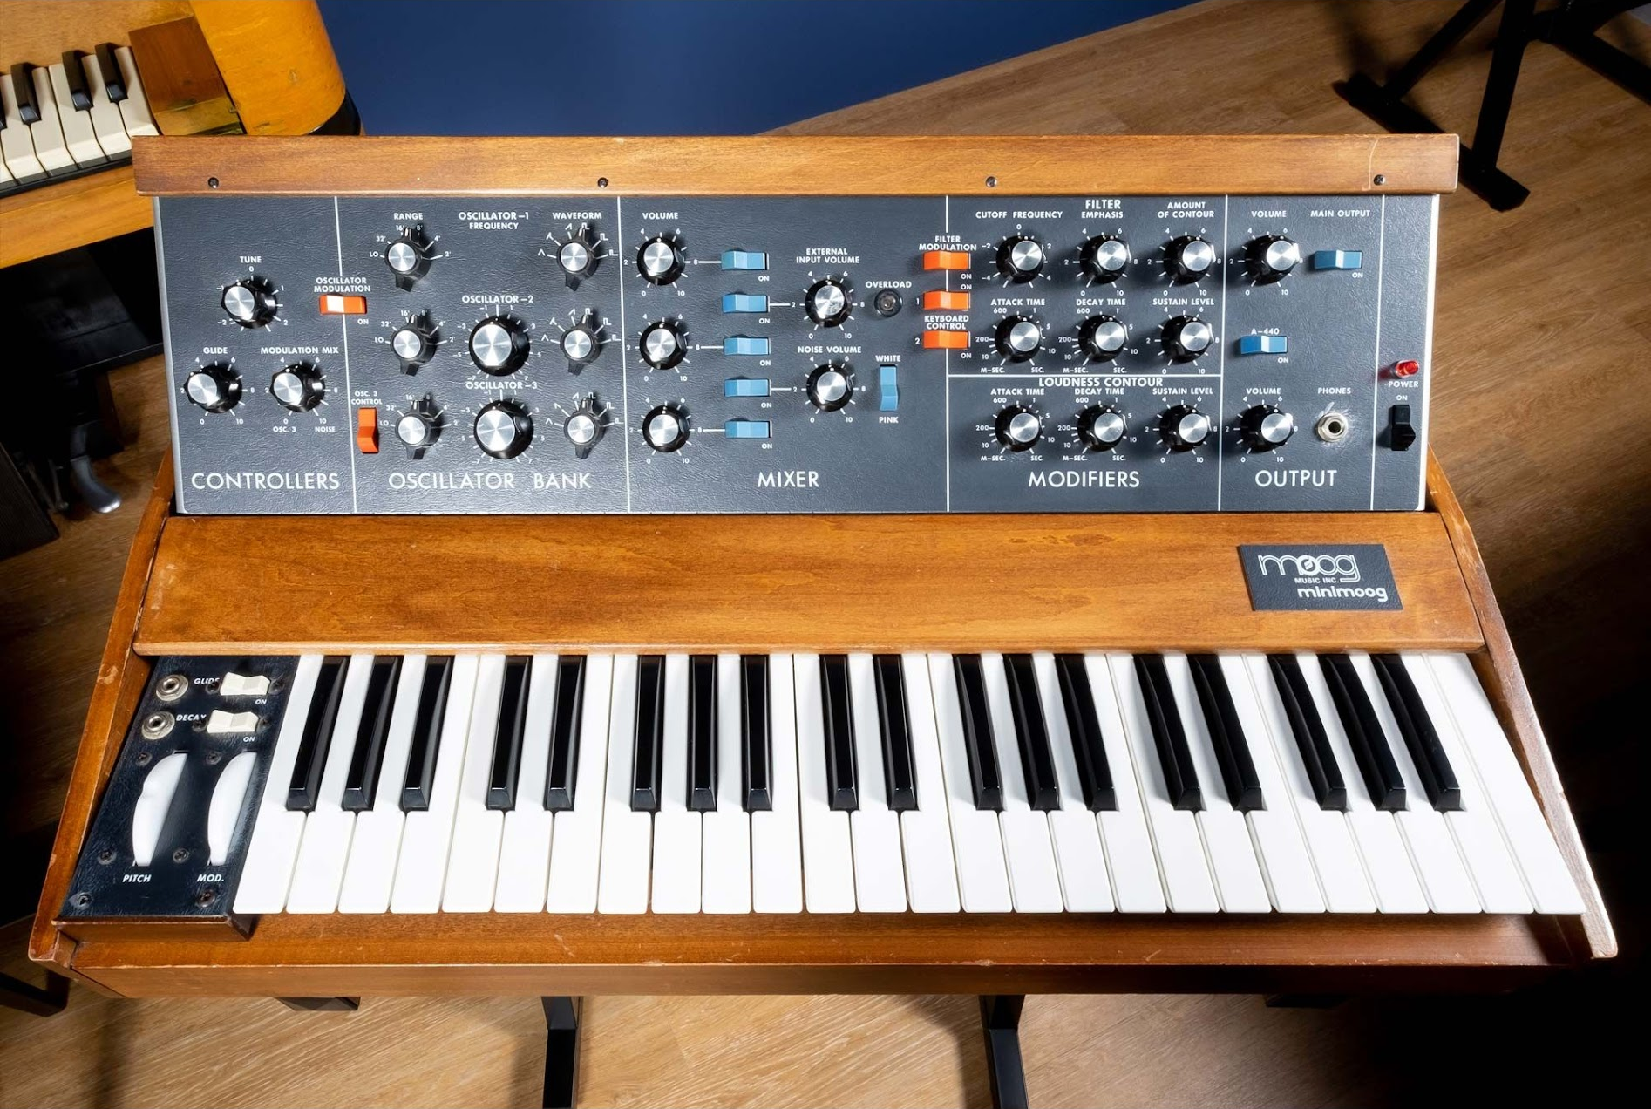
MiniMoog Synthesizer
Introduced in 1970, the Minimoog took the foundational features of Moog's large modular systems and integrated them into a portable, compact, performance-oriented synthesizer that could be programmed without patch cords.
Features like the pitch bend and modulation wheels fostered new playing techniques and styles that made the Minimoog, and synthesizers more generally, into an expressive and widely accepted lead instrument.
Notes:
Moog Music Minimoog, 1973

Slide 15
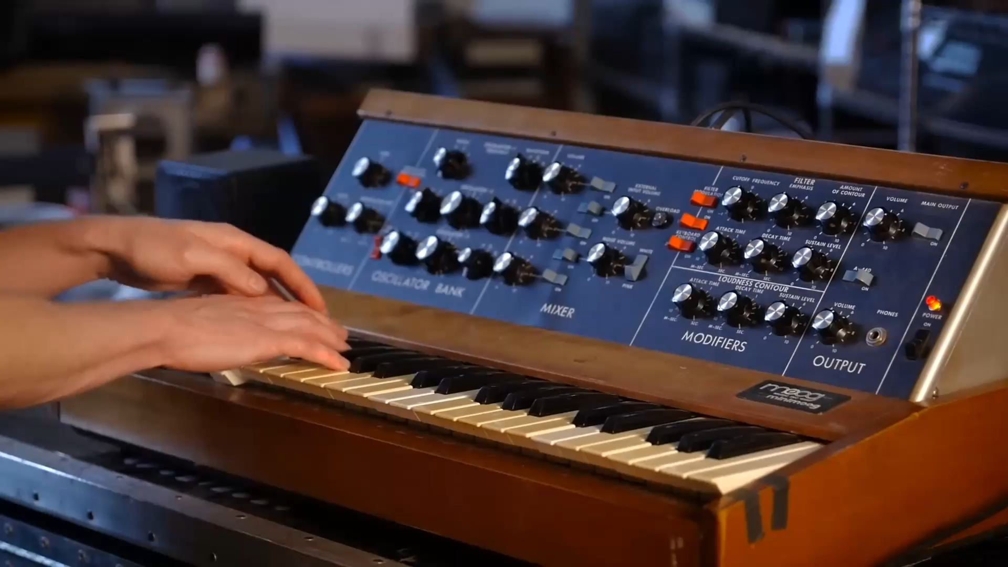
MiniMoog Synthesizer

Slide 16
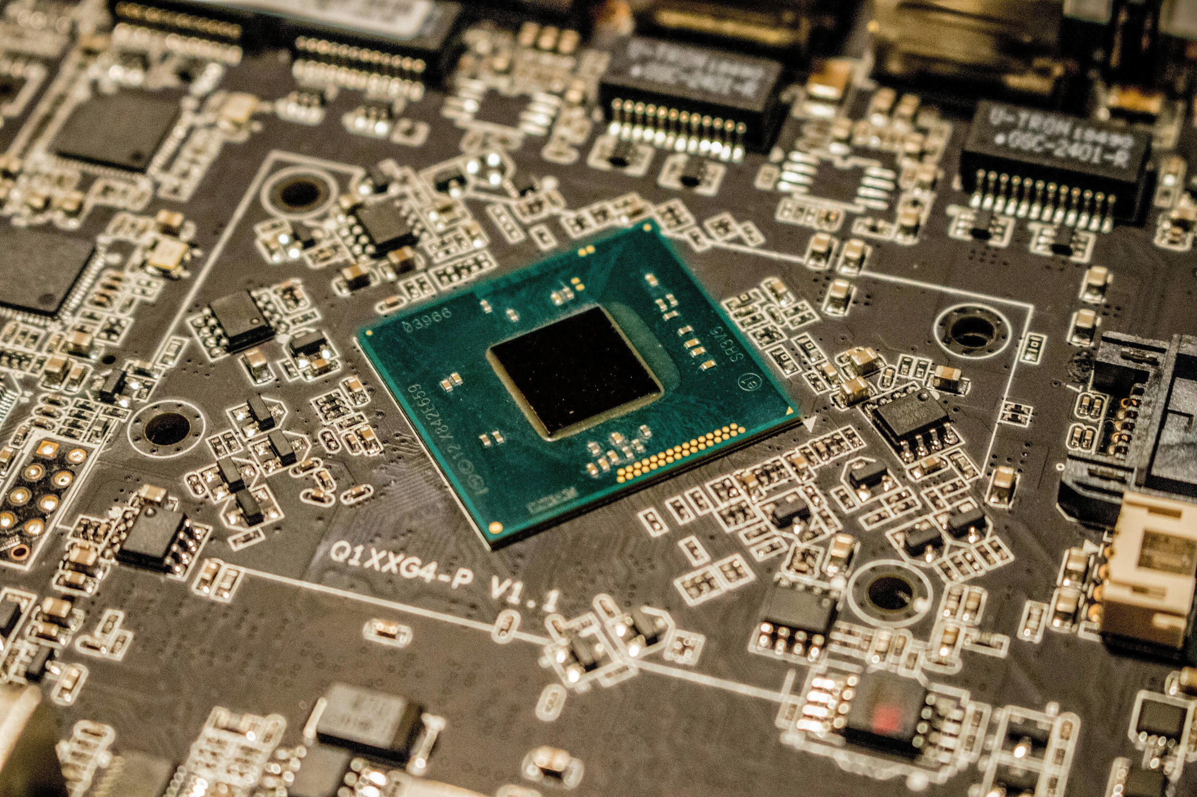
Microprocessor
Microprocessors, comprising huge numbers of transistors packed onto small chips of silicon, brought new capabilities and flexibility to synthesizers and even opened the possibility of creating virtual synthesizers entirely in software.
Microprocessor

Slide 17
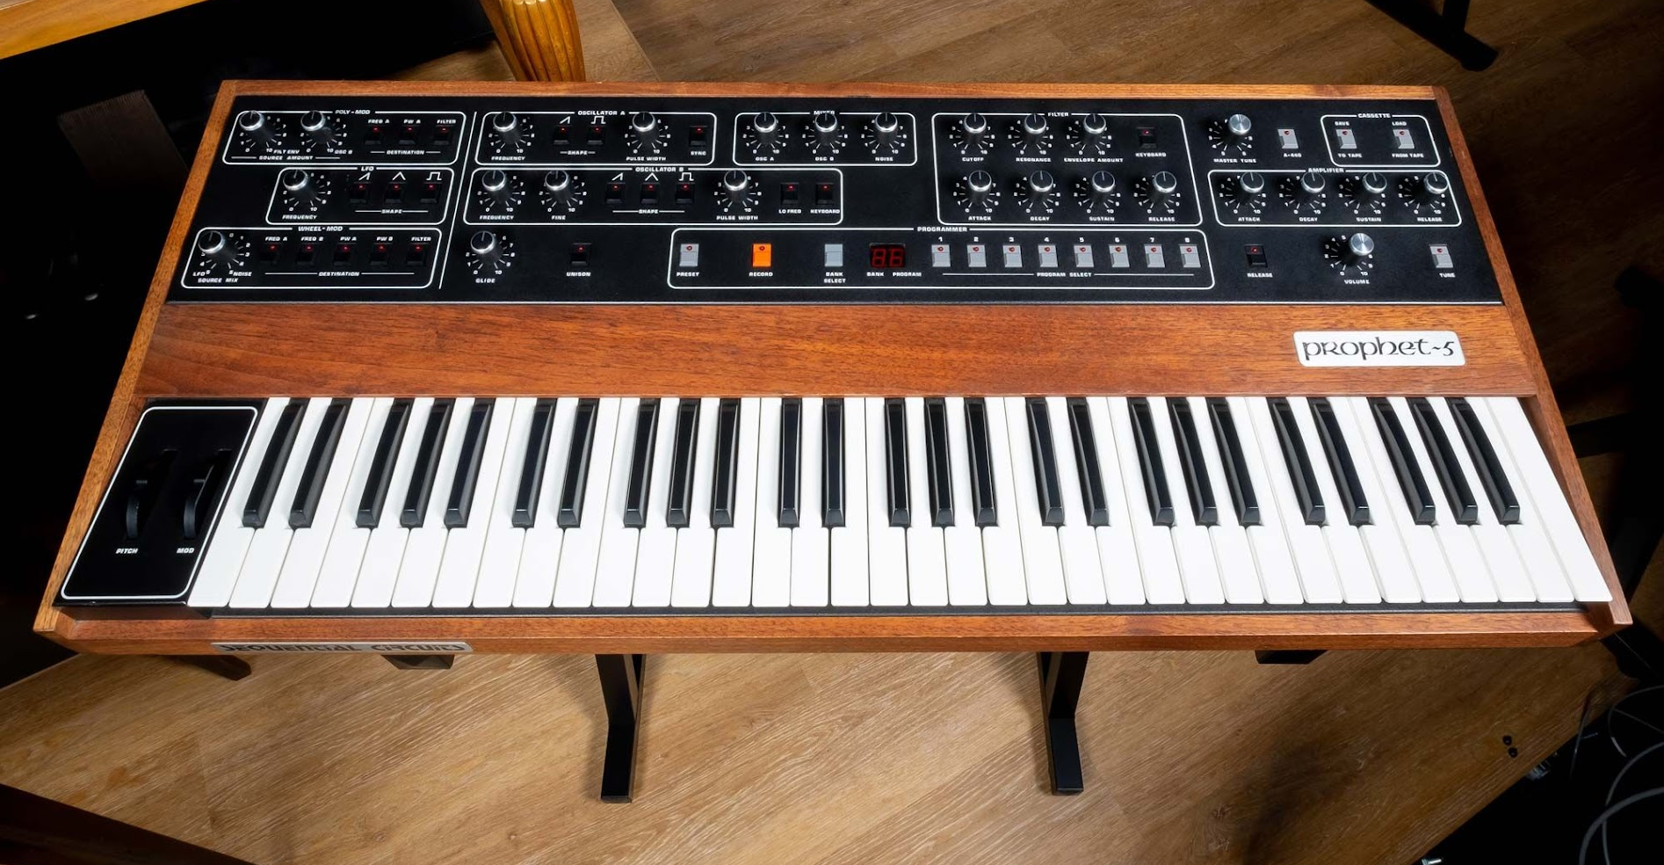
Prophet 5
Released in 1978, the Prophet-5 can play five notes at a time.
It was the first commercially available polyphonic synth that allowed players to store and recall their settings, and the first to include a microprocessor.
Notes:
Sequential Circuits Prophet 5

Slide 18
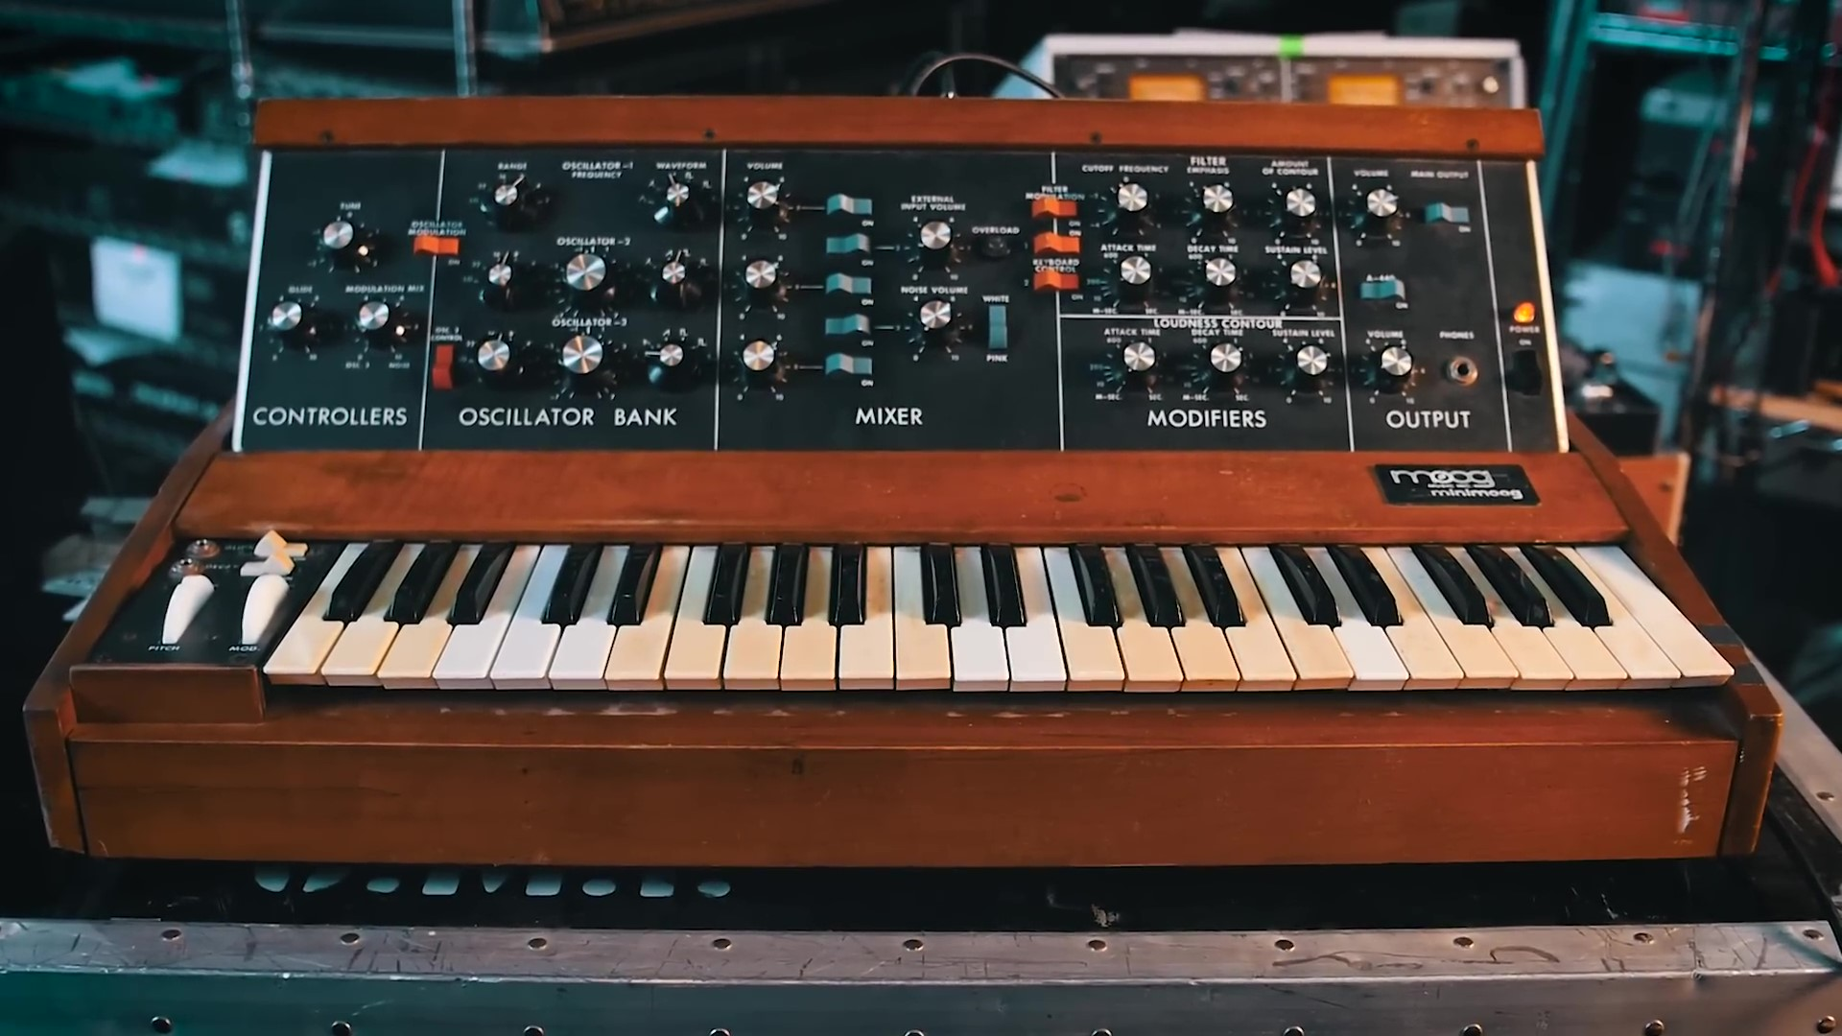
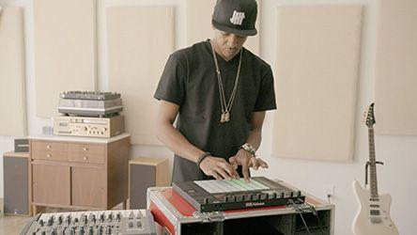
MiniMoog and Ableton Push Demos
Watch these videos and answer the questions on your worksheet.

Slide 19


Slide 20
MiniMoog and Ableton Push Demos
Watch these videos and answer the questions on your worksheet.

Slide 22
Let's Explore an older electronic instrument application

Slide 23
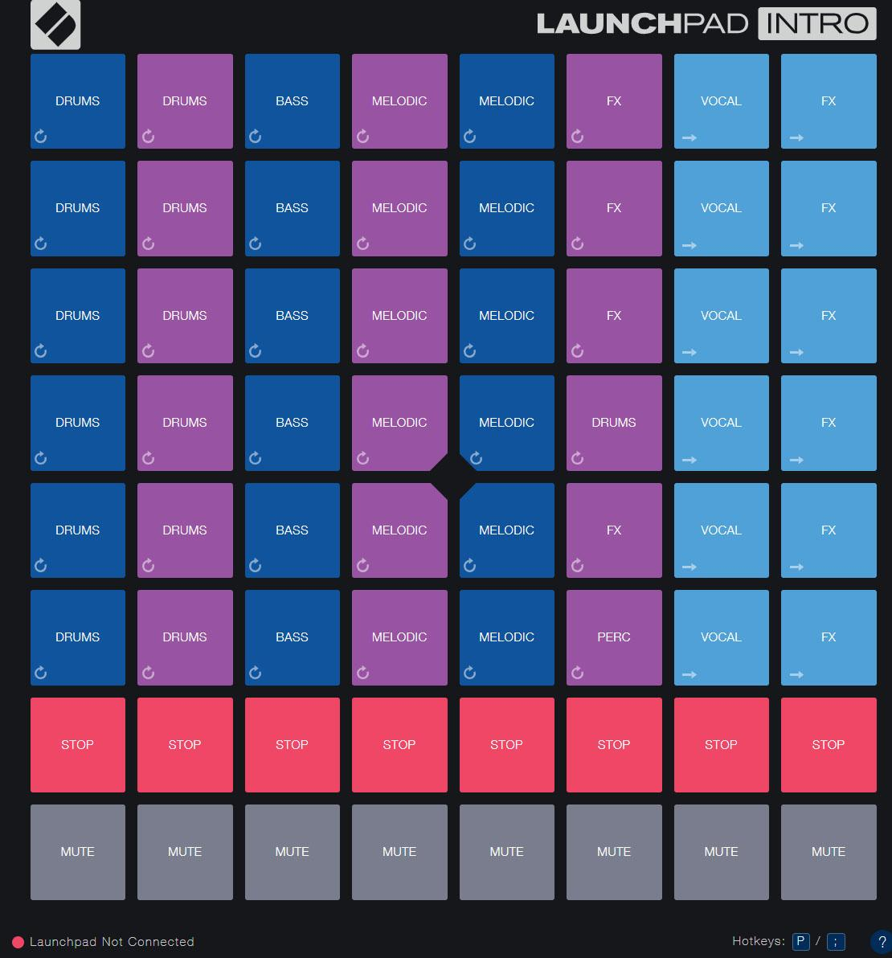
And a newer one!

Slide 24
Now It's Your Turn!
Open a DAW or Chrome Music Lab.
Create a melody using the DAW or the melody maker in
Chrome Music Lab.
Once you've created, download your Melody as an MP3 and submit it.

Slide 25
Let's Share
Share your newly created melody with the class.

Slide 26
Consider a Career in Music!
What careers are related to the lesson we just completed?
Instrument Maker
Engineer
Performer
DJ

Slide 27


