Slide 1
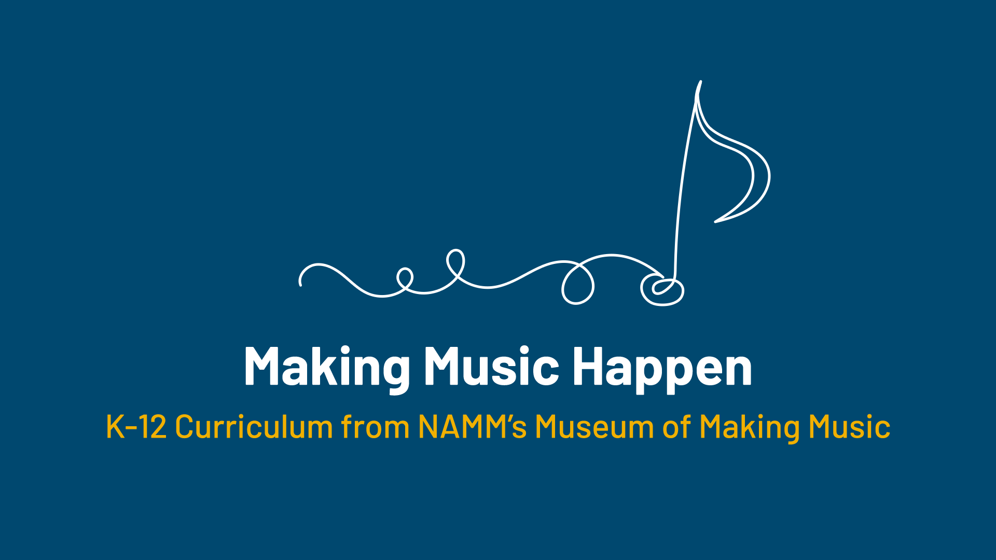

Slide 2
The Changing Role of
Music in Our Homes

Slide 3
Lesson Objectives
Describe how you interact with music in your homes.
Identify how the role of the piano in the home has changed since the Victorian era.
Analyze other ways music in the home has changed to meet the needs of consumers.
Explain other ways music in the home has changed to meet the needs of consumers.

Slide 4
Lesson Introduction
Think about how you interact with music in your home…by listening, creating, producing, etc.
Discuss with a partner.
After discussing, we will share and create a list.

Slide 5
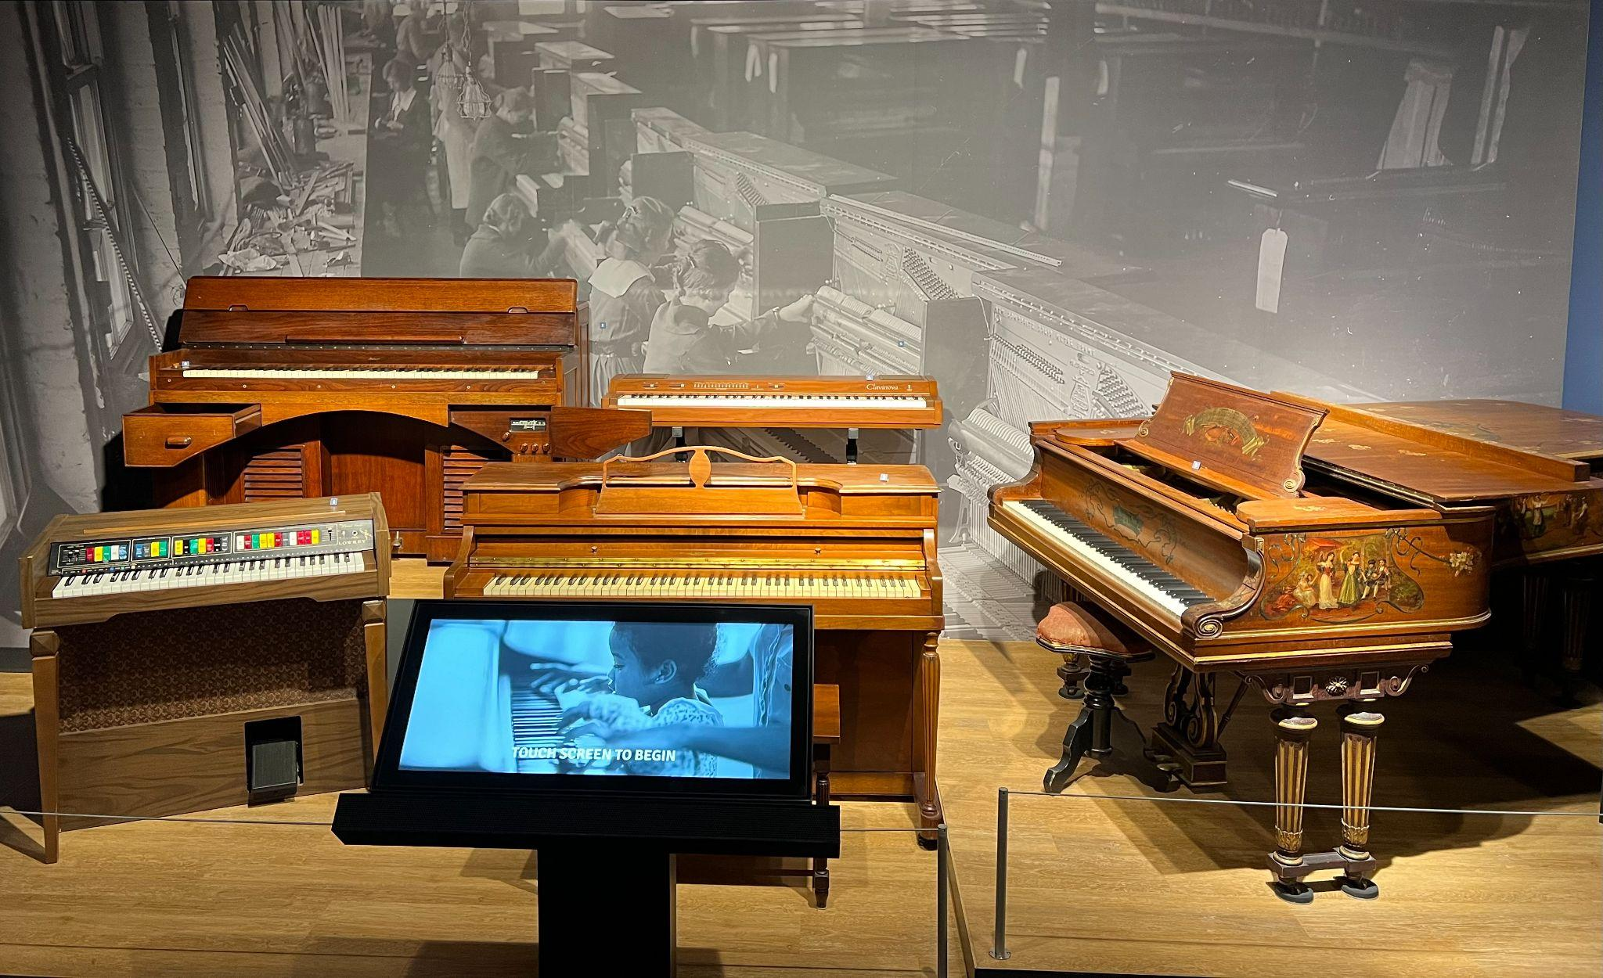
Life at Home display at the Museum of Making Music
Notes:
The home can be a vital and vibrant place for music making, from hosting a concert to entertaining family and friends to practicing and honing skills on an instrument. Since the birth of the music products industry in the late 1800s and early 1900s, few instruments have been as intimately connected to the space of the home than the piano. As homes have changed throughout the past century and a half, makers have created new pianos to better suit them. Processes of urbanization, periods of economic hardship, and popular trends have often led to smaller living spaces where compact pianos are more at home than grand pianos. Increased options for, and emphasis on, entertainment in the household drove the creation of pianos with integrated media players and teaching tools. The instruments to the right are just a few examples of pianos made to fit different ideas of the American home.

Slide 6
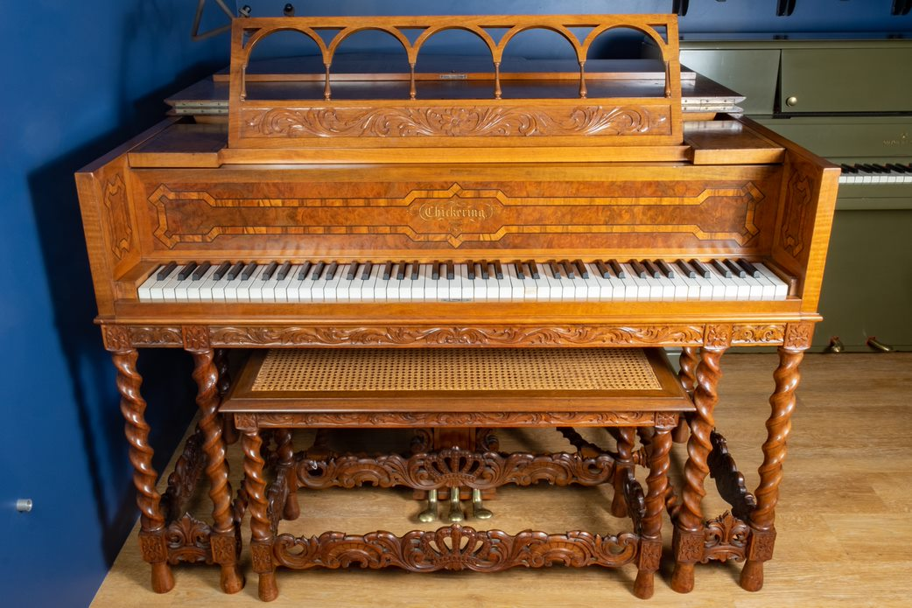
Life at Home
In the Victorian era (early 19th century to early 20th century), the piano was the instrument of preference in many homes. A piano was a status symbol, a source of entertainment, and a vivid sign of self-improvement, a core Victorian-era value.
Is having a piano in the home still a status symbol, a sign of having reached some level of economic success? Has something else replaced the piano in this way?
Notes:
The 19th century in the USA saw the rise of a new middle class that, by the turn into the 20th century, was increasingly able to devote a portion of its income to leisure.
Popular culture at the time was heavily informed by Victorian-era values that prioritized hard work and self-improvement, even in leisurely pursuits. The piano was an ideal musical instrument both for satisfying these priorities and firmly representing a level of financial security for the expanding middle class.
Chickering & Sons Anniversary Grand Piano, c. 1914
Chickering & Sons was founded as a partner of Jonas Chickering and James Stewart in 1823 and remained a significant American manufacturer and brand of pianos until 1983. Chickering pioneered the use of single-piece cast iron plates to support the high string tension in large grand pianos and the technique of overstringing to reduce the space taken up by an instrument's strings. This ornately appointed grand piano was created as part of a series around the company's centennial.

Slide 7
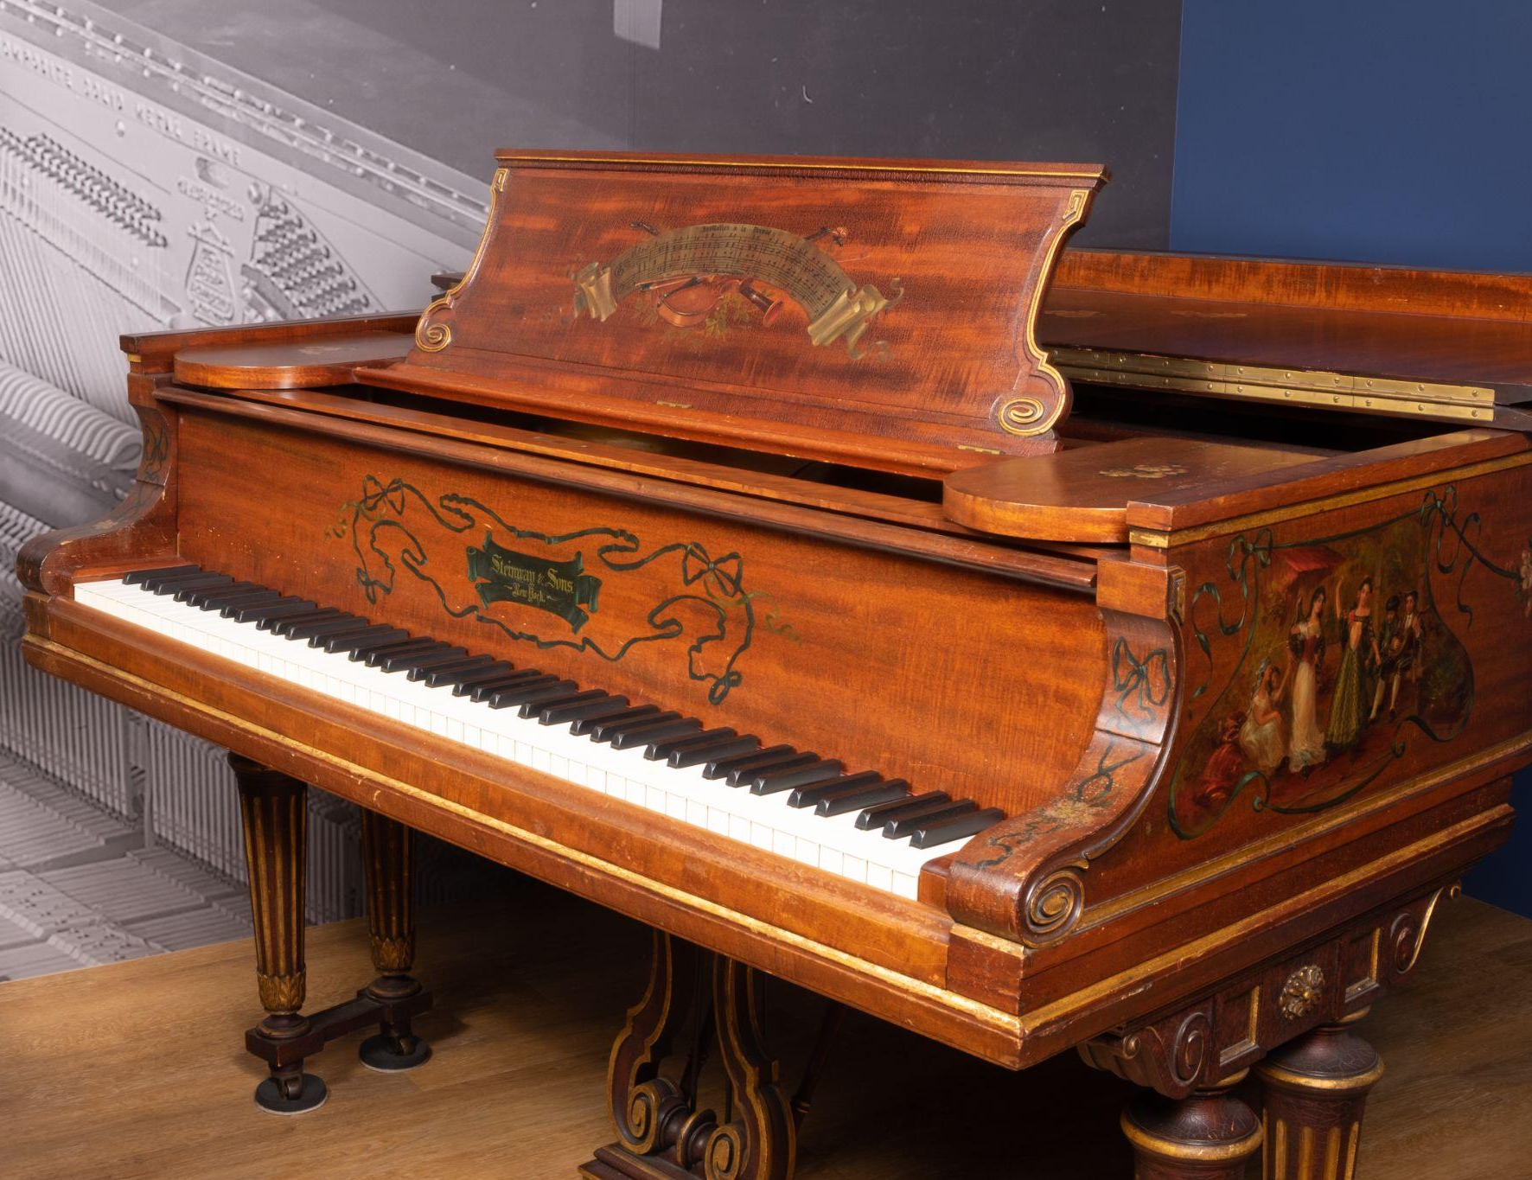
Life at Home
The piano came to be regarded as one of the most essential pieces of furniture in the Victorian home. Rising demand for the piano coincided with the industrialization of piano manufacture, which helped makers increase their production and lower costs.
Meanwhile, the piano’s role as an indicator of success drove some manufacturers to create “art case” pianos, with ornately decorated cases featuring exotic materials, intricate inlays, or painted scenes.
Art case pianos were made for special circumstances, such as for specific customers in the upper and upper-middle classes or as commemorations of a manufacturer’s milestone.
Notes:
Steinway & Sons Model B Grand Piano, 1902
An “art case” piano is one that features some combination of intricate carvings, paintings, exotic inlays, and more in its case, while still being built around a manufacturer’s “standard” piano mechanisms. This piano features hand-painted floral decorations and depictions of folk musicians and dancers around the case, including a large image on the lid of a group of dancers around a maypole. The instrument is signed on the plate by Henry Z. Steinway, former president of Steinway & Sons and founding president of the Museum of Making Music.

Slide 8
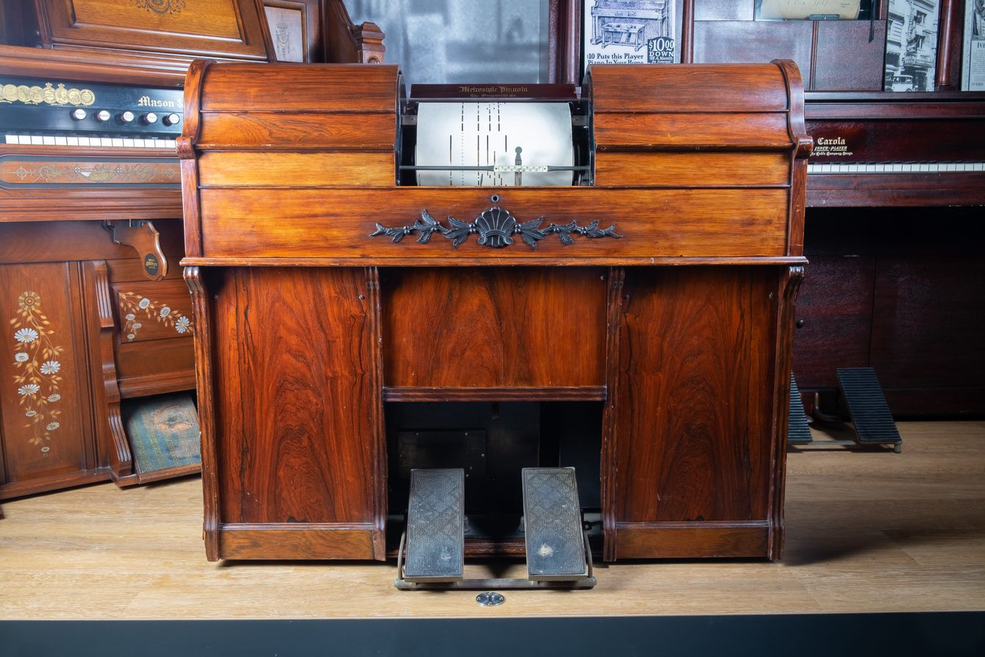
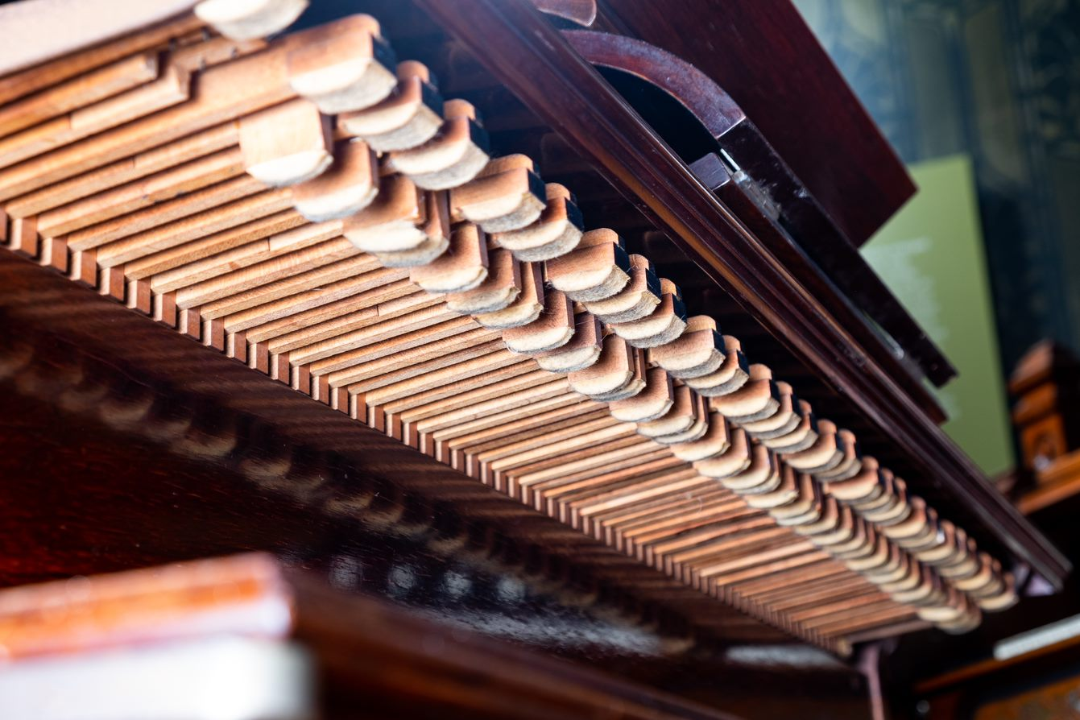
Life at Home
The first few decades of the 20th century saw the continued growth of the middle class, a booming economy, and advances in mechanical and electric technology that fueled an array of new leisure pursuits.
Notes:
An example of an instrument geared more to leisure than status.
Orchestrelle Company Metrostyle Pianola, c.1903
Introduced commercially by the Aeolian Company in 1898, the Pianola, or more generically the “push-up player,” turned any existing piano into an automated musical instrument. The pedal-driven, pneumatically-powered device accepted a perforated roll that controlled the action of levers that in turn depressed the keys of a piano. Aeolian’s “Metrostyle” feature enabled the pianolist to easily modify the tempo of the Pianola’s performance. The Orchestrelle Company was Aeolian’s London-based subsidiary.

Slide 9
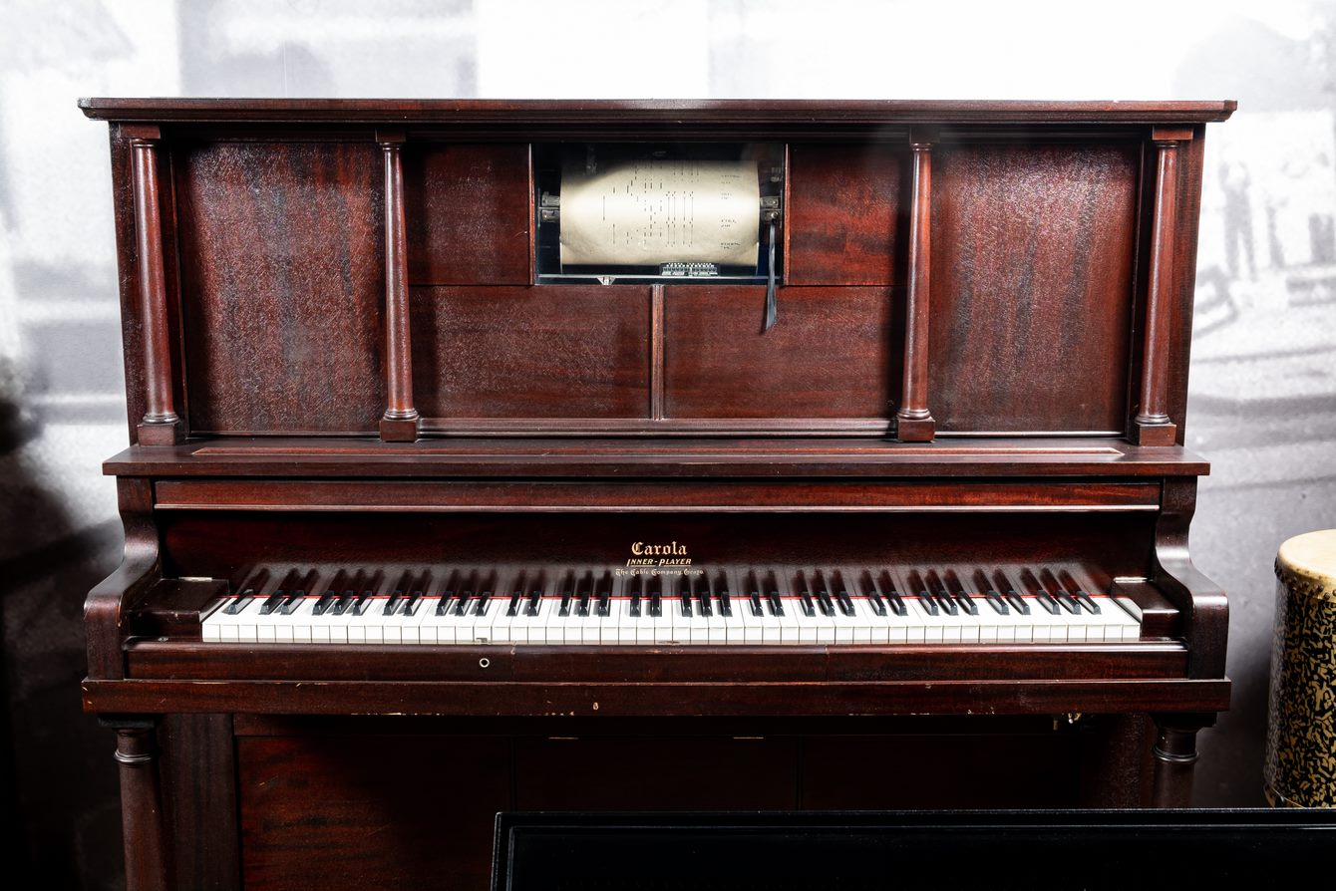
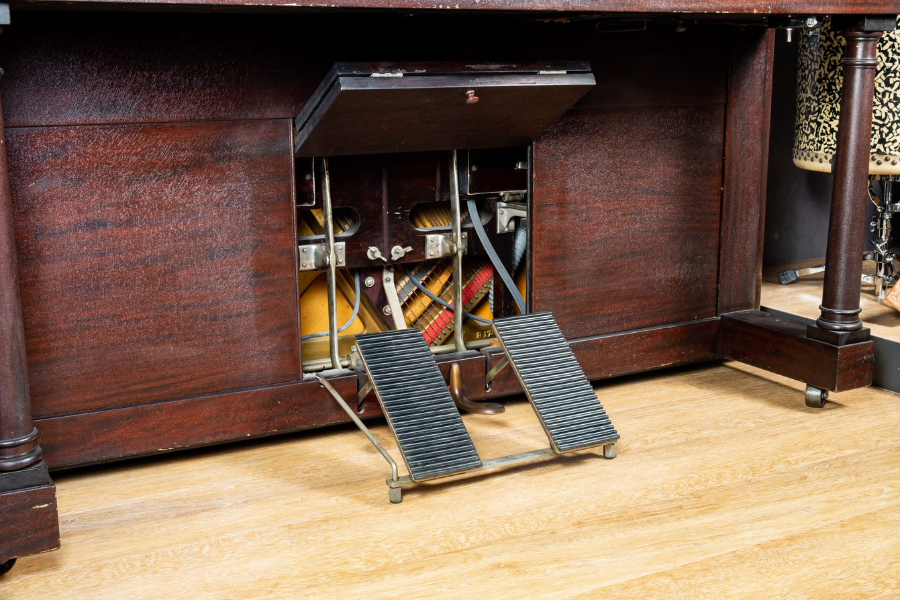
Life at Home
The widespread availability of the push-up piano player and, subsequently, the player piano in the early 1900s initiated a shift in the meaning of the home piano for many Americans. Rather than the object of Victorian self-improvement, the piano became a source of entertainment for the family.
Notes:
Carola Inner Player Piano, 1908
The “inner player piano,” later simply “player piano,” was a single instrument combining the piano player mechanism directly into the cabinet of the piano itself. The Buffalo Convention of 1908, a meeting of the major player piano manufacturers, led to the standardization of two different formats for piano rolls: 65-note and 88-note. Before long, player pianos overtook push-up players in popularity and, by the early 1920s, were being sold at a rate of more than 200,000 per year.

Slide 10
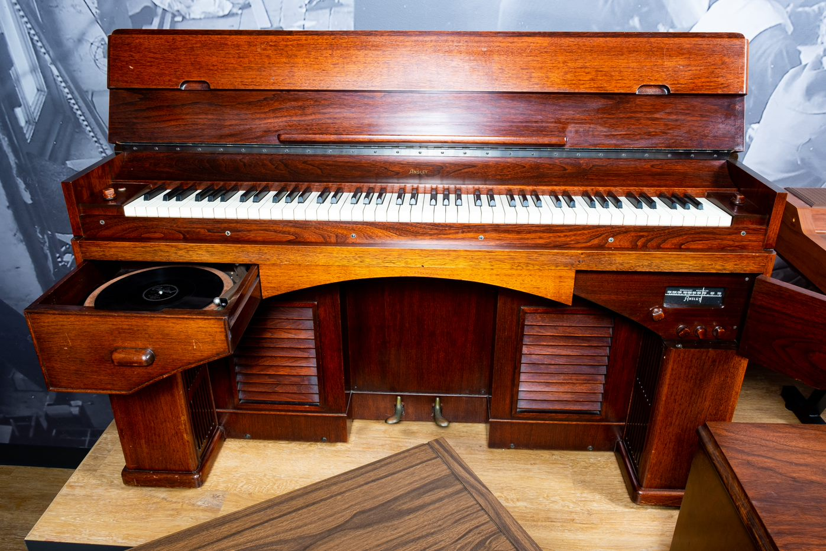
Life at Home
As radio and phonographs became nearly ubiquitous in American households over the 1930s and 40s, instruments like the Ansley DynaTone and RCA Storytone (a collaborative effort with Story & Clark) offered a complete home entertainment system: a radio and record player built directly into the cabinet of an amplified piano.
Notes:
Ansley Radio Corporation DynaTone Electric Piano, c. 1939
The DynaTone, first made in 1939, is an early example of an electric piano. It does not have a soundboard; instead it uses magnetic pickups to send the vibrations of the strings to an amplifier and speaker at the bottom of the piano. The DynaTone also has a phonograph and radio built directly into the piano, combining three of the most common home entertainment devices of the time into a single instrument.

Slide 11
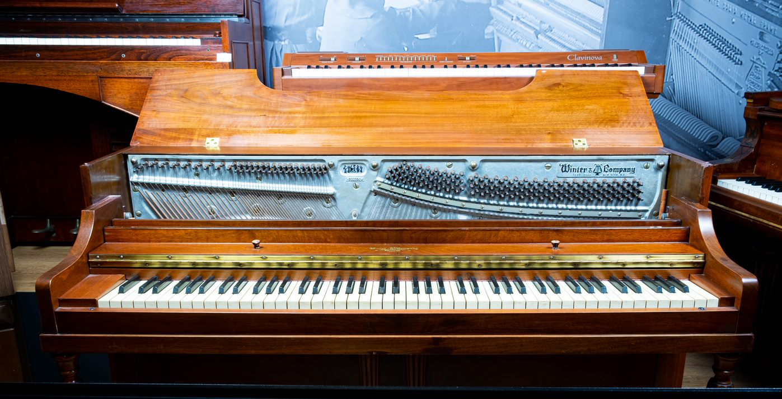
Life at Home
With the extreme economic hardship brought on by the Great Depression in 1930, huge numbers of Americans, and people worldwide, were forced to change their living arrangements. Often this meant moving into smaller homes, very few of which were designed – like the Victorian homes several decades earlier – to accommodate a piano as a central piece of furniture.
In response, Winter & Company released their Musette spinet piano in 1935. Utilizing a “drop action,” spinet pianos could be made significantly smaller – and more affordable – than the smallest upright piano.
Notes:
Winter & Company Musette Spinet Piano, 1948
In 1935, Winter & Company and the Haddorff Piano Company released, nearly simultaneously, their Musette and Vertichord pianos, respectively. Both instruments featured stylish, modern cases that were shorter, between 3 and 4 feet tall, than the uprights that were available at the time, some of which were up to 5 feet tall. They also featured significantly smaller price tags, around 20% lower than the most affordably priced upright and grand pianos of the time. These new “spinet” pianos were popular with consumers, many of whom were still feeling the effects of the Great Depression, and by 1937 nationwide piano sales topped 100,000 – including nearly 60,000 spinets – for the first time since the Stock Market Crash of 1929.

Slide 12
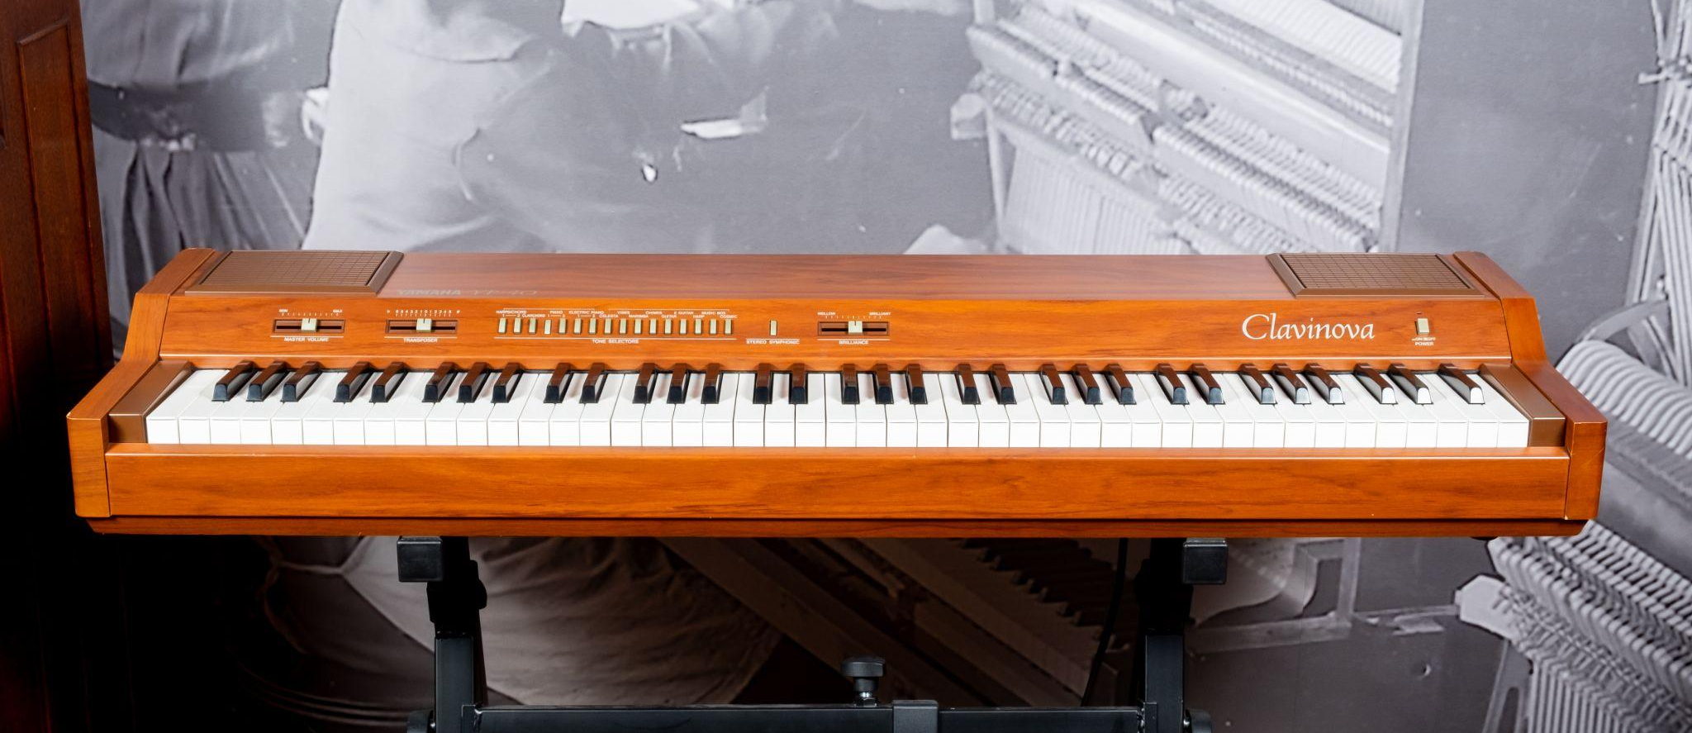
Life at Home
With the advent of digital technologies in the latter 20th century, instruments like Yamaha’s Clavinova have introduced additional entertaining (and educational) features like song playback, recording capabilities, and built-in music lessons.
Notes:
Yamaha Corporation YP-40 Clavinova Digital Piano, 1983
Yamaha’s Clavinova series of digital pianos, first introduced in 1983, was developed with the goal of delivering the experience of an acoustic piano in a much smaller instrument. The initial YP models, with the YP-40 positioned at the top of the range, used then-new frequency modulation (FM) synthesis and a reverberation effect to create a variety of realistic keyboard sounds. Subsequent Clavinova models have seen significant new features, including weighted keys, digital samples, song recording and playback, built-in lessons, and even internet connectivity for a range of functionality. The Clavinova was included in Time Magazine’s 2016 list of “Most Influential Gadgets of All Time.”

Slide 13
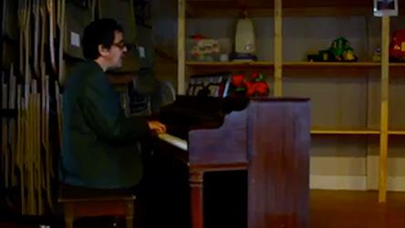
Life at Home: AJ Croce

Slide 14
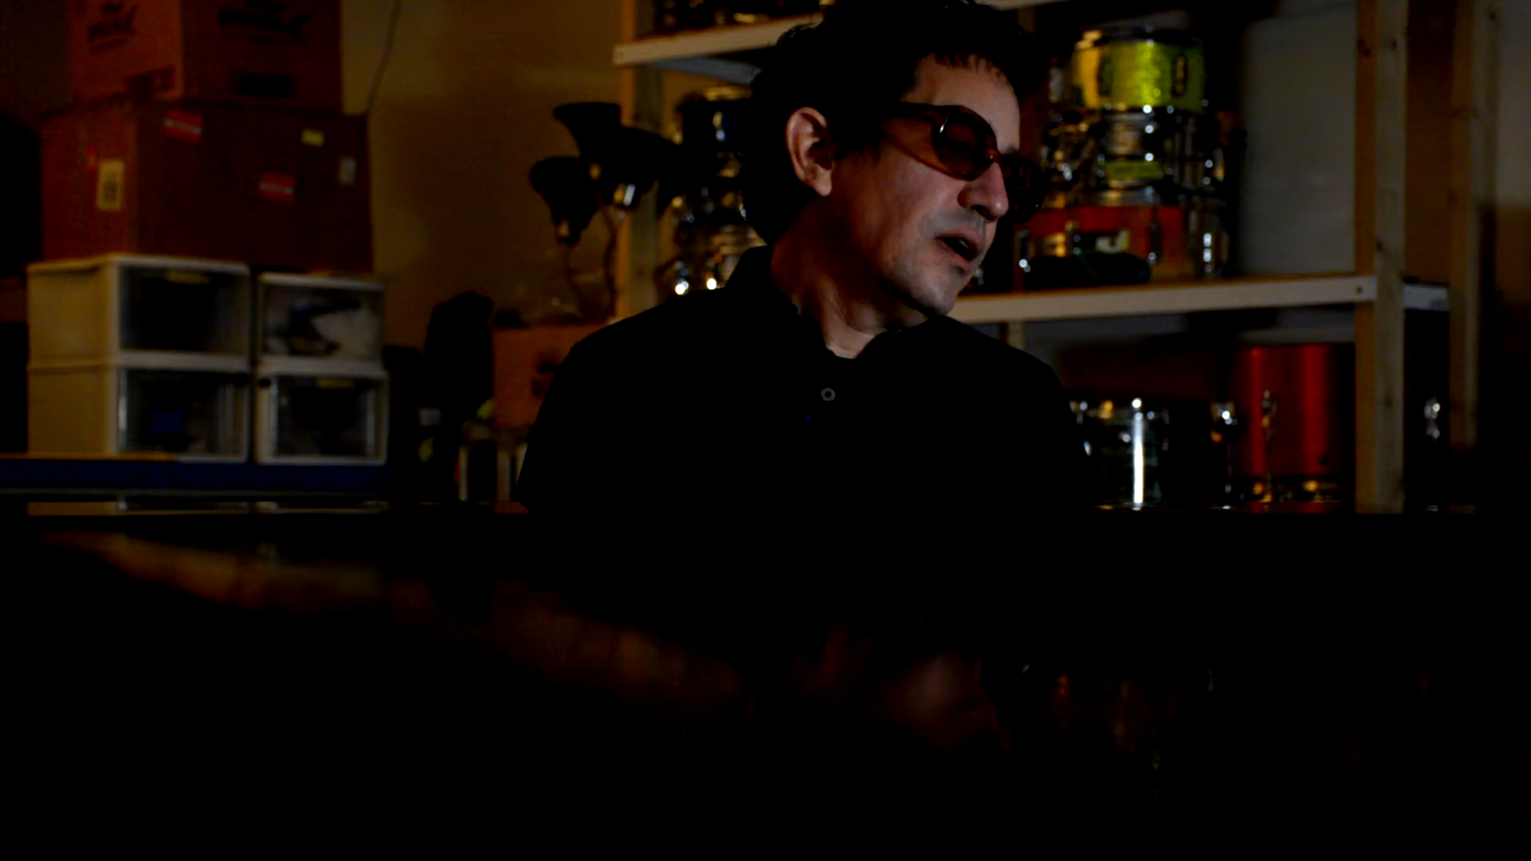

Slide 15
Let's Brainstorm
With a partner or in small groups, brainstorm other ways music in the home (listening, playing, creating, producing, etc.) has changed to meet consumer needs.

Slide 16
Let's Create
With a partner or in small groups, create a slide in a collaborative slide deck.
On your slide, show how a specific musical product has changed over the years.
Include the following…
  Images or a description of what has changed.
  How it meets the needs of the consumer.
Use your own experiences and the internet to research.
Think about how musical products are marketed - who is the target audience, and why does this person need the item?

Slide 17
Wrap-Up
As a class, let's review the slides we've created.
How have you personally used or been impacted by new ways of experiencing music in your home?

Slide 18
Consider a Career in Music!
What careers are related to the lesson we just completed?
Instrument manufacturer
Music retailer
Marketer
Engineer

Slide 19


