Slide 1
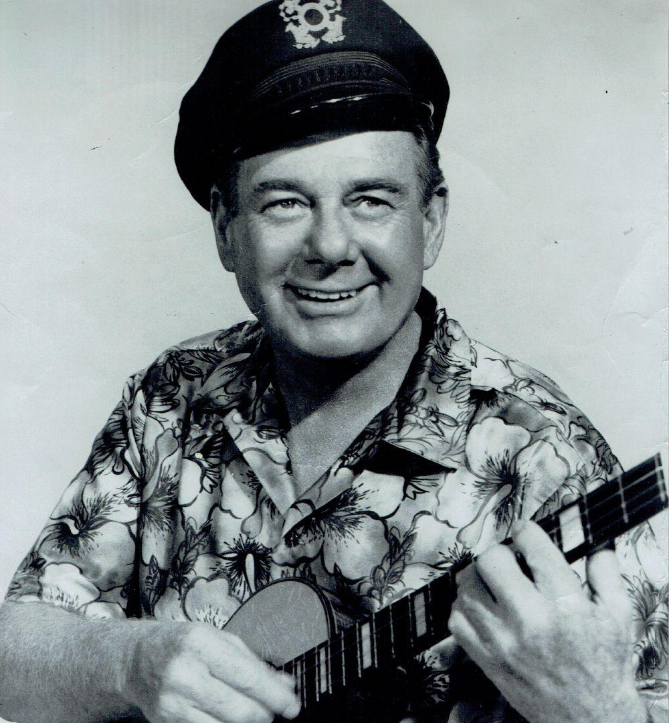
Riding the Rollercoaster:
History of the Ukulele
In 1945, the ukulele was brought back into the national spotlight by radio and TV star Arthur Godfrey.

Slide 2

Riding the Rollercoaster:
History of the Ukulele
Mattel, a new toy company, capitalized on both Godfrey’s popularity and cutting-edge plastics technology developed during World War II to create the first plastic ukulele, the Uke-A-Doodle, in 1947.
Competing companies quickly released plastic ukuleles, and soon the ukulele became almost synonymous with “plastic toy.”
Traditional makers worked against this stereotype, but the rise of the electric guitar in the 1950s rapidly overshadowed the popularity of the ukulele.

Slide 3
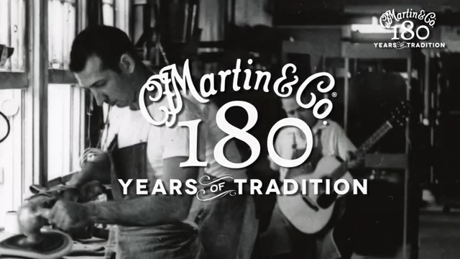
History of the Ukulele
Watch the video and answer the corresponding questions on your worksheet.

Slide 4


Slide 5
Let's Discuss!
Throughout the lesson, you have noted physical changes and other observations of the evolution of these instruments on your worksheet.
With your group, discuss your findings.
Be prepared to share with the class.

Slide 6


Wrap-Up
Listen to one of the performances below and answer the
questions on your worksheet.

Slide 7


Slide 8
Wrap-Up
Listen to one of the performances below and answer the
questions on your worksheet.

Slide 10
Consider a Career in Music!
What careers are related to the lesson we just completed?
Performer
Music critic
Manufacturer
Handcrafter
Luthier
Business owner
Business manager

Slide 11


