Slide 1
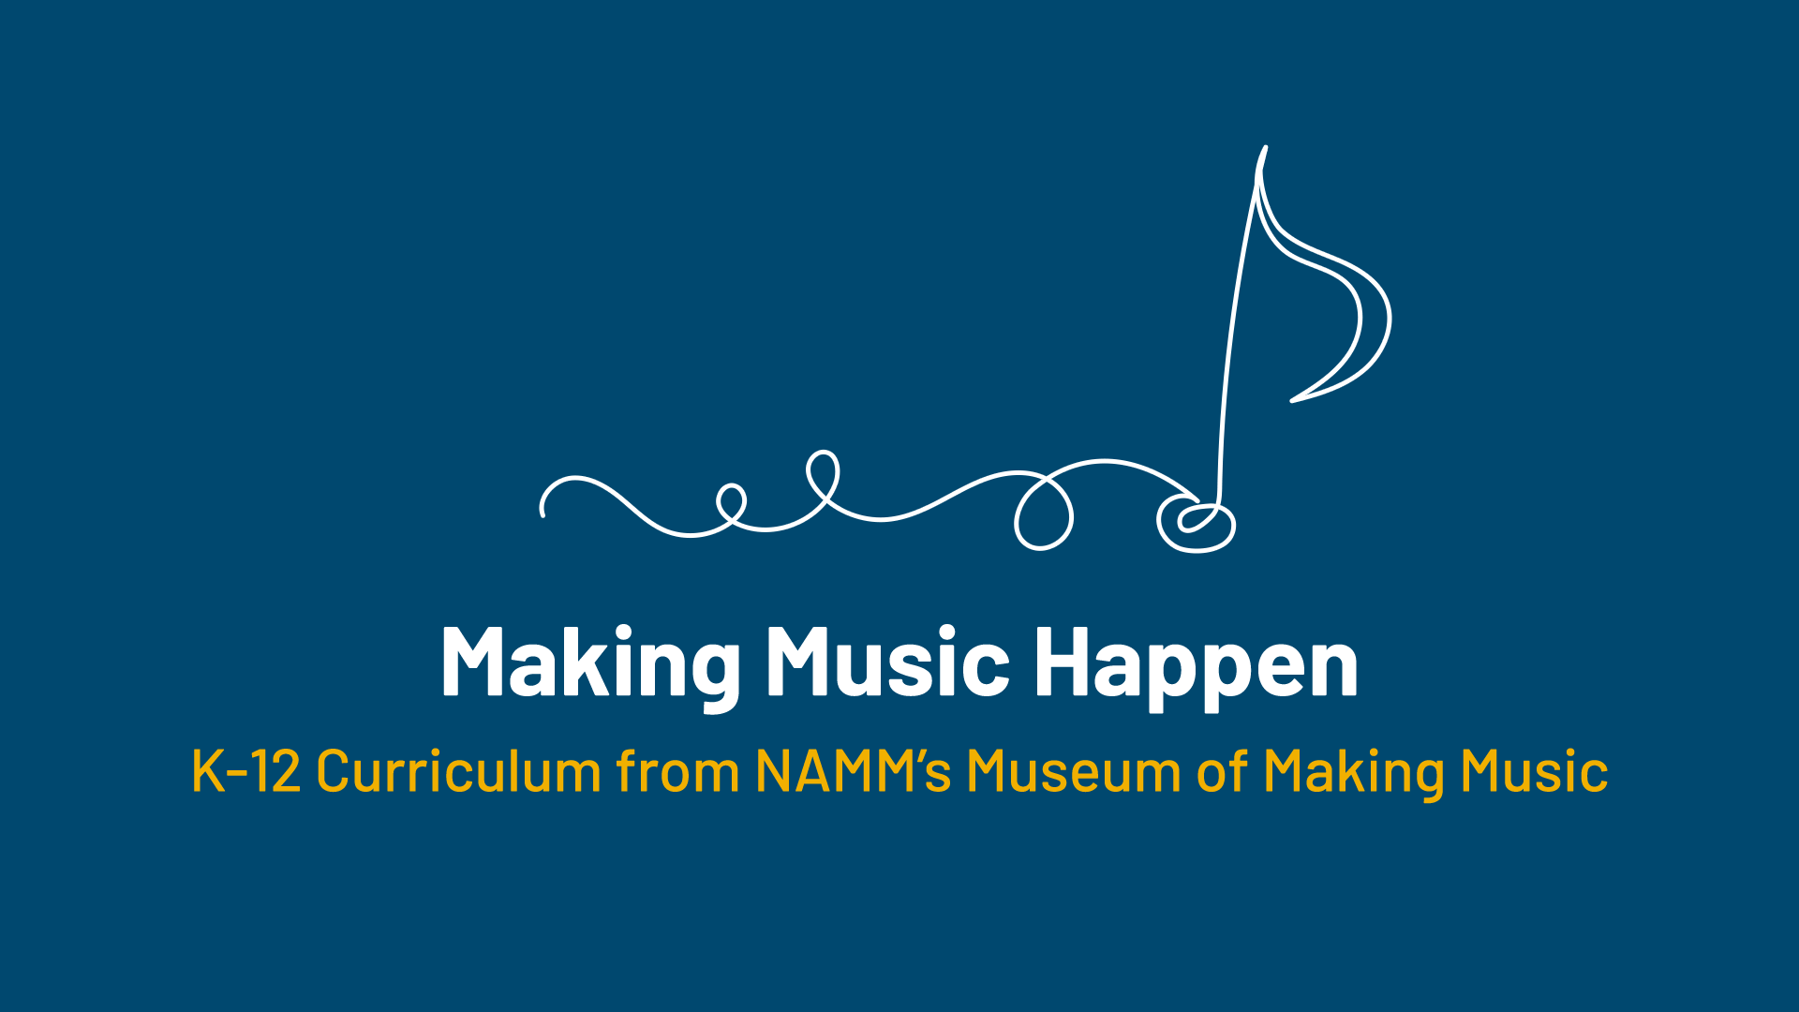

Slide 2
Making (Musical) Waves:
The History and Evolution of the Ukulele and Banjo

Slide 3
Lesson Objectives
Describe the history and evolution of both the banjo and ukulele.
Analyze the physical changes in both instruments.
Draw connections between the physical changes of the instruments and the evolution of musical styles.
Listen to and evaluate two different performances using the banjo and/or ukulele.

Slide 4
Introduction
What do you know about the ukulele?
What do you know about the banjo?
Record your brainstorm on your worksheet! Include facts, popular songs, or popular musicians who come to mind when you hear these instruments.

Slide 5
Let's Discuss
Form a small group and share your brainstorm ideas.

Slide 6
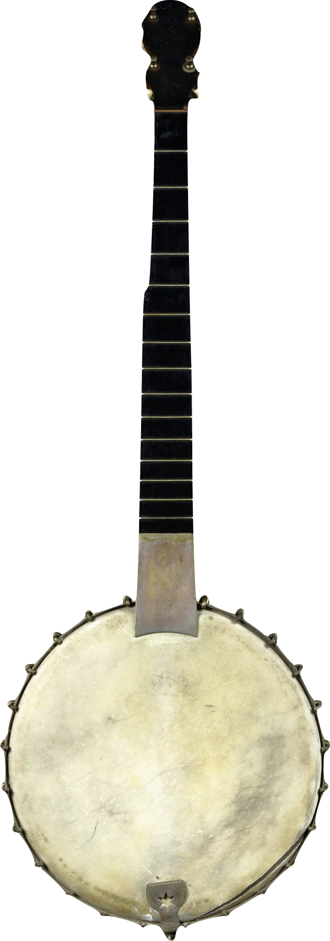
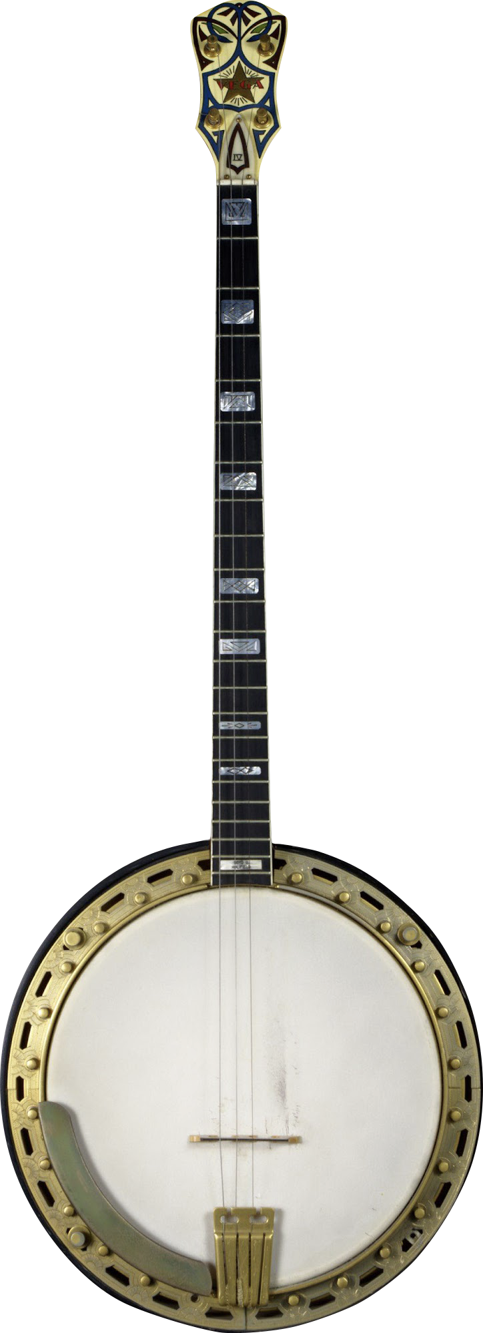
Building Steam:
History of the Banjo
Shifts in popular music literally shaped the banjo, with musicians and makers changing the instrument to fit new genres and styles.
Early banjos arrived in the Americas, brought by enslaved people taken from West Africa, with a gourd body, stick neck, and a varying number of strings - often including shorter drone strings.
Notes:
H.C. Dobson
Five-String Banjo, 1890s
Henry C. Dobson was an active promoter of the banjo, beginning in the 1850s, and helped to drive the instrument's popularity. The majority of Dobson's instruments were built by, or at least assembled from parts built by, J.H. Buckbee, a huge producer of banjos and components for other brands. The metal piece at the end of the neck is to provide an easily-removable extension to the fretboard while still allowing the head to be changed.
Vega Company
Vegavox IV Plectrum Banjo 1920s
In the 1920s, the Boston-based Vega Company teamed with "King of the Banjo" Eddie Peabody to develop the Vegavox line of instruments. These were notable for their very deep resonators, which are as deep as the banjo's body itself. (Resonators on other banjos, including some here, are typically at most half as deep as the body.) To make life easier for the player, the tension of the head could be adjusted from the front of the instrument, rather than the back as on most other banjos, without removing the large resonator. The Vegavox was available in multiple trims, initially from I to IV (and a custom IV Ultra Deluxe) and later to V in the 1970s.

Slide 7
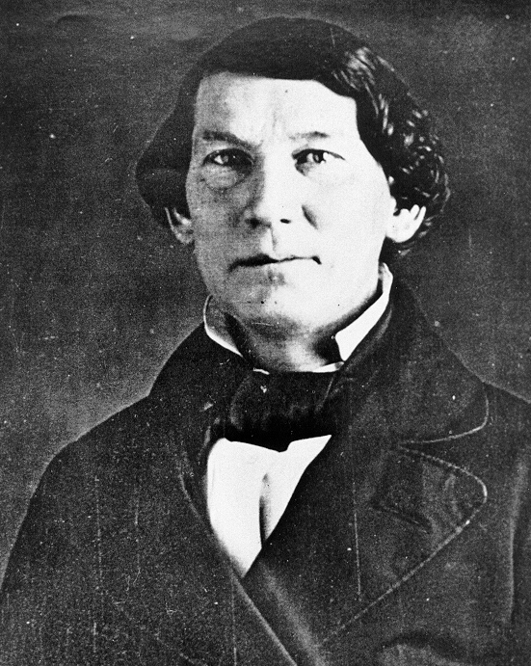
Building Steam:
History of the Banjo
Joel Walker Sweeney, a musician in early minstrel shows, is often credited with changing the banjo to use a drum-like sound box, playing with four full strings and a short fifth string, and popularizing the banjo with white audiences.
Joel Walker Sweeney
{{PD-US-expired}}

Slide 8
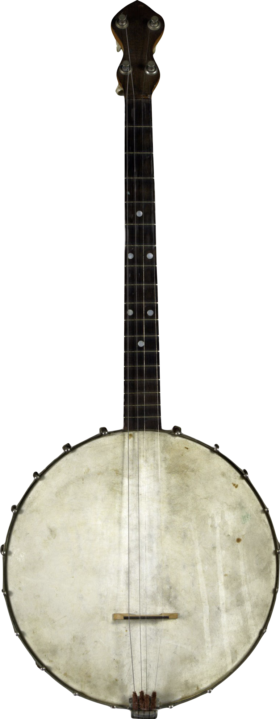
Building Steam:
History of the Banjo
As minstrel shows faded in popularity after the Civil War, players and makers like S.S. Stewart adapted the banjo to become the instrument of choice for middle-class amateur musicians.
These new banjos introduced a tone ring for enhanced projection, more metal and exotic materials, and a guitar-like playing style.
Notes:
S.S. Stewart
Tenor Banjo, c1922
Samuel Swaim Stewart began making banjos in the late 1870s after being dissatisfied with the instruments then on the market. He is associated with the movement to “elevate” the banjo from its association with minstrelsy to an equal of the violin family.

Slide 9
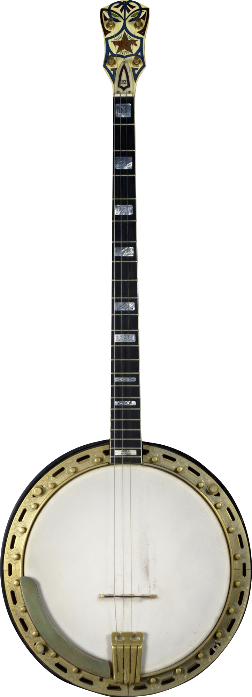
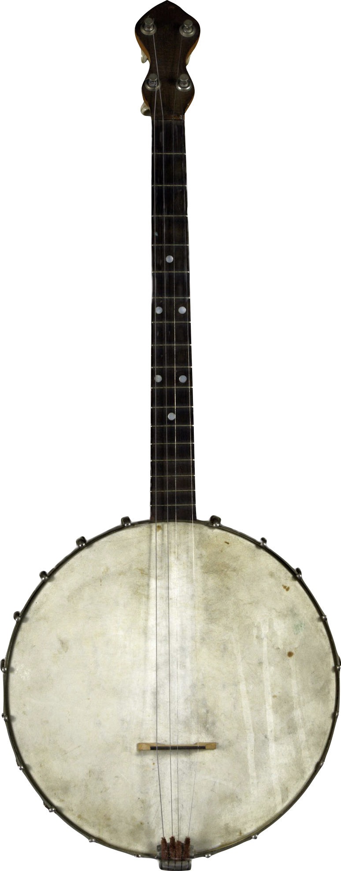
Building Steam:
History of the Banjo
Five-string banjos, however, were ill-suited for the ragtime and jazz music of the early 20th century.
Banjoists largely played a supporting role in these styles and had little use for the fifth string, leading to new four-string instruments: the full-length plectrum banjo and the shorter tenor banjo.
plectrum banjo
tenor banjo
Notes:
Vega Company
Vegavox IV Plectrum Banjo 1920s
In the 1920s, the Boston-based Vega Company teamed with "King of the Banjo" Eddie Peabody to develop the Vegavox line of instruments. These were notable for their very deep resonators, which are as deep as the banjo's body itself. (Resonators on other banjos, including some here, are typically at most half as deep as the body.) To make life easier for the player, the tension of the head could be adjusted from the front of the instrument, rather than the back as on most other banjos, without removing the large resonator. The Vegavox was available in multiple trims, initially from I to IV (and a custom IV Ultra Deluxe) and later to V in the 1970s.
S.S. Stewart
Tenor Banjo, c1922
Samuel Swaim Stewart began making banjos in the late 1870s after being dissatisfied with the instruments then on the market. He is associated with the movement to “elevate” the banjo from its association with minstrelsy to an equal of the violin family.

Slide 10
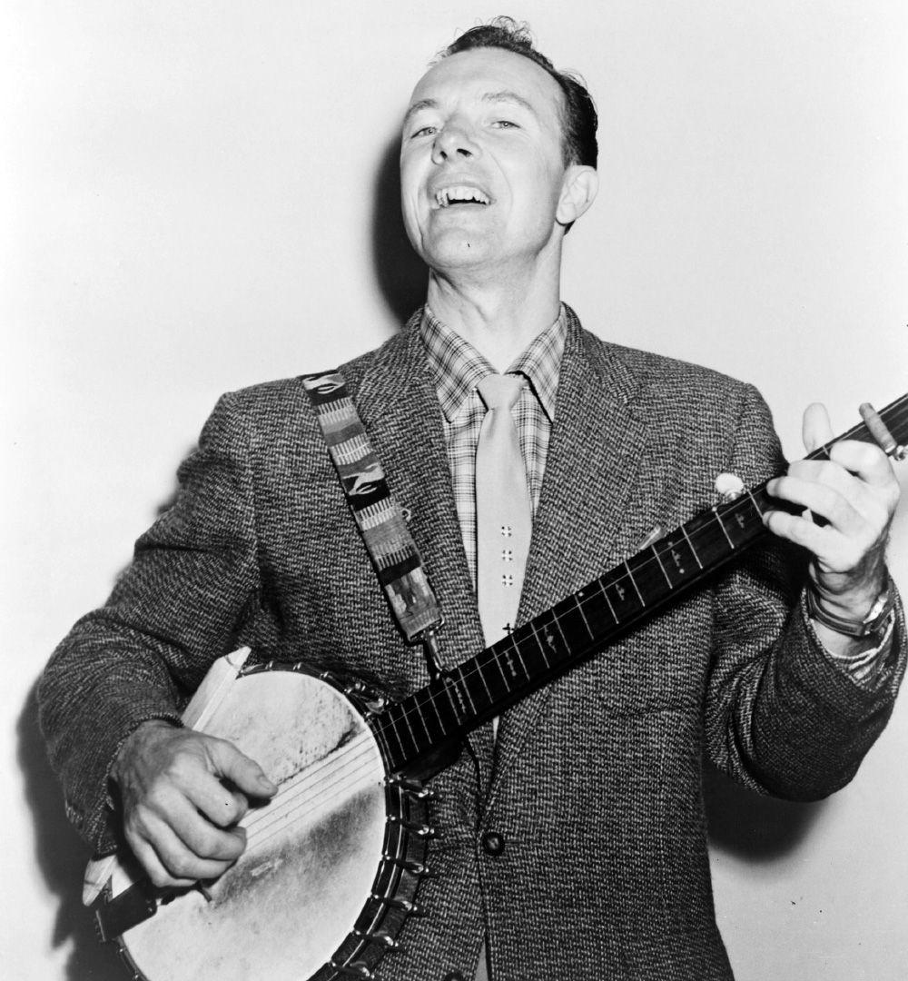
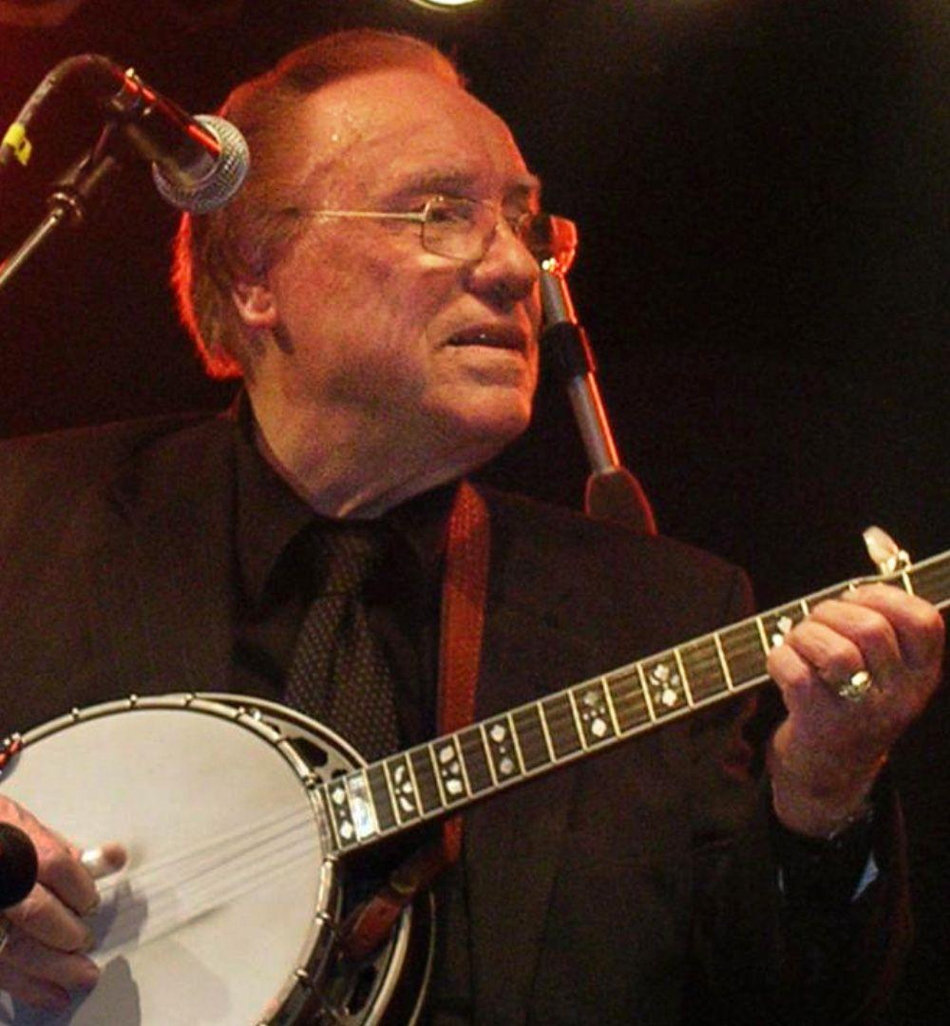
Building Steam: History of the Banjo
After World War II, the emergence of genres like folk and bluegrass, driven by the virtuosity and visibility of Pete Seeger and Earl Scruggs, reestablished the prominence of the five-string banjo.
Pete Seeger
Earl Scruggs

Slide 11
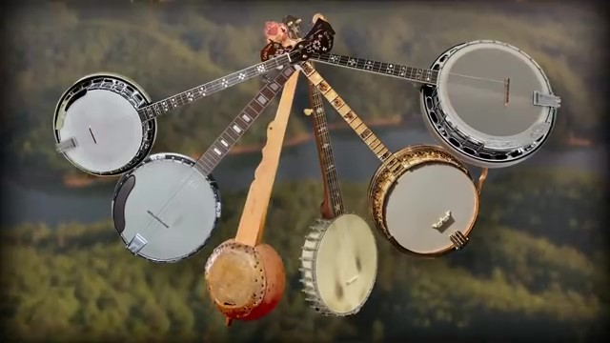
History of the Banjo

Slide 12


Slide 13
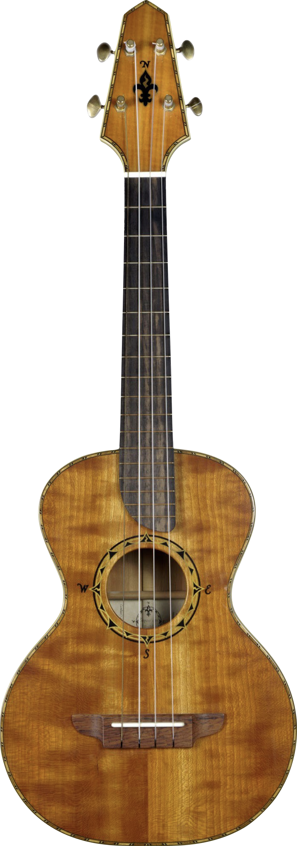
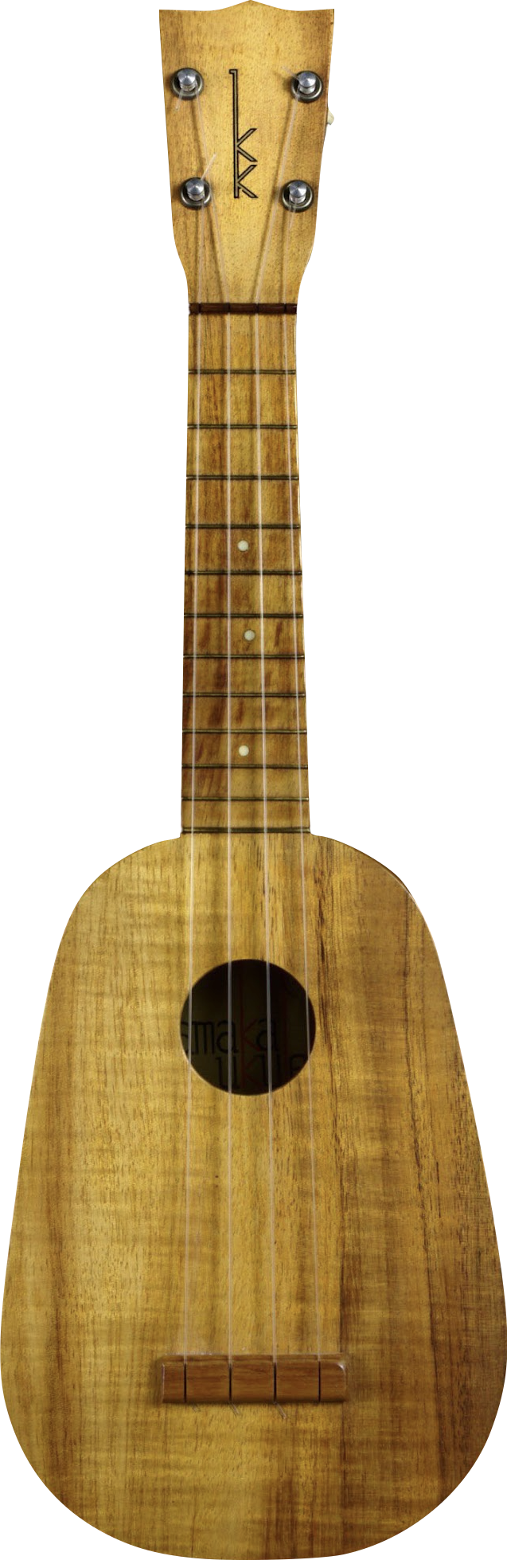
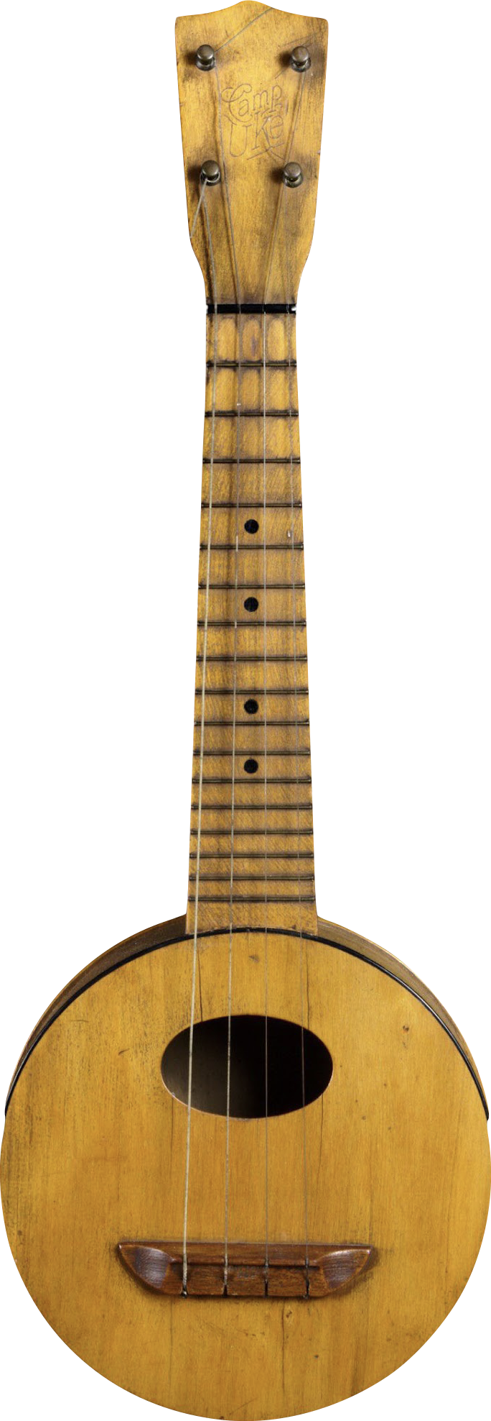
Riding the Rollercoaster:
History of the Ukulele
The popularity of the ukulele, from its first appearance in the 1880s through the 1960s, rose and fell with wider shifts in popular culture and sudden changes in technology and geopolitics.
As American colonialists pushed for the territorializing and eventual annexation of the Hawaiian Islands in the late 1890s, the ukulele emerged in the US as a readily identifiable and popular symbol of
Hawaiian culture.
Notes:
Renaissance Guitar Company Compass Rose Tenor Ukulele, 2008
Luthier Rick Turner, known for his innovations in electric guitars and basses, introduced his line of Compass Rose tenor ukuleles in 2011. The body shape is a nod to Howe-Orme instruments of the late 1800s and early 1900s.
Kamaka Hawaii, Inc. Gold Label Pineapple Ukulele, 1960
Samuel Kaialiilii Kamaka opened a ukulele manufacturing shop in Honolulu in 1916 after having apprenticed with Manuel Nunes. In 1928, Kamaka patented his “Pineapple Ukulele” design, featuring an oval body that produced a mellower sound than the standard instrument. Kamaka remains a family-owned and -operated business to this day.
Lyon & Healy Camp Uke, c. 1922
Lyon & Healy's Camp Uke (the generic name typically given to round-bodied ukuleles) was marketed for social outings. It features a wooden resonator back that helps to project its sound.

Slide 14
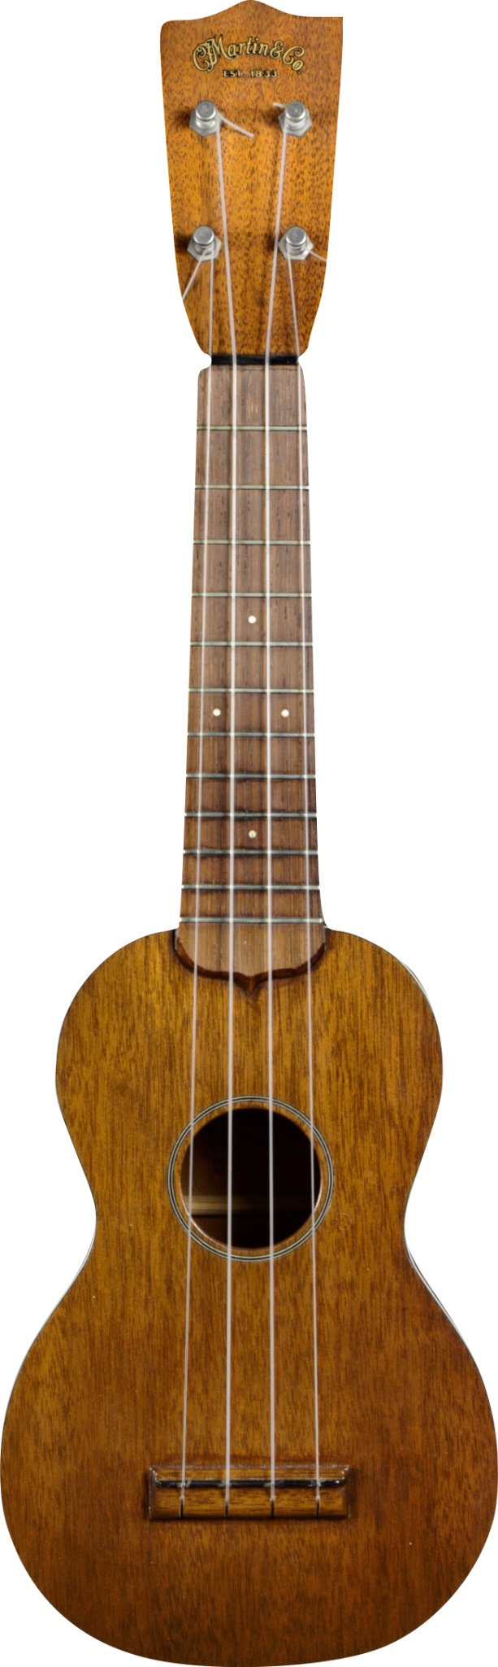
Riding the Rollercoaster:
History of the Ukulele
C.F. Martin was the first known mainland company to make ukuleles, with a trial run of six ukuleles in 1907, and by the 1910s numerous manufacturers joined in.
Notes:
C.F. Martin & Co. Style #1 Ukulele, 1950s
After having created a small test run of ukuleles in 1907, C.F. Martin resumed production in 1916 and helped to quickly grow the ukulele family. The company created the 10-string tiple ukulele in 1919, the concert ukulele in 1925, and the tenor ukulele in 1928. Though the ukulele boom of the 1950s was driven primarily by plastic instruments, C.F. Martin saw increased sales of their traditional wooden models.

Slide 15
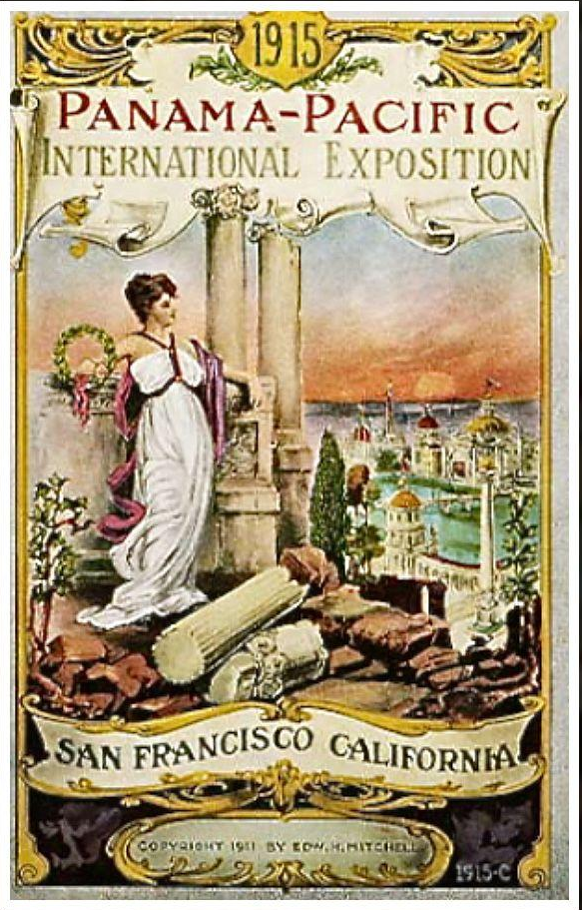
Riding the Rollercoaster:
History of the Ukulele
The 1915 Panama-Pacific International Exposition in San Francisco launched a nationwide craze for all things Hawaiian. The trend, bolstered by records, radio, and movies, drove ukulele popularity and manufacture until the onset of the Great Depression in 1930.

