Slide 1
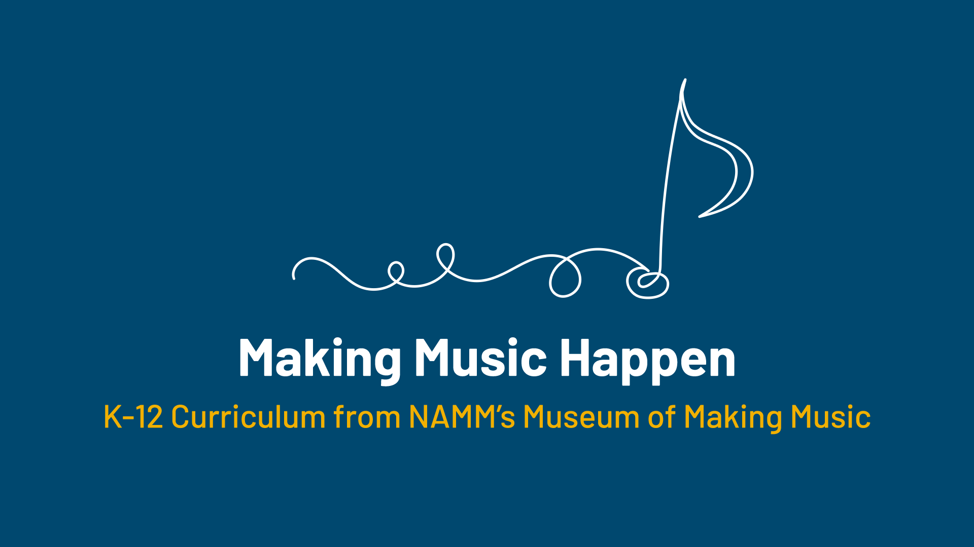

Slide 2
Instruments on the Move!

Slide 3
Lesson Objectives
Identify instruments brought from Europe to the United States by immigrants.
Identify how changes to instruments affected their sound and shape.
Describe how changes to instruments impacted musical styles.
Compare and contrast variations of mandolin and accordion designs over the years.
Connect learnings about instrument changes and their effects on musical styles to modern day music examples.

Slide 4

Lesson Introduction
Think of a meaningful item you would bring with you if you were moving to
a new home.
Why is the object meaningful to you?
Write your answer on your worksheet.

Slide 5

Class Discussion
Let's share your item and why you selected it.

Slide 6
Instruments on the Move
People often brought musical instruments, that were expressive symbols or tools, when they were moving to a new place.
This especially occurred if they were moving to a new country.
European immigrants brought mandolins and accordions with them to the United States to maintain their tie to home
These instruments were then adapted to suit new environments, audiences, and players.

Slide 7
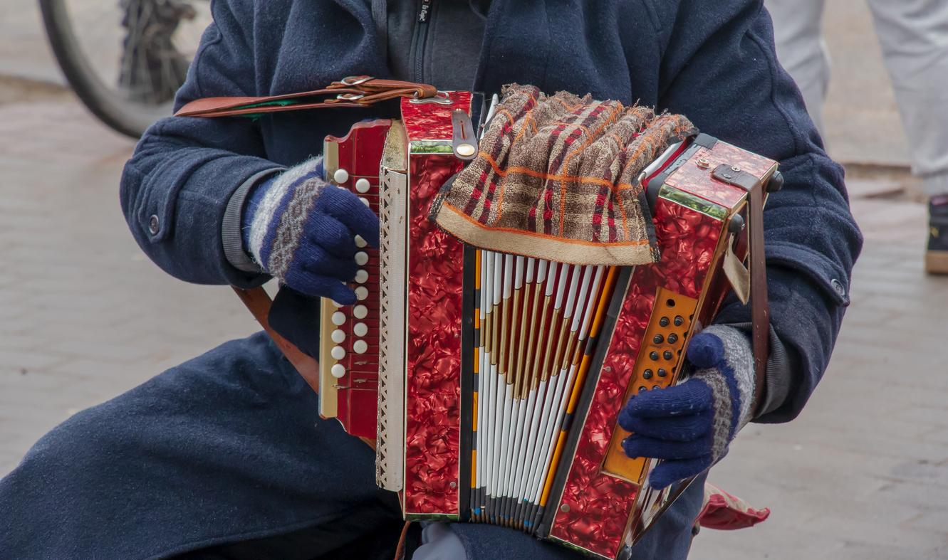
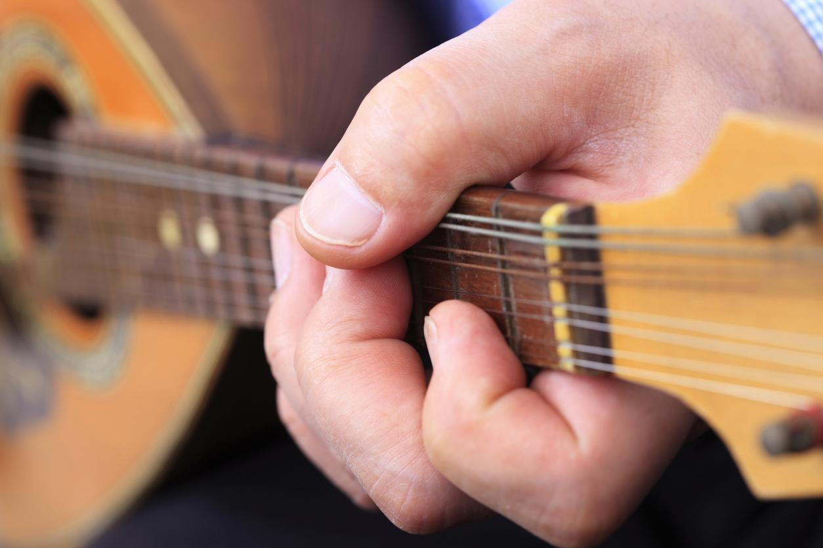
The Journey of the
Mandolin and Accordion
The accordion and mandolin, like many instruments, were brought to the USA by immigrants who, in many cases, sought to maintain a connection to their previous home.

Slide 8
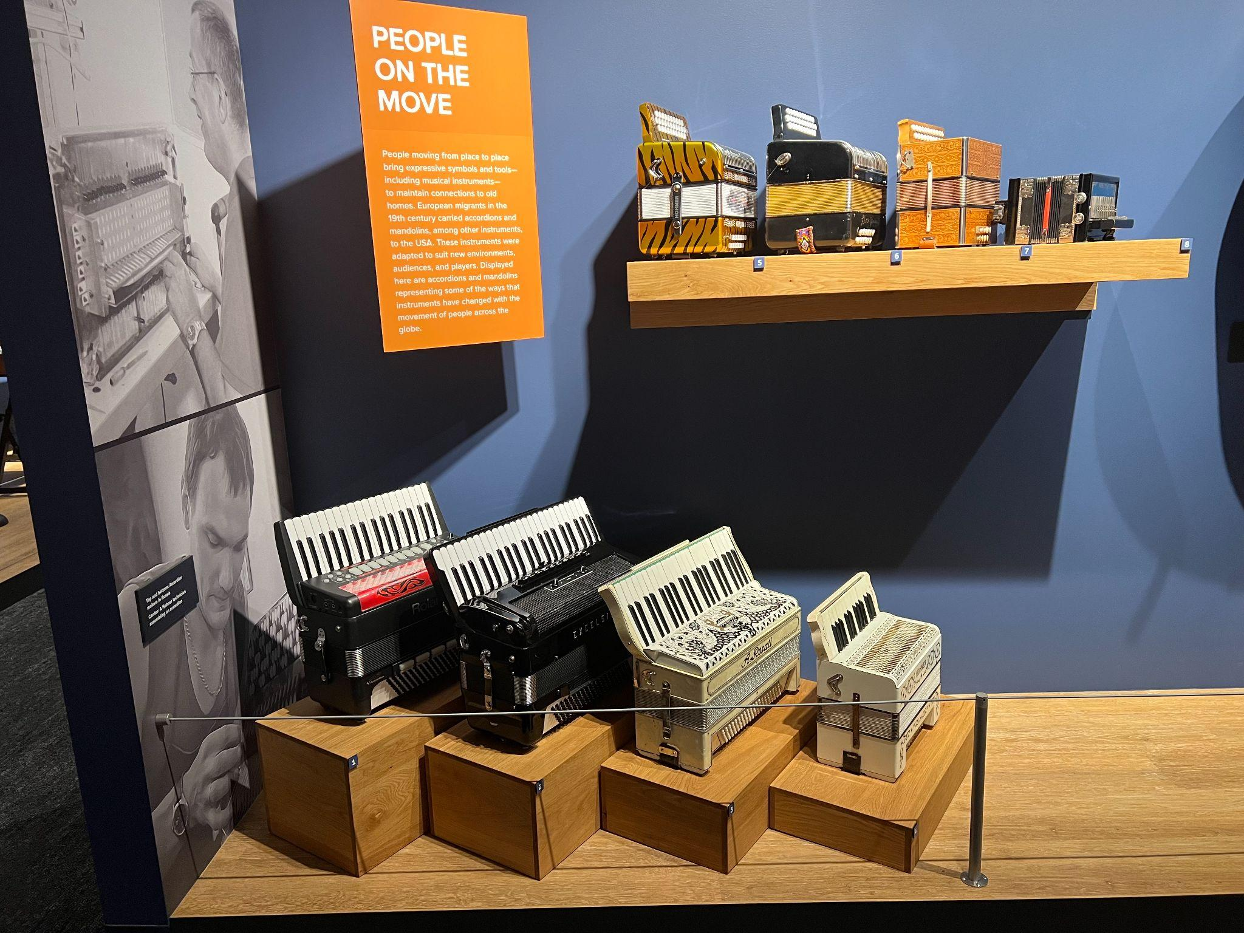
Accordions
Shortly after its invention in 1829, the accordion arrived in the USA from its birthplace of Vienna and by the early 1830s, immigrant musical instrument dealers from Germany were selling accordions in Philadelphia. Over the next few decades, numerous ethnocultural groups brought various forms of accordions to places like Chicago, Milwaukee and San Francisco. The instrument became, and would remain, closely tied to these regional centers of immigration.
Accordions from the Museum of Making Music

Slide 9
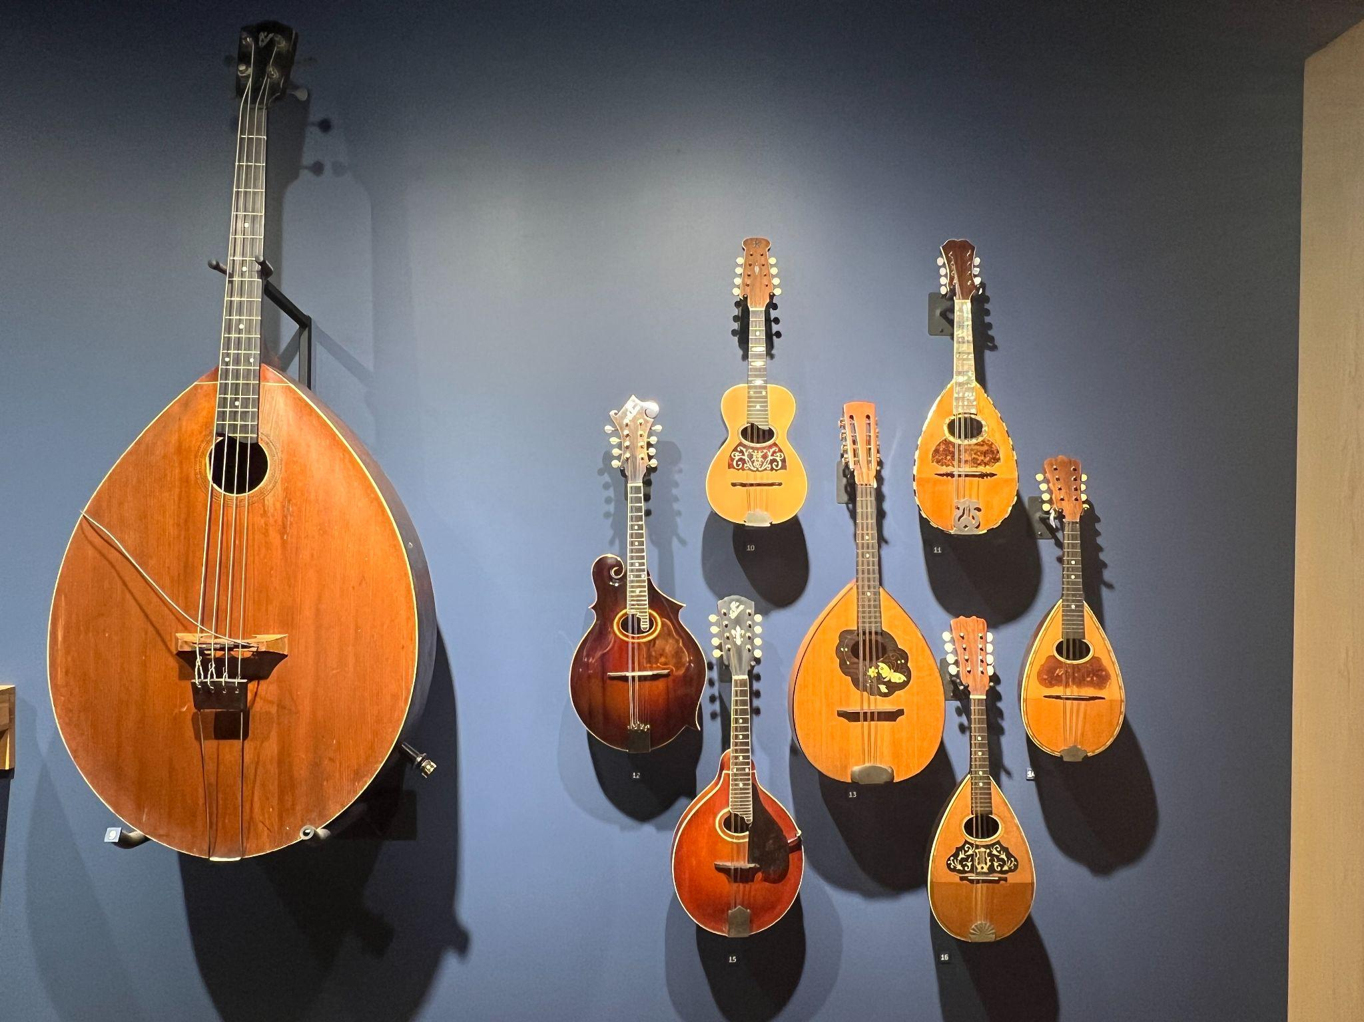
Mandolins
Mandolins, by contrast, reportedly first caught the American public’s attention because of a touring group called the Spanish Students, who ironically played bandurrias, a relative of the mandolin. Capitalizing on this interest, mandolin groups, many made up of Italian immigrants already established in the US, toured the country and drove the instrument to incredible popularity. Makers in the US were producing mandolins in the Neapolitan “bowlback” style by the end of the 1890s, and mandolin orchestras were formed in cities and towns nationwide.
Mandolins from the Museum of Making Music

Slide 10
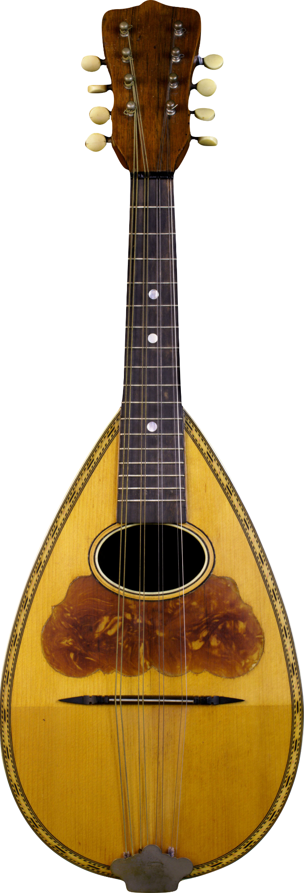
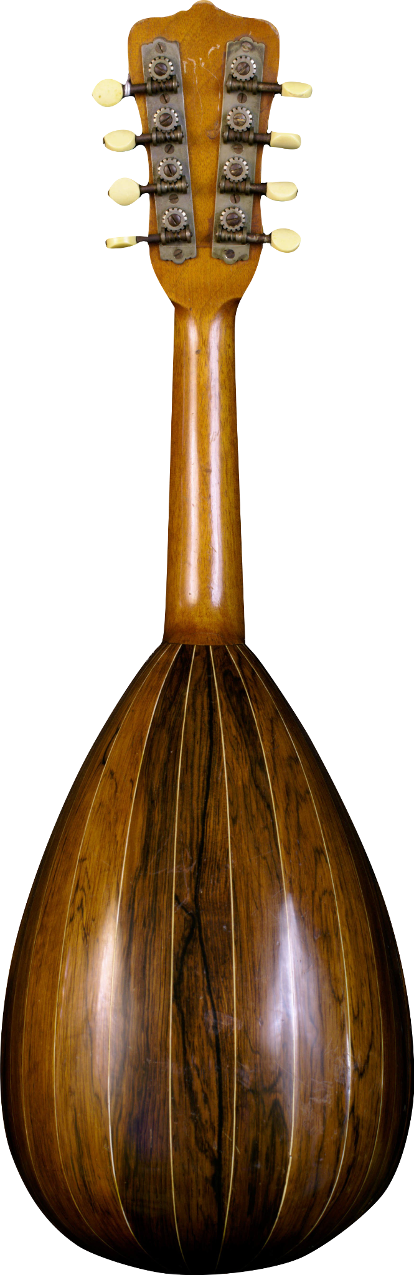
The Journey of the Mandolin
A mandolin is an instrument in the lute family with a fretted neck. It is tuned like a violin but instead of having four strings, G-D-A-E, it has eight. Each pair or “course” of strings is tuned to the same note, GG - DD - AA - EE. Sustaining a long note on a violin is done by using a bow. However since a mandolin is not played with a bow, a sustained note is made by using tremolo–rapid back and forth movements by the fingers or a pick.
When the mandolin arrived in the US, it had a traditional “bowl back” shape.
Notes:
Washburn Bowlback Mandolin c.1898
These mandolins are typical of the Neapolitan style of mandolin made in the USA between the turn of the 20th century and the 1920s. The Washburn’s bowl is made with nine ribs, while the Lyon & Healy’s is made with 15.

Slide 11
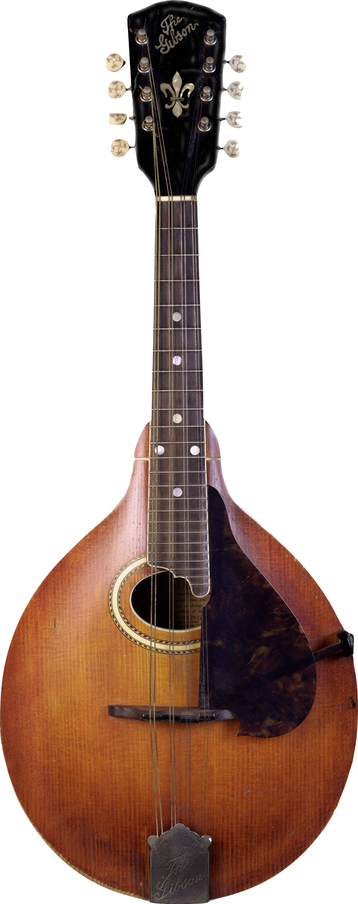
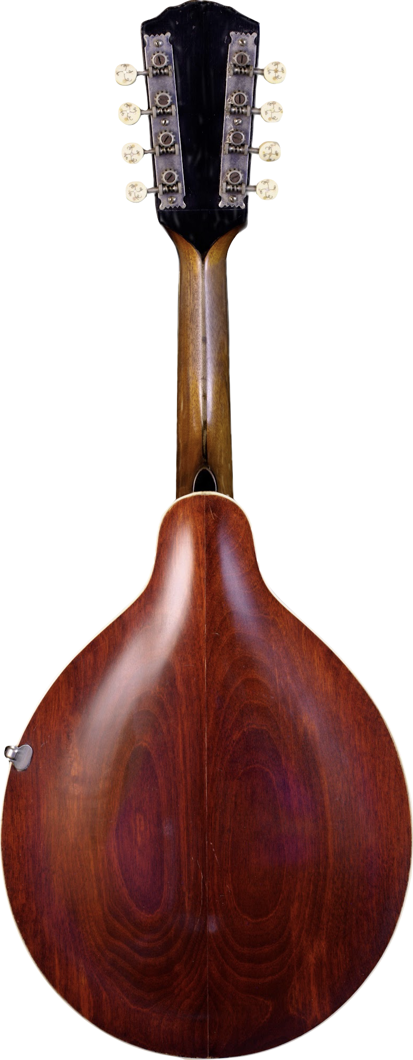
The Journey of a Mandolin
In the late 1800s, inventor and luthier Orville Gibson set out to redesign the instrument. Drawing from the construction of violins, in 1898 Gibson patented a new form of mandolin that featured a carved top and back with the purpose of increasing rigidity and reducing the need for internal bracing.
Notes:
Gibson Mandolin-Guitar A-4 Mandolin
Drawing directly from Orville Gibson's 1898 patent for an entirely new style of mandolin, the A model represents a dramatic departure from existing mandolin design. Instead of a deeply rounded, ribbed back and a canted top, the A introduced a carved top and back with much shallower rounding. Gibson instruments were named by their style and level of finish; this A-4 represents the most elaborate model available in the A style at the time.

Slide 12
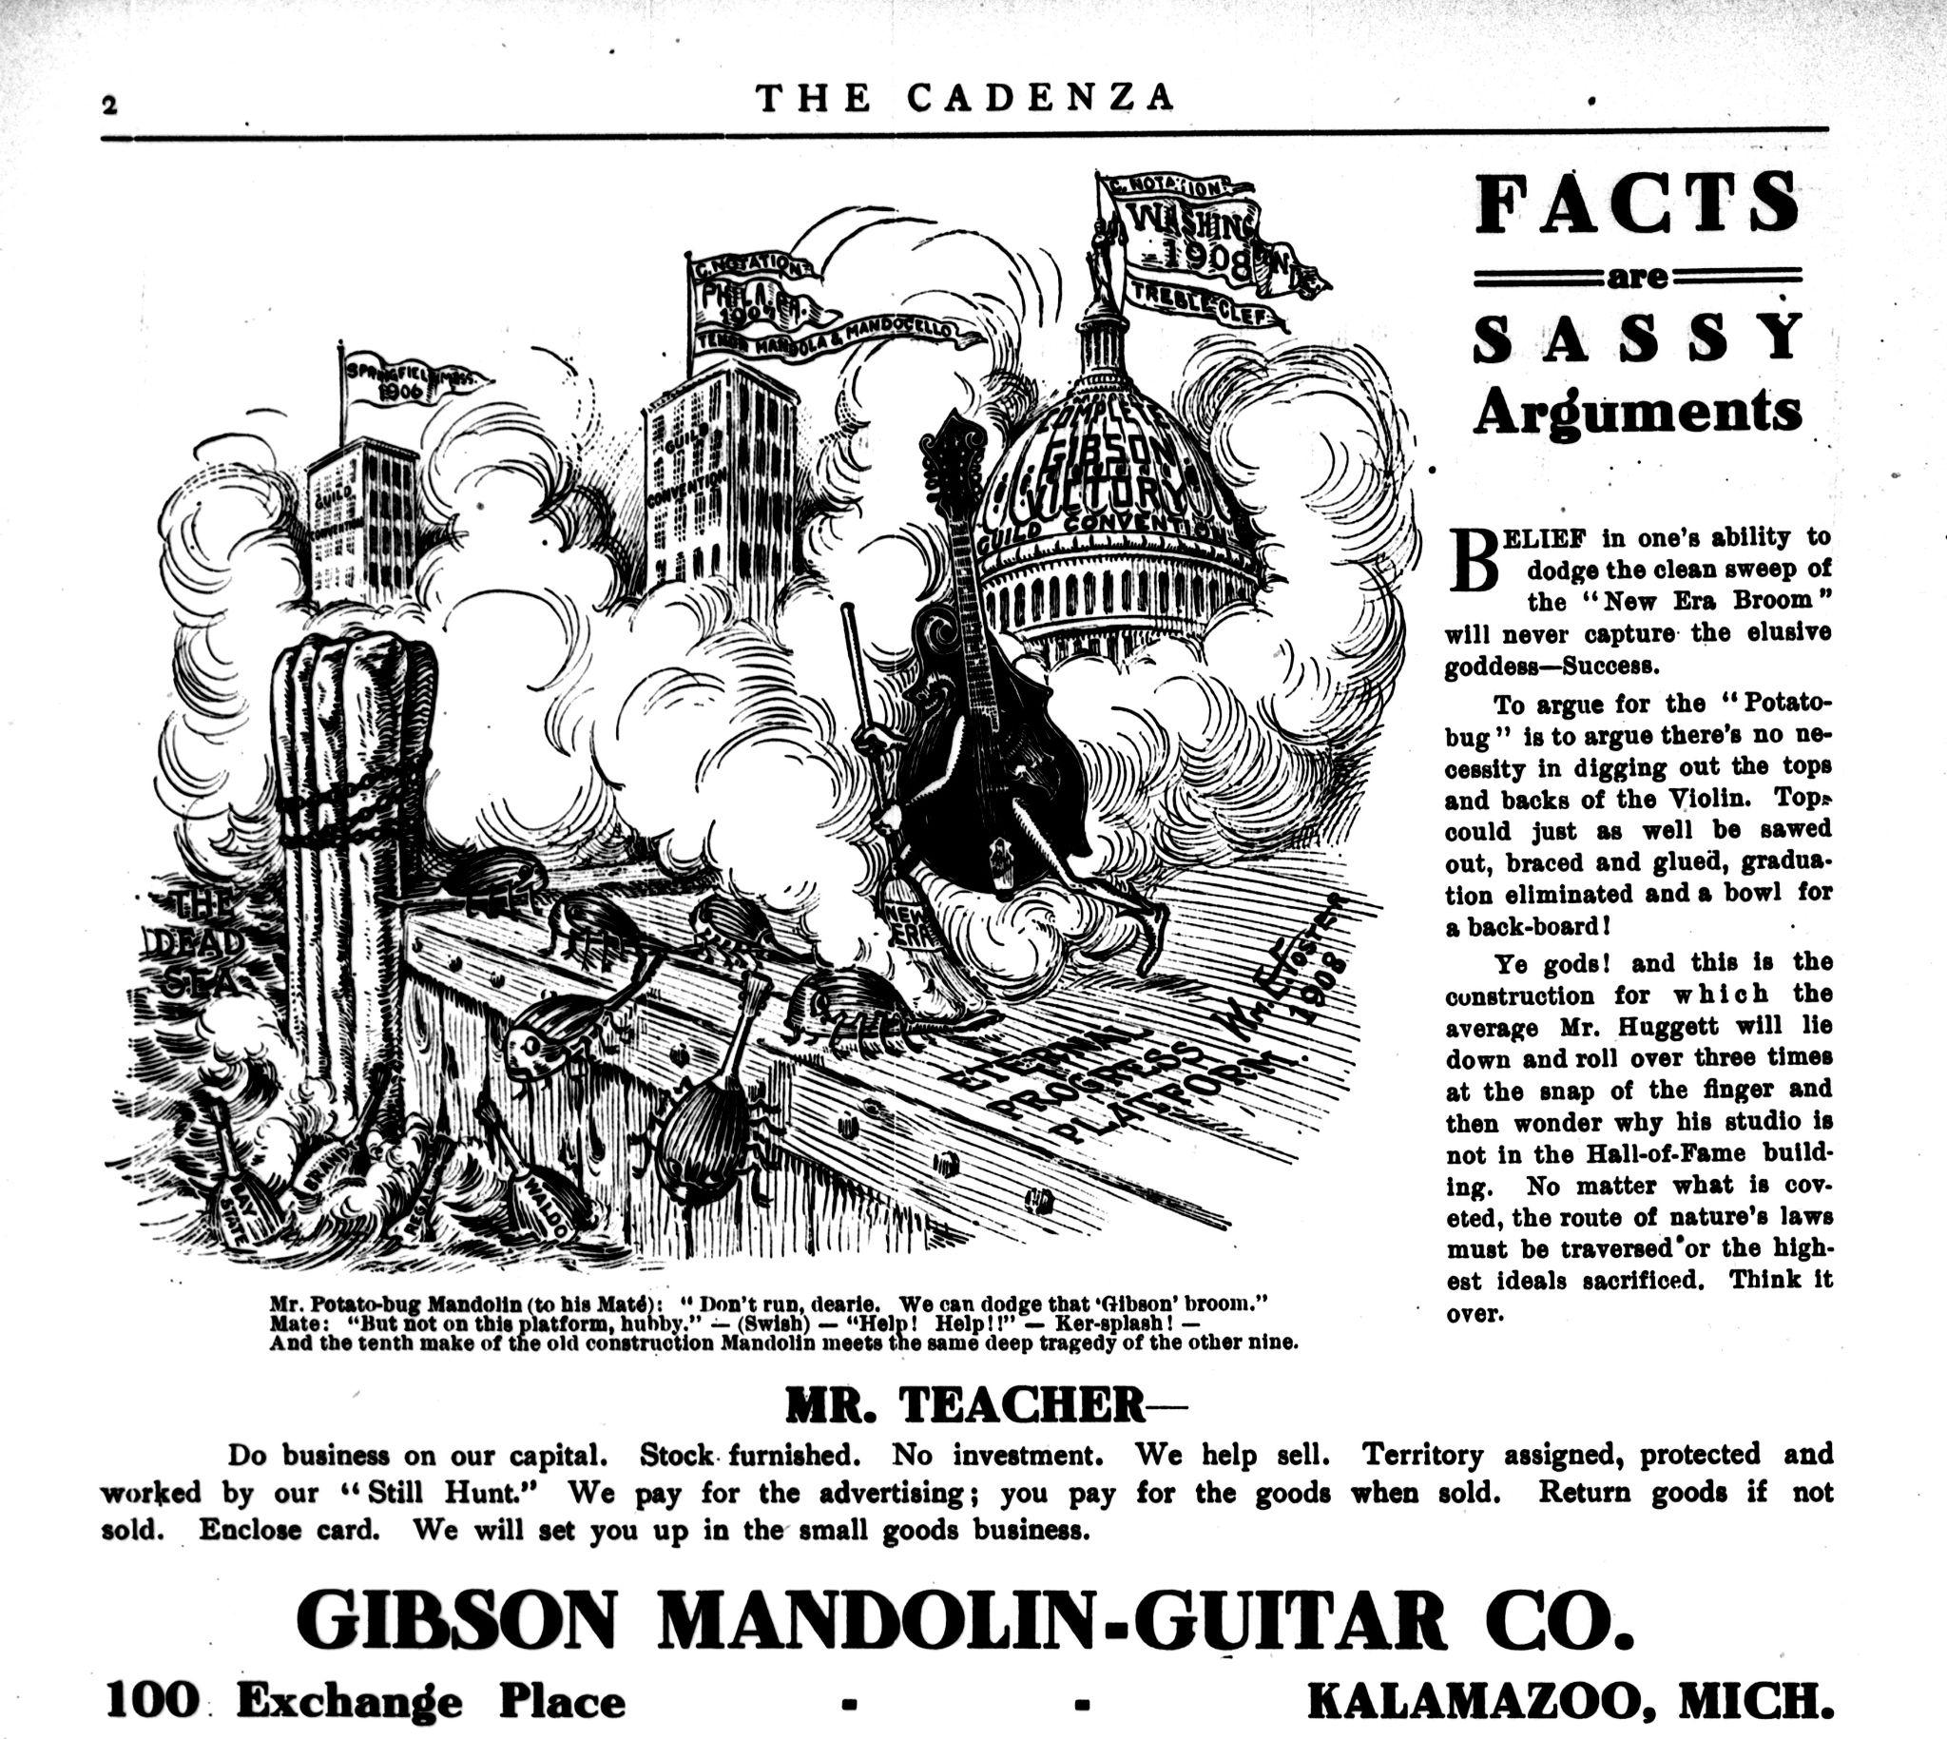
The Journey of the Mandolin
Gibson’s carved top mandolin proved to be much louder than the bowlback design. The Gibson Mandolin-Guitar Manufacturing Company, established in 1902, heavily promoted their instruments in print advertising and with music teachers, who in turn recommended them to their students. By the 1920s, the bowlback had all but disappeared from American popular music.

Slide 13
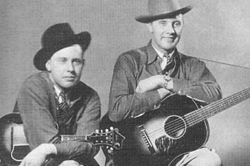
The Mandolin
Finds a Musical Home
Lloyd Loar, an acoustician and luthier hired by Gibson in 1919, refined the carved top design to create the F-5 mandolin. A 1923 F-5 was purchased by bluegrass pioneer Bill Monroe in the early 1940s. Over the course of the next few decades, Monroe’s use of the F-5 solidified it, and the carved top mandolin more generally, as a fixture of bluegrass, country, and numerous other American musics that are now popular around the world.
The Monroe Brothers

Slide 14
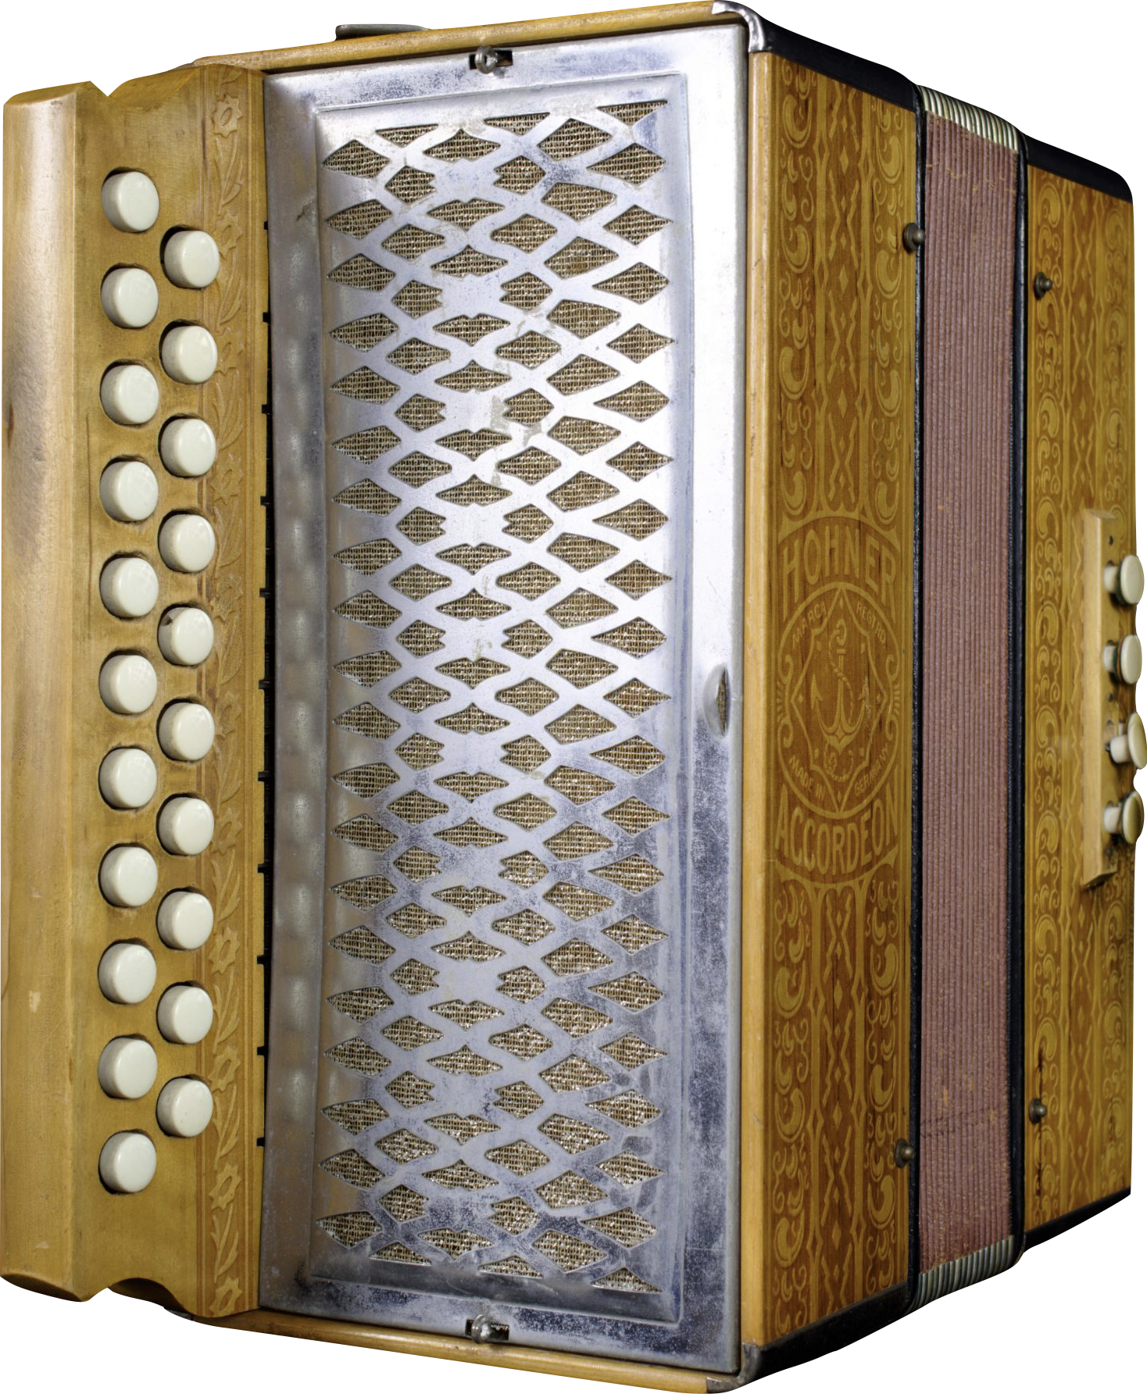
The Journey of the Accordion
The button accordion, despite being the predominant form of the instrument in the early 20th century, was largely unfamiliar to mainstream American audiences.
Notes:
Hohner, Inc. Vienna Pokerwork Button Accordion, c.1900
This compact two-row button accordion features 8 bass keys and ornate patterns pressed into the wood case. Hohner continues to make Pokerwork-style accordions to this day under the Vienna model name.

Slide 15
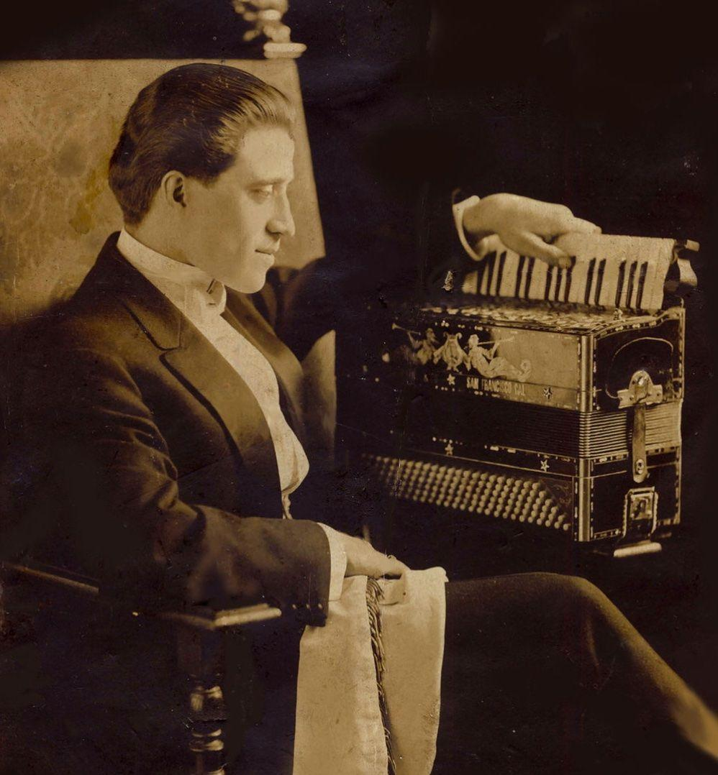
The Journey of the Accordion
Accordions with piano-style keyboards, which had been developed over the course of the latter 19th century, caught the public’s attention after performances by Guido Deiro at the Alaska-Yukon-Pacific Exposition in Seattle and in San Francisco in 1909. Deiro further popularized the accordion as a star within the vaudeville circuit. Many manufacturers added piano accordions to their catalogs to meet demand, and some even made button accordions disguised as piano models to allow button players to capitalize on the new craze.
Notes:
Count Guido Deiro, c.1909

Slide 16
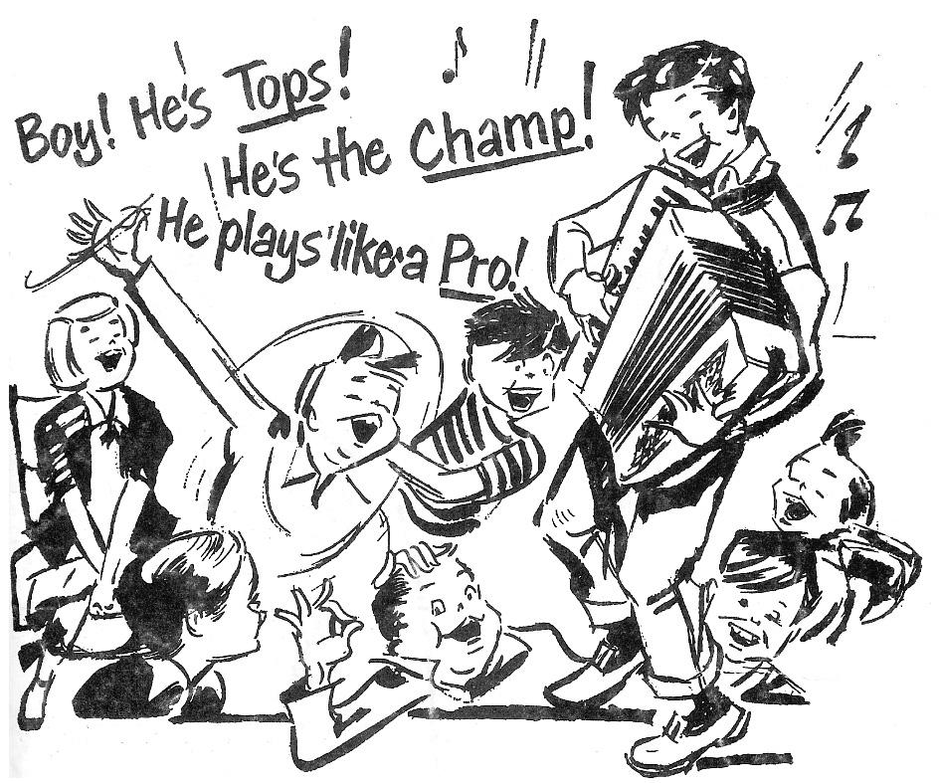
The Journey of the Accordion
While the piano keyboard helped drive the accordion to become the most popular instrument in the USA by the early 1950s (measured by annual sales), button accordions remained central to many musical styles rooted in migrant communities and cultures, including Norteño, Tejano, Waila, Irish, and more. Manufacturers like Hohner have found success by developing wide varieties of button accordions to meet the needs of these diverse musical cultures across the US and around the world.

Slide 17

Oral History
Watch the following clip of CJ Chenier,
then answer the questions on your worksheet.

Slide 18


Slide 19
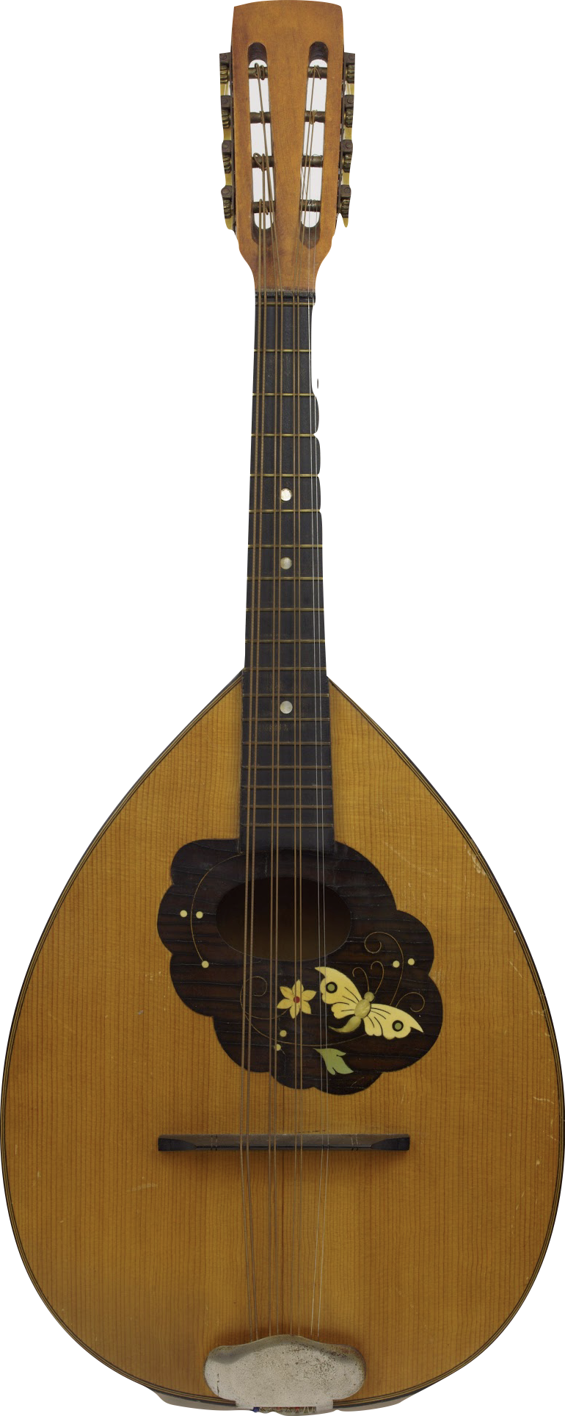
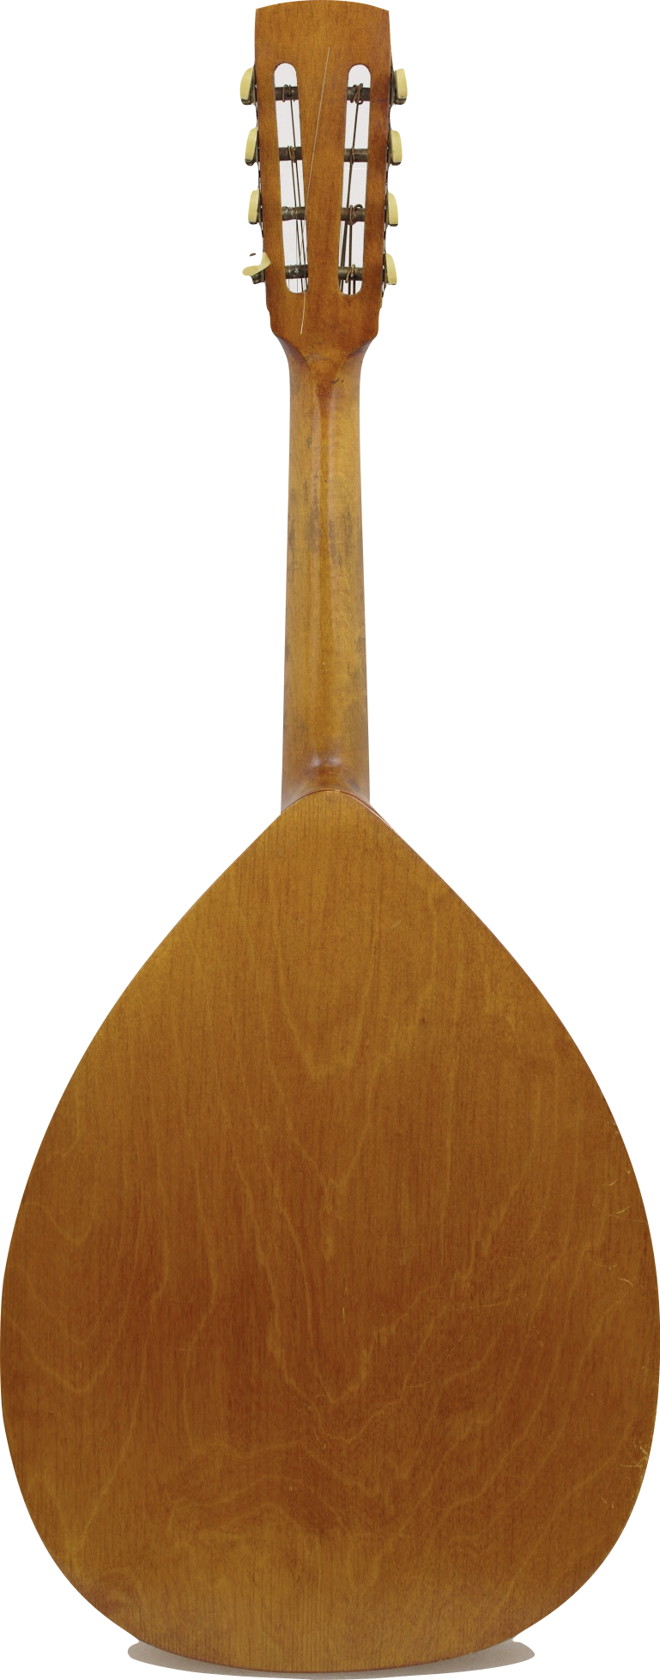
Compare and contrast mandolins
How are these artifacts the same? How are they different?
Record your findings on your worksheet.
Notes:
Washburn Bowlback Mandolin c.1898
These mandolins are typical of the Neapolitan style of mandolin made in the USA between the turn of the 20th century and the 1920s. The Washburn’s bowl is made with nine ribs, while the Lyon & Healy’s is made with 15.
Unknown Octave Mandolin, 1900s
The mandolin craze of the late 19th and early 20th centuries saw the rise of mandolin orchestras – collections of musicians playing different instruments in the mandolin family. This typically included the mandolin, mandola, octave mandolin, and mandocello. The octave mandolin, appropriately, is tuned one octave below the mandolin. This particular instrument features a flat back, a style popular with German makers in the latter 19th century.

Slide 20
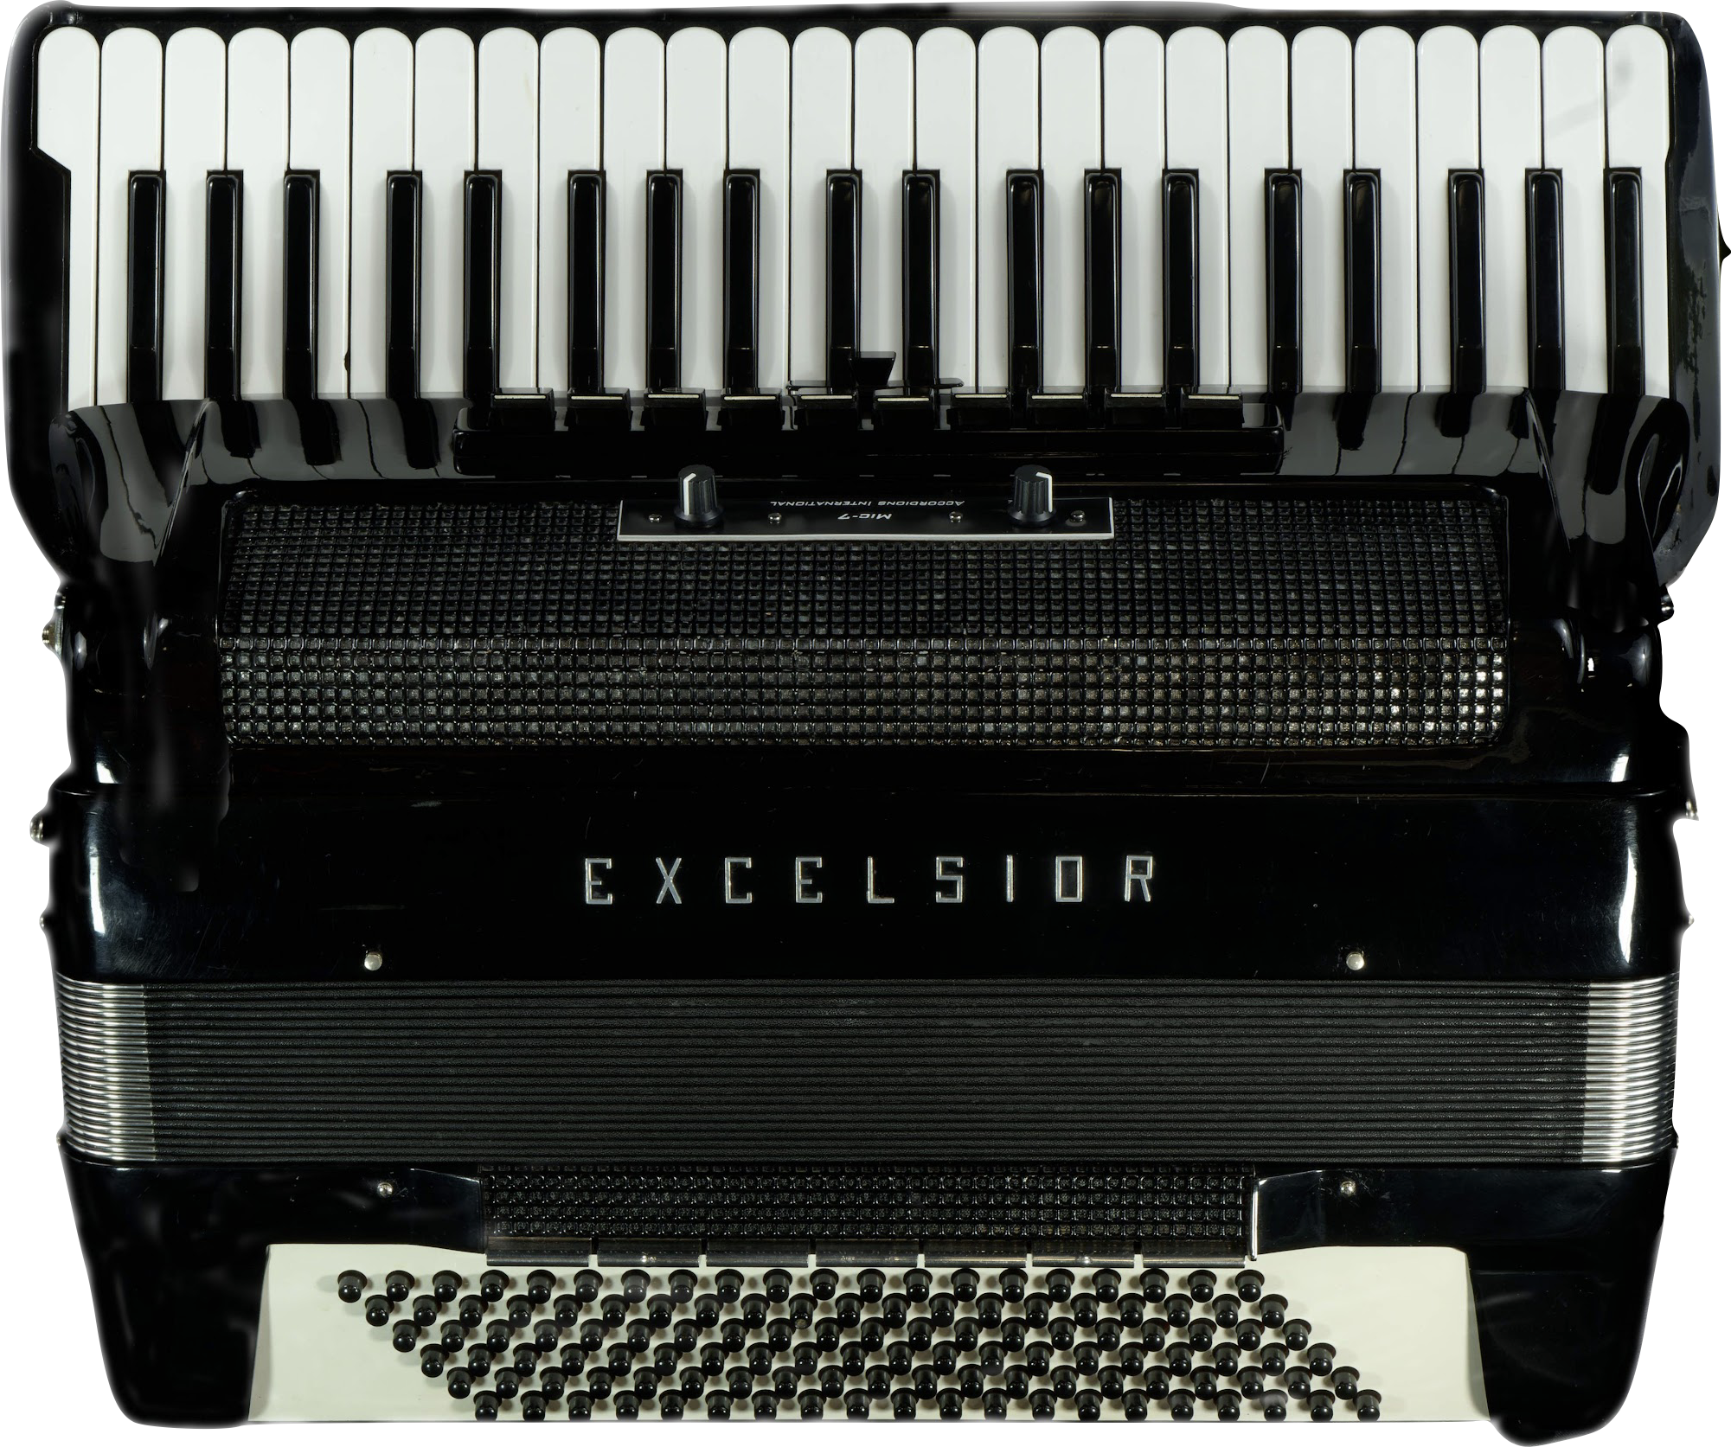
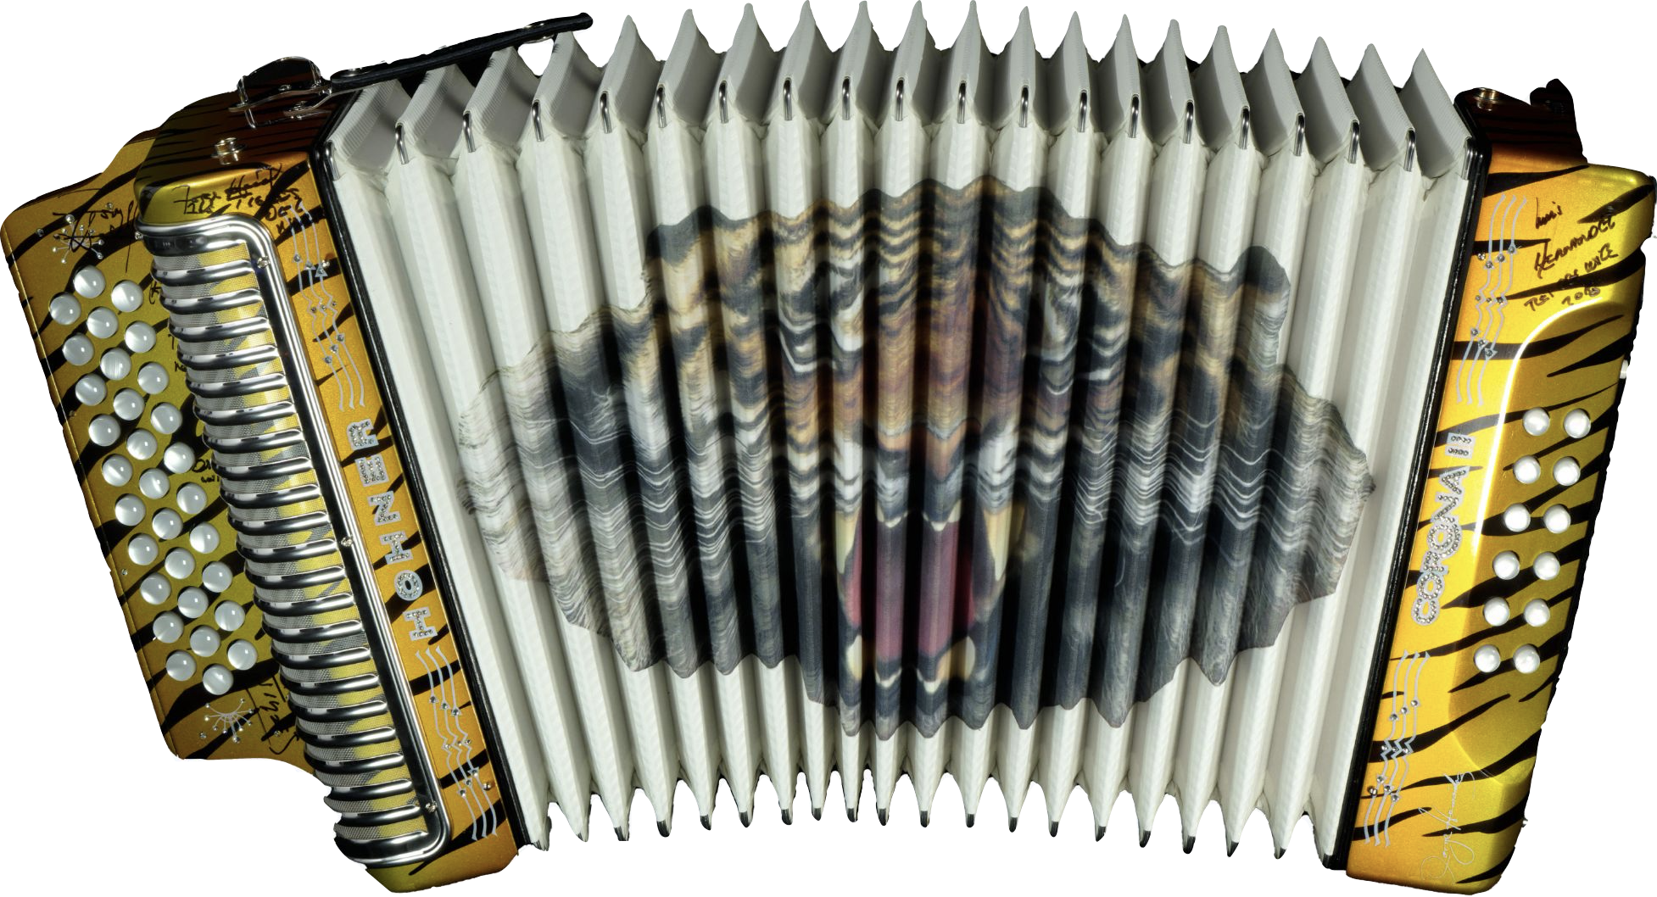
Compare and contrast accordions
How are these artifacts the same? How are they different?
Record your findings on your worksheet.
Notes:
Hohner, Inc. Corona II Button Accordion, 2017
Hohner’s Corona II has been a staple in Mexican regional music since its introduction in 1955. Its compact size, three rows of buttons, and loud sound make it an extremely flexible instrument. This accordion is signed by the members of Los Tigres del Norte, mainstays of Norteño music for over 50 years.
Excelsior A.C. Continental Piano Accordion, 1965
Custom-made for pioneering jazz/swing accordionist Art Van Damme, this accordion has an extended 44-key keyboard, a built-in microphone system, and rounded edges on the black keys to make it easier to slide across the keyboard.

Slide 21
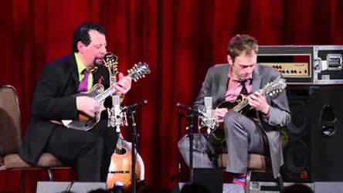
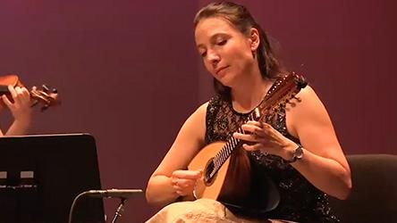
Mandolins: The Sounds
Listen to these two mandolin clips.
How are the sounds the same?
How are they different?
Record your findings on your worksheet.

Slide 23
Mandolins: The Sounds
Listen to these two mandolin clips.
How are the sounds the same?
How are they different?
Record your findings on your worksheet.

Slide 25
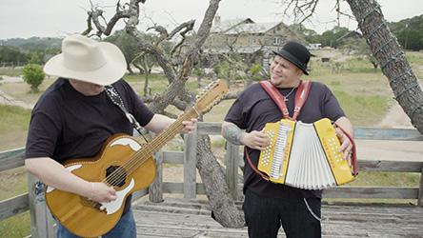
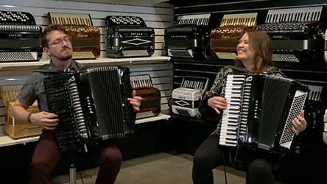
Accordions: The Sounds
Listen to these two accordion clips…
How are the sounds the same?
How are they different?
Record your findings on your worksheet.

Slide 26


Slide 27
Accordions: The Sounds
Listen to these two accordion clips…
How are the sounds the same?
How are they different?
Record your findings on your worksheet.

Slide 28


Slide 29
Let's Discuss!
What did you observe?
What did you hear?
How have accordions and mandolins changed?
How are they used in new musical styles?

Slide 30
Wrap-Up
What instruments can you think of that have changed in design in recent years?
What instruments can you think of that have become integrated into different musical styles in recent years?

Slide 31
Exit Ticket or Homework
Based on today's lesson, complete your exit ticket.

Slide 32
Consider a Career in Music!
What careers are related to the lesson we just completed?
Instrument Manufacturer
Music Store/Retailer Owner, Manager
Instrument Repair & Restoration Tech
Instrument Sales Associate
Composer
Performer

Slide 33


