Slide 1


Slide 2
Turn It Up:
Amplifying Guitars

Slide 3
Lesson Objectives
Define pickup, amplification, and electricity.
Identify the societal factors leading to the need for amplification.
Compare various makes and models of guitars on visual and aural differences.
Identify amplification preferences for self-selected artists.

Slide 4
Activity 1
Work collaboratively for five minutes to answer the question on the next slide.
You may use WORDS or DRAWINGS.

Slide 5

Activity 1
How does an electric guitar work?

Slide 6


Slide 7
Activity 1
Let’s Share!

Slide 8

Lesson Focus
This lesson will be focused on the development of the electric guitar and how it became essential to the music industry.

Slide 9

Lionel Loueke
Watch two minutes of the Lionel Loueke video and answer the questions on your worksheet.

Slide 10


Slide 11

Jackie Venson
Watch the Jackie Venson video and answer the questions on your worksheet.

Slide 13
Let’s Discuss Electric Guitars
Key ideas:
The development of the pickup.
The creation of amplification technology to project the sound.
The expansion of new shapes (no need for hollow body and resonating chamber).
Notes:
Through the early 20th century, the size of ensembles, venues, and audiences for popular music grew to the point where, in the 1920s, an acoustic guitar was almost inaudible. These ensembles played a wide range of music, including jazz, blues, and Hawaiian songs. Many guitarists found that they simply needed louder instruments to contribute to a band or, particularly in Hawaiian music, play a melody over one.
Luthiers and engineers began experimenting with electricity to determine what this then-new technology could do to add volume. With the amplifying vacuum tube and moving coil speaker already having been invented in 1906 and 1924, respectively, luthiers developed louder instruments that enabled guitarists to create new sounds, their own signature sound, and even entirely new music.
Electric guitars feature devices called pickups embedded in their bodies. Pickups convert the vibrations of the strings into an electric signal which is then sent to an amplifier through a cable. The amplifier converts the electric signal into sound and plays it.

Slide 14
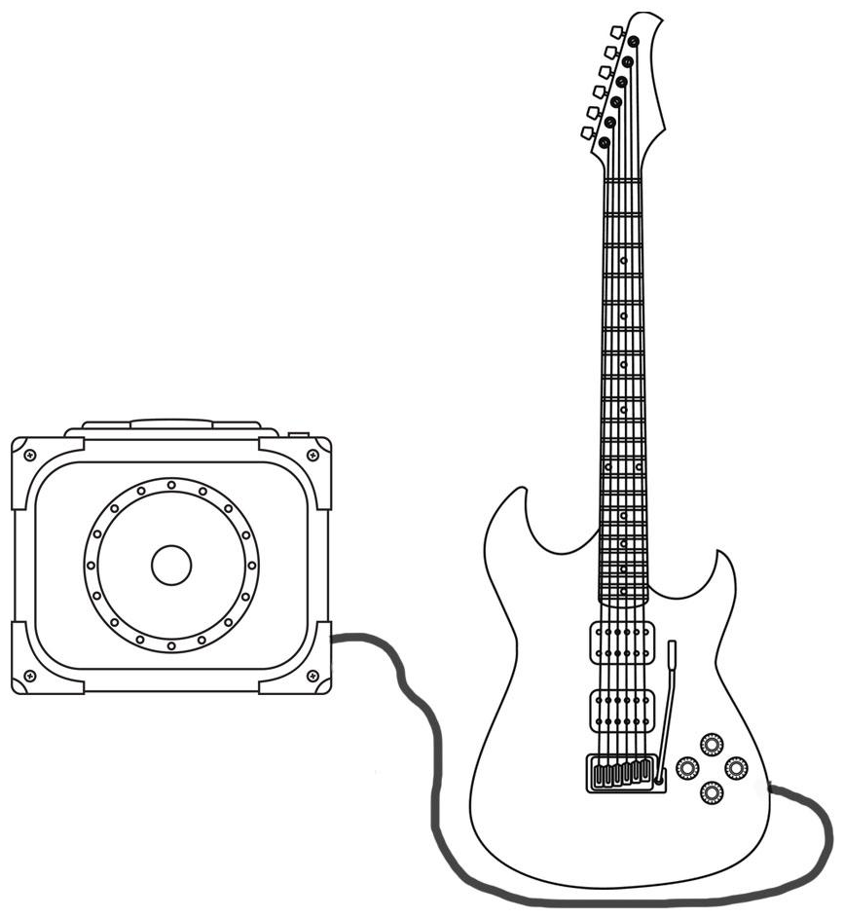
Here’s how electric guitars create and project sound.
Strings vibrate and sound is created
Amplifier: Amplifies the sound and outputs sound from the speaker
Pickups convert vibration into an electric signal
Speaker
Shielded Cable

Slide 15
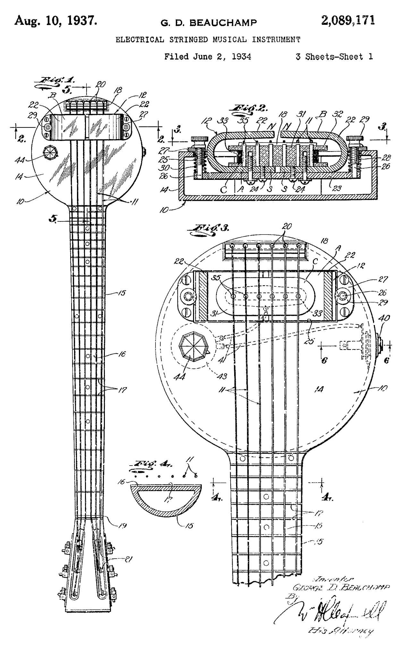
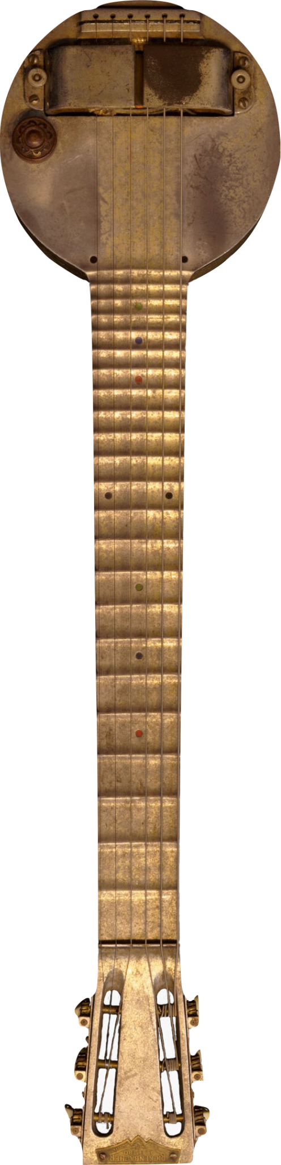
An early example:
The “Frying Pan” electric guitar
Notes:
Rickenbacker A-22 “Frying Pan” Electric Guitar, Mid 1930s
George Beauchamp sought to make guitars even louder using electrical amplification. He recognized that the vibration of the guitar’s strings, rather than its body, was the most effective source for a signal to amplify. Using two large magnets and a length of wire, he created the pickup that enabled Ro-Pat-In (later renamed Rickenbacker) to release the A-22 “Frying Pan” electric lap steel guitar in 1932. Paired with an amplifier, the pickup made the Frying Pan loud enough to play with the large bands of the day.
But as bands grew louder, venues and crowds grew – and so bands had to become louder again. Guitarists needed their pickups to be more efficient for higher volume and more customizable for better control over their sound. Makers innovated pickups with different magnets, variations in wiring, and even entirely new electric circuitry. These new designs have helped guitarists reach almost any volume level required with the ability for everyone to find their signature sound.

Slide 16
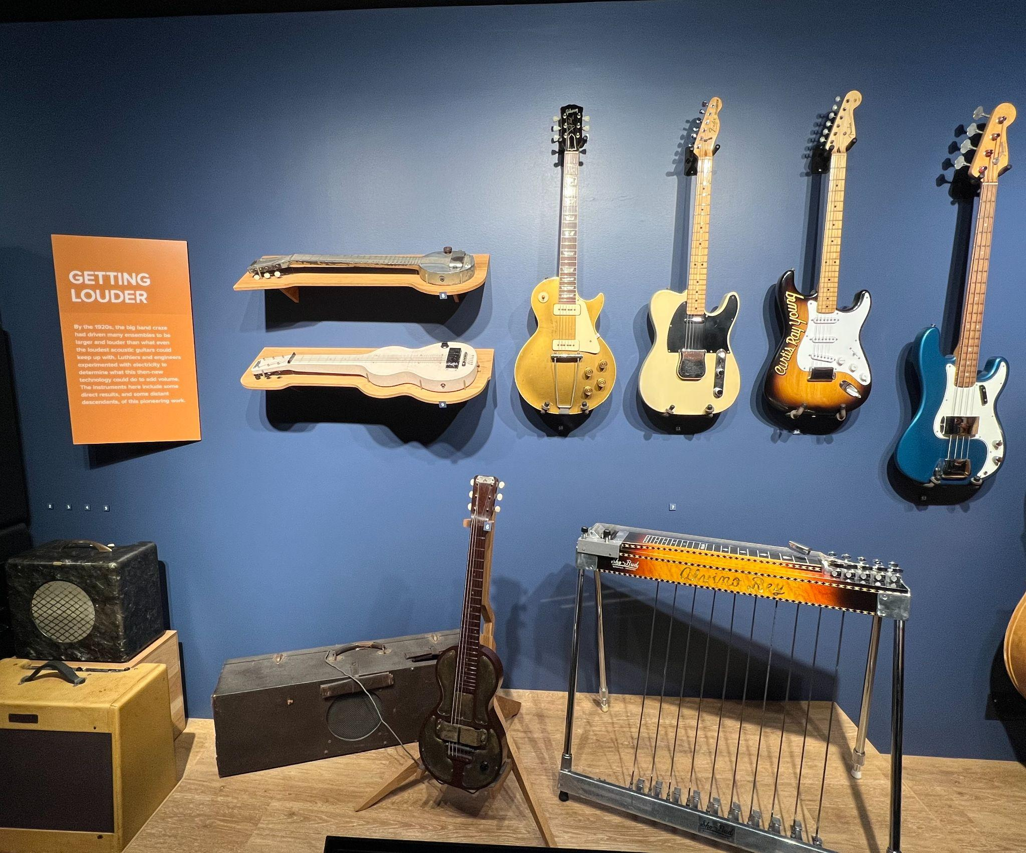
Electric Guitars
from the
Museum of Making Music
Notes:
Through the early 20th century, the size of ensembles, venues, and audiences for popular music grew to the point where, in the 1920s, an acoustic guitar was almost inaudible. These ensembles played a wide range of music, including jazz, blues, and Hawaiian songs. Many guitarists found that they simply needed louder instruments to contribute to a band or, particularly in Hawaiian music, play a melody over one. Luthiers and engineers began experimenting with electricity to determine what this then-new technology could do to add volume. With the amplifying vacuum tube and moving coil speaker already having been invented in 1906 and 1924, respectively, luthiers developed louder instruments that enabled guitarists to create new sounds, their own signature sound, and even entirely new music. The instruments to the right include some direct results, and some distant descendants, of this pioneering work.

Slide 17

Watch electric guitars being built in the Gibson factory.

Slide 19
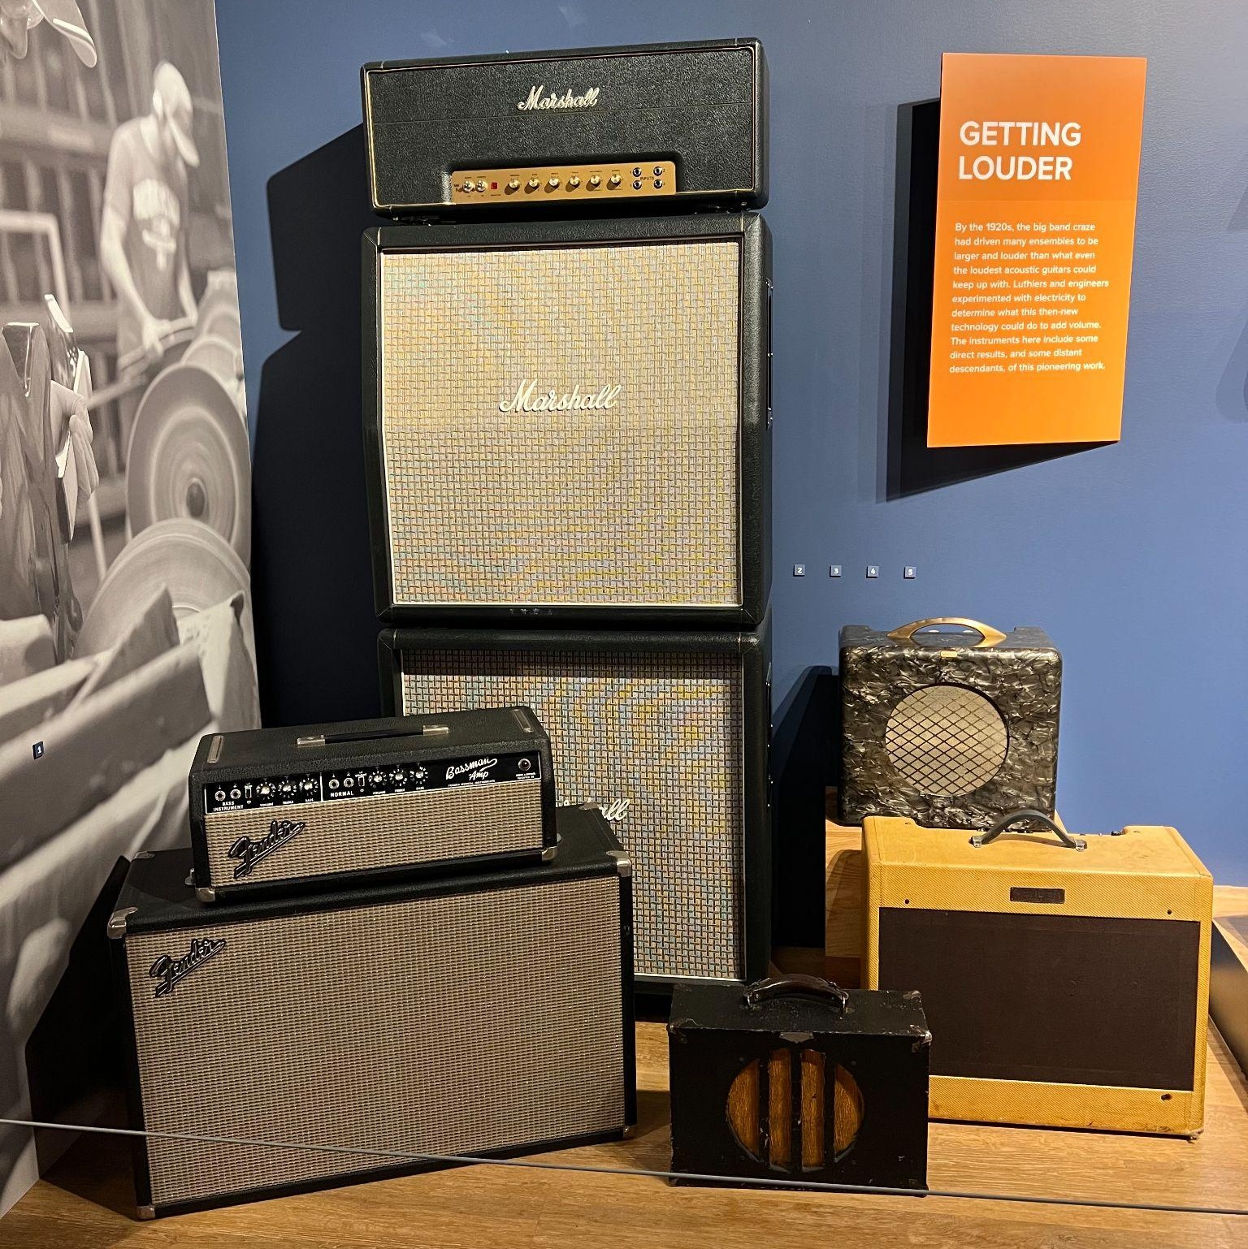
Amplifiers from the
Museum of Making Music
Notes:
Without amplification, many electric instruments would be almost silent – or at least much quieter. Early guitar amplifiers, first released with matching electrified guitars in 1928 and as standalone units in 1933, were scaled-down versions of public address and movie theater sound systems. Portability was key, as they were primarily used in performances by guitarists who needed to be heard in a larger band.
As popular tastes changed, particularly with the advent of rock and roll in the 1940s and 50s, many musicians demanded ever-increasing volume. In the 1960s, guitarists Dick Dale and Pete Townshend worked with Leo Fender and Jim Marshall, respectively, to develop 100 watt amplifiers that would let them push their sound to incredible levels.
The development of transistor-based, or solid-state, amplifiers led to even more power albeit with a different tone quality. Many guitarists continue to play through vacuum tube-based amplifiers, while bass guitarists often rely on the greater power afforded by solid-state amplifiers: bass frequencies need to be amplified at a higher level to be heard as equally loud.

Slide 20
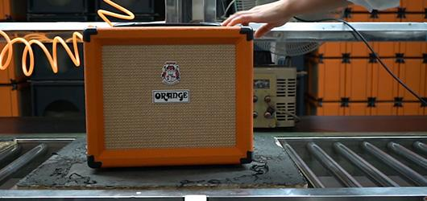
Watch amplifiers being built in the Orange Amps factory.

Slide 21


Slide 22
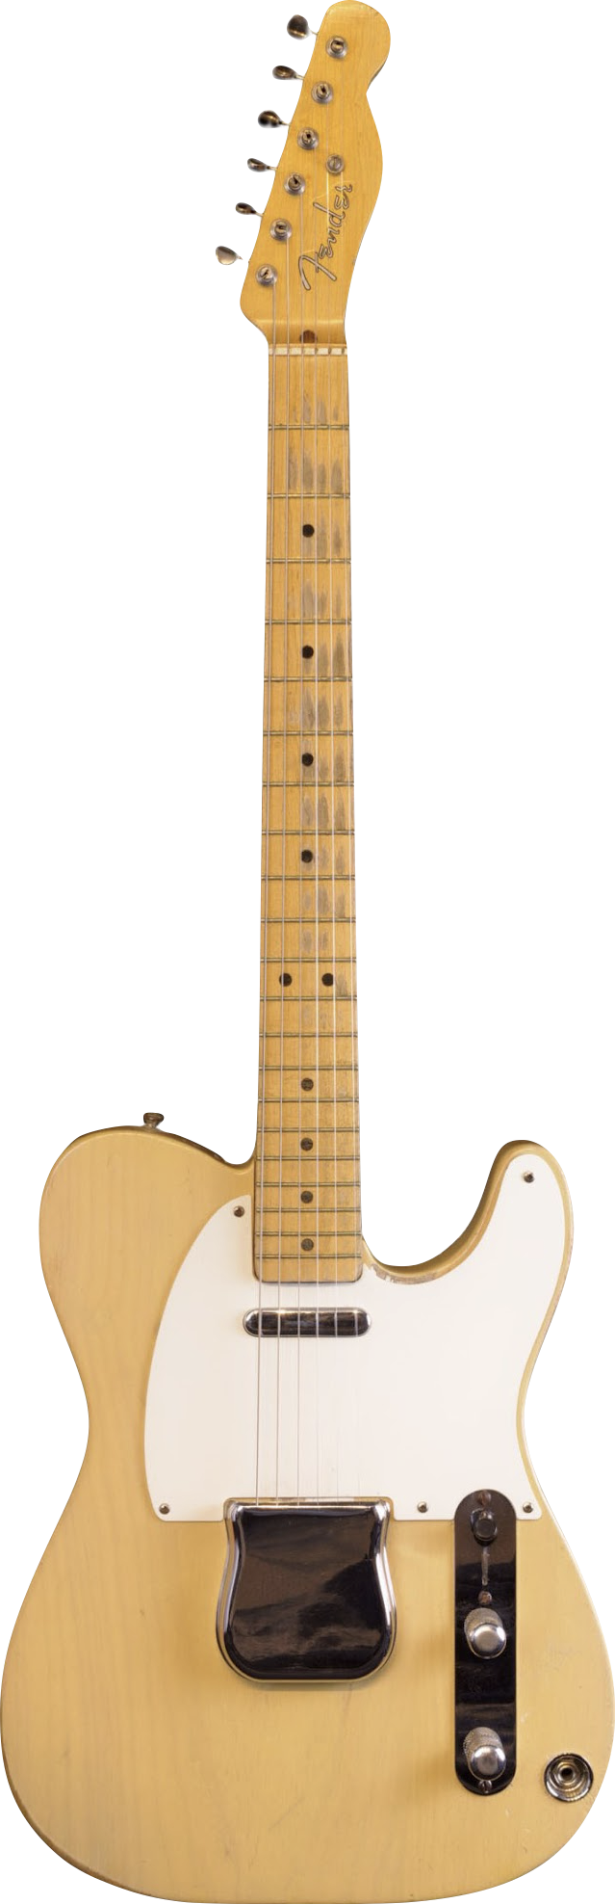
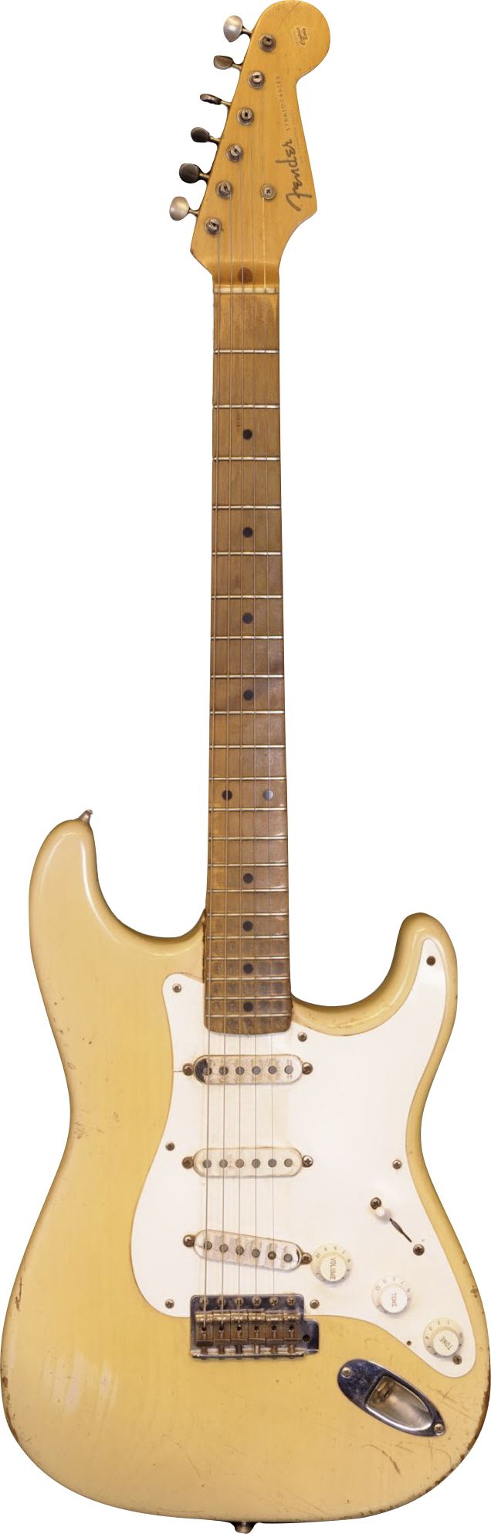
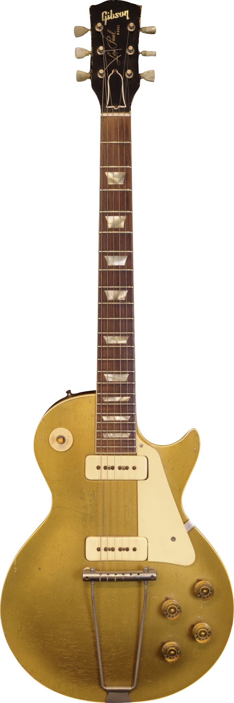
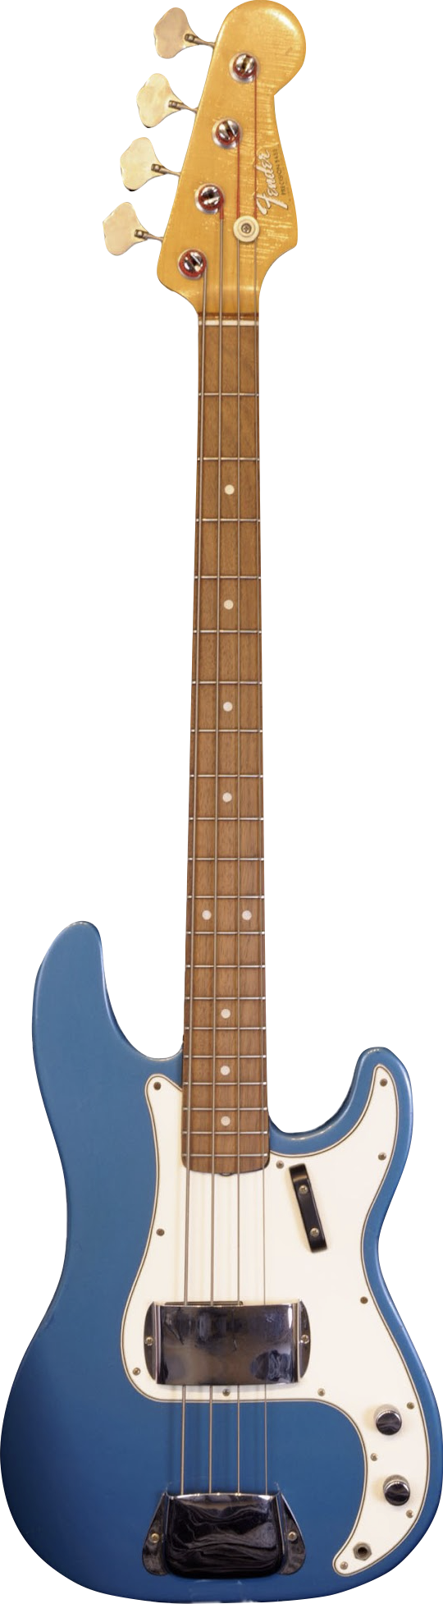
Experimenting with Shapes
Notes:
Because magnetic pickups take their signal directly from vibrating strings rather than a resonating body, luthiers making electric instruments are free to make instruments in just about any shape. Rickenbacker’s Frying Pan, based on the Hawaiian lap guitar, eliminated almost all of that instrument’s body other than a small circular section supporting the pickup, bridge, and volume control.
Fender’s solid-body Telecaster was larger than the Frying Pan, but still much shallower than an acoustic or hollow-body electric.
The Stratocaster, Fender’s follow-up to the Telecaster, featured extensive contouring on its body to make the guitar more comfortable to hold. Unconstrained entirely by the need for a resonant body, luthiers pioneered new designs, styles, and even new instruments.
Fender’s Precision Bass (“P-Bass”), with its fret markers and significantly smaller size compared to an upright string bass, gave bass guitarists new opportunities for dexterity and virtuosity. Luthiers like Ned Steinberger and Phil Kubicki created radical new designs for the electric bass guitar with, among other innovations, slimmer or even no headstocks, greatly reduced weight, and tuning mechanisms that keep the musician’s hands near playing position.
1. Fender “Nocaster” Electric Guitar, 1951
2. Fender Stratocaster, 1955
3. Gibson, Inc. Les Paul “Goldtop” Electric Guitar, 1952
4. Fender Musical Instrument Company Precision Electric Bass Guitar, 1965

Slide 23

Luthier Rick Turner

Slide 24


Slide 25
Let’s Dive Deeper!
Spend 5-10 minutes researching a guitarist from a band/artist you listen to.
Once you’ve done so, answer the questions on your worksheet.

Slide 26
Wrap-Up
Return to your small groups.
Based on the new information you received throughout the class period, edit your answers.
Then, answer the exit ticket question.

Slide 27
Consider a Career in Music!
What careers are related to the lesson we just completed?
Luthier
Instrument Manufacturer
Singer/Songwriter
Guitar Tech
Guitar Repair Person
Sound Engineer (stage)
Stage Manager
Acoustic Engineers
Roadie
Production Design
Lighting Design
Artist Relations

Slide 28


