Slide 1


Slide 2
Think Like a Retailer

Slide 3
Lesson Objectives
Identify the impact of music history on instrument retailers.
Design your own music retail store based on
current popular music.

Slide 4
Who are some popular innovators and
company owners you know of?
Notes:
Jeff Bezos = Amazon, Steve Jobs = Apple, Mark Zuckerberg = Meta

Slide 5
Why do you think these innovators
created their companies?

Slide 6
Common Ground
Though these innovations and businesses are all different, the common ground is a passion for the product and/or service.
Just like these businesses, instrument retailers are the same.
They have a passion for the products and services they provide to musicians.
Today we will be further examining this aspect of the music industry and how it has evolved over the years.

Slide 7
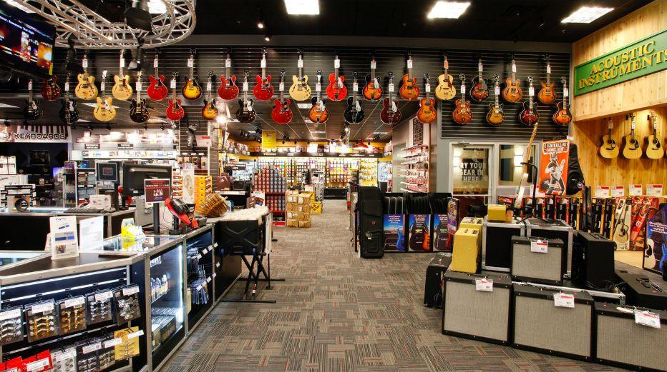
Music Retail
In small groups, you will be asked to choose a music retailer and decide what makes them successful.
Notes:
Brick and Mortar Music Store

Slide 8
First, listen to one of the
following oral histories:
Chuck Surack
David Kalt
Sam & Peggy Falcetti

Slide 9
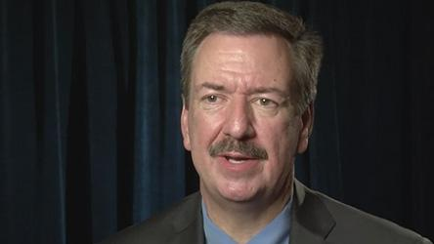
Sweetwater
Sweetwater is one of the largest music retailers in the country.
Sweetwater was started by Chuck Surack to provide equipment for music-makers.
What does Chuck say is the key to success at Sweetwater?

Slide 10


Slide 11
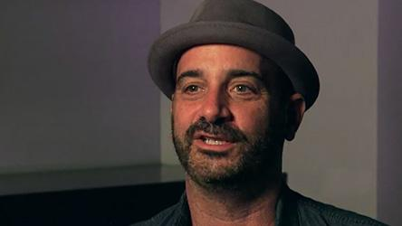
Reverb
Reverb was started in 2013 by David Kalt as an online platform to buy and sell musical products (both new and used).
It is now owned by Etsy.

Slide 12
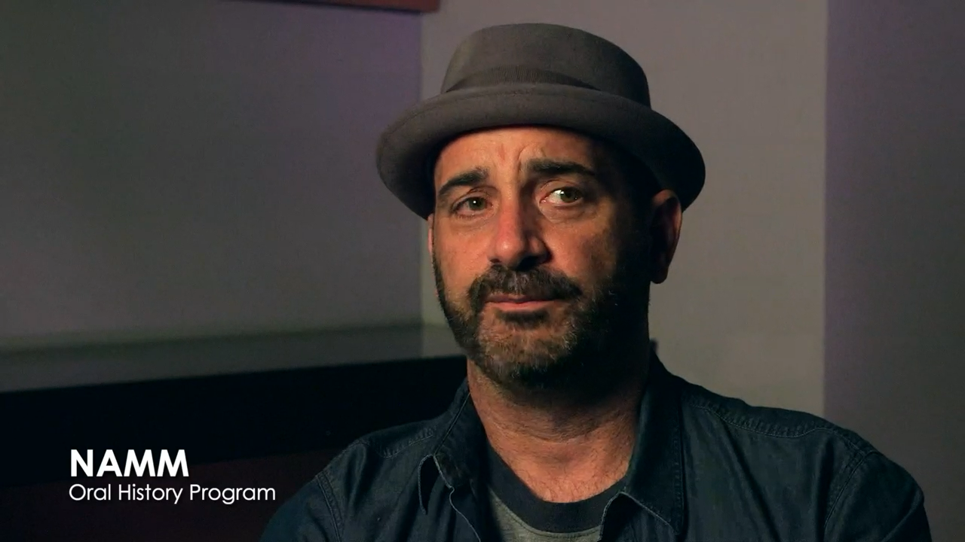

Slide 13

Falcetti’s Music
There are lots of brick and mortar music stores. Many of them are family-owned.
Listen to Sam and Peggy Falcetti talk about Falcetti Music stores.

Slide 14


Slide 15
Next, read and annotate the stories provided.
Stories: A Platform for Everything

Slide 16
Share

Slide 17
Now, it's your turn!
Complete the brainstorm questions in your
handout to create your own retail concept.

Slide 18
Consider a Career in Music!
What careers are related to the lesson we just completed?
Music Retailer
Entrepreneur
Instrument Manufacturer
Store Design Specialist
Marketer
Accountant
Salesperson
Human Resources

Slide 19


