Slide 1


Slide 2
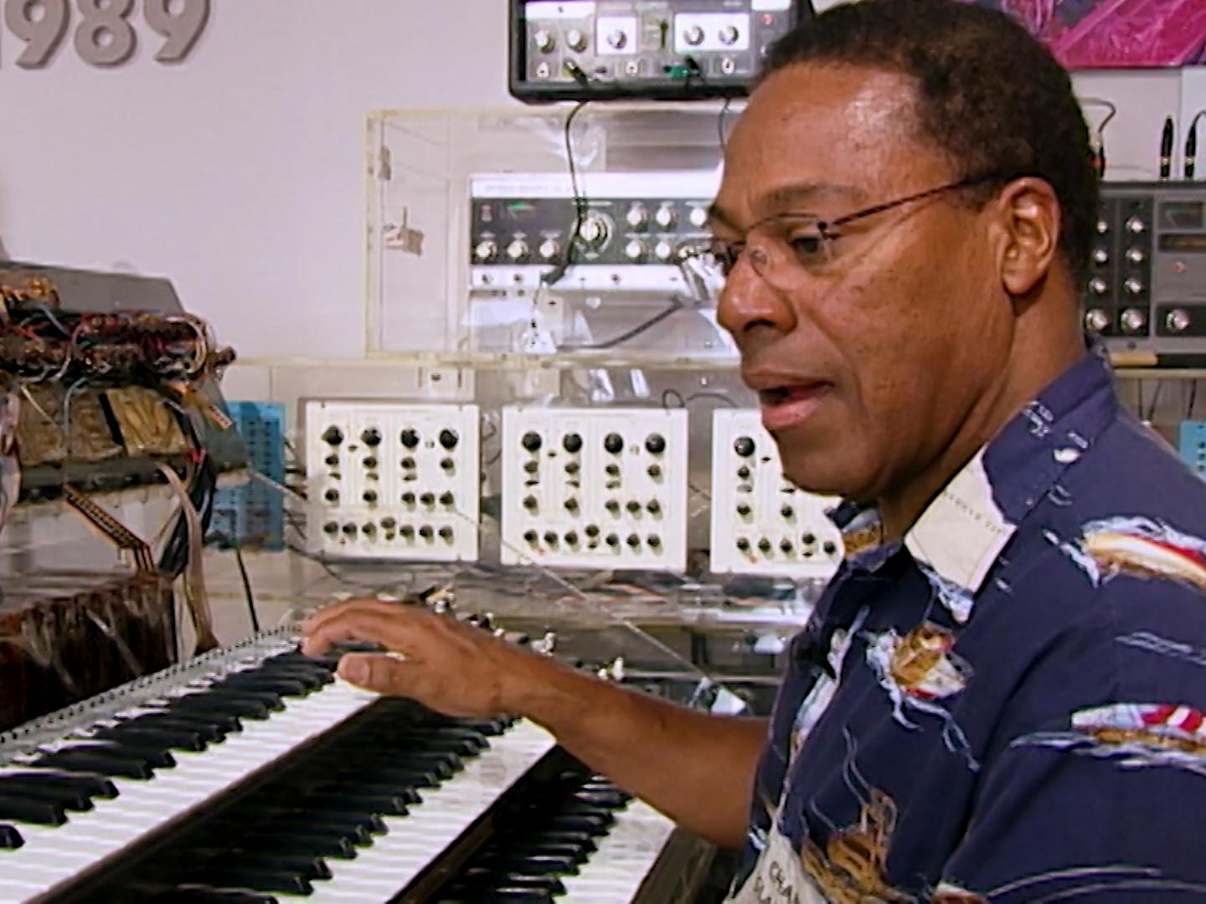
Impact
Innovations like LEO open the door for more innovation and creativity to occur.
Notes:
Don Lewis and LEO

Slide 3
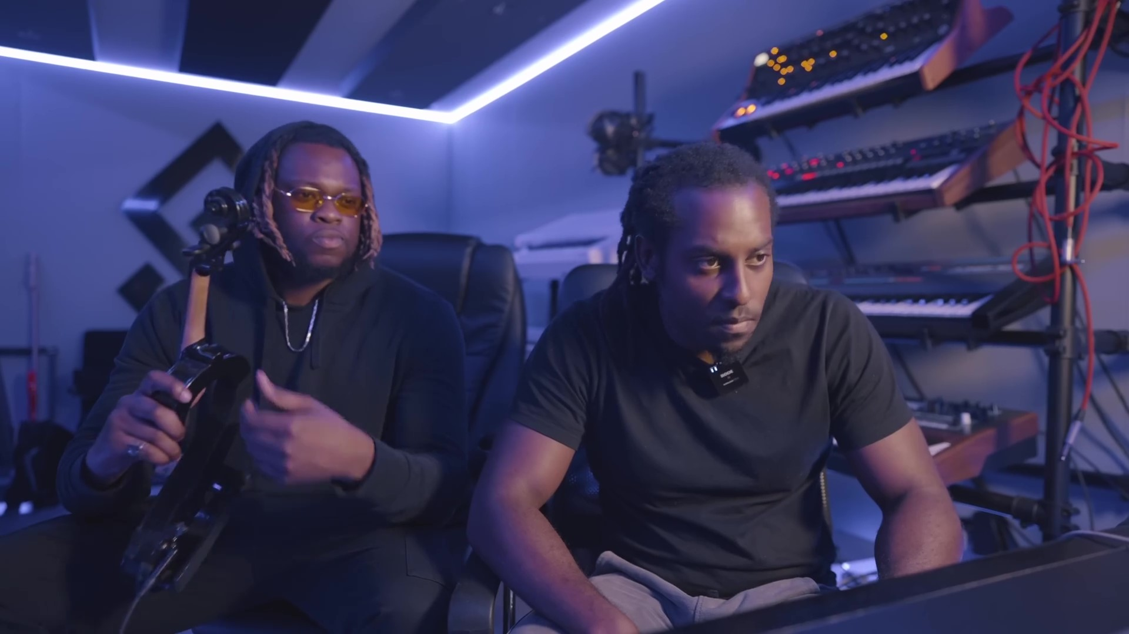
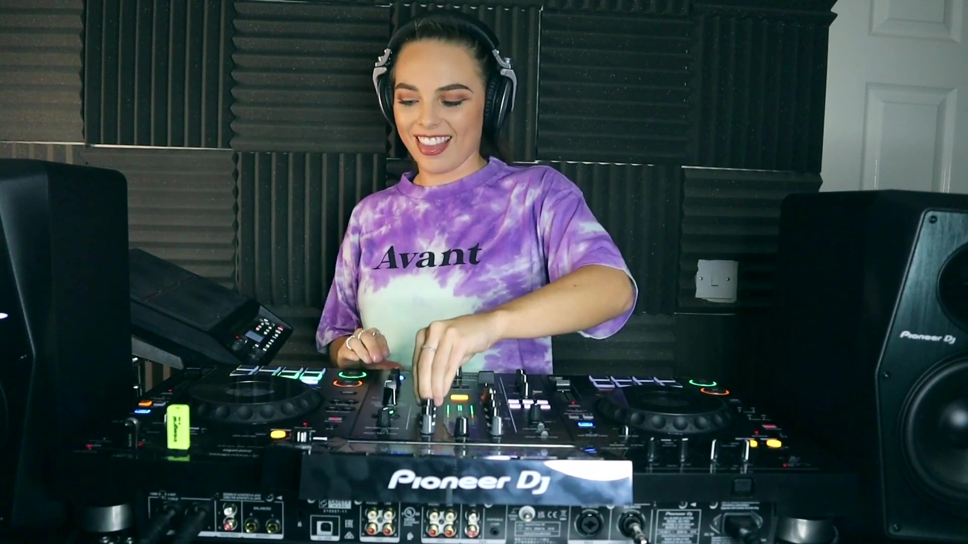
Creativity of Modern DJs
Ocean & 4Stringsz sampled a violin to make a beat.
Stephani B incorporated live percussion into the DJ Mix

Slide 4
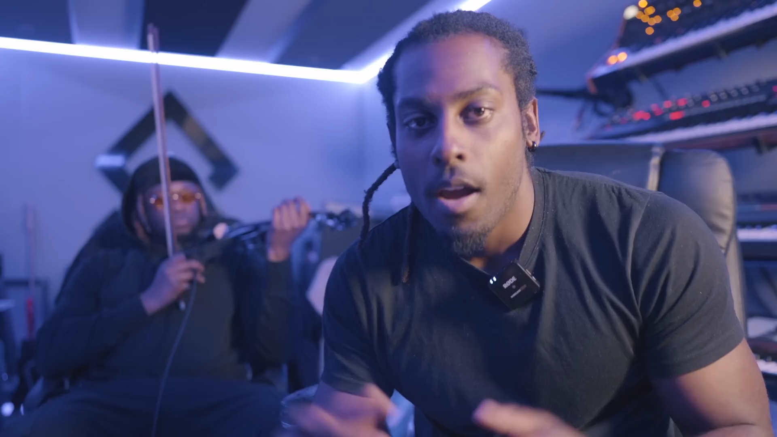

Slide 5
Creativity of Modern DJs
Ocean & 4Stringsz sampled a violin to make a beat.
Stephani B incorporated live percussion into the DJ Mix

Slide 6
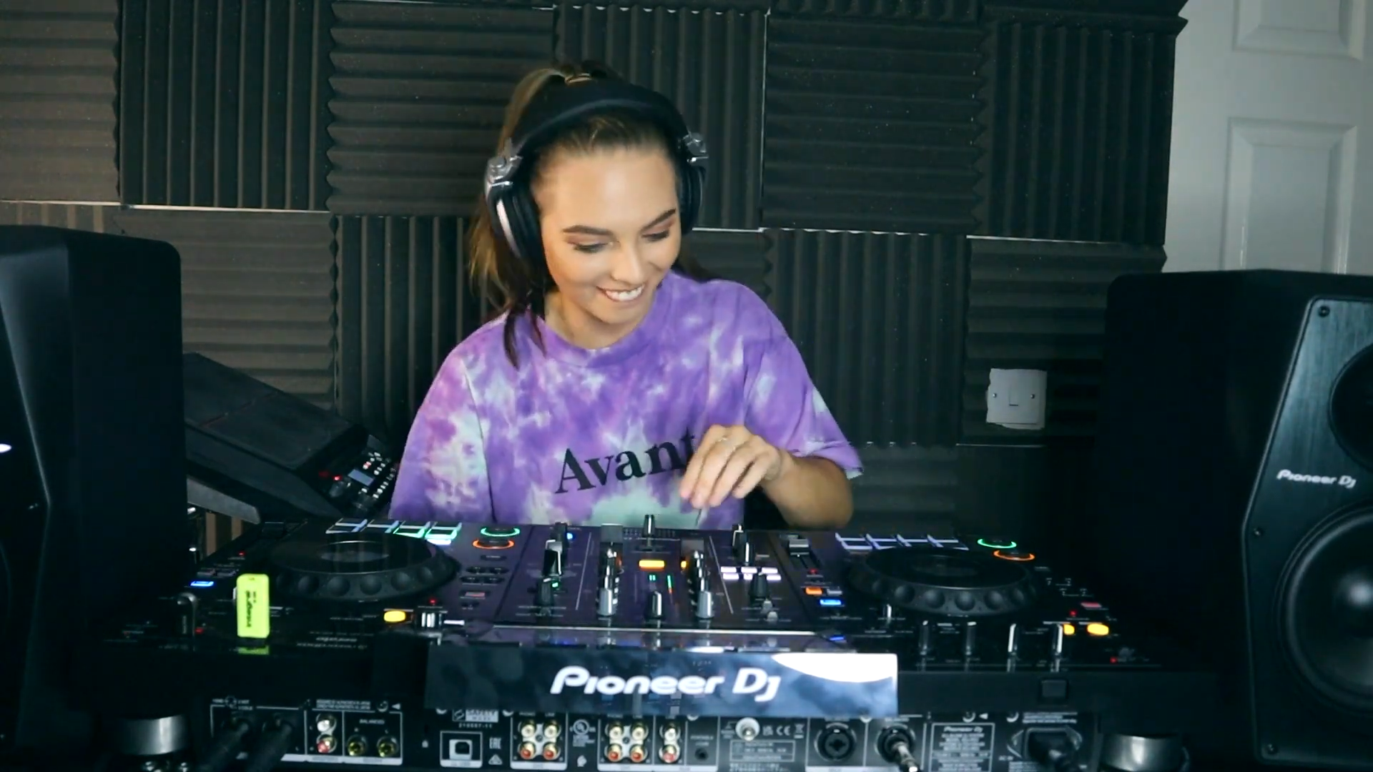

Slide 7
Your Own Creativity
Innovations in digital musical instruments have increased access to music making for millions of people and allowed them to express their creativity.
As you create your own beat using beatbox.co, imagine if you had to program the website first before using it - that’s what Don Lewis had to do when he programmed his Live Electronic Orchestra!

Slide 8
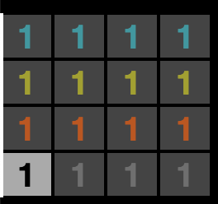
Beepbox Beat
Enter the url beepbox.co
*note: it is .co and NOT .com
Enable the beat maker by clicking on
the gray number 1.
When it is selected, it will look like this:
Notes:
Beepbox Directions

Slide 9

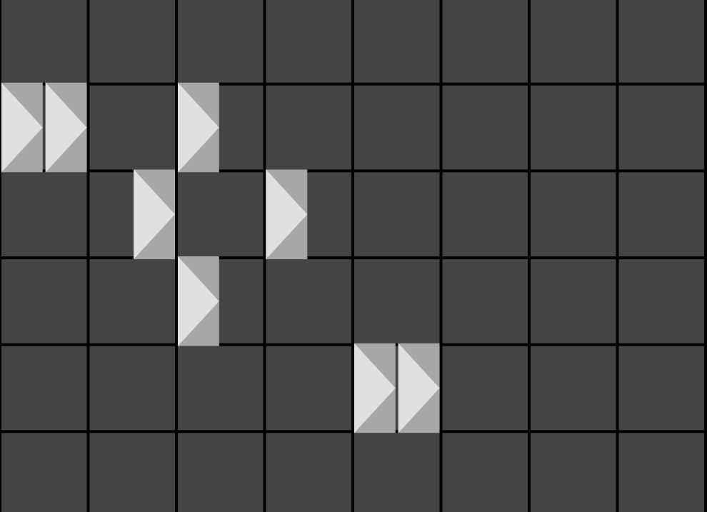
Beepbox Beat
Click in the boxes on the grid to add sounds to your beat - each row will produce a different sound.
You will know you added a sound when a solid white triangle appears. Click on the white triangle again to remove the sound.

Slide 10
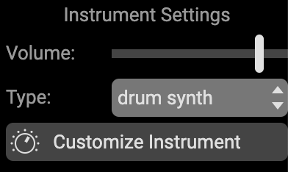
Beepbox Beat
Experiment by changing the “type,” which is located under “Instrument Settings” - each type will have a different set of sounds.

Slide 11
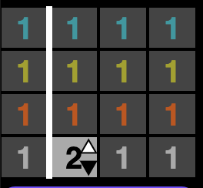
Optional Extension
Add more to your beat by changing the 1 to another number, which will bring up a new grid. You can switch back to work on the first part of your beat by clicking on the number 1 again.

Slide 12
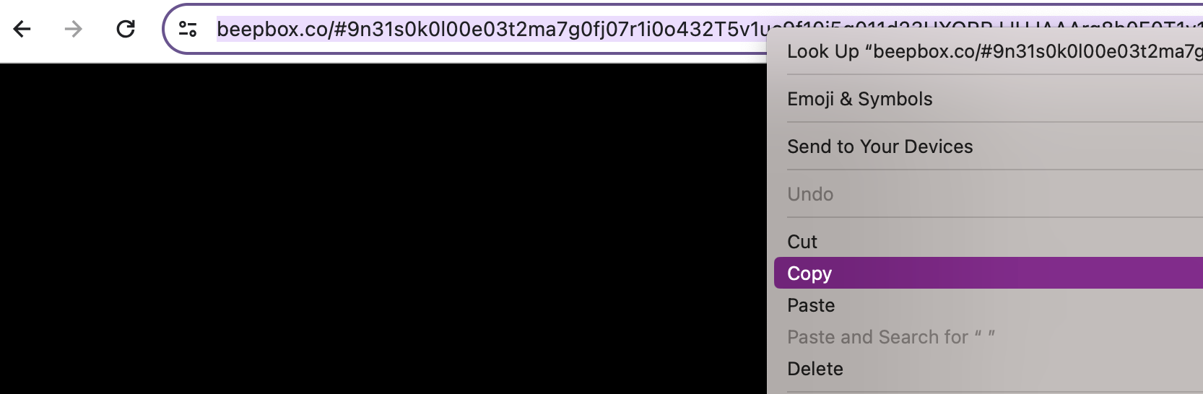
Beepbox Beat
To save your Beepbox Beat, click on the url bar and make sure the ENTIRE url is highlighted. Then, right click and select copy.
This url is unique - if you want to open the project you worked on today, you just need to open the url you copied.

Slide 13
Wrap-Up
Complete Exit Ticket
Do we want to make a pdf/worksheet of this? Yes!

Slide 14
Consider a Career in Music!
What careers are related to the lesson we just completed?
Instrumentalist
DJ
Performer
Music software developer
Instrument Technician
Engineer

Slide 15


