Slide 1
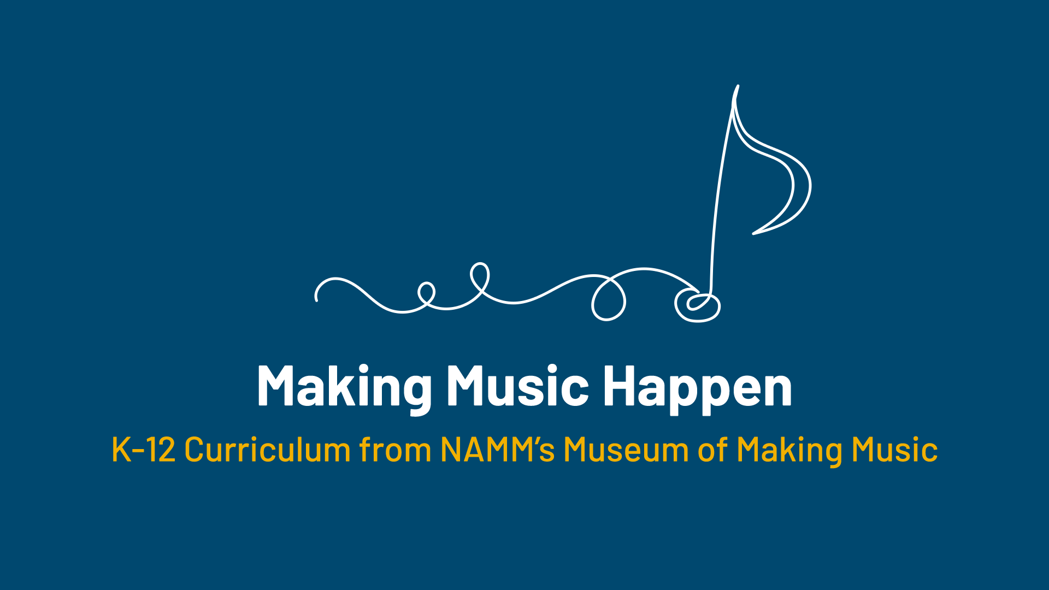

Slide 2
Innovation & Creativity in
Musical Instruments

Slide 3
Lesson Objectives
Describe the innovative changes made to various instruments.
Explain the contributions of Don Lewis and The Live Electronic Orchestra.
Explain how modern DJs embrace creativity and innovation.
Create a beat using a digital tool (Beepbox.co).

Slide 4
Think About It
What is something you wish existed that would make your life better?

Slide 5
Why Innovate Musical Instruments?
To improve an instrument
Because of influences of society or culture
Nothing exists like the instrument already

Slide 6
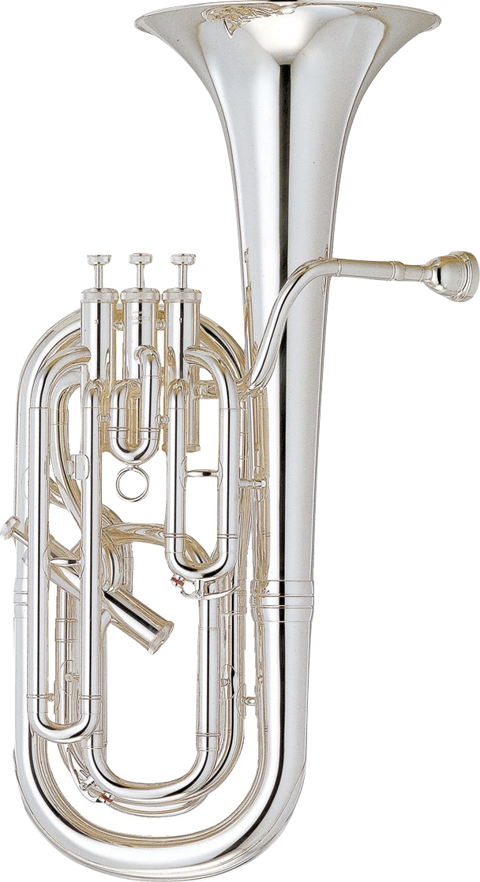
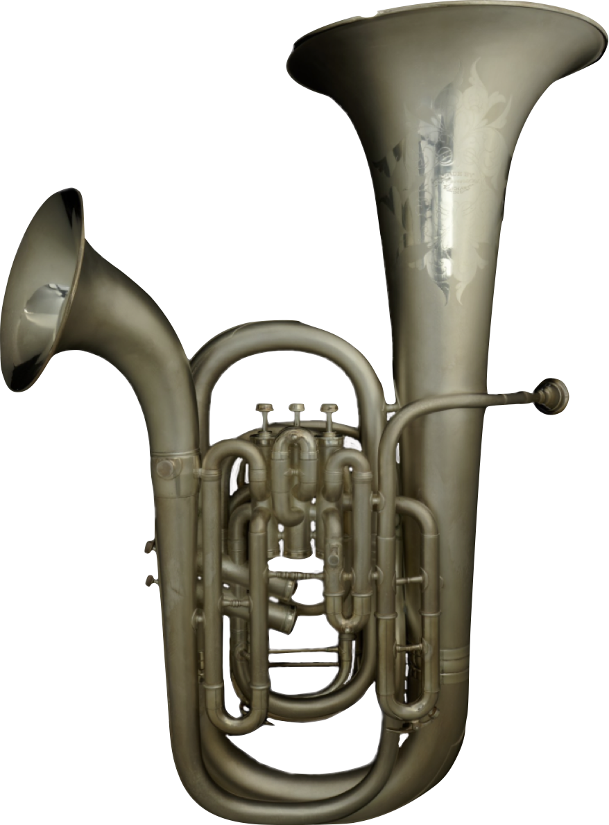
What do you notice?
Notes:
Yamaha Baritone horn YBH-621S, 2017
2. C.G. Conn Double-Bell Euphonium, c. 1915
Many members of the brass instrument family have been made with more than one bell. By pressing a valve, the player changes the flow of air through the instrument (the same mechanism controls the instrument's pitch) to emerge from one bell or another. Secondary bells were typically designed to provide a different tone quality.

Slide 7
Double Bell Euphonium
C.G. Conn began manufacturing double bell euphoniums in the 1880s.
By pressing a valve, the player changes the flow of air through the instrument to emerge from one bell or the other.
Secondary bells provided a different tone quality.
Notes:
C.G. Conn Double-Bell Euphonium, c. 1915
Many members of the brass instrument family have been made with more than one bell. By pressing a valve, the player changes the flow of air through the instrument (the same mechanism controls the instrument's pitch) to emerge from one bell or another. Secondary bells were typically designed to provide a different tone quality.

Slide 8
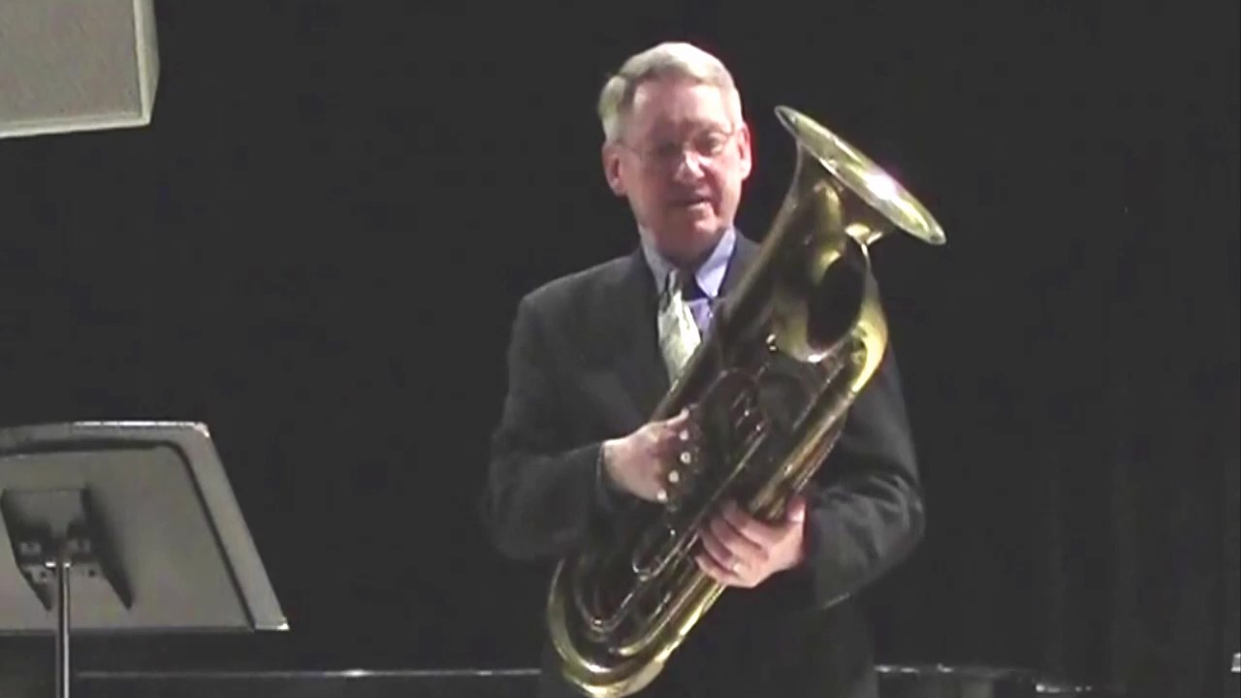
The Double Bell Euphonium
Watch the video and describe the
differences between
the larger and smaller bell sound.

Slide 9


Slide 10
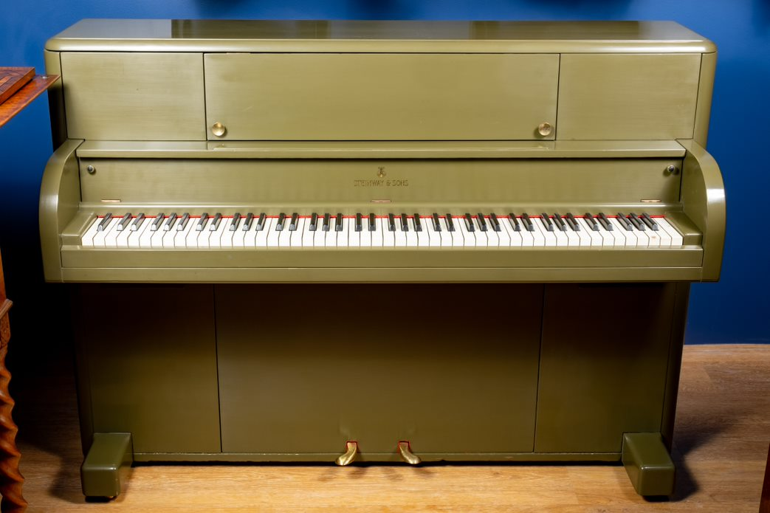
Steinway & Sons
Victory Vertical Piano, 1944
Notes:
Steinway & Sons Victory Vertical Piano, 1944
Like most other musical manufacturers during World War II, Steinway & Sons was effectively prohibited from making instruments. Its production facilities were retooled to produce troop transport gliders and coffins. However, Steinway petitioned for and was awarded a government contract to design and build pianos that could be delivered to troops overseas. These pianos were ruggedized both to withstand the harsh environments that troops might encounter near front lines and to endure being airdropped in crates. Deliveries of the pianos, available in olive, blue, and gray, began in 1942.

Slide 11
Victory Vertical Piano
During World War II, instrument manufacturer’s production facilities were retooled to produce troop transport gliders and coffins.
Steinway & Sons received a government contract to design and build pianos that could be delivered to troops overseas.
Over 3,000 Victory Pianos were produced from 1942 - 1953 to withstand the harsh environments that troops might encounter near front lines and to endure being airdropped in crates.

Slide 12
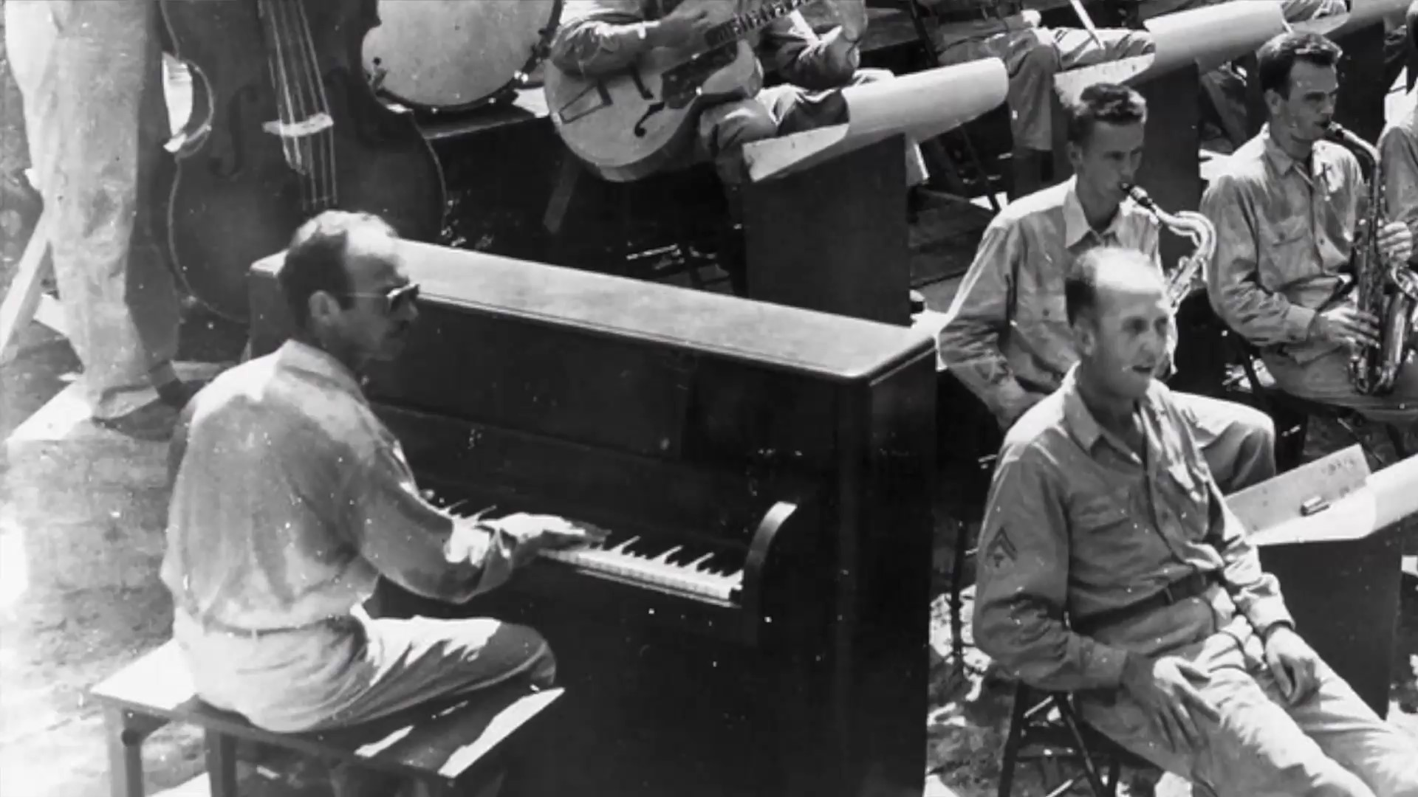
Victory Vertical Piano
What purpose did the piano serve in WWII?
Why was music/entertainment important during WWII?

Slide 13
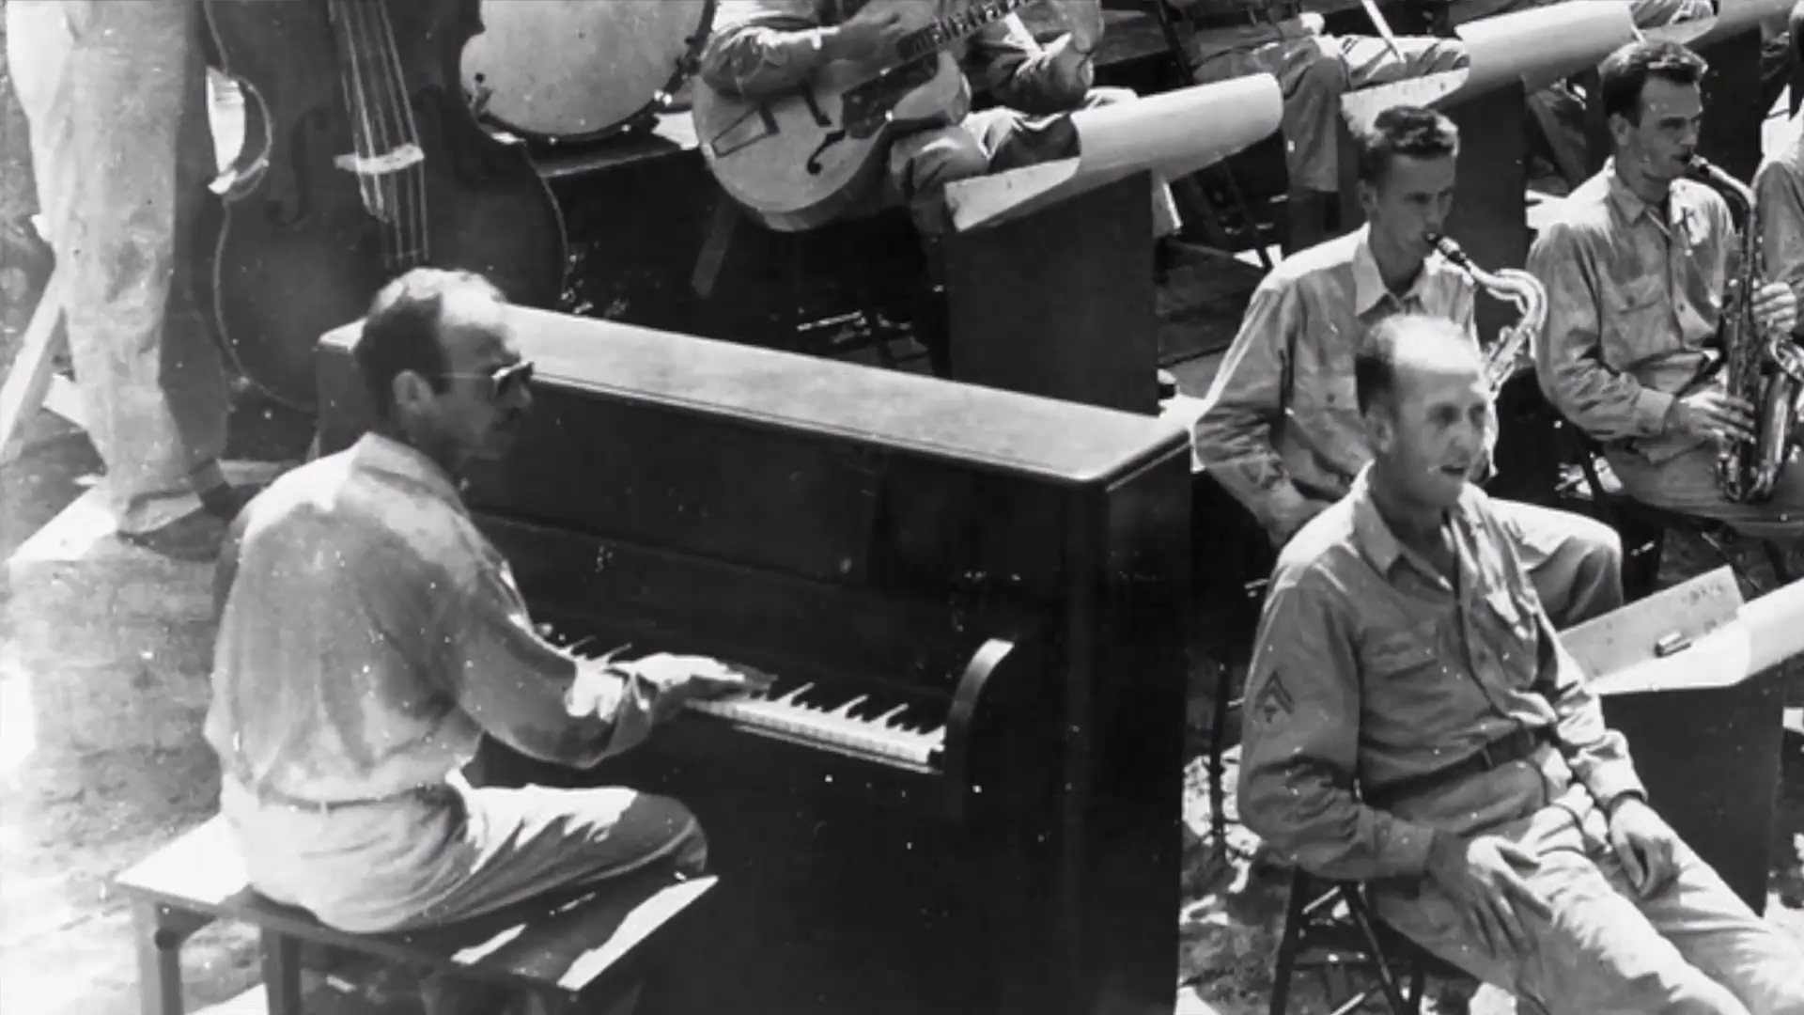

Slide 14
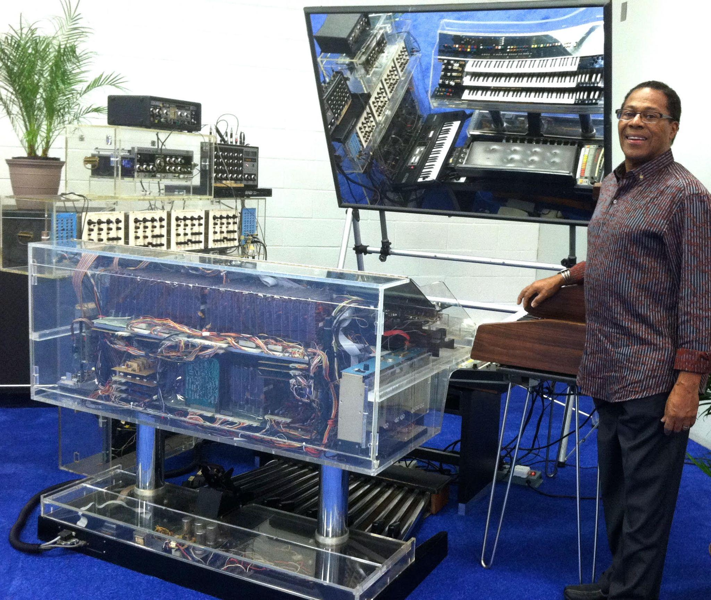
Don Lewis
Pioneer of electronic music.
Created the Live Electronic Orchestra (LEO), which combined multiple synthesizers into a single playable setup (which had never been done before).
Notes:
Picture attribution: Julie Lewis, CC0, via Wikimedia Commons https://commons.wikimedia.org/wiki/File:Don_Lewis_standing_by_his_LEO_(Live_Electronic_Orchestra).jpg

Slide 15
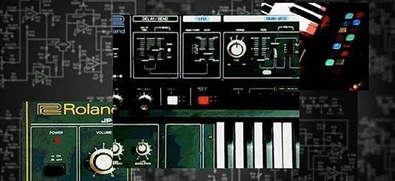
Don Lewis & Live Electronic Orchestra (LEO)
As we view the video, consider the experiences that influenced Don Lewis to innovate and create LEO.

Slide 16


Slide 17
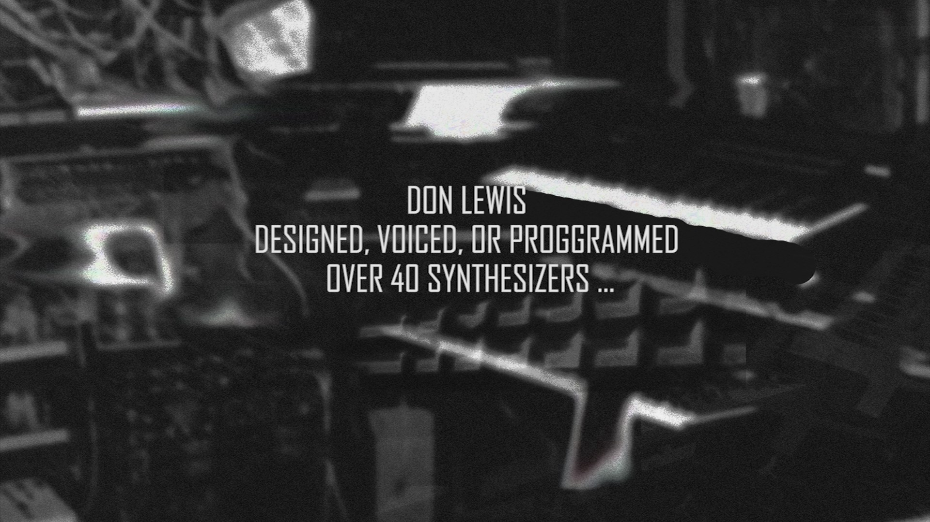
Don Lewis & Live Electronic Orchestra (LEO)
As we continue the video, think about how Don Lewis influenced the music industry.

