Slide 1
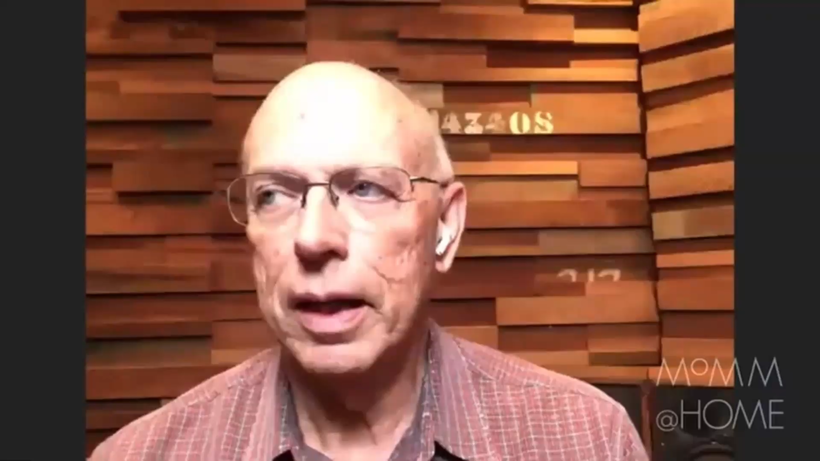

Slide 2
Instruments and Personal Expression
How can instrument construction affect
personal expression through music?

Slide 3



Watch, Analyze, and Reflect
Watch one or more of the music clips, and answer the questions on your worksheet.

Slide 4


Slide 5
Watch, Analyze, and Reflect
Watch one or more of the music clips and answer the questions on your worksheet.

Slide 6
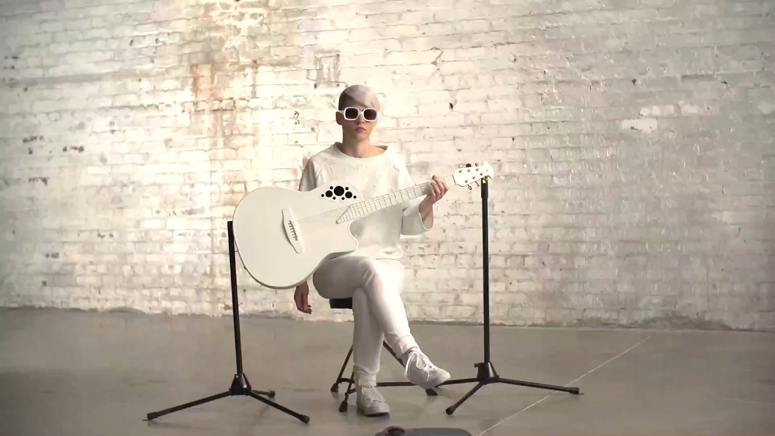

Slide 7
Watch, Analyze, and Reflect
Watch one or more of the music clips and answer the questions on your worksheet.

Slide 9
Consider a Career in Music!
What careers are related to the lesson we just completed?
Luthier
Repair Technician
Factory Floor Manager
Singer/Songwriter
Composer
Sound engineer
Research & Development
Artist Relations
Venue Manager
Stage Manager
Interviewer

Slide 10


