Slide 1


Slide 2
Being Heard:
Luthiers and Musicians

Slide 3
Lesson Objectives
Identify concrete examples of collaboration between musicians and luthiers.
Describe how instrument manufacturing helped broaden possibilities for expression.
Analyze and connect musical performances in guitar with personal preference.
Evaluate musical performances based on expressive elements.
Describe individual luthier contributions in the field of music

Slide 4

Reflection
Use your worksheet to reflect on your experiences listening to and performing music.

Slide 5
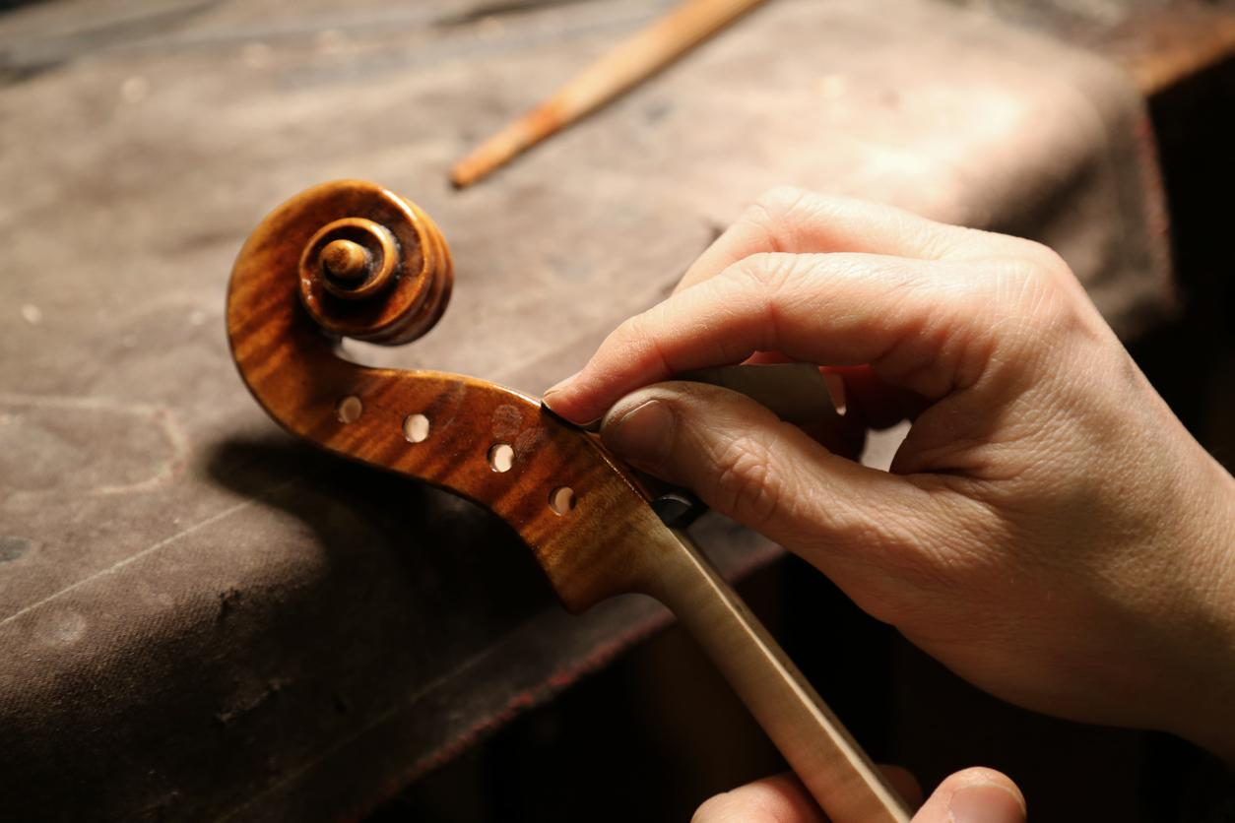
What is a luthier?
A luthier is a maker of stringed instruments such as ukuleles, mandolins, violins,
cellos, and guitars.

Slide 6
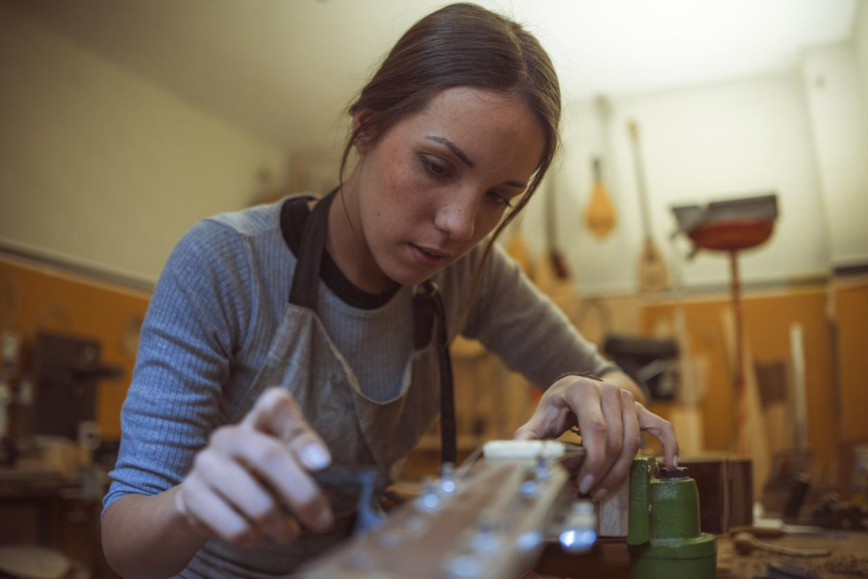
How do luthiers adapt to changing needs?
Luthiers work with musicians to develop the best instrument possible; one that serves the need of the musician and helps them use their instrument as a vehicle for personal expression.

Slide 7

One example: The Need to be Heard!
Think of a band that you like to listen to.
Would it be the same if one or more of the players couldn’t be heard above the rest?
How would your listening experience be different?

Slide 8
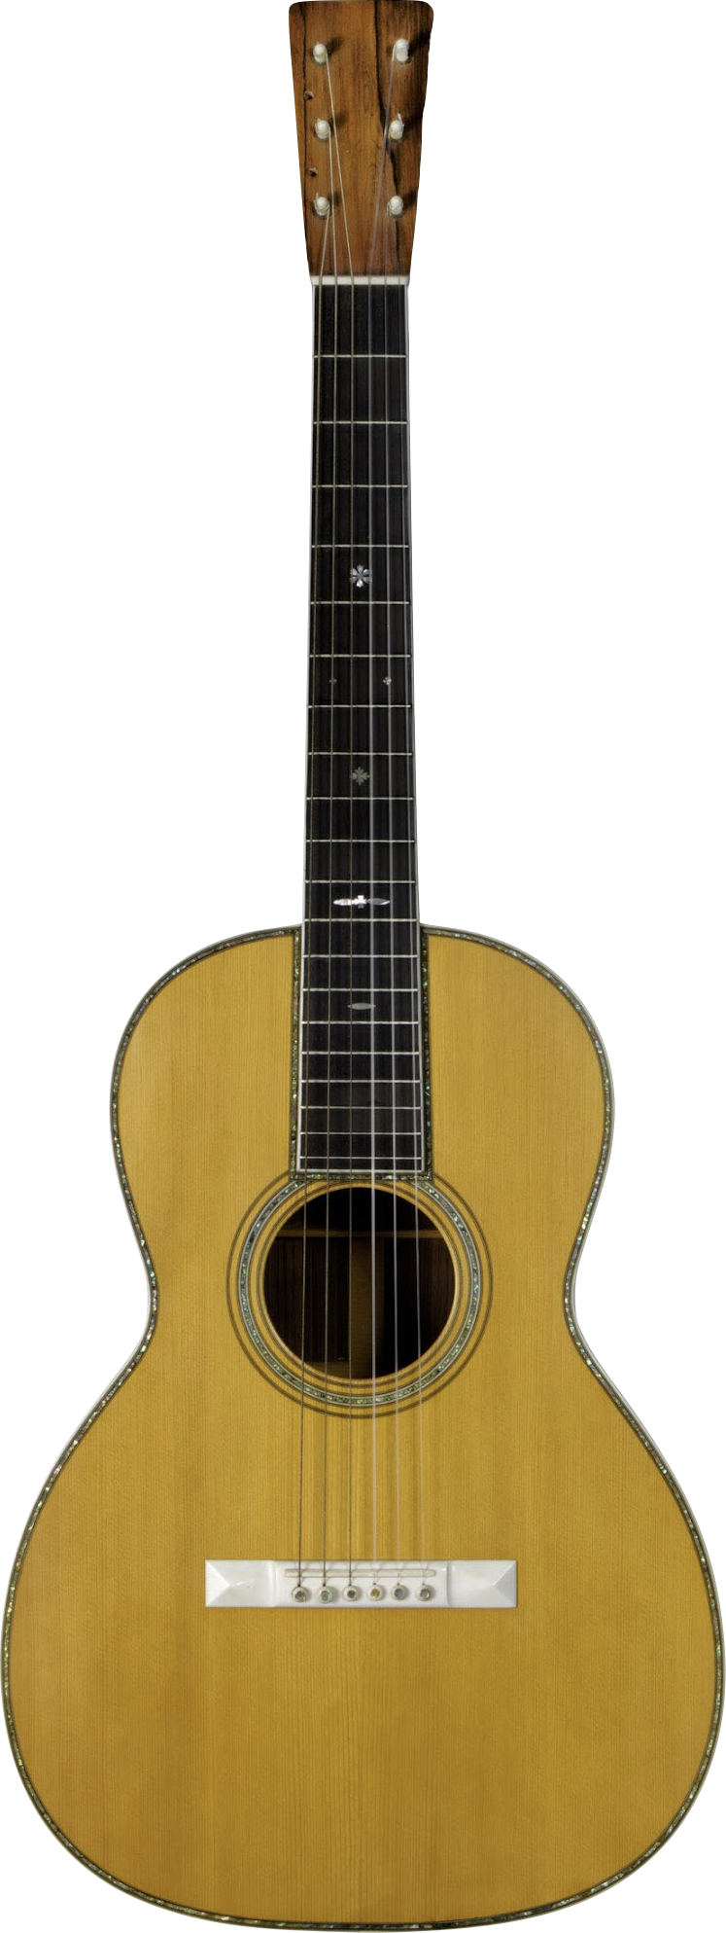
Historical Insight
As ensembles and venues grew larger in the late 1800s, the parlor guitar of the time proved too quiet to accompany louder instruments like the banjo and the mandolin. Luthiers developed–and have not stopped developing–new volume enhancing guitars that helped musicians be heard in and even above a crowd.
What are some ways this was accomplished?
Notes:
C.F. Martin & Co. 00-42 Parlor Guitar, 1902
The 00 body type, known as the Grand Concert, was the largest instrument available from C.F. Martin through the early 20th century but is now among the smallest. The second part of the model name, in this case 42, refers to the instrument's style, or level of appointment. Style 42 was, at the time, the top of Martin's line and featured pearl inlay, ivory components, and an ebony fingerboard. The two additional holes on the headstock of this instrument indicate that it had previously been adapted for use with eight strings.

Slide 9
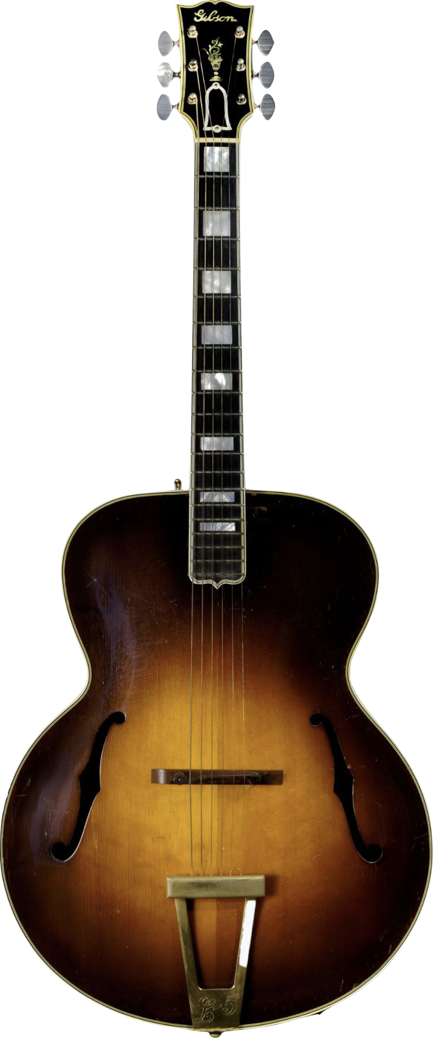
Gibson L5 1937
This guitar that has sound holes shaped like “f’s” similar to the violin or cello.
This guitar has a carved arched top which makes it louder. These types of sound holes are called “F-holes.”
The f-holes not only let the sound pass through to the audience, they also tune the sound and maintain the integrity of the archtop structure.
Notes:
Gibson, Inc. L-5 Archtop Guitar, 1937
In 1919, Gibson hired luthier and sound engineer Lloyd Loar to help design new instruments and revive flagging sales. Loar’s L-5 replaced the traditional round sound hole with violin-like f-holes and floated the fingerboard above the guitar’s top, among other changes. Initially released at 16” wide, the L5 was expanded to 17” in 1934.

Slide 10
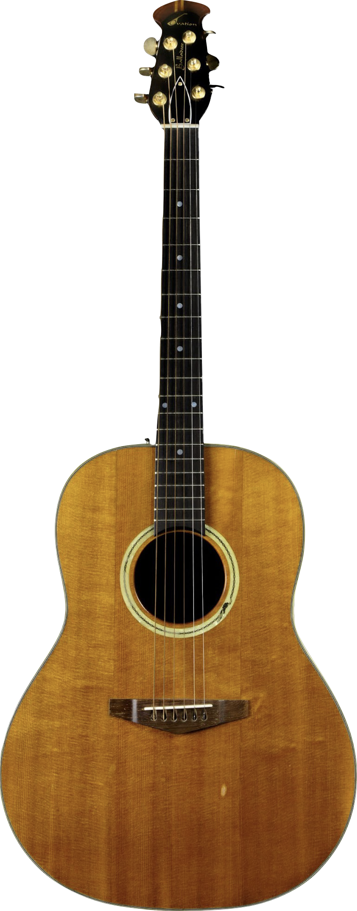
Ovation Balladeer 1968
The maker of this guitar, Charles Kaman, was an aeronautical engineer with an interest in guitars. He developed this acoustic guitar using aerospace composite materials.
His design featured a rounded back made from Lyrachord, similar to materials used in helicopter rotors.
This material gives the guitar noticeably more volume than comparably sized all-wood guitars.
Notes:
Ovation Instruments Balladeer Guitar, 1968
In 1966, helicopter engineer Charles Kaman and the Ovation Guitar Company released their first guitars. These featured a parabolic bowl-shaped back made from Lyrachord, a form of fiberglass based on materials used in helicopter rotors and other aerospace components, giving them noticeably more volume than comparably sized all-wood guitars.

Slide 11
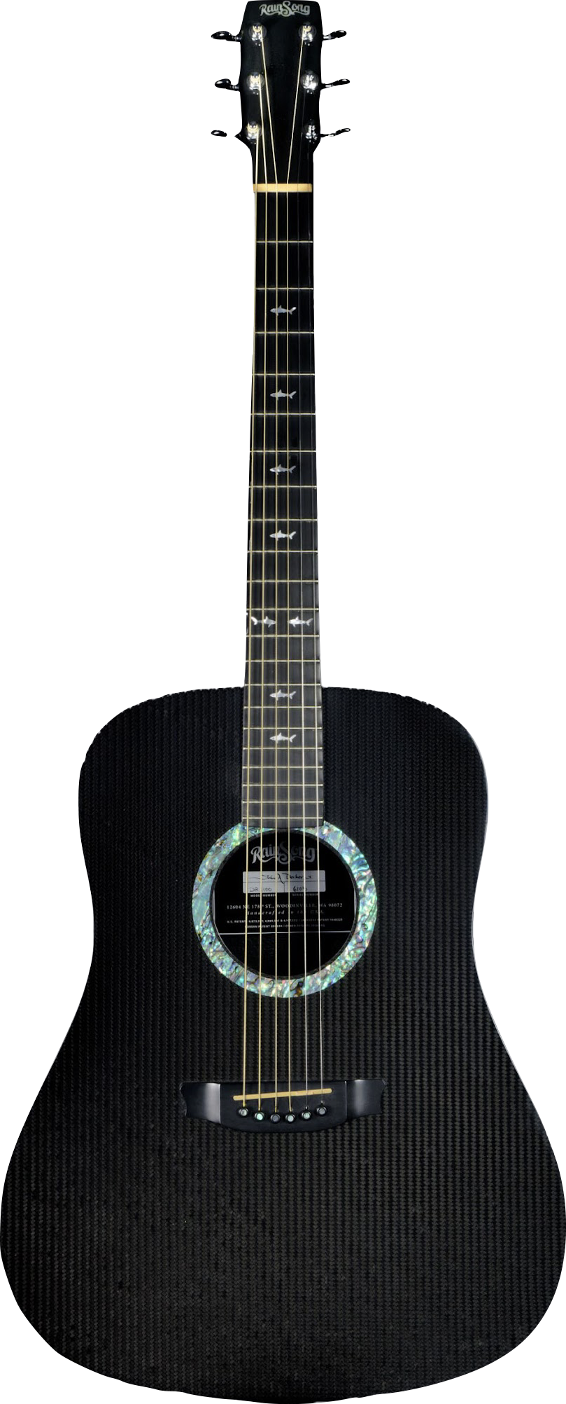
Rainsong DR1100 Dreadnought 2003
Rainsong guitars were developed by plasma physicist, Dr. John Decker, who explored alternate materials after seeing a guitarist caught in a rainstorm in Hawaii.
Released in 1995, his guitars were made from graphite fiber, a very strong but lightweight material that gives the guitar a bright and clear sound. This guitar is constructed without any internal bracing which, when combined with graphite’s lightness and rigidity, reduces damping and makes them louder. This guitar was impervious to environmental changes – including sudden rainstorms.
Notes:
RainSong Graphite Guitars DR 1100 Dreadnought Guitar, 2003
In the early 1980s, plasma physicist and RainSong founder Dr. John Decker explored alternate materials after seeing a guitarist caught in a rainstorm in Hawaii. Decker engineered a guitar made of graphite fiber, acoustically similar to spruce. Released in 1995, these guitars were made without any internal bracing which, combined with graphite’s lightness and rigidity, reduced damping and made them louder. And, true to his inspiration, Decker’s guitar was impervious to environmental changes – including sudden rainstorms.

Slide 12
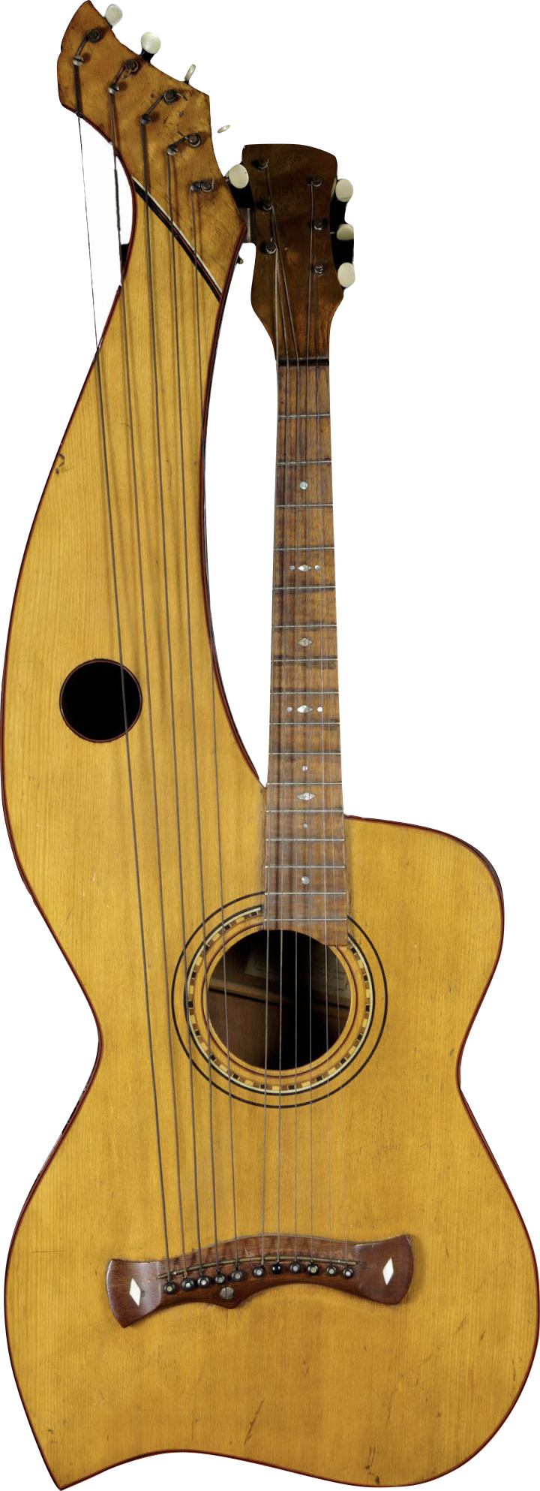
Chris Knutsen Harp Guitar 1908
This guitar is called a “harp guitar” and the extra strings are called “floating strings.” This extra arm helps to create more sound and gives a musician more range.
Though their exact origins are uncertain, harp guitars – guitars with a number of additional “floating” unstopped strings – seem to have appeared in Europe in the early to mid-1800s as a means to extend the guitar’s low end and increase volume.
Notes:
Chris Knutsen Harp Guitar, 1908
Though their exact origins are uncertain, harp guitars – guitars with a number of additional “floating” unstopped strings – seem to have appeared in Europe in the early to mid-1800s as a means to extend the guitar’s low end and increase volume. Chris Knutsen, a designer based in Port Townsend, WA, began creating harp guitars in the late 1890s. This example features five strings mounted over a hollow arm extending from the guitar’s body.

Slide 13
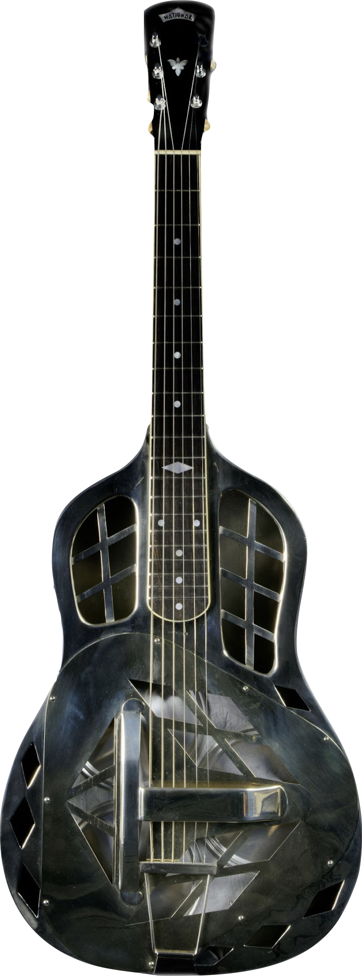
National Resonator Guitar Prototype 1926-27
The resonator cones work like megaphones and make the sound louder.
In the 1920s, vaudeville steel guitarist George Beauchamp (pronounced Beecham) asked inventor John Dopyera to devise a way to amplify the sound of a guitar. Dopyera experimented with placing resonating cones in the body of the instrument, and in 1927 he and Beauchamp were making resonator guitars with Hawaiian-style bodies under the name National String Instrument Company. This example, made of nickel silver, was National's first prototype guitar with three resonators.
Notes:
National String Instrument Company Spanish-Style Resonator Guitar Prototype, 1926-7
In the 1920s, vaudeville steel guitarist George Beauchamp asked inventor John Dopyera to devise a way to amplify the sound of a guitar. Dopyera experimented with placing resonating cones in the body of the instrument, and in 1927 he and Beauchamp were making resonator guitars with Hawaiian-style bodies under the name National String Instrument Company. This example, made of nickel silver, was National's first prototype guitar with three resonators. Its Hawaiian-style square neck was replaced with a Spanish-style one at the request of guitarist Waltimor Shablowski, and it subsequently became the prototype for National’s Spanish-style resonator guitars.

Slide 14
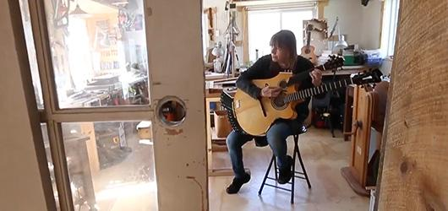
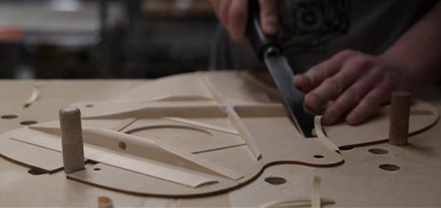
Let’s watch luthiers in action.
Guitars can be made in factories or small workshops.
As you watch the videos, answer the questions on your worksheets.
Notes:
Martin video is best at 2x speed
Linda Manzer video without volume and at 2x speed!

Slide 15
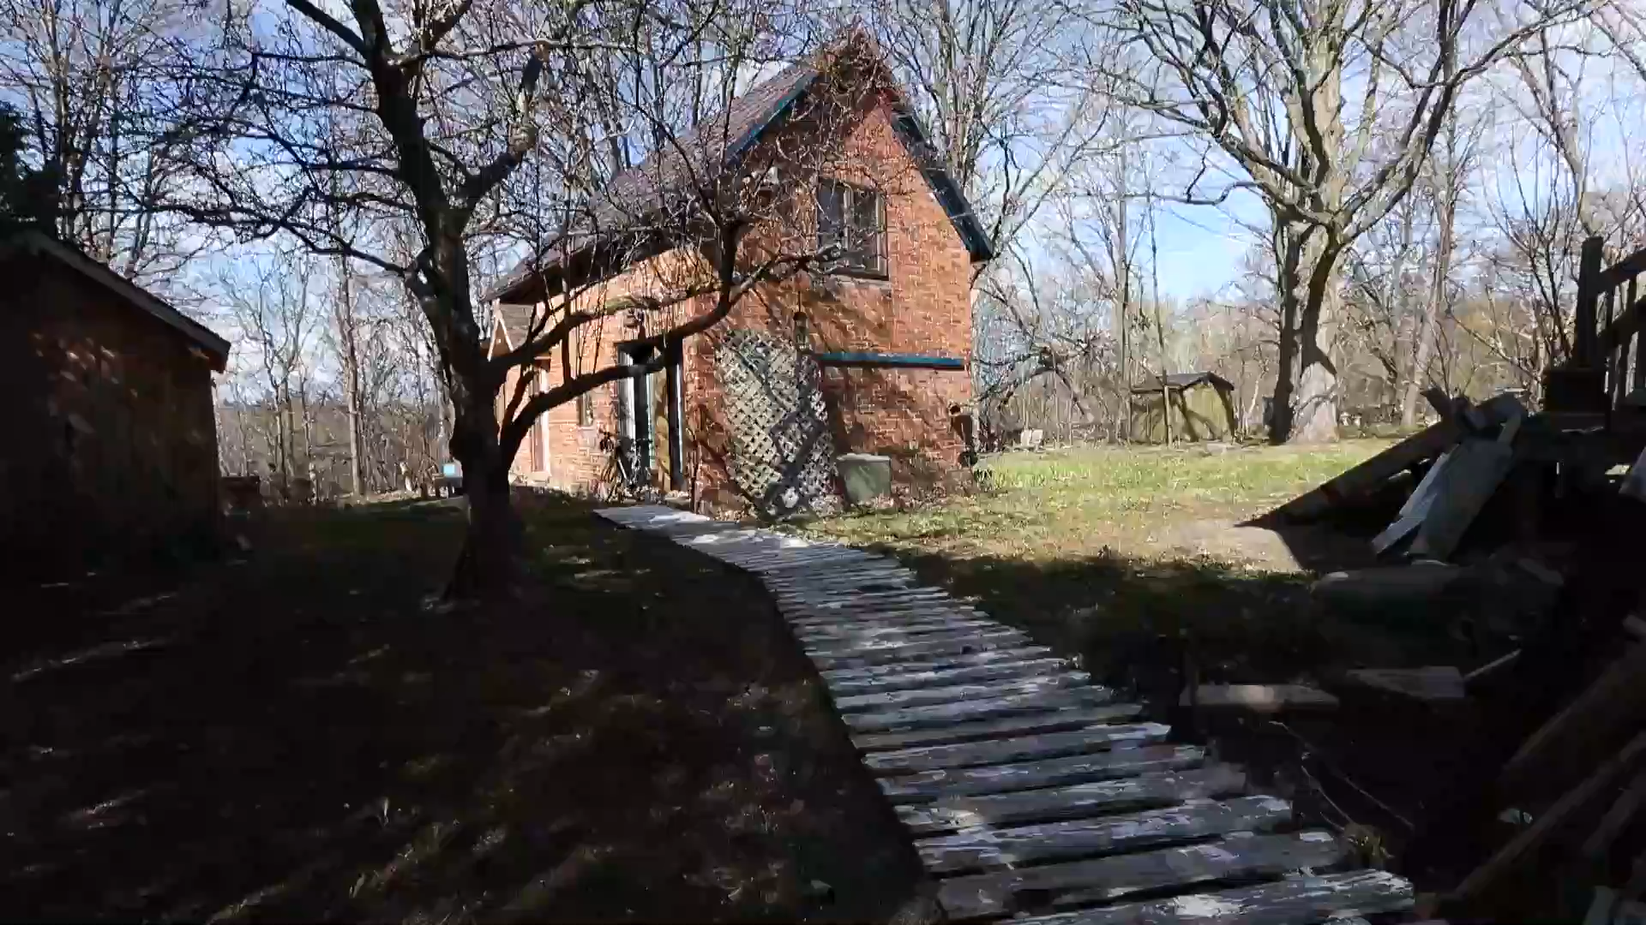

Slide 16
Let’s watch luthiers in action.
Guitars can be made in factories or small workshops.
As you watch the videos, answer the questions on your worksheets.
Notes:
Martin video is best at 2x speed
Linda Manzer video without volume and at 2x speed!

Slide 17


Slide 18
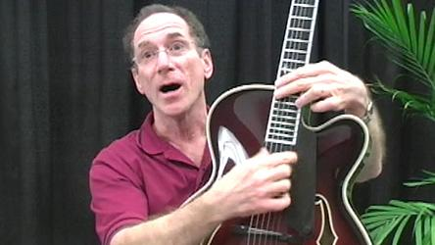

The People Behind the Instruments
Listen to the interview with Bob Benedetto of Benedetto Guitars, and answer the question on your worksheet.
Listen to the interview with Bob Taylor, founder and owner of the Taylor Guitar Company, and answer the question on your worksheet.

Slide 20
The People Behind the Instruments
Listen to the interview with Bob Benedetto of Benedetto Guitars, and answer the question on your worksheet.
Listen to the interview with Bob Taylor, founder and owner of the Taylor Guitar Company, and answer the question on your worksheet.

