Slide 1
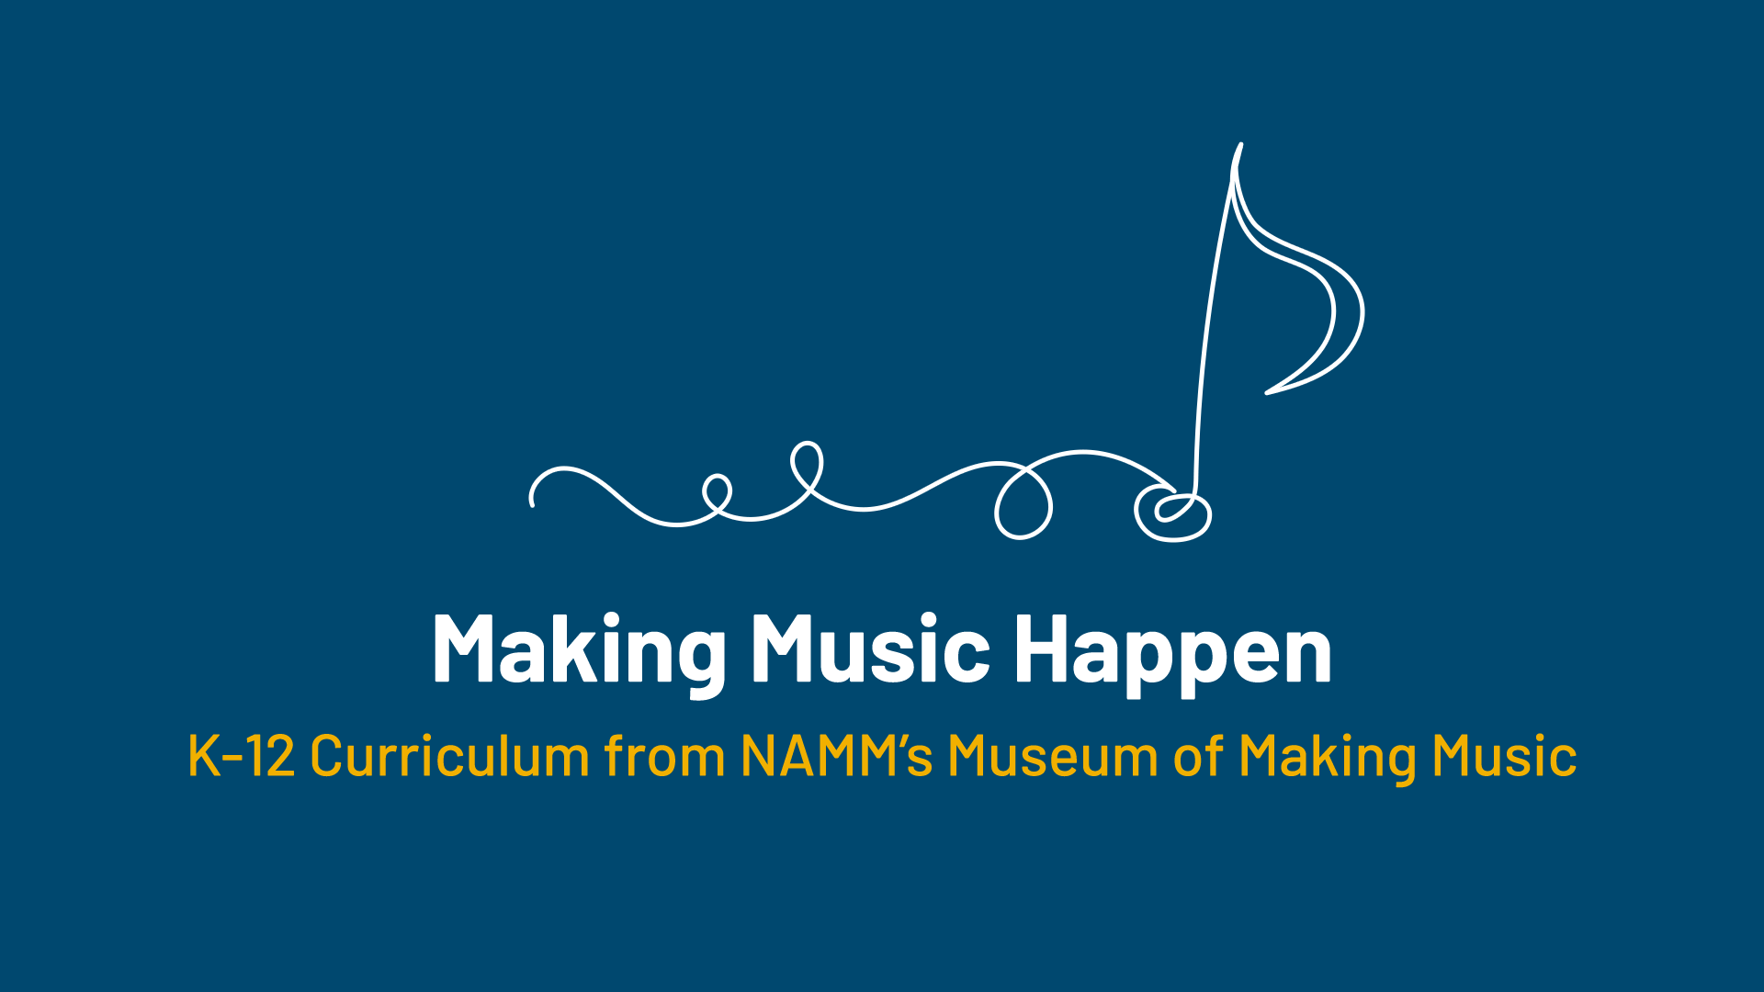

Slide 2
Balloon Drums!

Slide 3
Lesson Objectives
Understand the meaning of “percussionist” and some of the products they can use.
Understand the difference between animal skin and synthetic drumheads.
Create unique timbres by using a balloon and tin canister to make their own drums.
Use their drums to create a beat alone or with a partner.

Slide 4
What is a percussionist?
Notes:
A percussionist is a musician who plays a percussion instrument, which is an instrument sounded by striking, shaking, or scraping.

Slide 5
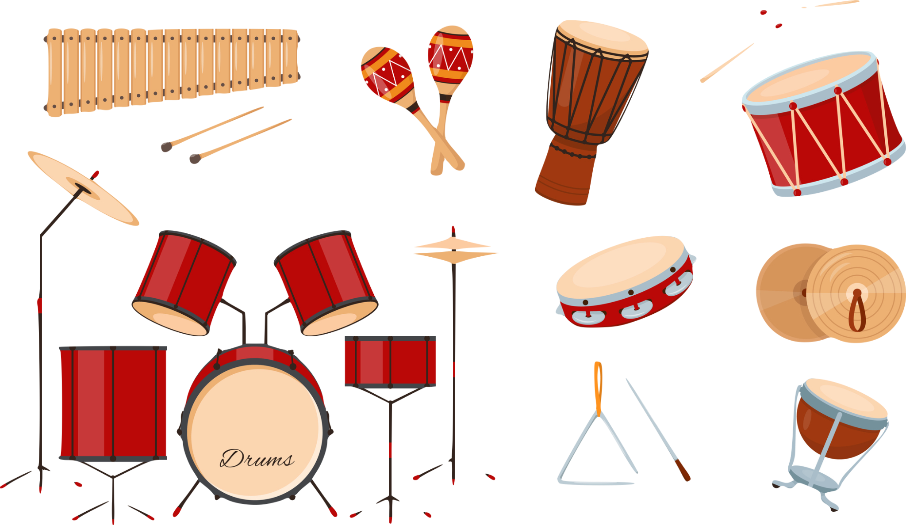
When you think of instruments a percussionist would play, what sounds do you think of?

Slide 6

Question of the Day
Do all percussion instruments have their own unique sound?

Slide 7
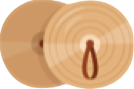

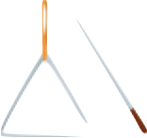

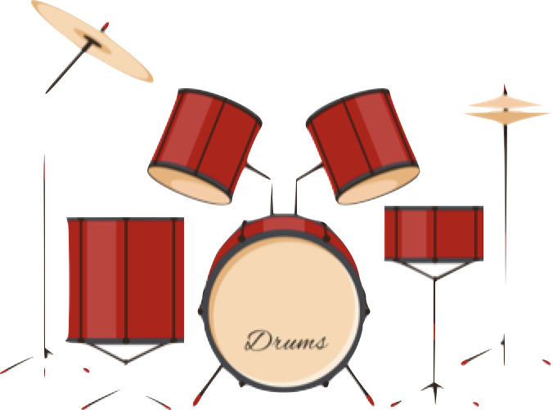
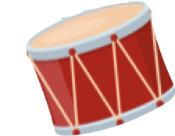
The Sonic Palette
Instrument makers and musicians are often searching for new sounds. In many cases, that has meant creating variations on existing instruments or developing entirely new ones.
This is especially true for percussion instruments!

Slide 8
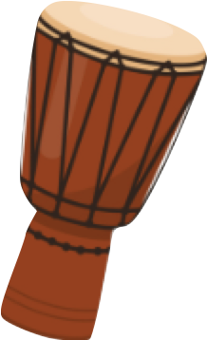
Drums
Drums have been used for centuries using animal skin that was dried and stretched over a drum body.
The amount of stretch changes the pitch of the drum.

Slide 9
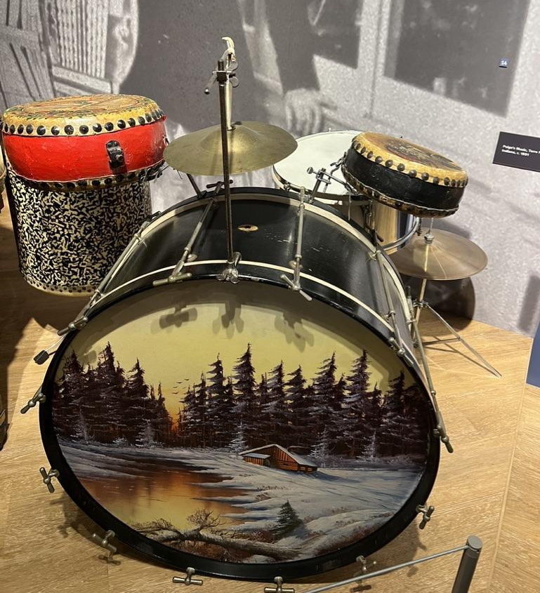
Drums with animal skins
This is an example of an early drum set. Drum heads in the early days used to be made out of animal skins. They were hugely affected by temperature, which could make them sound out of tune or even cause them to crack!
*This bass drum has a lamp inside it which was used to keep the drum head warm.
Notes:
“Early Modern Drum Kit,” early 20th century
28” Bass Drum, 1920s
Snare Drum, 1911
Chinese Tom Tom Drums, 1900s.
10” Cymbal and Stand, 1920s.
Low-Boy Cymbal, 1920s.
Vintage Hardware.
The drum kit as we know it was developed in the early 20th century. The invention of the modern bass drum pedal in 1909 by William Ludwig, combined with the “low-boy” cymbal pedal, allowed drummers to play while sitting and effectively use their feet in addition to their hands. This dramatically expanded the number of instruments they could play at once, leading to the concept of the “contraption set,” or simply “trap set,” and later the drum kit. This kit includes a 28” bass drum with painted calfskin head (an internal lamp to illuminate the head and regulate its temperature), a low-boy cymbal, a hanging cymbal, three “Chinese” tom-tom drums, and a metal snare drum.

Slide 10
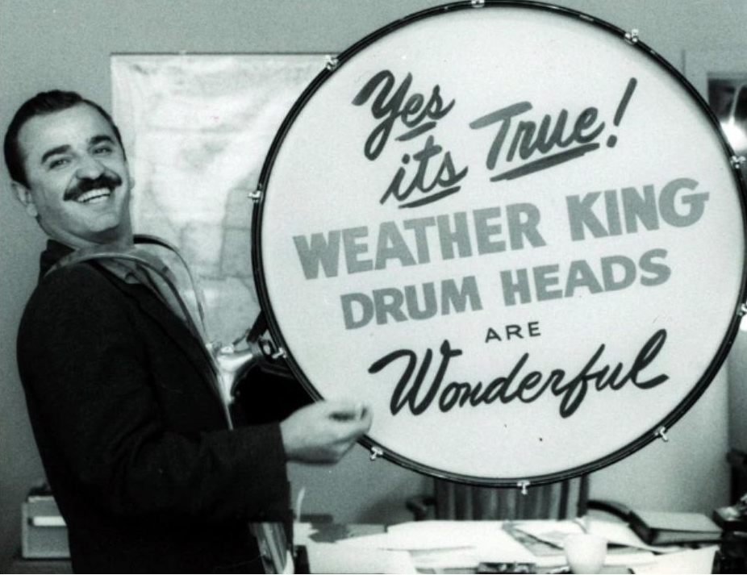
The Synthetic Drumhead
Drum heads today are made with a synthetic drum head.
In the 1950s, drummer Remo Belli experimented with replacing skins with Mylar, a heat-resistant film developed during World War II. These types of drum heads were more reliable, predictable, and durable!

Slide 11
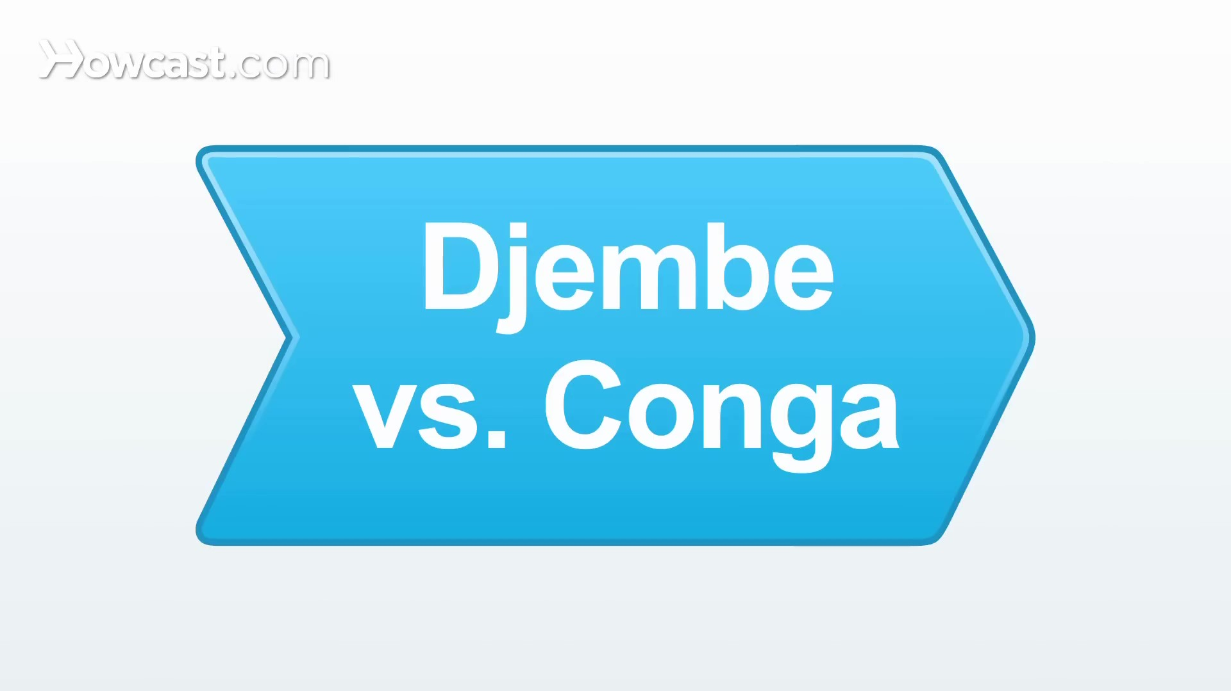
Let’s watch!
Listen for the different sounds these two types of drums can make.

Slide 12


Slide 13
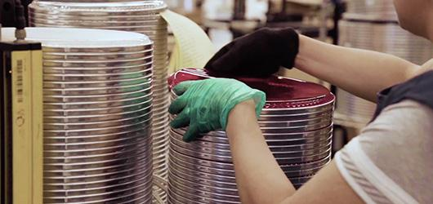
Let's watch how drumheads are made today
in the Evans drum head factory.

Slide 14


Slide 15
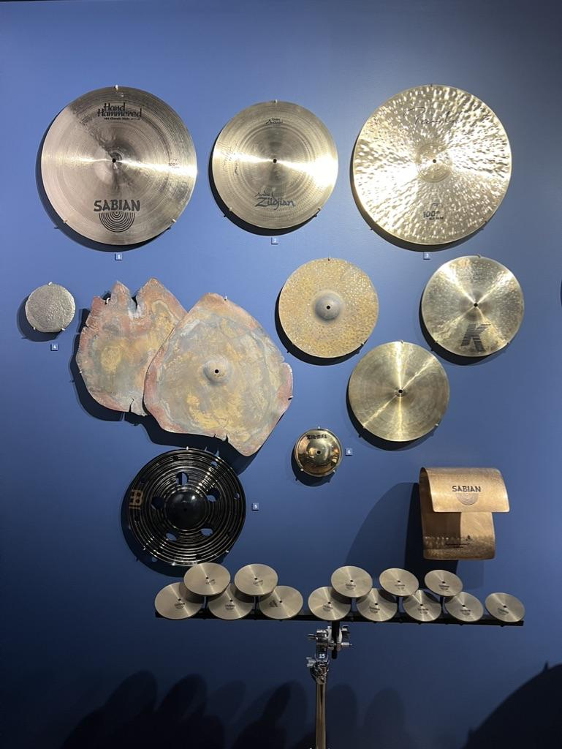
Cymbals
Another instrument percussionists use to make many different sounds is the cymbal.
Cymbals were created almost 10,000 years ago!
Their construction has remained remarkably consistent over the years.
Even with similarities in appearance, the many styles of cymbals can provide musicians with a huge range of sonic possibilities.
Cymbals from the Museum of Making Music

Slide 16
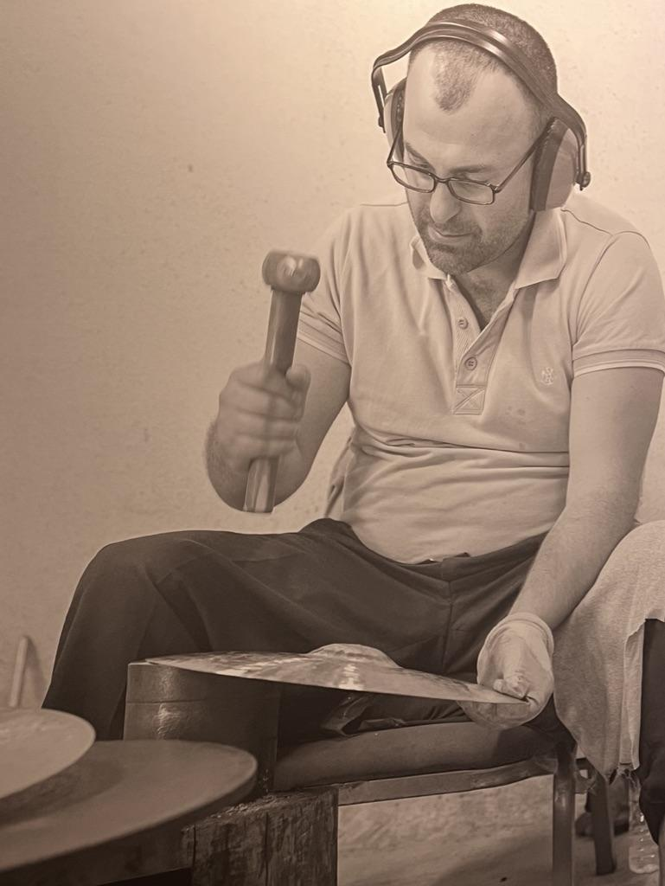
Cymbals are crafted.
Here is a picture of a cymbal
being shaped by hand.
And in the video on the next slide, cymbals being made in a factory!
Notes:
A Bosphorus cymbalsmith hand-hammers a cymbal in Istanbul, Turkey, 2019
Photo by Bradley Secker

Slide 17
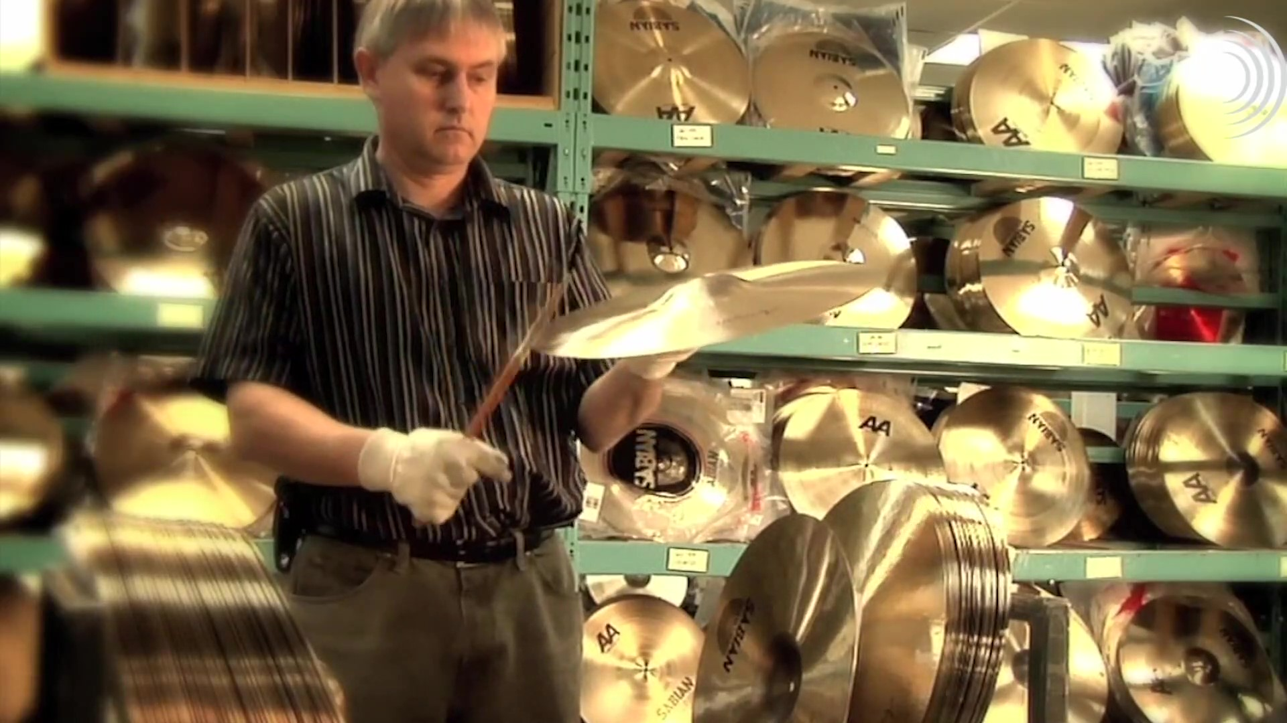
SABIAN Cymbals

Slide 19
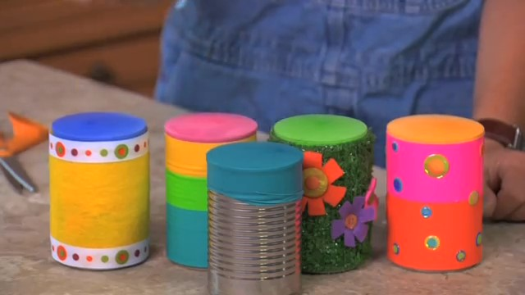
Let's create balloon drums, and
see what different sounds we can make!

Slide 20


Slide 21
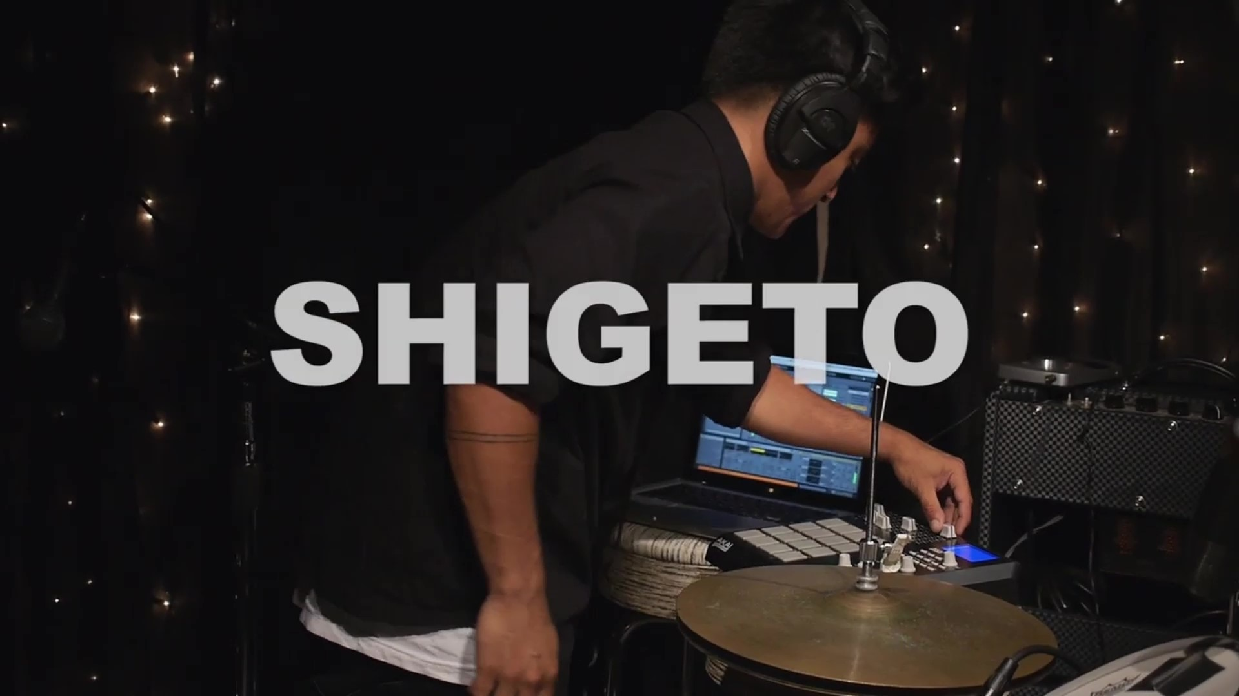
Let's play with our new drums!

Slide 22


Slide 23
Consider a Career in Music!
What careers are related to the lesson we just completed?
Drum manufacturing
Traditional drum performance
Percussionist
Music Therapy
Retailer
Teacher

Slide 24


