Slide 1


Slide 2
Let's explore virtual instruments!

Slide 3
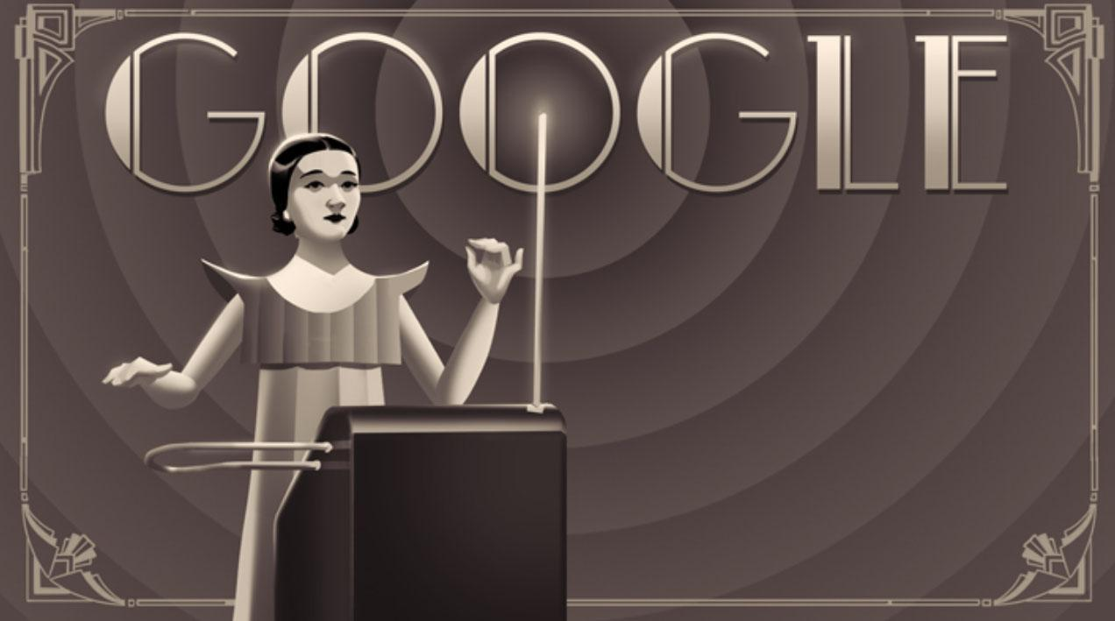
Clara Rockmore Google Doodle

Slide 4
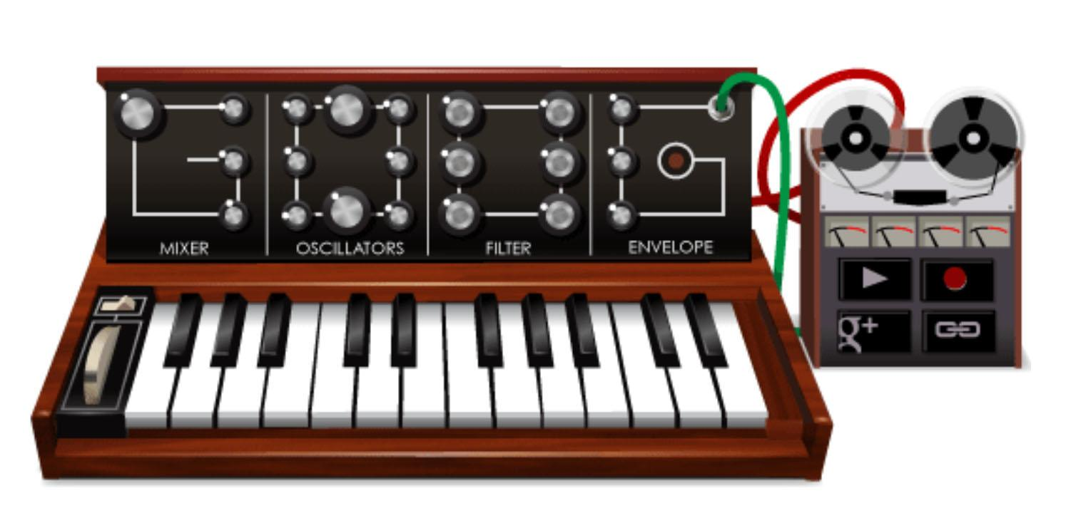
Robert Moog MiniMoog Google Doodle

Slide 5
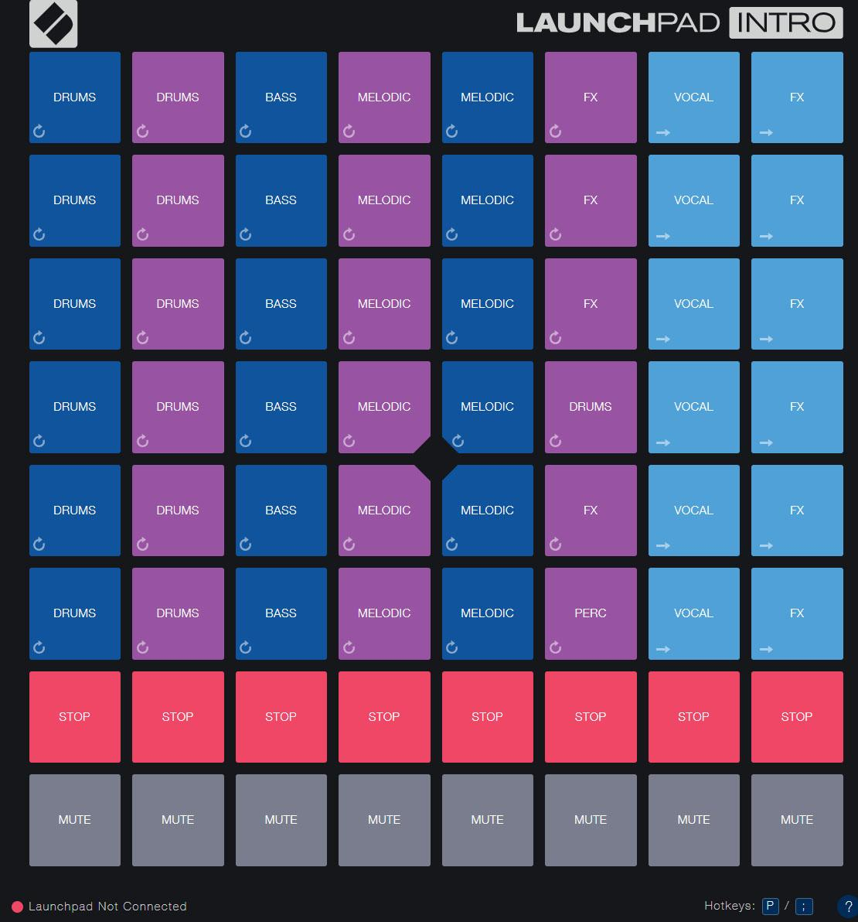
Novation LaunchPad Intro

Slide 6
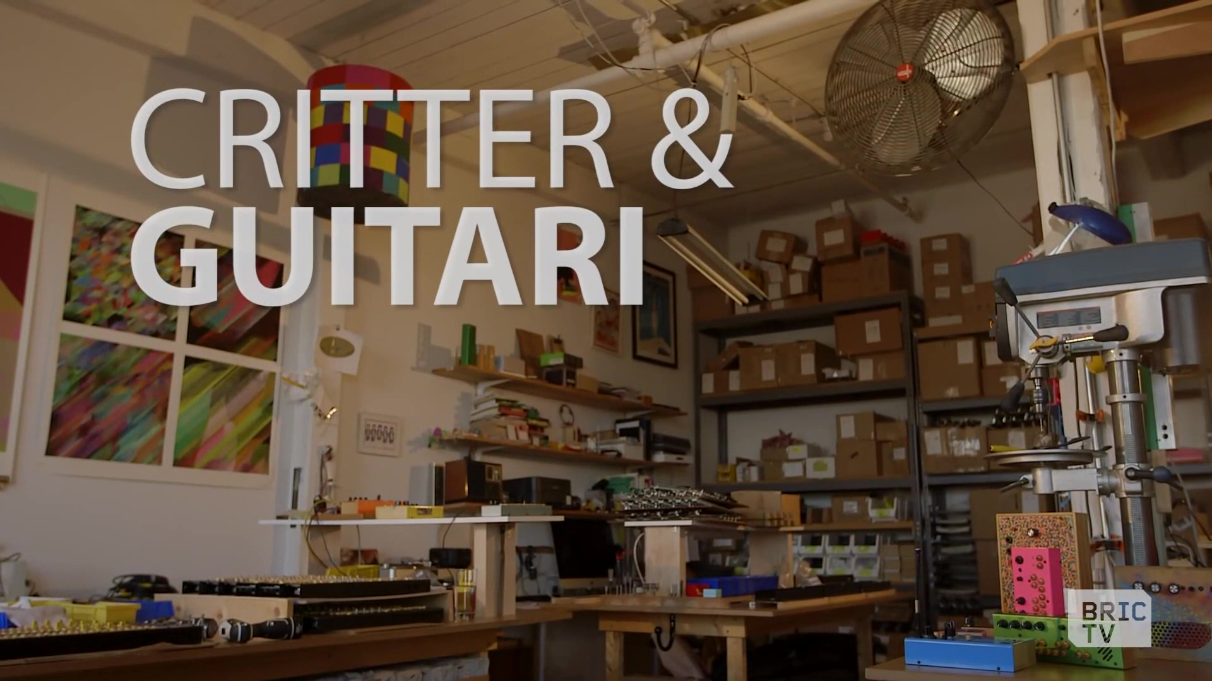
How do you build an instrument?

Slide 8
Let’s reflect
What were the instruments you saw being made in the video made of?
What did they look like?
What kind of instrument would you make?

Slide 9
Consider a Career in Music!
What careers are related to the lesson we just completed?
Electronic music performer
Composer, beatmaker, songwriter
Electronic instrument builder
Music software engineer
Movie sound effects person
Retailer/Music Store Owner

Slide 10


