Slide 1
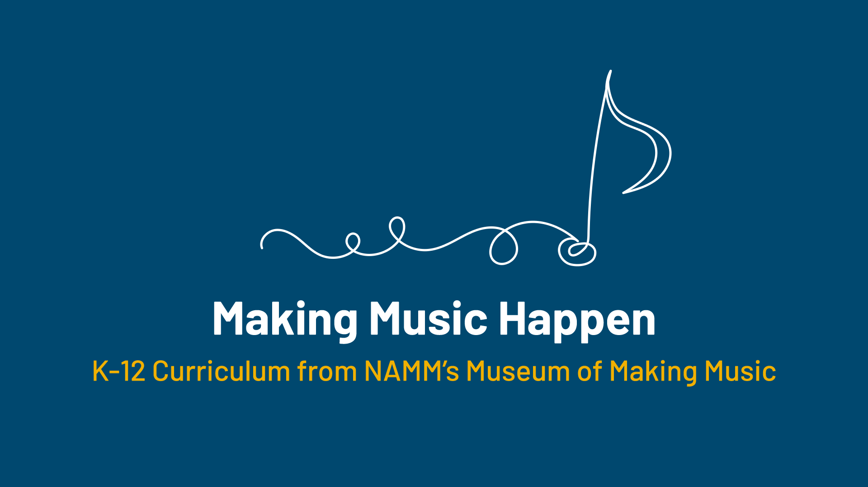

Slide 2
Emerging Technology:
Making Music Electronic

Slide 3
Lesson Objectives
Demonstrate, using various virtual instruments, how these electrical instruments work.
Understand how modern advancements in technology shaped the way instruments are built, played, and performed.
Understand how these instruments might be used in a performance setting.
Improvise and compose various musical ideas on various virtual or live instruments related to this lesson.
Demonstrate an understanding of how to build an instrument using MIDI protocol, a computer, and an invention kit.
Demonstrate what goes into designing and planning out a new instrument design with parameters.

Slide 4
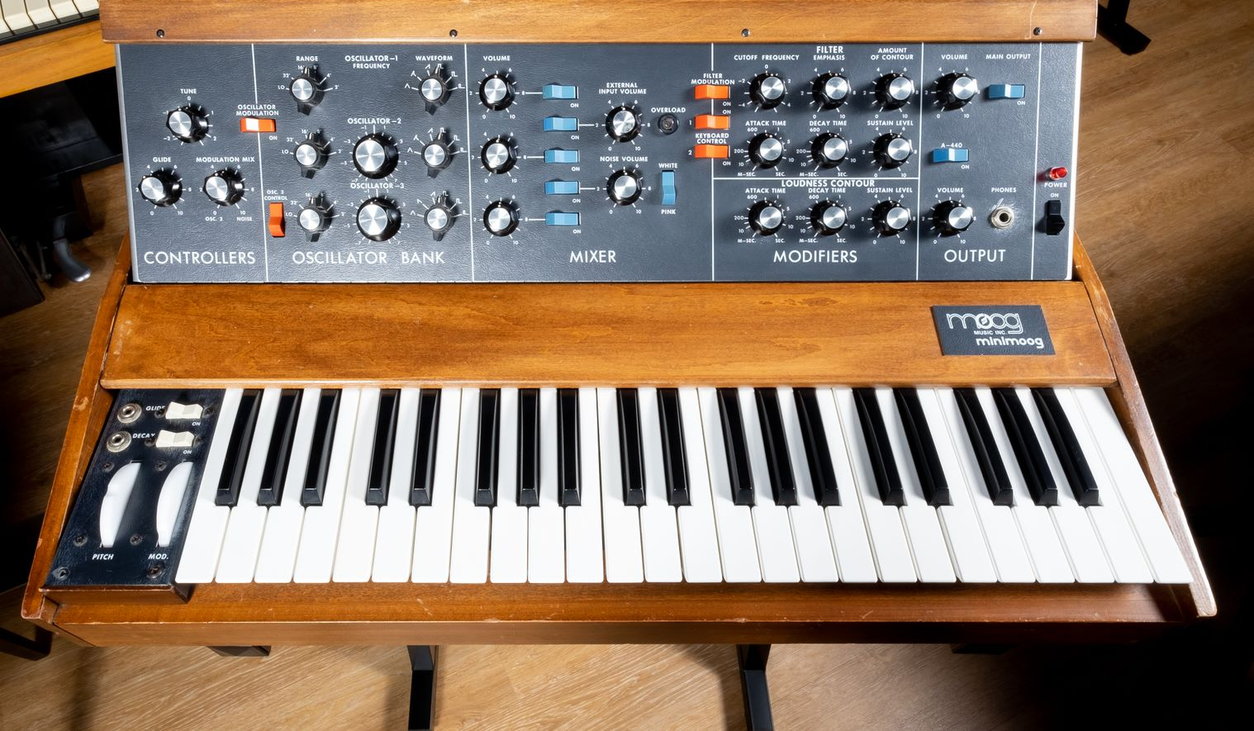
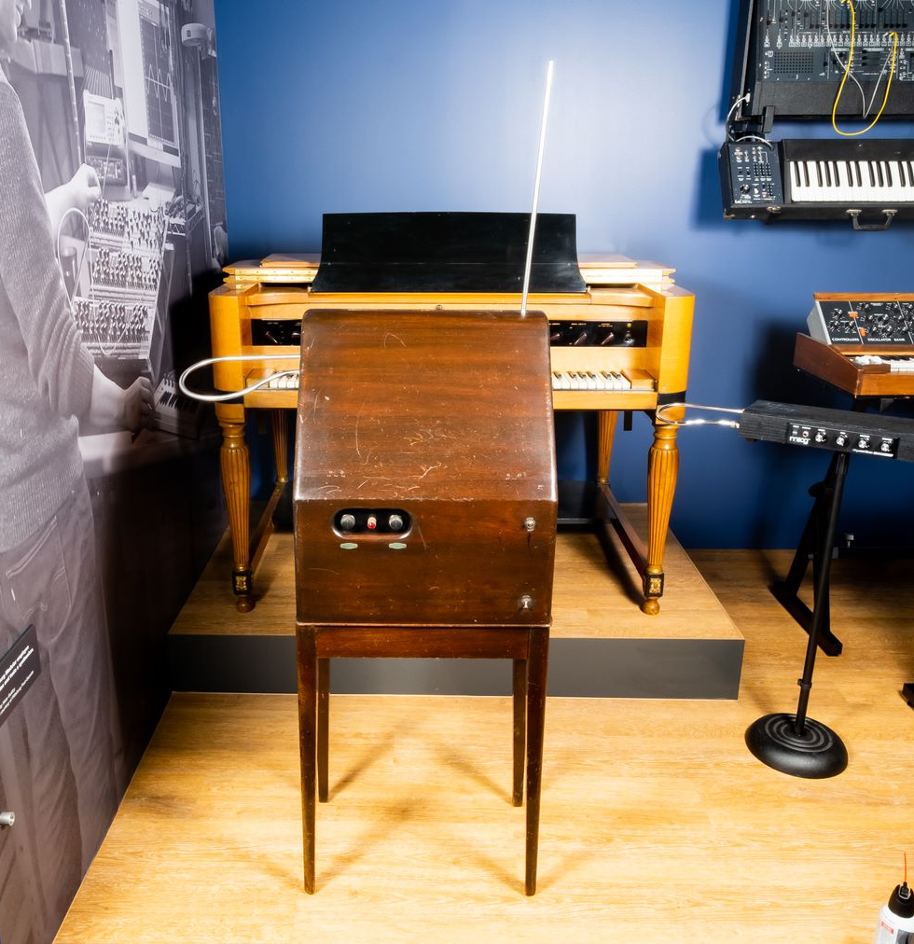
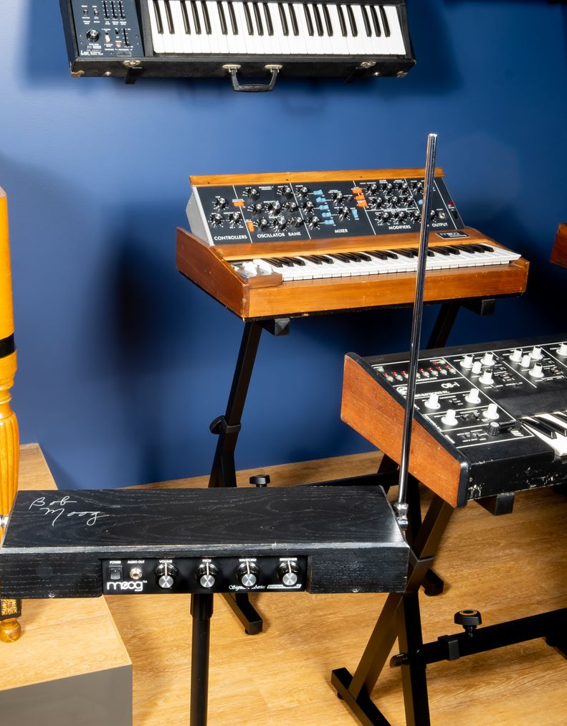
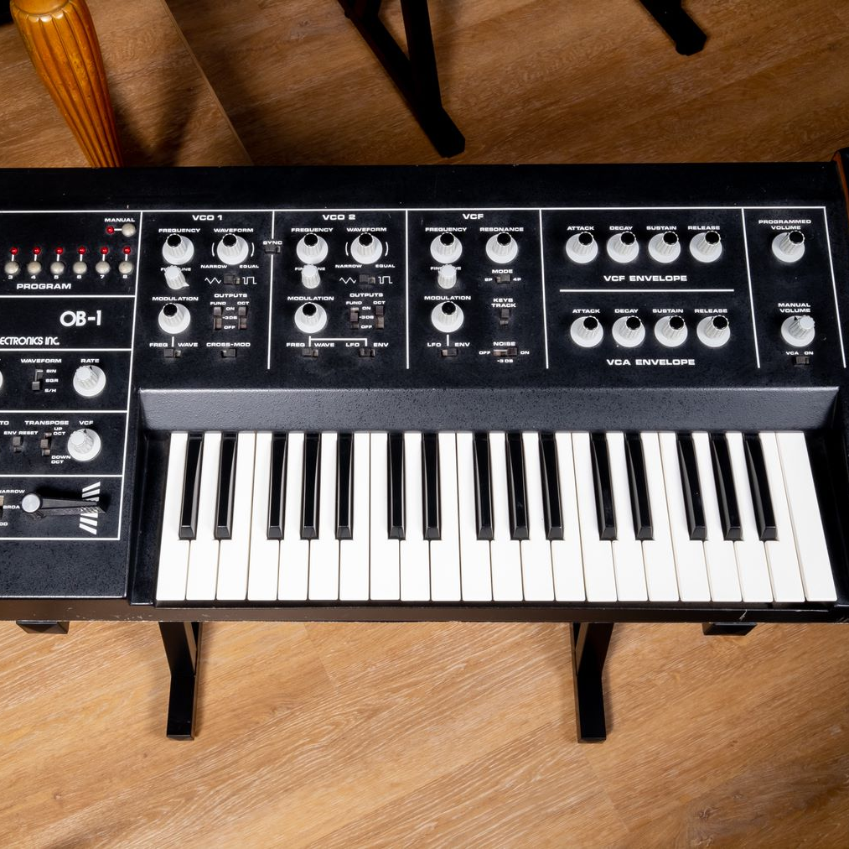
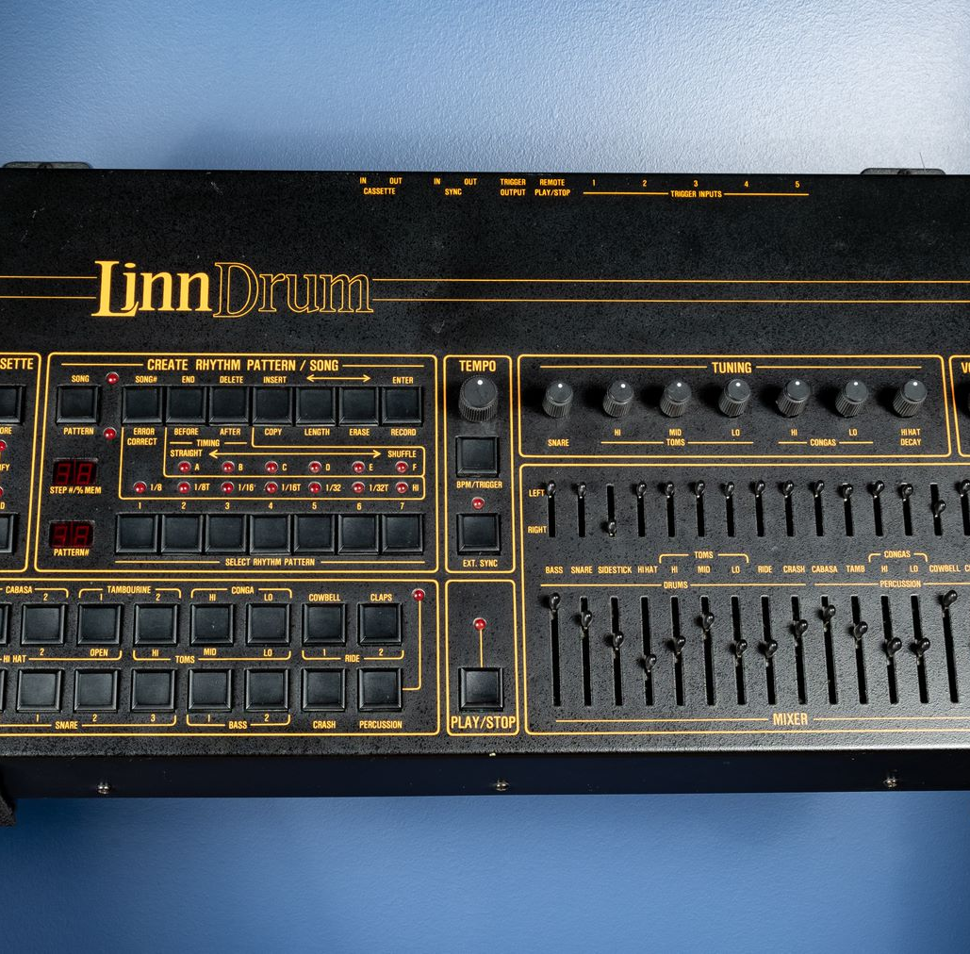
What do you notice?

Slide 5

Watch and Discuss the Theremin

Slide 6


Slide 7
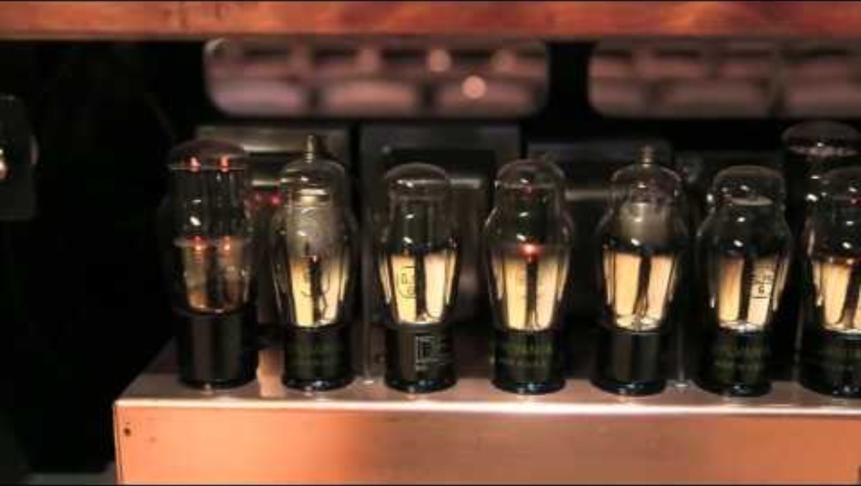
Watch and Discuss the Hammond Novachord

Slide 8


Slide 9

Watch and Discuss the Abelton Push

