Slide 1


Slide 2
Finding Your Match

Slide 3
Lesson Objectives
Define the difference between “student” and “professional”.
Describe the innovations in materials used to create woodwind and/or brass instruments.
List factors that can be manipulated on instruments for customization.
Identify personal preference in instrument selection.

Slide 4
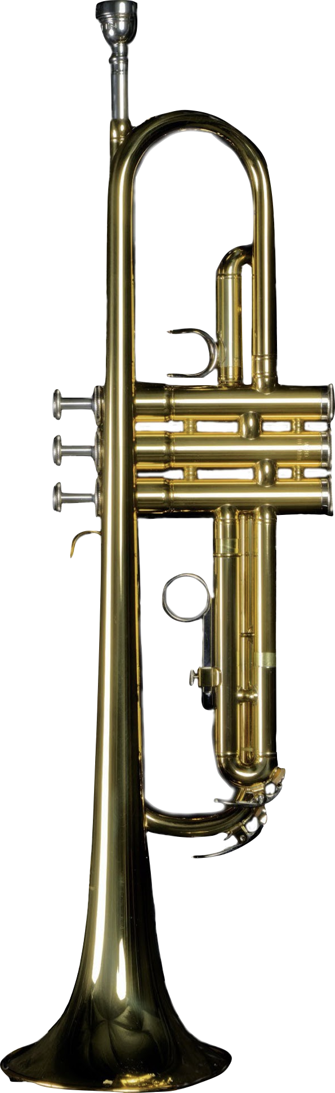
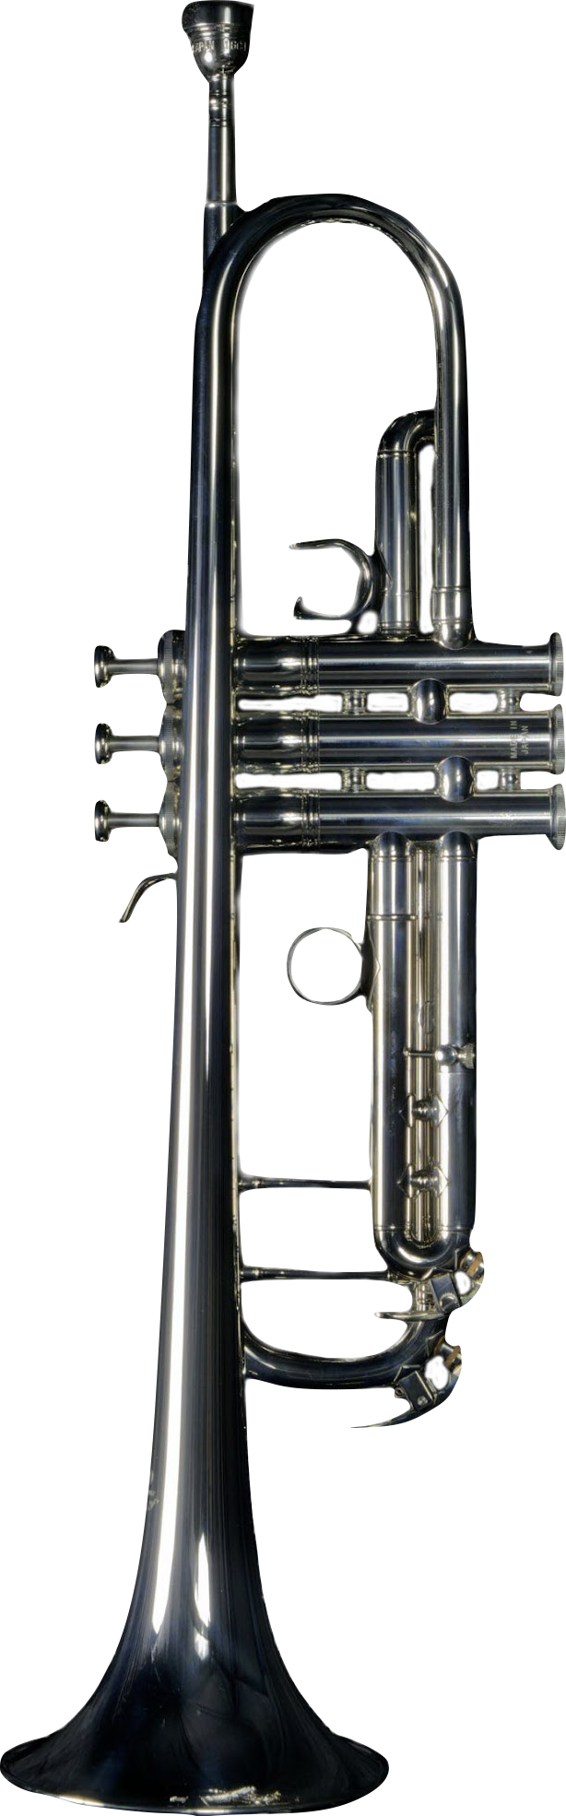
Spot the differences
Notes:
Note that differences may not be readily apparent to the naked eye.

Slide 5
Which instrument do you think is a student instrument and which one do you think is for a professional?

Slide 6
Why would two similar instruments have such different uses?

Slide 7
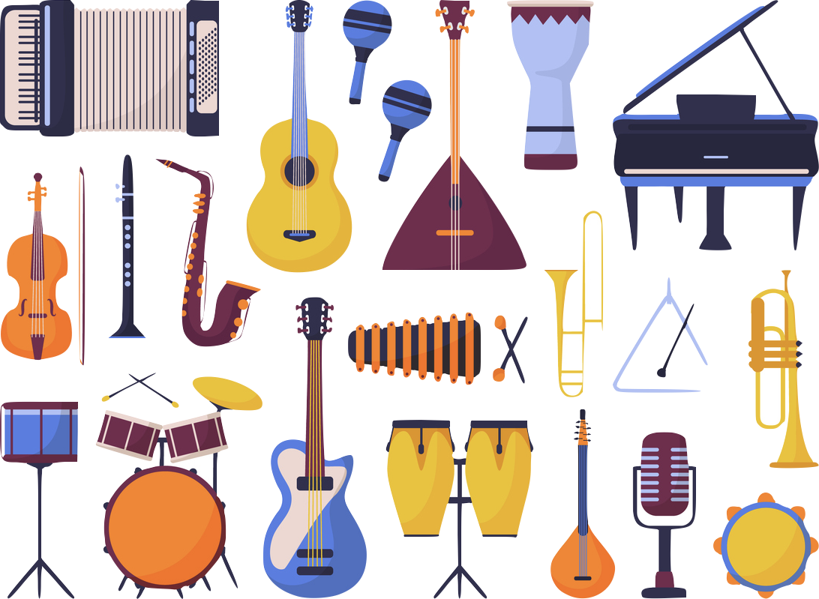
Today we will be learning about different instruments in the woodwind and brass family and how there are variations within individual instruments that make it possible for a variety of people to learn and perform.

Slide 8

There’s an instrument for everyone!
For a variety of reasons, like budget or skill level, the right instrument for one musician might not be the right instrument for another.
To make sure that nearly anyone who wants to make music can make music, manufacturers (instrument builders) design instruments to meet a variety of needs.

Slide 9

Meeting the Musician’s Needs
With more and more people participating in community bands, school bands, garage bands, and more, instrument makers have seen growth in their market, and an explosion in skill levels, physical abilities, and aspirations.
This has led many makers to develop a wide range of instruments and products to address the specific needs and skills of different players.
Some differences between instruments could include variations of different components to create specific combinations of weight, ease of playing, responsiveness, and more.

Slide 10

Using Different Materials
Brass and woodwind instruments have traditionally been made primarily from brass and wood.
However, newly developed and exotic materials, particularly plastics pioneered in the middle of the 20th century, proved to have significant advantages in certain situations.
In 1948, the Selmer Company released the first commercially successful clarinet, the Bundy Resonite, made from molded plastic. The plastic clarinet, while having a different tone quality than a wooden instrument, was more durable, easier to maintain, and could be made more affordably – all benefits for student musicians and those in marching bands who might perform in a variety of climates.

Slide 11
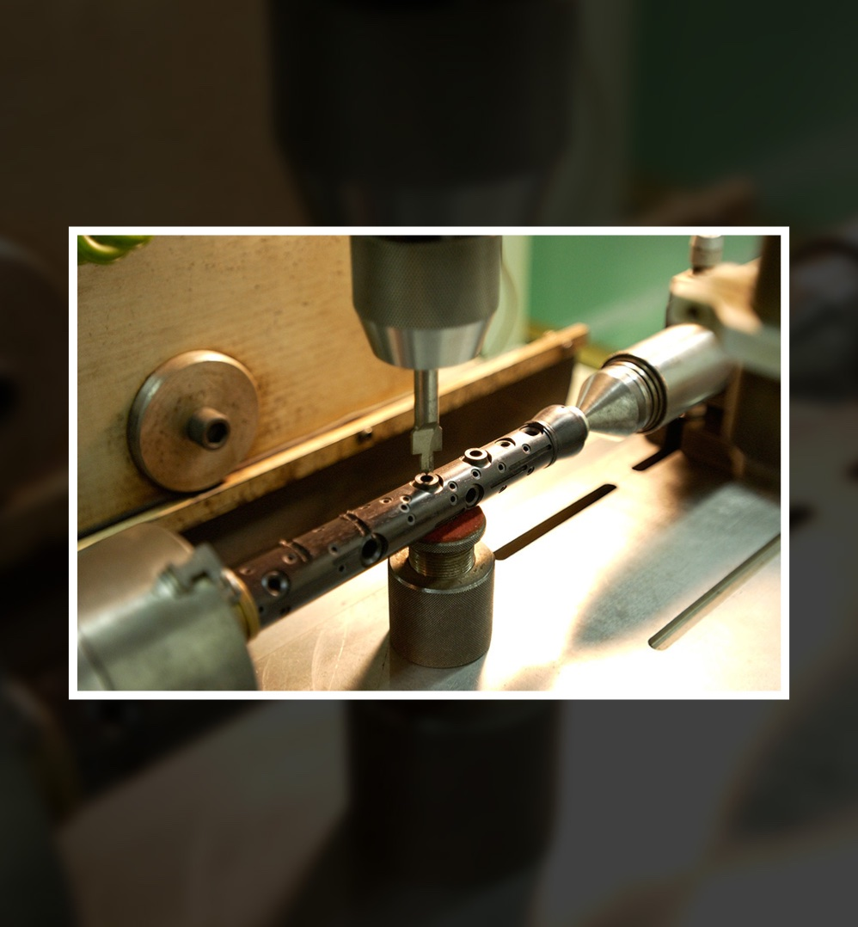
Incorporating New Techniques
The world of manufacturing was revolutionized in the 1950s and 60s with the development of computer numerical control (CNC), a technique for precision automation of tools based on computer input. CNC manufacturing allowed for higher accuracy, faster output, and lower cost.

Slide 12
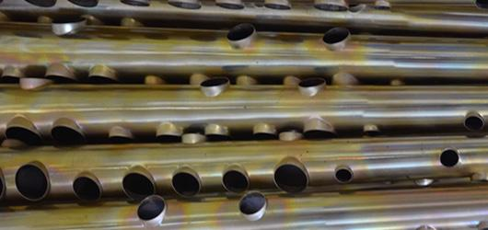
Cannonball Saxophone Factory
Watch all the amazing tools and techniques used to build saxophones!

Slide 13


Slide 14

Let’s watch: Rebirth Brass Band
What instruments do you see? What do you notice about how they look and sound?

Slide 15


Slide 16
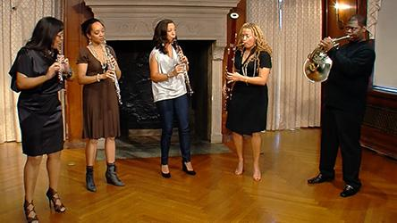
Let’s watch: Imani Winds
What instruments do you see?

Slide 18
Activity: Finding Your Match
You will be forming small groups to analyze a
variety of instruments.
You will have three minutes at each station to answer the questions on your worksheet.

Slide 19
What instrument do you like best?
Why?

Slide 20
Consider a Career in Music!
What careers are related to the lesson we just completed?
Instrument Maker
Performer
Music Teacher
Instrument Repair Tech

Slide 21


