Slide 1
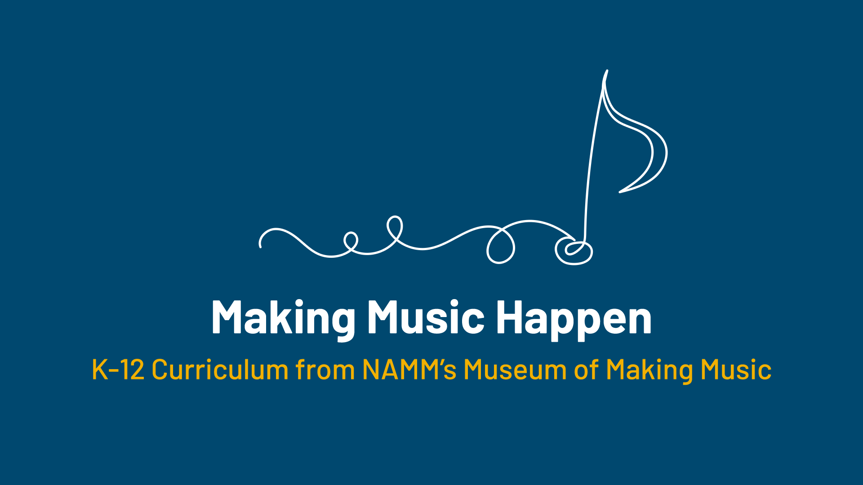

Slide 2
Ukulele Popularity Contest

Slide 3
Lesson Objectives
Describe the ukulele.
Define the word “popular.”
Analyze the physical changes in the ukulele throughout time.
Listen to and evaluate two contrasting ukulele performances.

Slide 4
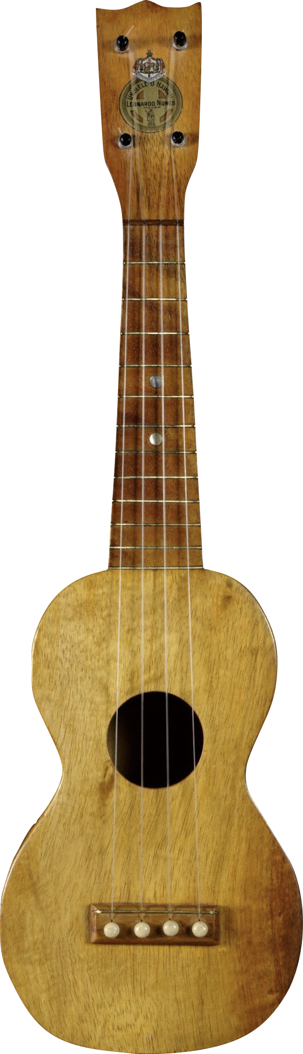
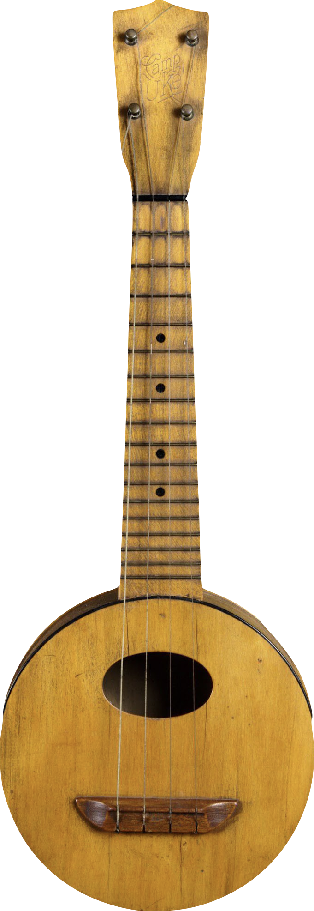
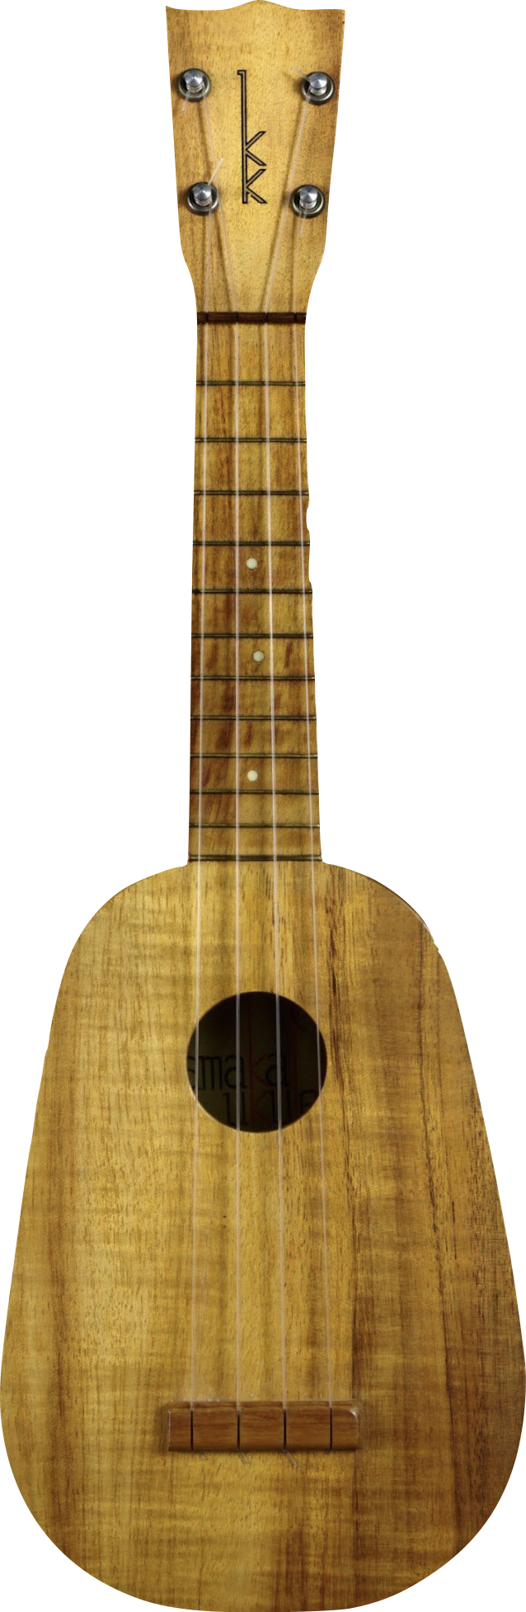
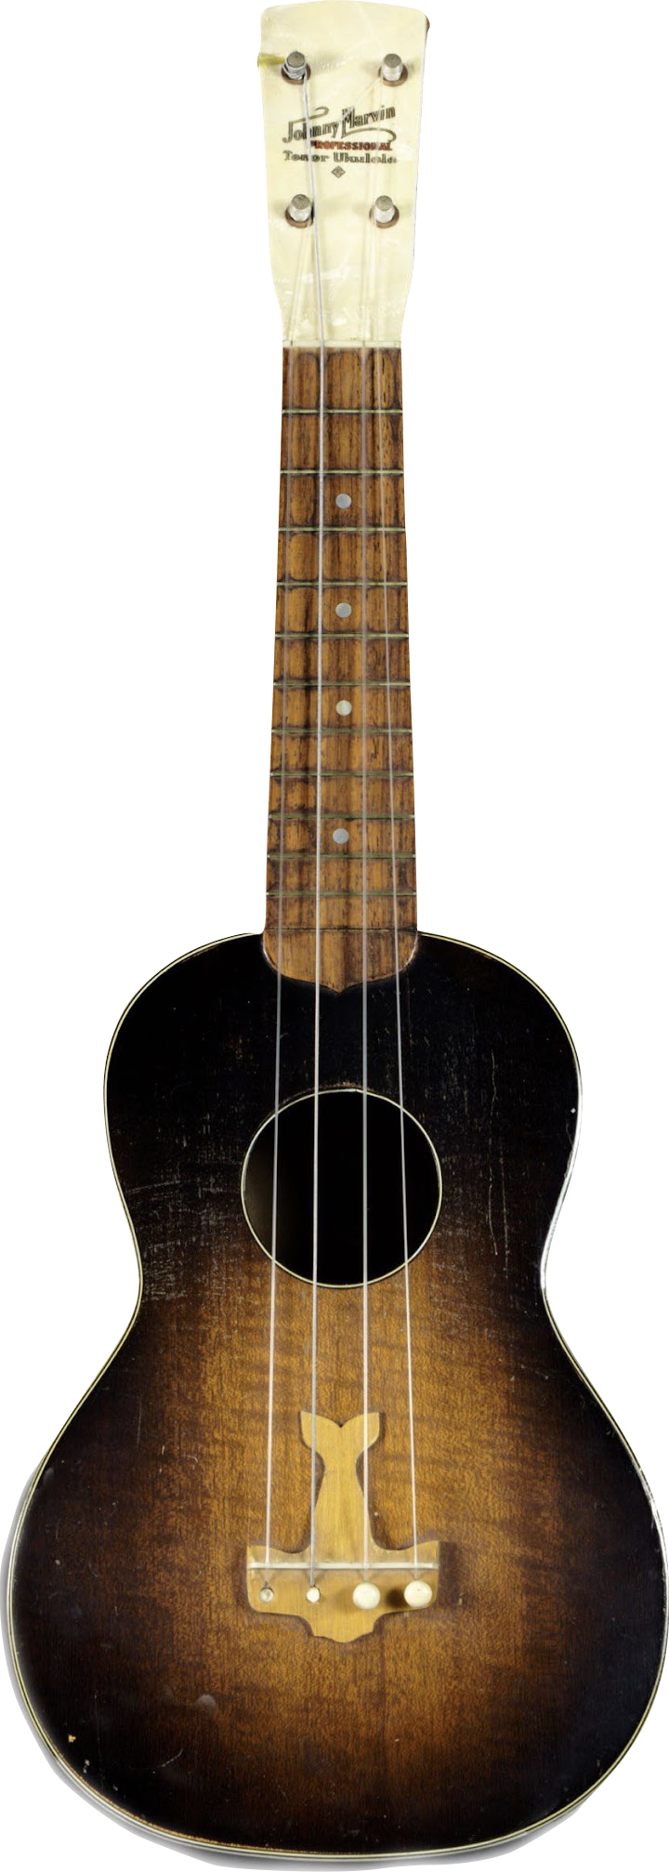
Do you know the name of these instruments?
Notes:
1. Leonardo Nunes Ukulele, 1920
Leonardo Nunes was the son of Manuel Nunes, one of the three Madeiran-borne luthiers often credited with having invented the ukulele around 1890. The younger Nunes moved to Los Angeles in the 1910s to produce ukuleles for the exploding mainland market.
2. Lyon & Healy Camp Uke, c. 1922
Lyon & Healy's Camp Uke (the generic name typically given to round-bodied ukuleles) was marketed for social outings. It features a wooden resonator back that helps to project its sound.
3. Kamaka Hawaii, Inc. Gold Label Pineapple Ukulele, 1960
Samuel Kaialiilii Kamaka opened a ukulele manufacturing shop in Honolulu in 1916 after having apprenticed with Manuel Nunes. In 1928, Kamaka patented his “Pineapple Ukulele” design, featuring an oval body that produced a mellower sound than the standard instrument. Kamaka remains a family-owned and -operated business to this day.
4. Harmony Johnny Marvin Professional Tenor Ukulele, 1920s
Vaudeville performer Johnny Marvin recorded extensively with the ukulele between 1924 and 1944, with 49 records on the Victor label between 1926 and 1930. Marvin’s popularity led to him working with Harmony Musical Instruments Company to create a signature instrument.

Slide 5
Today, we will be learning about ukuleles and what makes instruments "popular."

Slide 6

Parts of a Ukulele
Tuning Pegs
Neck
Strings
Sound Hole
Body

Slide 7
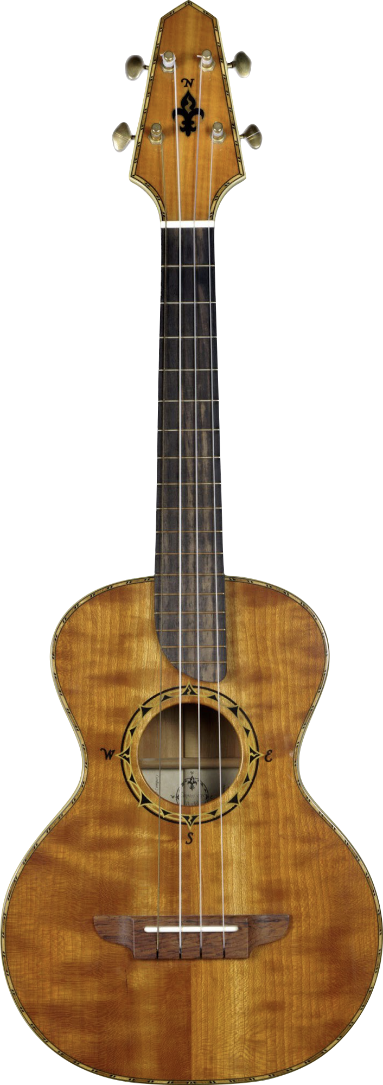
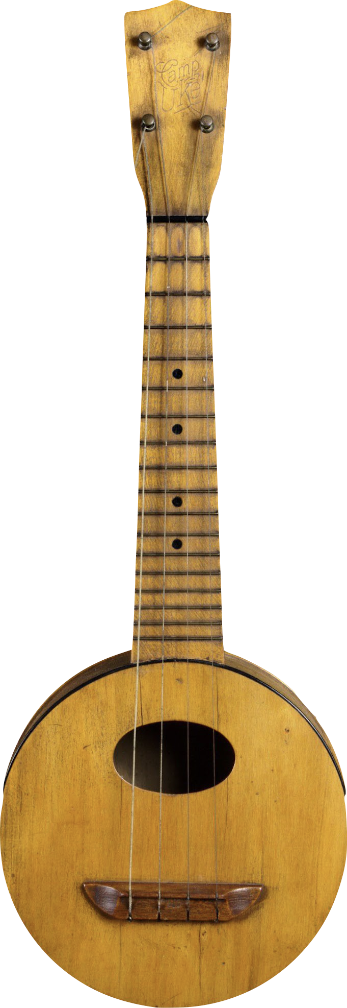
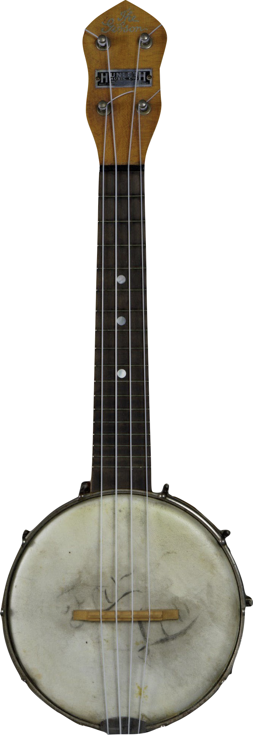
Can you spot all of the differences?
Notes:
1. Renaissance Guitar Company Compass Rose Tenor Ukulele, 2008
Luthier Rick Turner, known for his innovations in electric guitars and basses, introduced his line of Compass Rose tenor ukuleles in 2011. The body shape is a nod to Howe-Orme instruments of the late 1800s and early 1900s.
2. Lyon & Healy Camp Uke, c. 1922
Lyon & Healy's Camp Uke (the generic name typically given to round-bodied ukuleles) was marketed for social outings. It features a wooden resonator back that helps to project its sound.
3. Gibson Mandolin-Guitar Company UB-1 Ukulele Banjo, 1920s
Gibson marketed its “ukulele banjo” to two distinct audiences: one seeking “glorious good times … social popularity … fun a plenty,” and the other looking for “money-making opportunities in vaudeville, radio, and recording.” This reflects the public’s interest in the ukulele both as a component of mass media and as a marker of leisure.

Slide 8
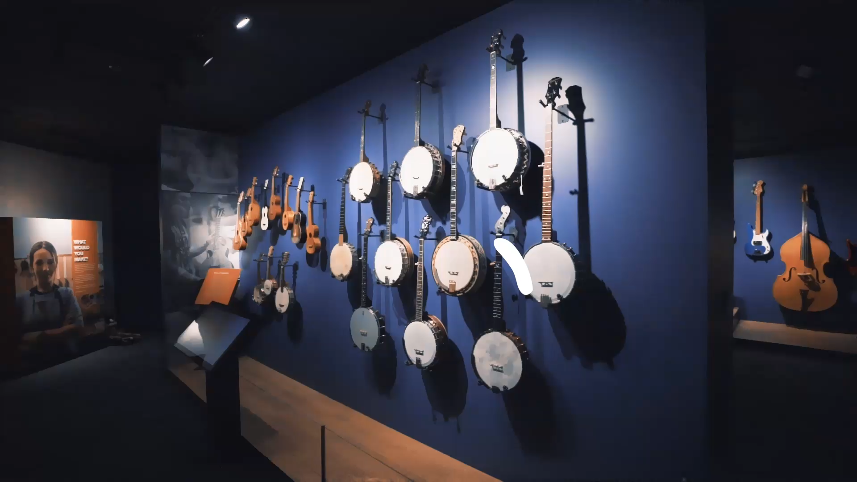
The roller coaster ride of the ukulele

Slide 9
What does it mean to be "popular"?
List all of the instruments that you think are "popular" today.

Slide 10
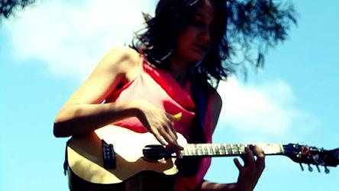
What do you notice about this ukulele?
How does it sound?

Slide 11


Slide 12
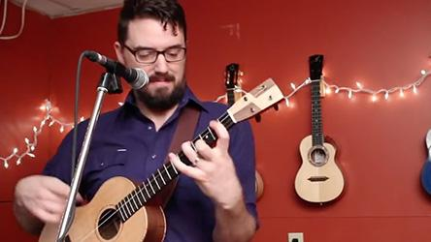
What do you notice about this one?

Slide 14
Create-your-own Ukulele
Use the space on your handout to create your own ukulele!

Slide 15
Consider a Career in Music!
What careers are related to the lesson we just completed?
Musician
Instrument Maker
Videographer
Music store owner/Retailer
Artist
Composer

Slide 16


