Slide 1
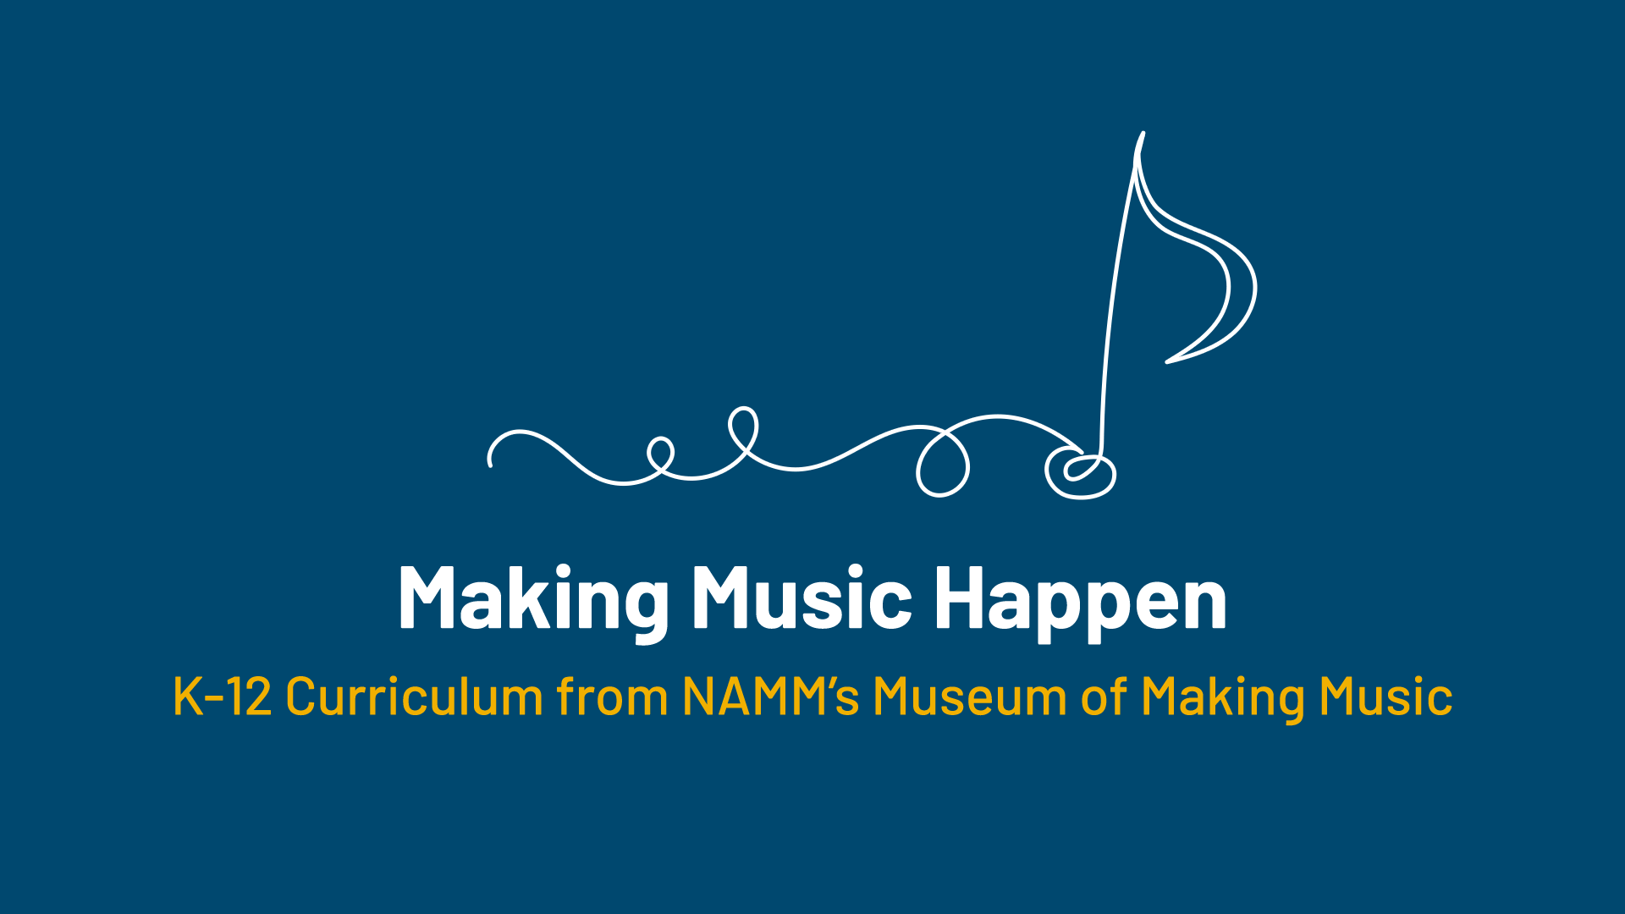

Slide 2
Accordion Adventures!

Slide 3
Lesson Objectives
Identify and define an accordion.
Describe main styles of accordion.
Analyze the connections between design and sound.
Connect technological progress in instrument design with changes in musical styles.
Reflect on personal preference and accordion.

Slide 4
What instrument was playing when you
walked into the classroom?

Slide 5
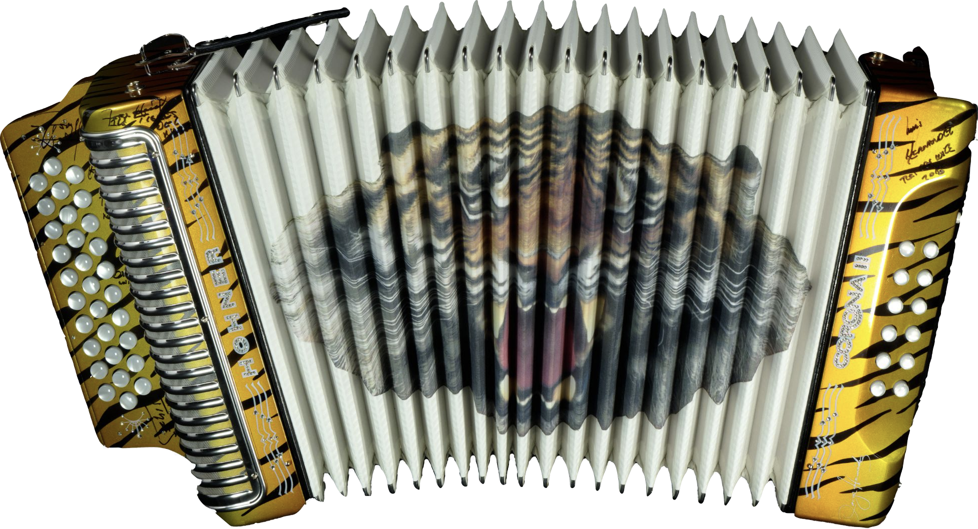
Today we’re going to learn about an
instrument called the accordion.
Notes:
Hohner, Inc. Corona II Button Accordion, 2017 - Gift of KHS America
Hohner’s Corona II has been a staple in Mexican regional music since its introduction in 1955. Its compact size, three rows of buttons, and loud sound make it an extremely flexible instrument. This accordion is signed by the members of Los Tigres del Norte, mainstays of Norteño music for over 50 years.

Slide 6
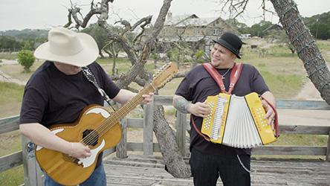
Listen and Analyze: Same or Different?
Write your answers on your worksheet.

Slide 7


Slide 8
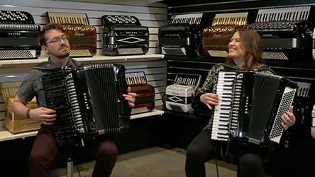
Listen and Analyze: Same or Different?
Write your answers on your worksheet.

Slide 9


Slide 10
Let’s share some of our observations.

Slide 11
We watched two videos with very different styles.
When instruments like accordions were brought to this country by different groups migrating to the US, they exposed Americans to new musical tastes which led to creative enhancements to instruments and music.

Slide 12
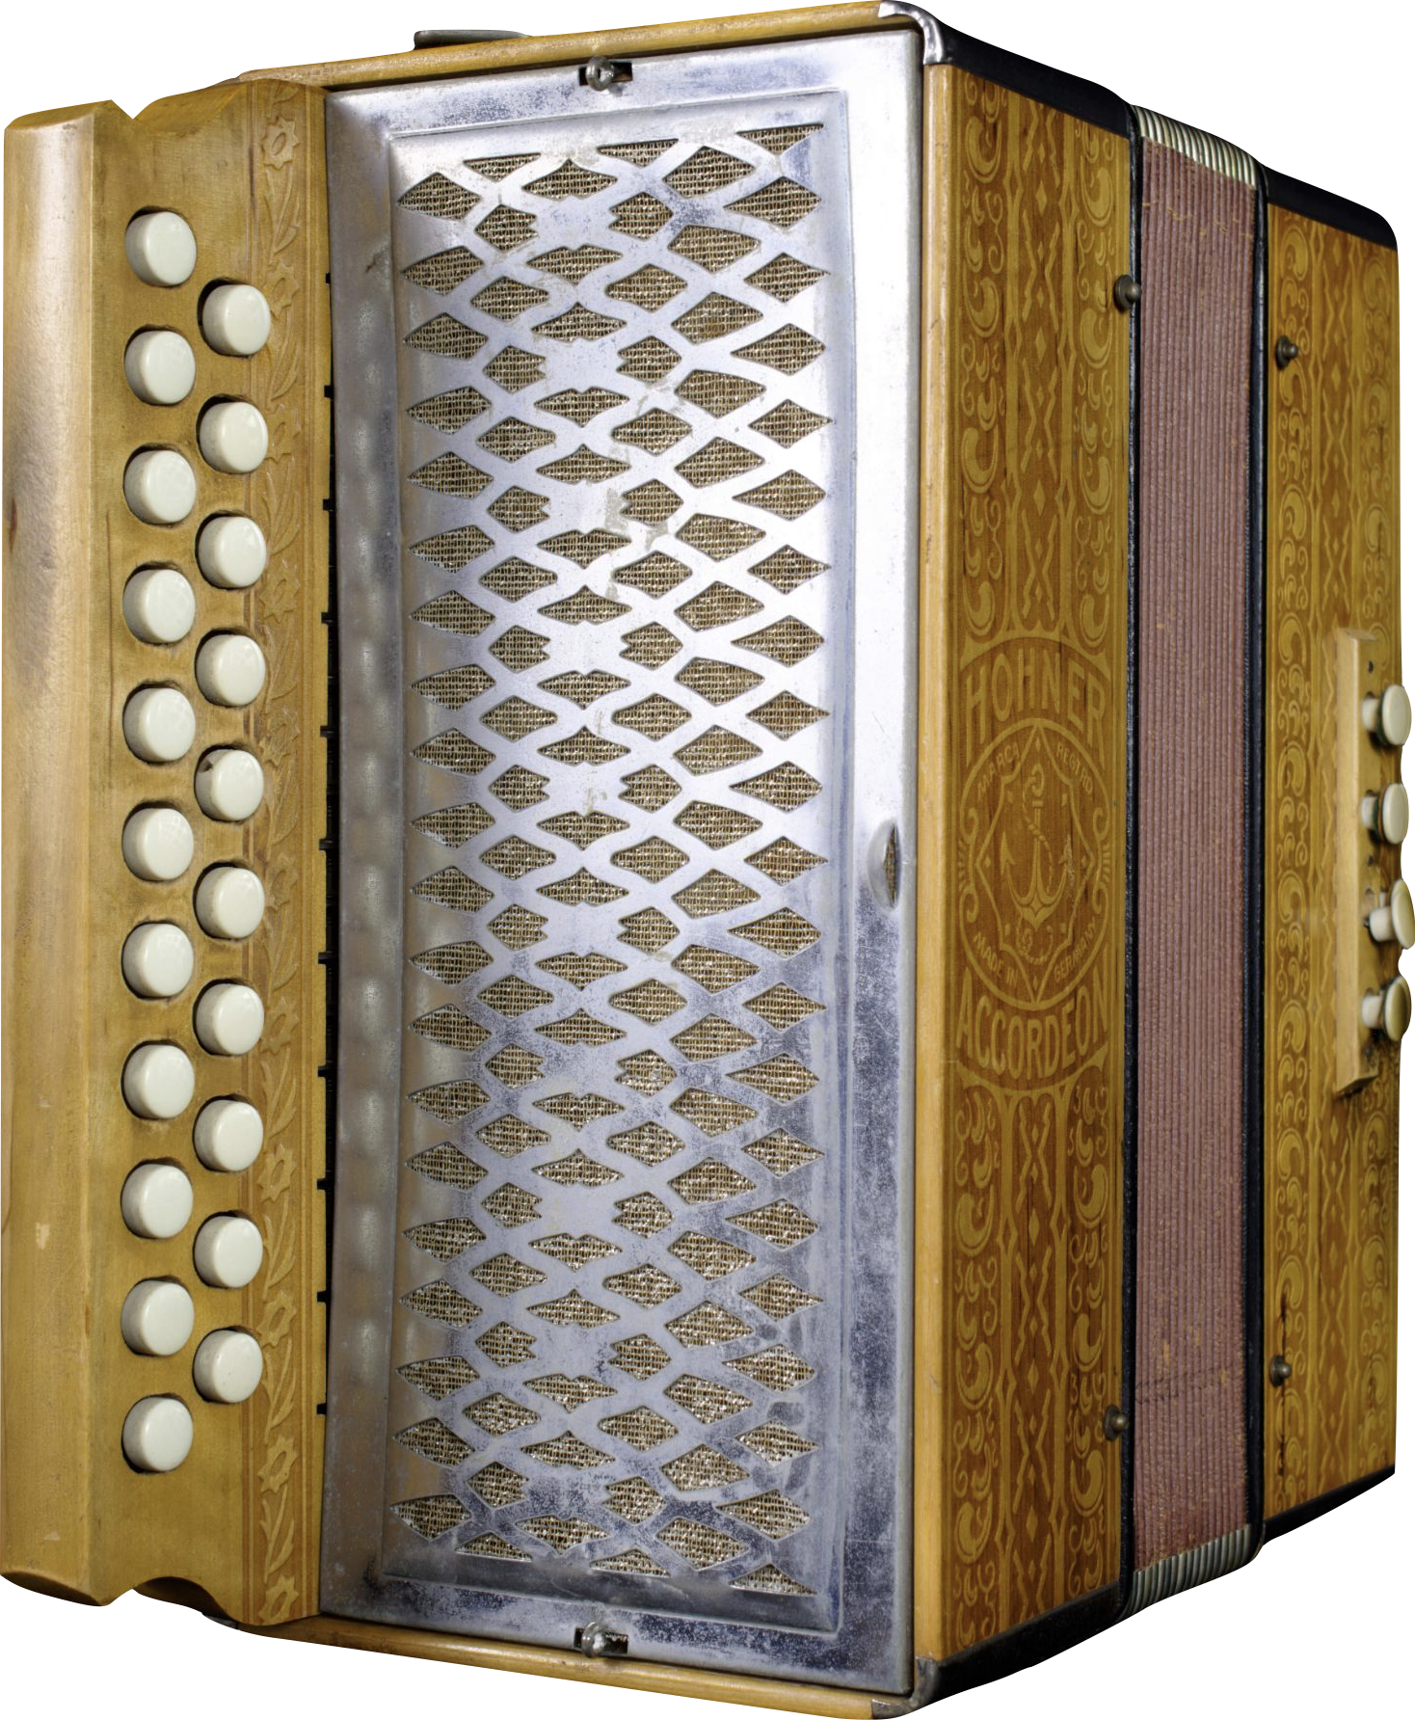
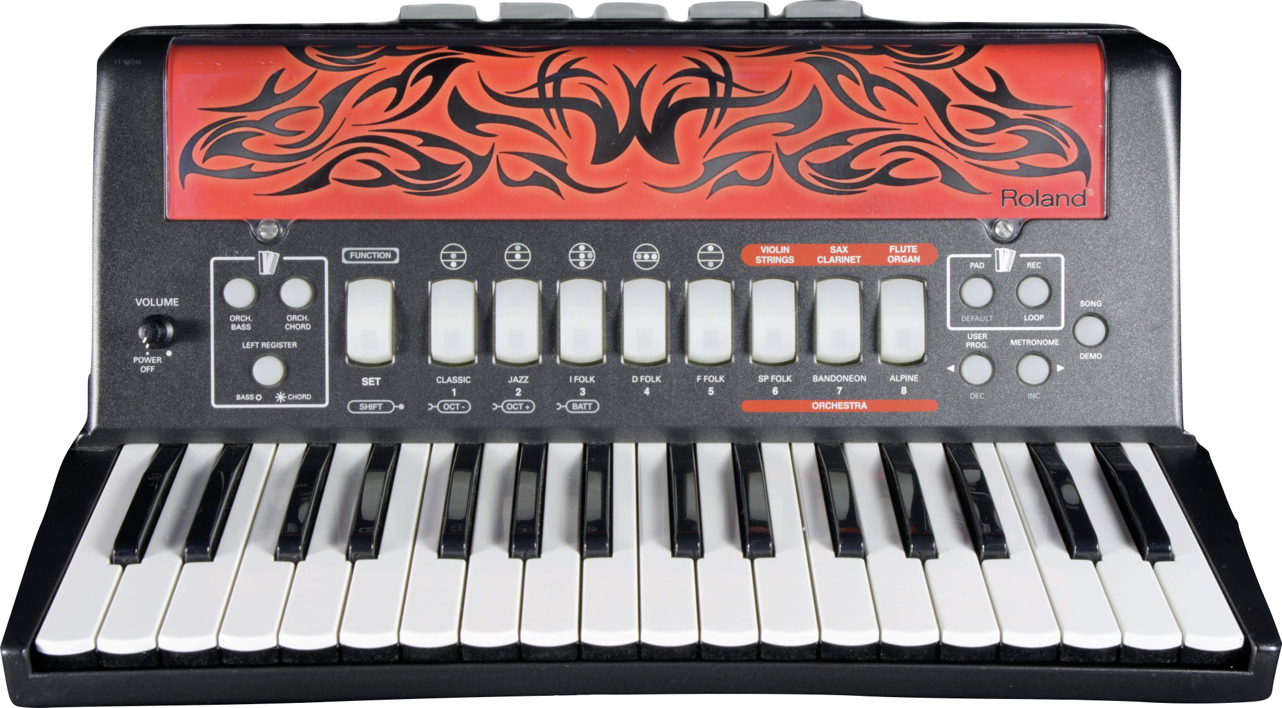
What happened to the accordion
when it came to the United States?
It stayed the same and it changed!
Notes:
Immigrants brought instruments like the accordion to the United States as a means to stay connected to their homeland. The accordion was brought to the USA by European immigrants almost immediately after being invented in Vienna in 1829. By the early 1830s, immigrant musical instrument dealers from Germany were selling accordions in Philadelphia. Over the next few decades, numerous ethnocultural groups brought accordions in various forms to new homes across the country, including in Chicago, Milwaukee, and San Francisco. The instrument became, and would remain, closely tied to these regional centers of immigration.
The button accordion, despite being the predominant form of the instrument worldwide in the early 20th century, was largely unfamiliar to mainstream American audiences. Accordions with piano-style keyboards, which had been developed over the course of the latter 19th century, caught the public’s attention after performances by Guido Deiro at the Alaska-Yukon-Pacific Exposition in Seattle and in San Francisco in 1909. Deiro immediately found stardom on the vaudeville circuit and in turn made the “piano accordion” popular nationwide. Many manufacturers added piano accordions to their catalogs to meet demand, and some even made button accordions disguised as piano models to allow button players to capitalize on the new craze.
Hohner, Inc. Vienna Pokerwork Button Accordion, c.1900
This compact two-row button accordion features 8 bass keys and ornate patterns pressed into the wood case. Hohner continues to make Pokerwork-style accordions to this day under the Vienna model name.
Roland Corporation FR-2 V-Accordion, 2011
In the late 1990s, Roland Corporation founder Ikutaro Kakehashi asked his engineers to build an electric accordion. Their V-Accordion, introduced at the 2005 NAMM Show, combines traditional bellows with advanced sensors and signal processing to create sounds – nearly any sounds imaginable – without reeds.

Slide 13
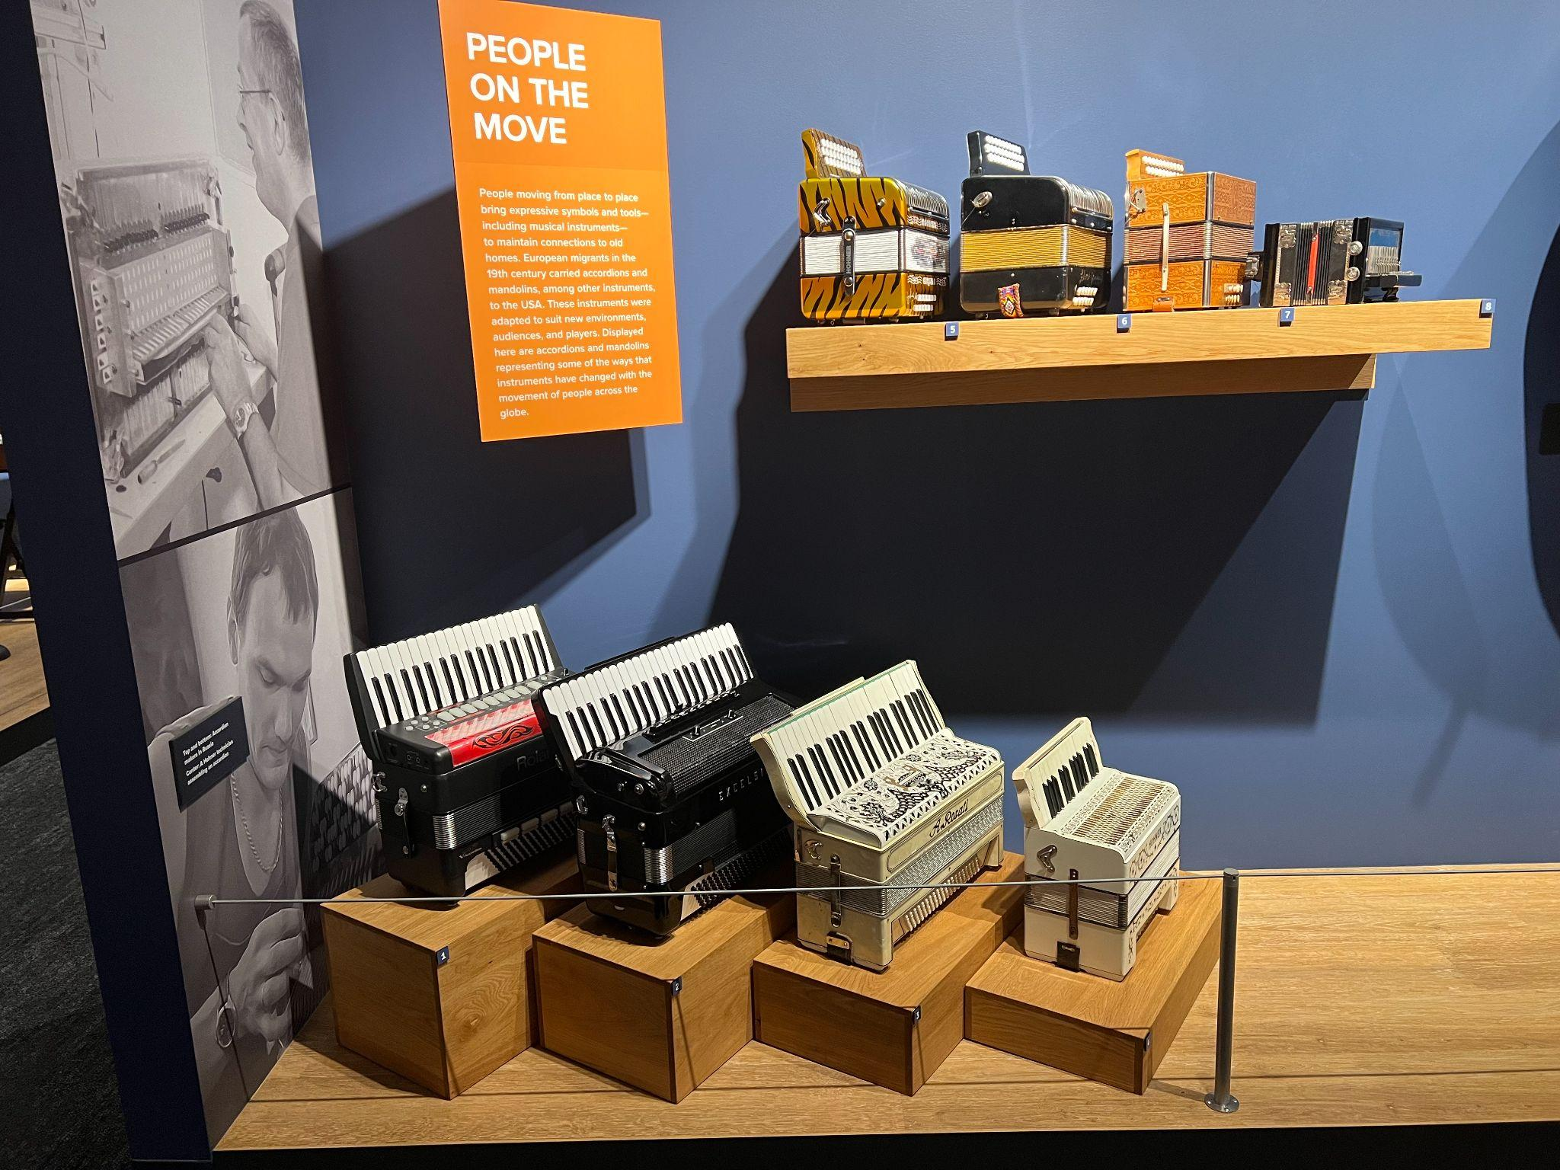
Accordions have changed through the years, but they have also stayed the same.
What does that mean?
The button accordion was the most played form of the instrument worldwide in the early 20th century, but it was unfamiliar to American audiences.
Accordions from the Museum of Making Music

Slide 14
Button Accordion
Button accordions were the first to be brought to the United States. They were largely unfamiliar to mainstream American audiences, but they are central to many musical styles rooted in migrant communities and cultures, including Norteño, Tejano, Waila, Irish, and more.
Notes:
Hohner, Inc. Vienna Pokerwork Button Accordion, c.1900
This compact two-row button accordion features 8 bass keys and ornate patterns pressed into the wood case. Hohner continues to make Pokerwork-style accordions to this day under the Vienna model name.

Slide 15
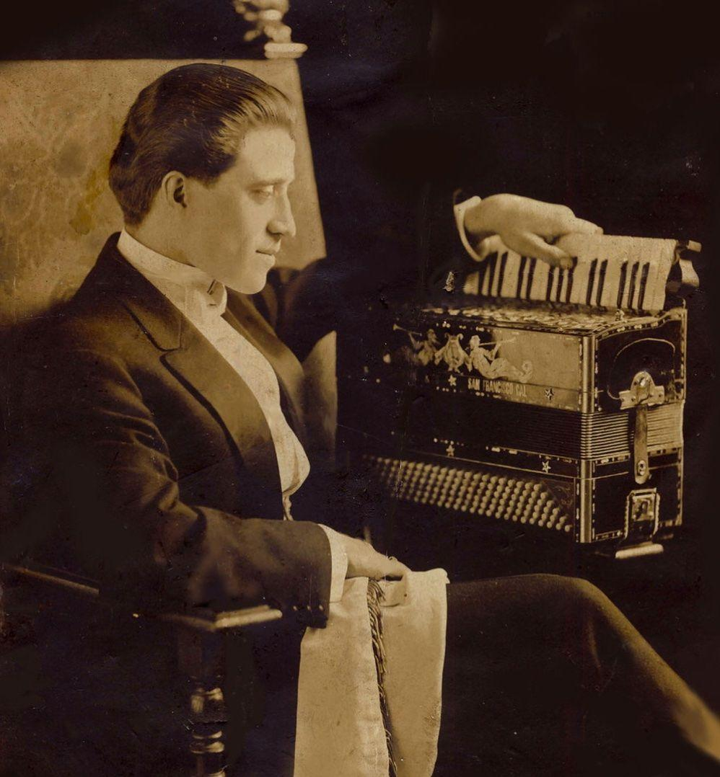
Piano Accordion
It wasn’t until a performer named
Guido Deiro played concerts on the west coast on a piano accordion, that the accordion caught the American public’s attention.
Because of his stardom, many instrument manufacturers decided to start making piano accordions. Some even made button accordions disguised as piano models to allow button players to capitalize on the new craze.
Notes:
Count Guido Deiro, c.1909

Slide 16
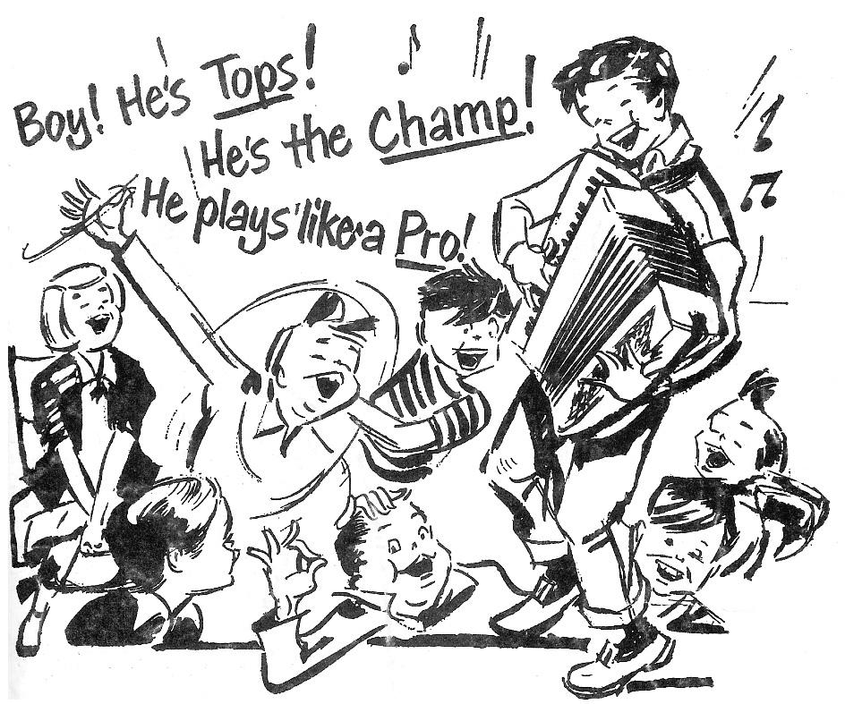
Piano Accordion
The piano accordion was much more familiar to American audiences, and by 1950, the accordion had become the most popular instrument in the USA! Many, many school-aged children of the time learned to play the accordion.

Slide 17
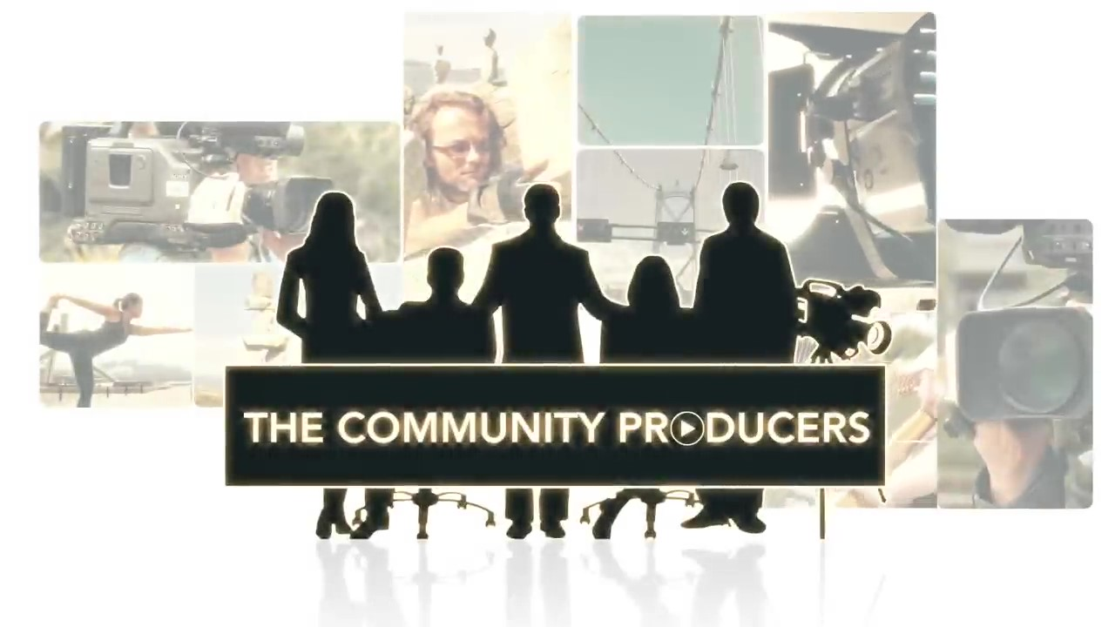
How do
accordions work?
Watch the first minute of this video to find out!
Notes:
The bellows act like a bow, controlling the sound, dynamics, and touch. The buttons or keys, on the other hand, control the pitch. When the bellows are moved, air flows over reeds, which are strips of brass or steel, and they vibrate to produce sound. Valves on opposing reeds of each note prevent air from leaking out while also making the reeds louder.

Slide 19
Let’s watch again!
How does the size and construction of the accordion affect the way the performer plays?

Slide 21
Let’s watch again!
How does the size and construction of the accordion affect the way the performer plays?

Slide 23
Create-your-own Accordion Craft
Accordions have bellows which push air through the reeds inside to make the sound. If the air isn’t flowing, no sound can be made.
We’re going to make simple paper accordions to get an idea how this works.
Notes:
Cut a piece of construction paper into long, even strips. Then, fold the strip back and forth at even intervals. S can practice opening and closing the strip.

Slide 24
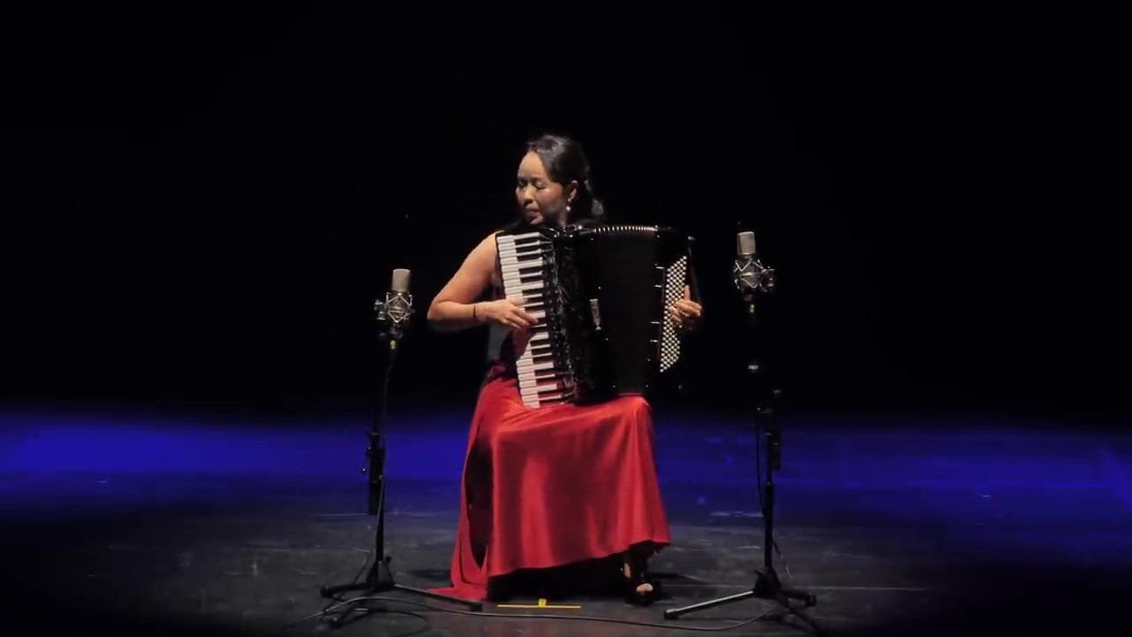
Play along!

Slide 26
Consider a Career in Music!
What careers are related to the lesson we just completed?
Accordion player
Instrument maker
Instrument manufacturer

Slide 27


