Slide 1


Slide 2
Guitars: Can You Hear Me Now?

Slide 3
Lesson Objectives
Define the word “luthier.”
Identify six different parts of the guitar.
Synthesize information on guitar engineering to make predictions about sound.
Collaborate to identify types of guitars and their characteristics: size, materials, and construction techniques.

Slide 4

Draw a guitar from memory!

Slide 5
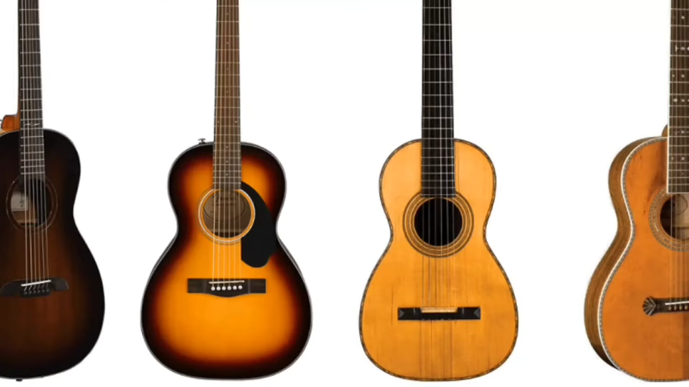
All About the Guitar!
The guitar is a very old instrument, dating back thousands of years.
It has developed over the centuries and the modern guitar now typically has 6 strings and is played all over the world.
Notes:
Play video up to 2:15

Slide 6
What is a “luthier?”
A luthier is a person who builds or repairs stringed instruments, such as violins, ukuleles, and guitars.

Slide 7
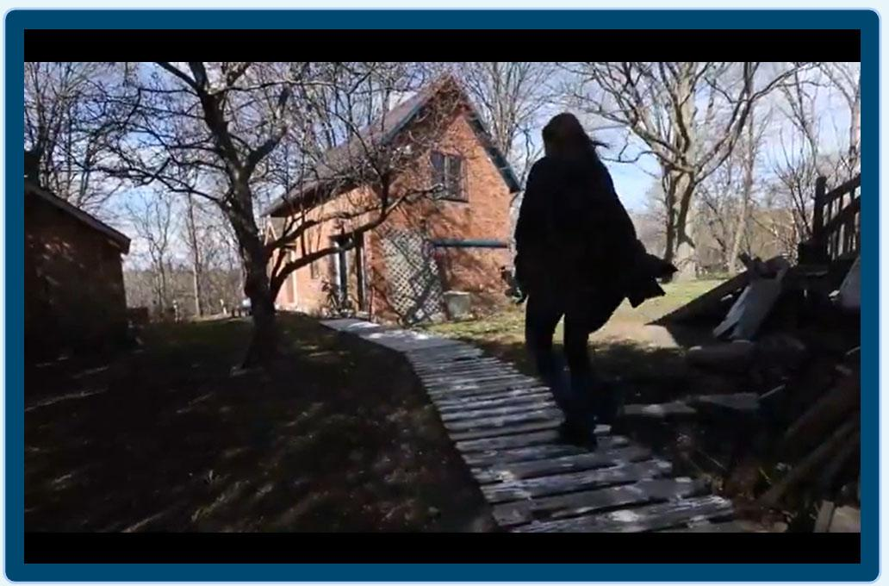
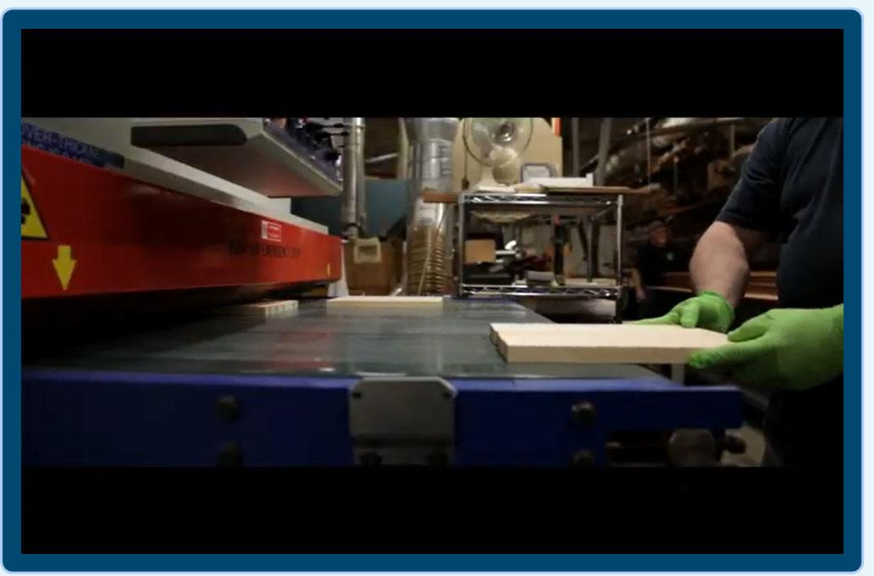
How is a guitar made?
In small shops and in factories…
Luthier Linda Manzer
Martin Guitar Factory
Notes:
Martin video is best at 2x speed
Linda Manzer video without volume and at 2x speed!

Slide 8
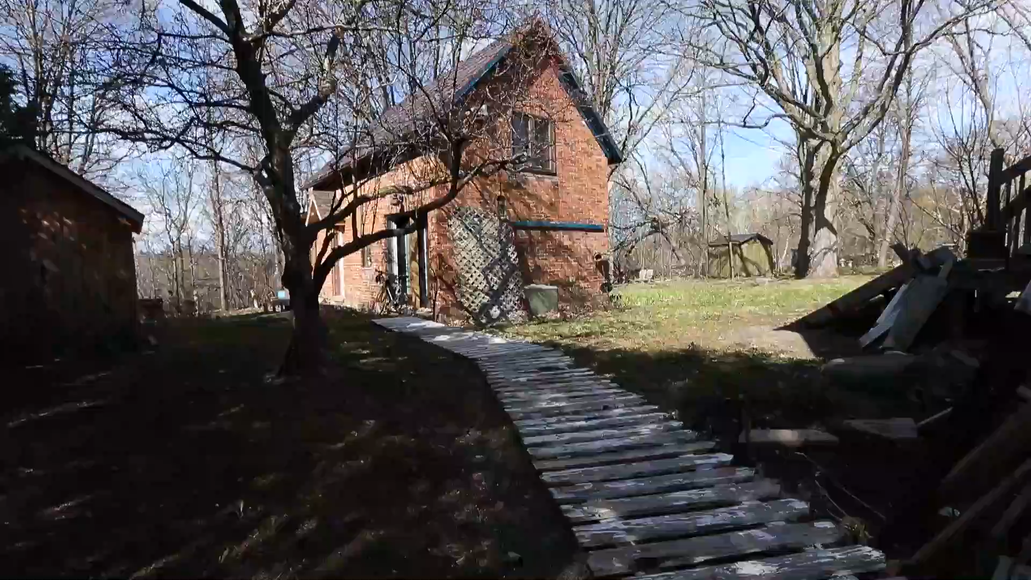

Slide 9
How is a guitar made?
In small shops and in factories…
Luthier Linda Manzer
Martin Guitar Factory
Notes:
Martin video is best at 2x speed
Linda Manzer video without volume and at 2x speed!

Slide 10


Slide 11
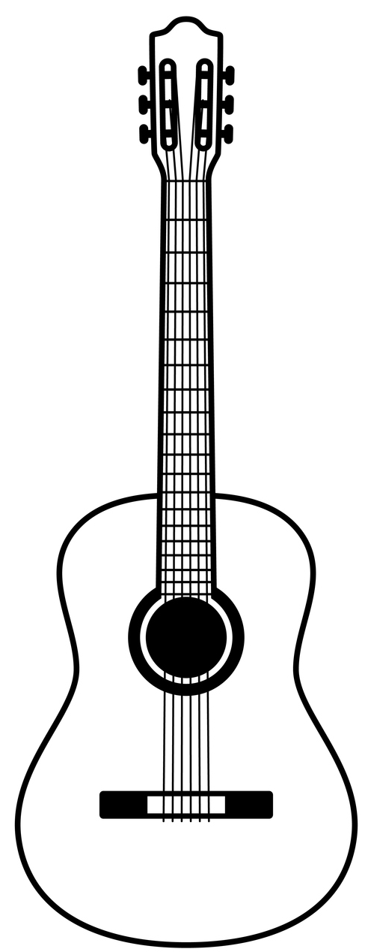
What are the parts
of the guitar?
Head
Tuning Pegs
Frets
Neck
Body
Sound Hole
Bridge
Notes:
How does each part affect the sound?
Head: Holds the tuning pegs. Maintains the tension and tuning of the strings
Tuning Pegs: Adjust the tension of the strings to achieve the desired pitch.
Frets: Make it easier for a player to be in tune and determine the positions for the correct notes and chords.
Neck: Is the foundation for the fretboard
Body: The size of the body affects the sound. A smaller body has a more focused sound vs. a larger body that has deeper sound.
Soundhole: Helps the guitar project sound
Bridge: Anchors the strings
Strings: Make the sound when plucked or strummed!

Slide 12
Luthiers and Musicians! What a team!
Musicians and luthiers need each other. Luthiers want to help musicians have their ideal instrument. And musicians need luthiers to build them!
Because of the needs of musicians, there are many different kinds of guitars made out of many different materials.
One important need is to be heard! As audiences and music groups get bigger, concert halls also get bigger, and guitarists need their instruments to be heard by all!

Slide 13
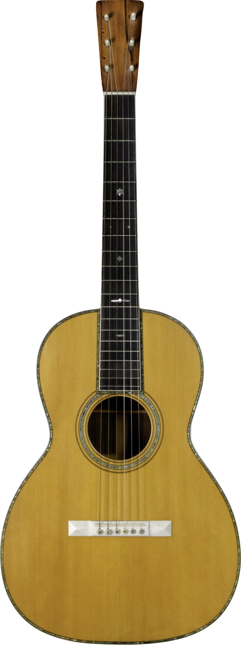
Meet the Parlor Guitar!
It is a smaller guitar.
It was played in small
rooms (parlors).
It has a soft beautiful sound.
Notes:
C.F. Martin & Co. 00-42 Parlor Guitar, 1902
The 00 body type, known as the Grand Concert, was the largest instrument available from C.F. Martin through the early 20th century but is now among the smallest. The second part of the model name, in this case 42, refers to the instrument's style, or level of appointment. Style 42 was, at the time, the top of Martin's line and featured pearl inlay, ivory components, and an ebony fingerboard. The two additional holes on the headstock of this instrument indicate that it had previously been adapted for use with eight strings.

Slide 14

Let’s go on a scavenger hunt!
There are five stations set up around the room with photos of guitars from the Museum of Making Music.
Each guitar you find will be different from the parlor guitar we just met.
Use the clues on your worksheet to find each guitar.

Slide 15

Scavenger Hunt
Find the guitar made of nickel silver. If you look closely you’ll see three resonating cones inside!
Did you know?
The cones work like megaphones and make the sound louder.

Slide 16
Scavenger Hunt
Find the guitar that is made of wood and has an extra arm with additional strings and a second sound hole.
Did you know?
This guitar is called a “harp guitar” and the extra strings are called “floating strings.” This extra arm helps to create more sound.

Slide 17
Scavenger Hunt
Find the guitar that is made of graphite fiber.
Did you know?
Graphite fiber is a very strong but lightweight material and can give the guitar a bright and clear sound.

Slide 18
Scavenger Hunt
Find the guitar that has sound holes shaped like “f’s” similar to the violin or cello.
Did you know?
These types of sound holes are called “F-holes.” The guitar has a carved arched top which makes it louder.

Slide 19
Scavenger Hunt
Find the guitar that has a round back.
Did you know?
This back is made from Lyrachord, similar to materials used in helicopter rotors which makes this guitar sound louder.

Slide 20
Closing Questions
Look at the drawing you made at the beginning of the class. What do you notice? Is anything missing?
Which guitar that you’ve learned about today do you think is the most interesting? Why?
If you are inspired to create a new guitar, what materials will you use?

Slide 21
Consider a Career in Music!
What careers are related to the lesson we just completed?
Luthier
Instrument Manufacturer
Singer/Songwriter
Guitar Repair Tech
Guitar Store Owner/Retailer
Acoustic Engineer
Lutherie School Owner or Manager

Slide 22


